Slide 1

Depleted Uranium Soaring Temperature Reactor (DUSTR)
“Leaves other reactor designs in the dust!”
Based on the Energy Multiplier Module by GA
Landon Brockmeyer
Mason Childs
Daniel Holladay
Jacob Landman
Anas Mohammad
Texas A&M University
Mid-Semester Design Presentation

Slide 2
Core Criticality

Slide 3
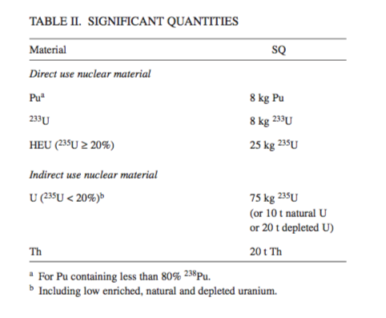
IAEA Significant Quantities

Slide 4
Plutonium Quantities (depleted uranium)

Slide 5
Plutonium SQ’s are somewhat high
How many elements do you need for 1 SQ?

Slide 6
Uranium Quantities (LEU)

Slide 7
Uranium SQ are relatively small

Slide 8
What’s next?
Perform analysis on version 6 of our core
Currently running a depletion simulation on cluster
Run a depletion simulation using smaller time intervals
Currently using 1 year intervals, which is pretty large
Possibly look into the activities of the burned fuel

