Slide 1

Depleted Uranium Soaring Temperature Reactor (DUSTR)
“Leaves other reactor designs in the dust!”
Based on the Energy Multiplier Module by GA
Landon Brockmeyer
Mason Childs
Daniel Holladay
Jacob Landman
Anas Mohammad
Texas A&M University
Mid-Semester Design Presentation

Slide 2
Depletion Analysis What has been accomplished so far?
Validation of the burn card implemented in MCNP
Initial burn on a single pin of depleted uranium Reflecting boundaries
Assuming uniform power distribution
Initial burn on a single pin of LEU
Reflecting boundaries
Assuming uniform power distribution
Notes:
Modifier order fixed…changes in ALL CAPS

Slide 3


Initial Validation Test

Slide 4
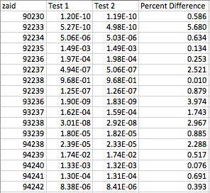
Validation Test Results

Slide 5
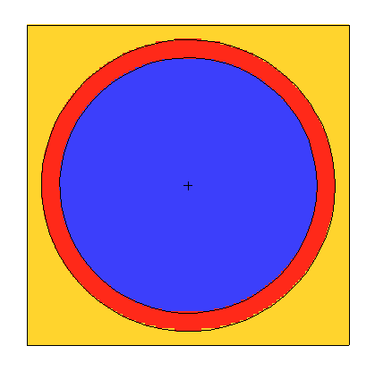
Burn of the Depleted and LEU Fuel
Burned for 30 years
This initial run is assuming a constant power profile
In fact the power profile will not be constant throughout the core lifetime
Initially the power fraction in the depleted uranium will be small
This will increase as the U-238 is converted to Pu-239

Slide 6
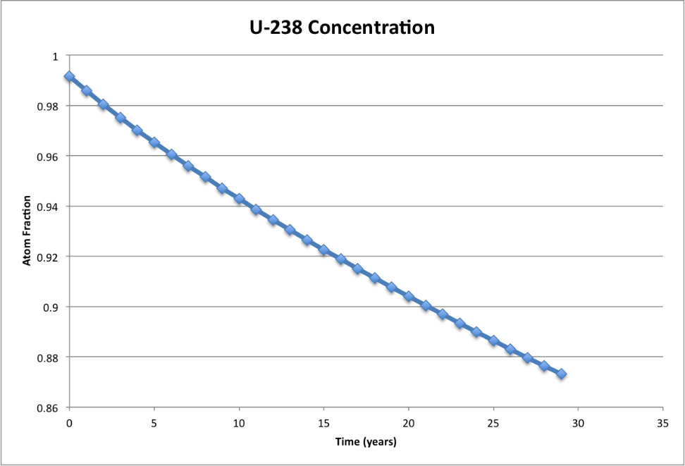
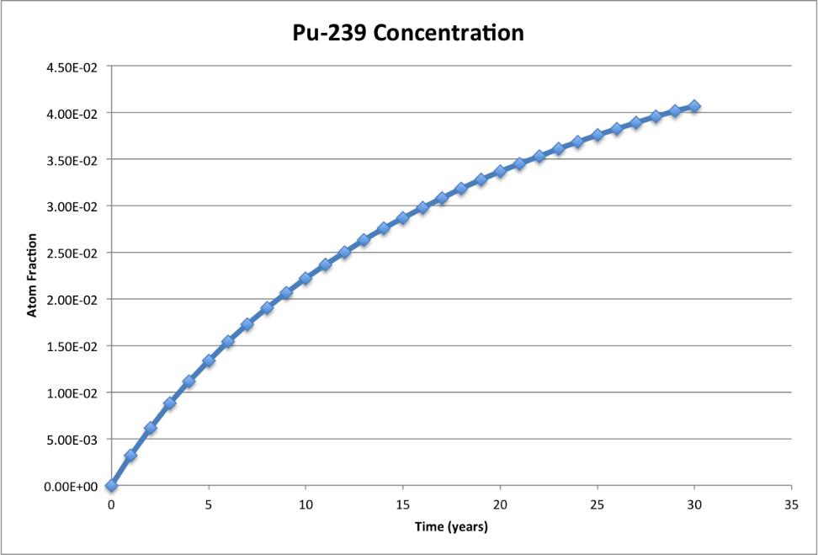
Burn of the Depleted Uranium

Slide 7
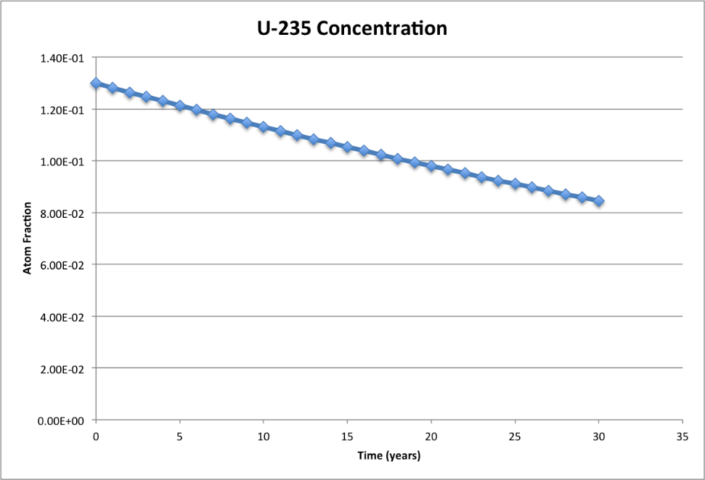
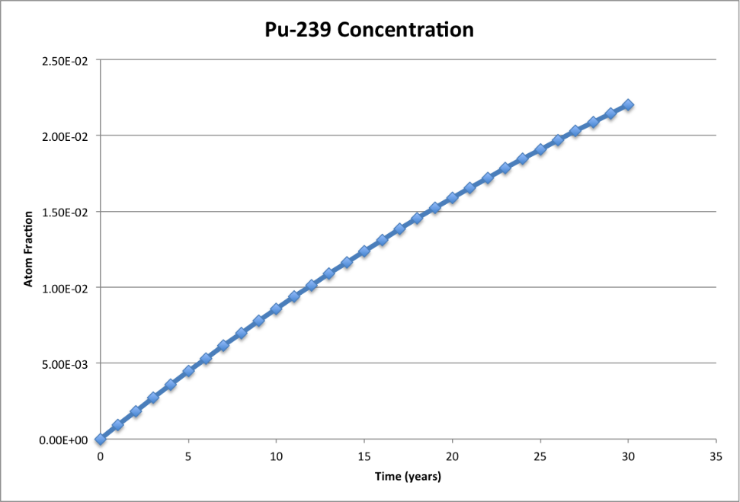
Burn of the LEU

Slide 8
What’s next for depletion?
Hopefully burn the entire core to determine an estimate of the core lifetime
This will be decided through the multiplication factor, not the integrity of the materials
Run depletion calculations using different power fractions to determine spatial differences in the fuel compositions
Analyze EOL fuel compositions
Core lifetime may be uncertain so a sensitivity analysis may be needed

Slide 9
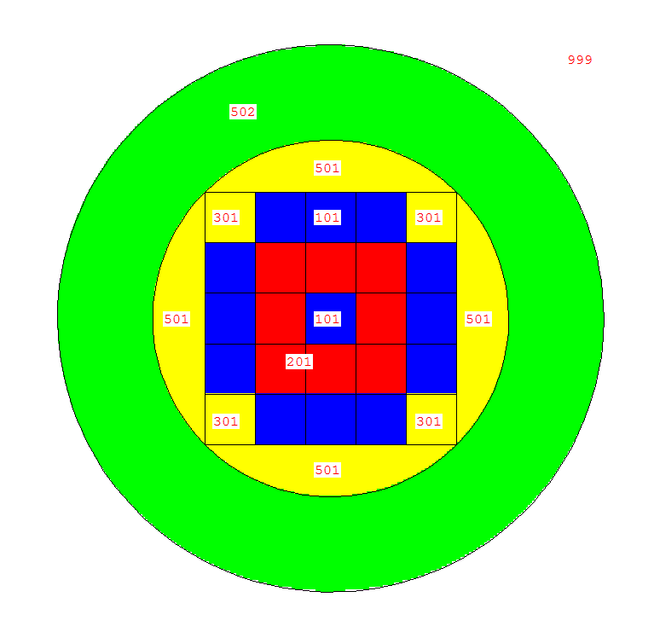
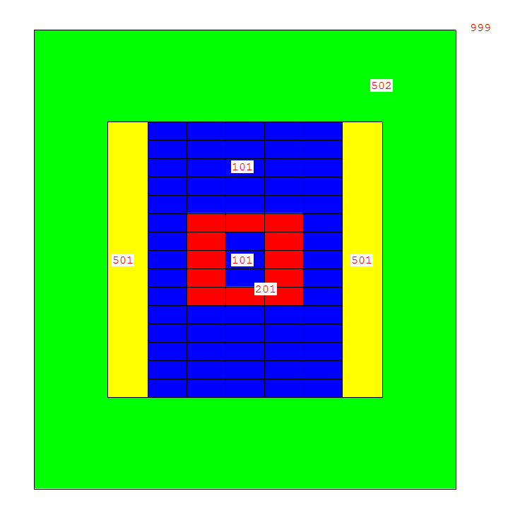
Core Layout
XY center plane – “looking down”
XZ center plane

Slide 10
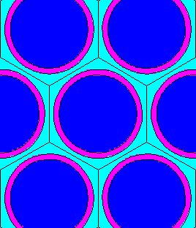
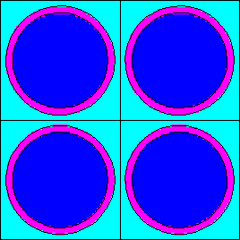

Fuel Elements
Hexagonal Lattice of Pin Fuel
“Standard” for fast reactors
Hexagonal Lattice of Pin Fuel
Square Lattice of Pin Fuel
Allows for cooler channels but not ideal flow
Square Lattice of Plate Fuel
Large ratio of fuel:coolant

Slide 11
Neutron Spectrum in Fuel Regions
Notes:
Modifier order fixed…changes in ALL CAPS

Slide 12
Spectrum in Reflector and Shield

Slide 13

Moving Forward
Fuel Composition
Fuel Element Lattice geometry
Pitch to Pin ratio
Assembly geometries
Move enriched fuel to improve spectrum shape

Slide 14
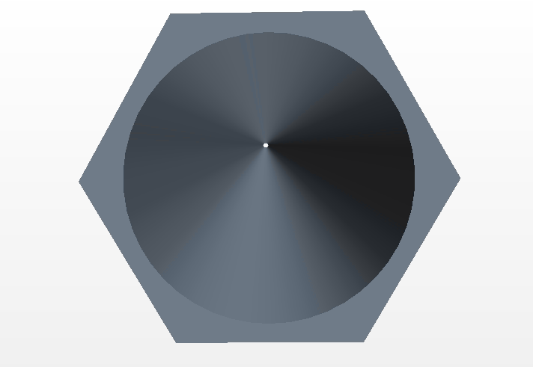
Pin Geometry Analytical
Seider Tate Correlation for Nusselt Number
Imperical Correlations for Cp, μ, k, and rho of Helium
Imperical Correlation for k of UC and SiC
60 W/cm3 average subchannel (TOP)
120 W/cm3 hot subchannel (BOTTOM)
Constraints:
Tfuel max < 2000 K
Tclad max < 1600 K
Δ clad 1.5 mm (1.5 x recommended thickness for SiC)
Tbulk in = 850 K, Tbulk out ~ 1150 K, Pressure = 10 MPa
Varried:
Fuel Diameter
Rod Pitch
Vin

Slide 15
Example Results
q’’’=60 W/cm3 constant
q’’’=120 W/cm3 constant

Slide 16
Configuration Comparisons
Pressure 10 Mpa
Fuel D 1 cm
Rod Pitch 1.4 cm
Inlet V 90 m/s
Fuel Frac 0.463
He Frac 0.218
Pressure 10 Mpa
Fuel D 1.2 cm
Rod Pitch 1.7 cm
Inlet V 70 m/s
Fuel Frac 0.452
He Frac 0.294
Pressure 10 Mpa
Fuel D 1.2 cm
Rod Pitch 1.8 cm
Inlet V 50 m/s
Fuel Frac 0.403
He Frac 0.370
Pressure 10 Mpa
Fuel D 1.4 cm
Rod Pitch 2 cm
Inlet V 60 m/s
Fuel Frac 0.444
He Frac 0.345

Slide 17
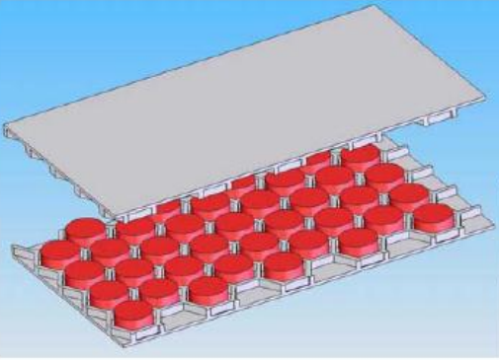
Slab Geometry Analytical
Seider Tate Correlation for Nusselt Number
Imperical Correlations for Cp, μ, k, and rho of Helium
Imperical Correlation for k of UC and SiC
60 W/cm3 average subchannel (TOP)
120 W/cm3 hot subchannel (BOTTOM)
Constraints:
Tfuel max < 2000 K
Tclad max < 1600 K
Δ clad 2 mm (1.5 x recommended thickness for SiC)
Tbulk in = 850 K, Tbulk out ~ 1150 K, Pressure = 10 MPa
Varried:
Fuel Diameter
Rod Pitch
Vin

Slide 18
Example Results
q’’’=60 W/cm3 constant
q’’’=120 W/cm3 constant

Slide 19
Configuration Comparisons
Pressure 10 Mpa
Fuel thick 2.5 cm
Channel T 1.5 cm
Inlet V 40 m/s
Fuel Frac 0.568
He Frac 0.341
Pressure 10 Mpa
Fuel thick 2 cm
Channel T 1 cm
Inlet V 50 m/s
Fuel Frac 0.588
He Frac 0.294
Pressure 10 Mpa
Fuel thick 1.5 cm
Channel T 1.5 cm
Inlet V 25 m/s
Fuel Frac 0.441
He Frac 0.441
Pressure 10 Mpa
Fuel thick 1.5 cm
Channel T 1 cm
Inlet V 35 m/s
Fuel Frac 0.517
He Frac 0.345

Slide 20
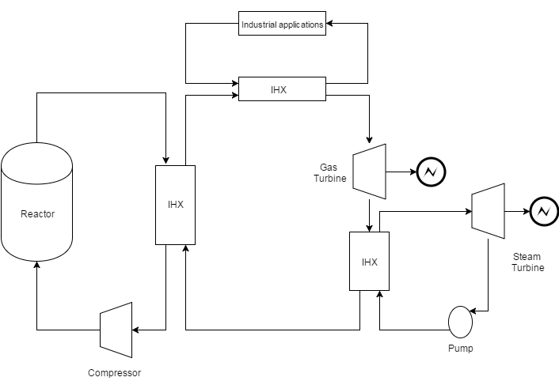
Thermodynamic Analysis
Compound cycle
4 loops
Advantages:
2,3 and 4 are non-radioactive loops.
Separate cycles
Disadvantages:
Loos a lot of heat from the primary loop
4
1
2
3

Slide 21
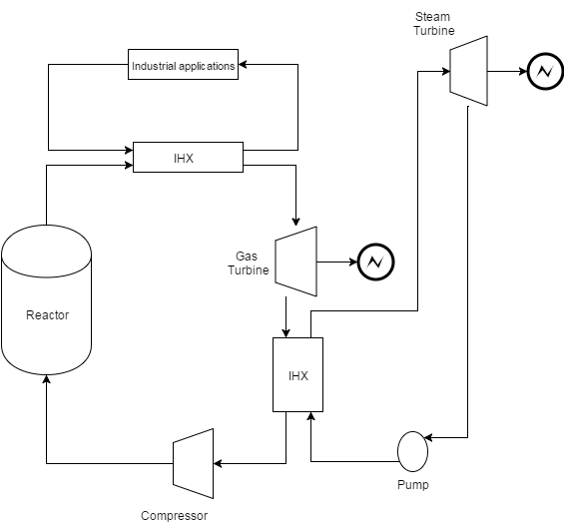
Thermodynamic Analysis
3 loops
He is a noble gas
Loop 1 still radioactive
Loop 2,3 non-radioactive
Industrial applications and steam turbine on the ground (maintenance and access).
Limit the access for the underground
3
underground container line
1
2

Slide 22
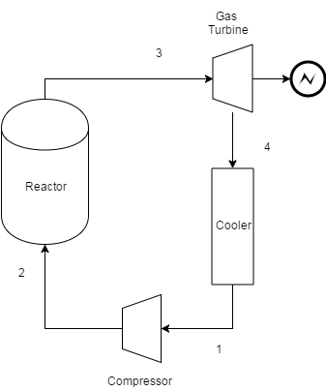
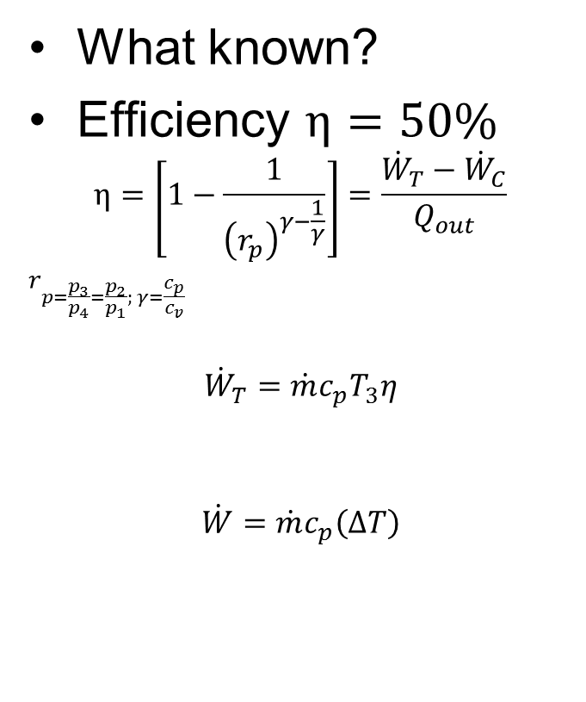


Gas Cycle
What known?
Efficiency $η=50\%$
$$η=\left[1−\frac{1}{{\left(r_{p}\right)}^{γ−\frac{1}{γ}}}\right]=\frac{{\dot{W}}_{T}−{\dot{W}}_{C}}{Q_{out}}$$
$$r_{p=\frac{p_{3}}{p_{4}}=\frac{p_{2}}{p_{1}}; γ=\frac{c_{p}}{c_{v}}}$$
$${\dot{W}}_{T}=\dot{m}c_{p}T_{3}η$$
$$\dot{W}=\dot{m}c_{p}\left(∆T\right)$$
$$T_{out}=850C^{o}$$
$$\dot{m}=\frac{320kg}{sec}$$
$$Q_{out}=500 MW$$
$$T_{in}=550C^{o}$$
$$P_{out}=10 MPa$$
$$\dot{m}=320kg/sec$$

Slide 23




Gas Cycle
$$T_{out}=850C^{o}$$
$$\dot{m}=\frac{320kg}{sec}$$
$$Q_{out}=500 MW$$
$$T_{4}=288C^{o}$$
$$P_{4}=1.8MPa$$
$$T_{in}=550C^{o}$$
$$P_{out}=13.3 MPa$$
$$T_{1}=139C^{o}$$
$$P_{1}=1.8MPa$$

Slide 24

Economics
Look at “real levelized cost” analysis
Analysis methodology well established
Compare to standard LWRs as well as other forms of power
Ensure viability
Constrain fuel properties

Slide 25
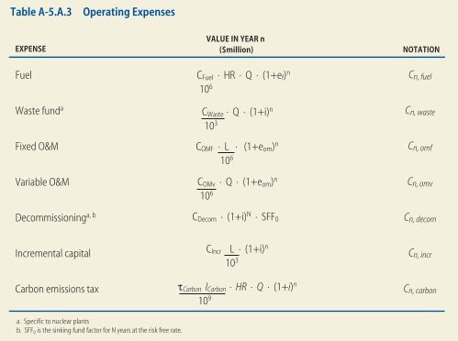
Further Investigation
Look at impact of industrial heat usage
High temp vs low temp
Ensure model efficacy
SMRs
Construction
Lifetime
Capacity factors
Fuel

