Slide 1

Depleted Uranium Soaring Temperature Reactor (DUSTR)
“Leaves other reactor designs in the dust!”
Based on the Energy Multiplier Module by GA
Landon Brockmeyer
Mason Childs
Daniel Holladay
Jacob Landman
Anas Mohammad
Texas A&M University
Mid-Semester Design Presentation (2)

Slide 2


Version 1 Core

Slide 3
Core Versions
Version | Axial Layers between LEU | Depleted Uranium Assemblies | LEU Assemblies | LEU Enrichment (%) | Plates per Assembly
1 | 5 | 231 | 42 | 13 | 29
2 | 7 | 215 | 58 | 13 | 29
3 | 5 | 231 | 42 | 20 | 29
4 | 3 | 239 | 34 | 20 | 29
6 | 7 | 215 | 58 | 13 | 27

Slide 4


Version 2 / Version 3
Additional LEU assemblies
Higher Enriched LEU

Slide 5

Version 4 / Version 6
Altered Clad Thickness
27 plate/assm
Moved LEU assemblies

Slide 6
Version 6 k_{eff} = 1.04127 ± 0.00007
Fission Fractions
(0.625 ev - 100 kev): 43.01% (>100 kev): 56.42%

Slide 7
Core Criticality

Slide 8
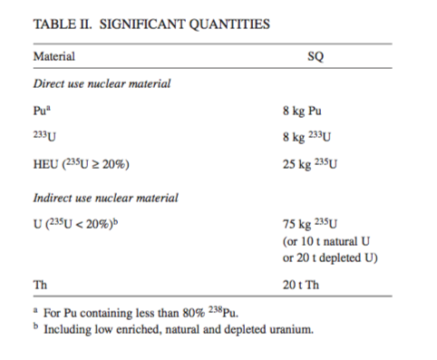
IAEA Significant Quantities

Slide 9
Plutonium Quantities (depleted uranium)

Slide 10
Plutonium SQ’s are somewhat high
How many elements do you need for 1 SQ?

Slide 11
Uranium Quantities (LEU)

Slide 12
Uranium SQ are relatively small

Slide 13
What’s next?
Perform analysis on version 6 of our core
Currently running a depletion simulation on cluster
Run a depletion simulation using smaller time intervals
Currently using 1 year intervals, which is pretty large
Possibly look into the activities of the burned fuel

Slide 14
Core Geometry
Fuel Plates
Thermally Decouple Subchannels
Higher Accident Tolerance
Equal, Consistent Cooling
Higher Surface Area to Fuel Mass
Flat Temperature Gradients
He Coolant
Hot Channels Naturally Cool Better
Non-Corrosive

Slide 15
Core TH Specs
Fuel
Final Channel Dimensions
Fuel Width: 1 cm
Clad Thickness: 1.1 mm
Channel Thickness: 3.5 mm
Fuel/Coolant Ratio: 2.857
Core Specs
Pressure: 15 MPa
Pressure Drop: ~1 MPa
Single Channel Mass Flow Rate: 0.2 kg/s
Power: 623 MWth
Clad
He

Slide 16
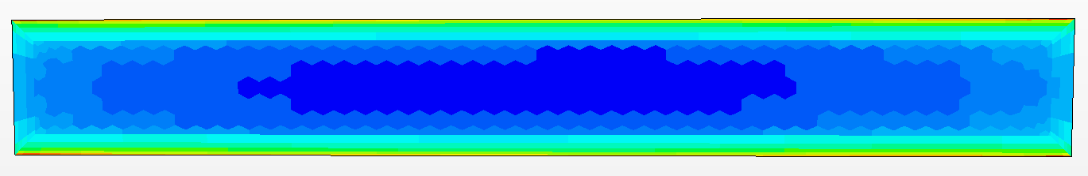
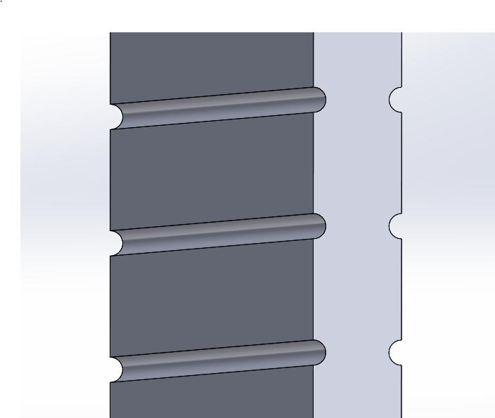
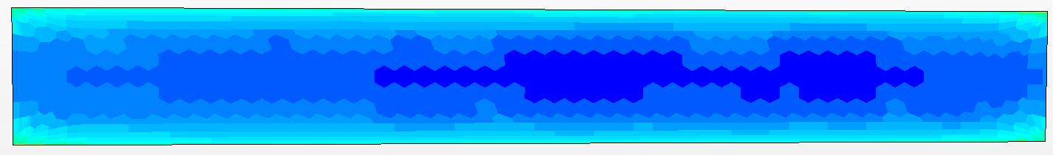
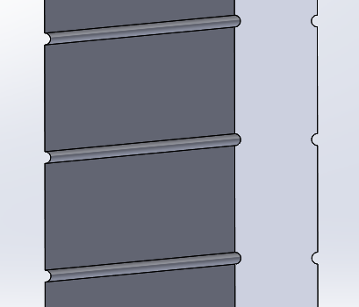

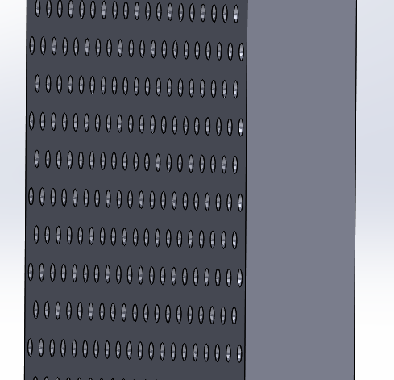


Plate Surface
Surface Design Impacts Coolant Mixing
Flat
Ribbed (1mm)
Ribbed (0.5mm)
Dimpled (0.5mm)

Slide 17
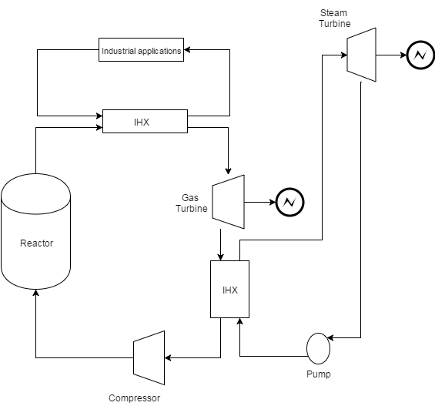
Thermodynamic Analysis
3 loops
Loop 1 radioactive
Loop 2,3 non-radioactive
Industrial applications and steam turbine on the ground (maintenance and access).
Limit the access for the underground (loop 1)
3
underground container line
1
2

Slide 18
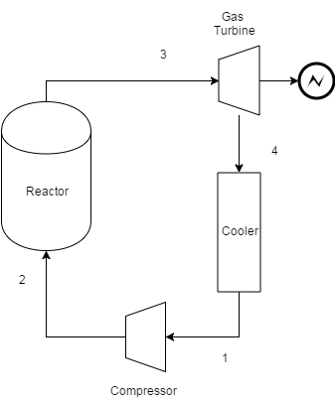
Gas Cycle
What wwe known?
Efficiency $η=30\%$
$$η=\left[1−\frac{1}{{\left(r_{p}\right)}^{γ−\frac{1}{γ}}}\right]=\frac{{\dot{W}}_{T}−{\dot{W}}_{C}}{Q_{out}}$$
$$r_{p=\frac{p_{3}}{p_{4}}=\frac{p_{2}}{p_{1}}; γ=\frac{c_{p}}{c_{v}}}$$
$${\dot{W}}_{T}=\dot{m}c_{p}T_{3}η$$
$$\dot{W}=\dot{m}c_{p}\left(∆T\right)$$
$$T_{out}=877C^{o}$$
$$\dot{m}=424kg/sec$$
$$Q_{out}=623.4MW$$
$$T_{in}=550C^{o}$$
$$P_{out}=15 MPa$$
$$\dot{m}=424kg/sec$$

Slide 19
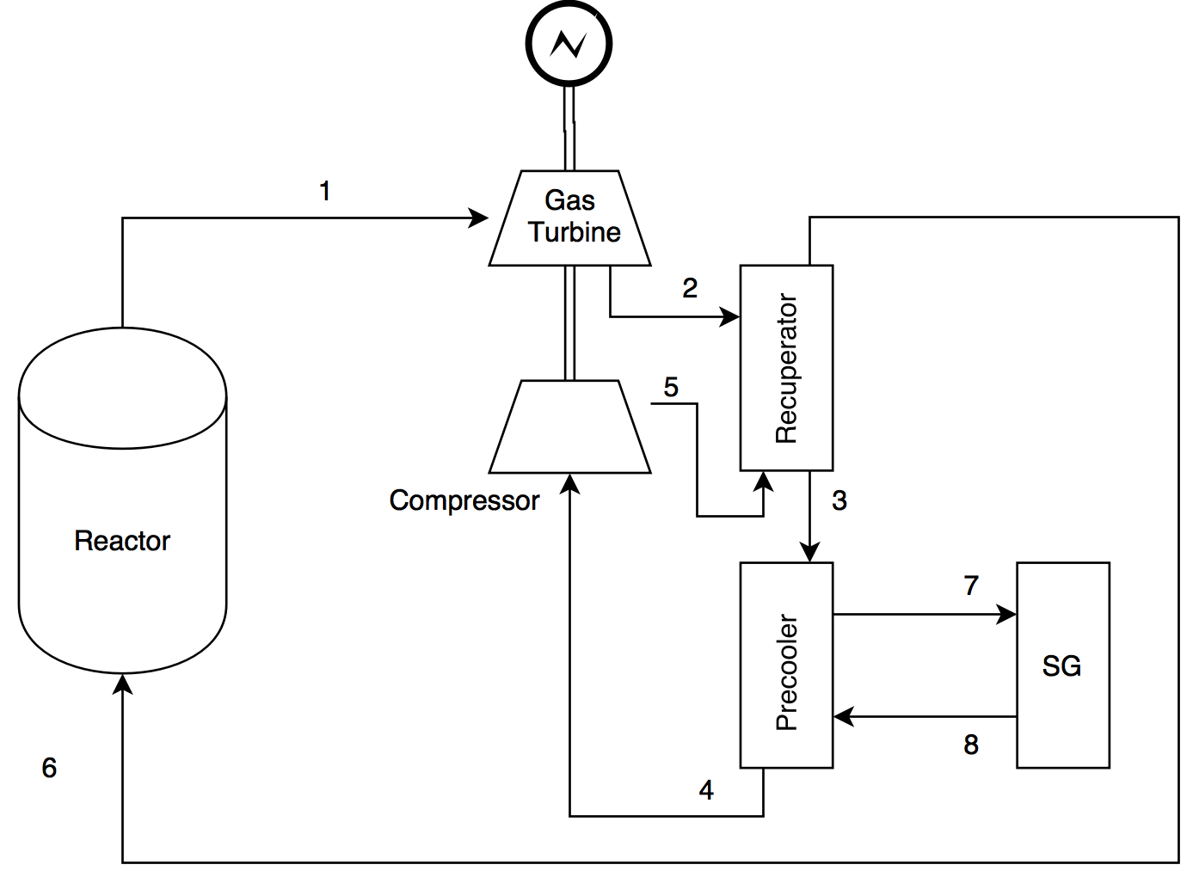
Gas Cycle
Recuperator to recover the waste heat
Precooler to be connected to the SG
Pressures: P1=15MPa and P4=6.15MPa
Temperatures
Mass flow
Efficiency of GT and Compressor ~ .9%
$$T_{2}=532C^{o}$$
$$T_{out}=877C^{o}$$
$$T_{in}=550C^{o}$$
$$T_{4}=290C^{o}$$

Slide 20
Why this reactor?
Secure ( the number of people who access underground ‘core area’ are limited).
Easy for maintenance while the reactor is working.
Not just the power!
3
underground container line
1
2

Slide 21
What is next?
Design and calculate the SG
Choses the industrial applications
Combine all the cycles

Slide 22
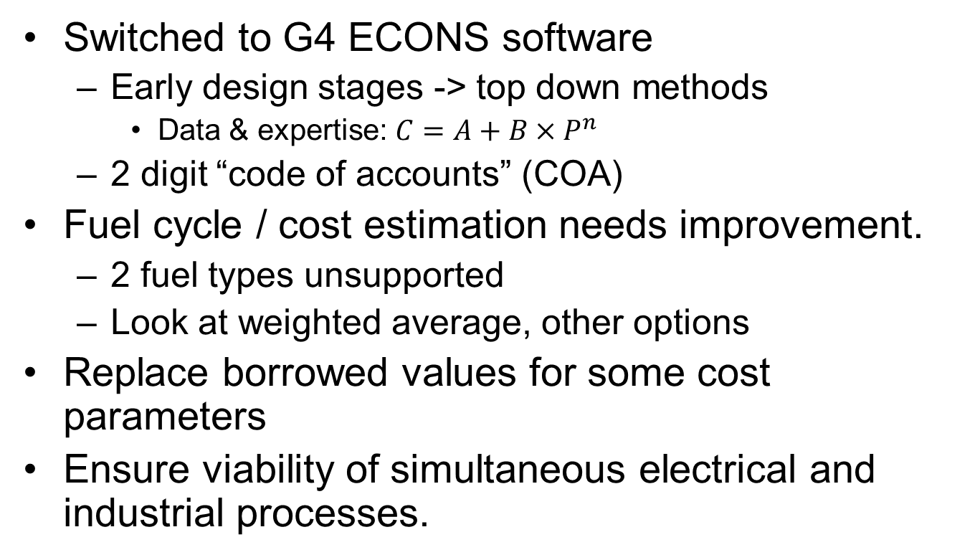
Econ Analysis Update
Switched to G4 ECONS software
Early design stages -> top down methods
Data & expertise: $C=A+B×P^{n}$
2 digit “code of accounts” (COA)
Fuel cycle / cost estimation needs improvement.
2 fuel types unsupported
Look at weighted average, other options
Replace borrowed values for some cost parameters
Ensure viability of simultaneous electrical and industrial processes.

Slide 23
Current Results
REACTOR SUMMARY: IMPORTANT OUTPUTS and INTERMEDIATE CALCULATED VARIABLES
Output Table Variable Names
Description | Value in mills/kwh or $/MWh | variableName
Total LUEC | 110.33 | totalLuec
Capital (Including Financing) | 86.59 | cap_comp_LUEC
Operation | 21.69 | om_comp_LUEC
Fuel Cycle - Front End | 0.74 | fcFront_comp_LUEC
Fuel Cycle - Back End | 1.01 | fcBack_comp_LUEC
Fuel Cycle - Total | 1.76
D&D Sinking Fund | 0.29 | danddSink_comp_LUEC
Tails Assay for U-enrichment | 0.3 | % U-235 (optimized if switch is on) Switch position >>>>
Average fuel burnup (Calculated) | 1,406,537 | MWd(th)/MTHM
Include Cost of 1st Core in Capital | Yes
Total Capital Investment Cost (TCIC) | 14,215 | $/kWe
Discount Rate | 5.00% | %/Year
Annual Electricity production | 2.602E+09 | kwh/yr

Slide 24
Comparison
Estimate in $/MWh |  | Conventional coal | NG combined cycle |  | Nuclear advanced | wind
year | for year |  | conventional | advanced |  | onshore | offshore
2010 | 2016 | 100.4 | 83.1 | 79.3 | 119 | 149.3 | 191.1
2011 | 2016 | 95.1 | 65.1 | 62.2 | 114 | 96.1 | 243.7
2012 | 2017 | 97.7 | 66.1 | 63.1 | 111.4 | 96 | N/A
2013 | 2018 | 100.1 | 67.1 | 65.6 | 108.4 | 86.6 | 221.5
2014 | 2019 | 95.6 | 66.3 | 64.4 | 96.1 | 80.3 | 204.1
2015 | 2020 | 95.1 | 75.2 | 72.6 | 95.2 | 73.6 | 196.9
https://en.wikipedia.org/wiki/Cost_of_electricity_by_source

Slide 25


