Slide 1
Reactor Marketing
Higher enrichment and high plutonium mass will limit market
High temperature hydrogen production:
Clean production of hydrogen at scale
Necessity for “hydrogen economy”
Long lifetime = low fuel costs

Slide 2
Analysis
G4-ECONS excel tool
Top down approach
PBMR example in spreadsheet
Scaling:
α = 0.25
Capital and O&M
2 digits probably closer to 1.5 digit
Vary parameters to get range of costs

Slide 3
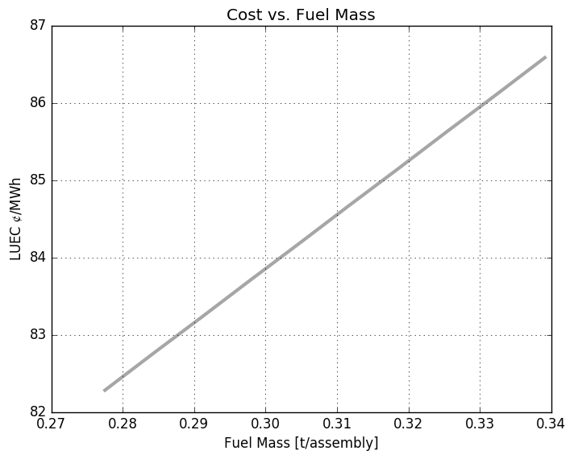
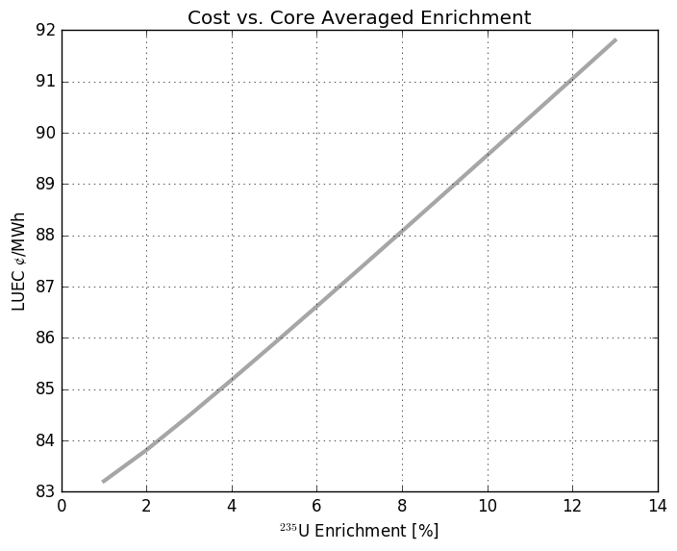
Left: Fuel Mass Right: Fuel Enrichment

Slide 4
Nominal Results
Description | Value in mills/kwh or $/MWh
Total LUEC | 84.43
Capital (Including Financing) | 69.03
Operation | 13.57
Fuel Cycle - Front End | 0.64
Fuel Cycle - Back End | 1.01
Fuel Cycle - Total | 1.65
D&D Sinking Fund | 0.18
Capacity and Unit Cost in English Units:
Capacity | 298.6 | Mft3 H2/day
Unit Cost | 1.68 | $/lb H2
Unit heat cost from reactor in $/million BTUs | 12.37 | $/MBTU
Product density in g/cc or multiple of water density | 0.0000892 | g/cc or Mg/m3
(for use in converting mass to volume units and vice versa)
Notes:
Reactor still has turbine-generator, but this case uses heat only for H2 production. Not in electric production mode

Slide 5
Comparison
Estimate in $/MWh |  | Conventional coal | NG combined cycle |  | Nuclear advanced | wind
year | for year |  | conventional | advanced |  | onshore | offshore
2010 | 2016 | 100.4 | 83.1 | 79.3 | 119 | 149.3 | 191.1
2011 | 2016 | 95.1 | 65.1 | 62.2 | 114 | 96.1 | 243.7
2012 | 2017 | 97.7 | 66.1 | 63.1 | 111.4 | 96 | N/A
2013 | 2018 | 100.1 | 67.1 | 65.6 | 108.4 | 86.6 | 221.5
2014 | 2019 | 95.6 | 66.3 | 64.4 | 96.1 | 80.3 | 204.1
2015 | 2020 | 95.1 | 75.2 | 72.6 | 95.2 | 73.6 | 196.9
https://en.wikipedia.org/wiki/Cost_of_electricity_by_source

Slide 6
Conclusions
Many simplifications and assumptions
Uncertainties in final design
In our analysis, this design (and perturbations thereof) merit further and more detailed investigations
Potentially viable design

