Slide 1
FONTYS UNIVERSITY OF APPLIED SCIENCE DEPARTMENT OF ICT & SOFTWARE
CAR TRAFFIC SIMULATION APPLICATION
Group members
Aktar, Dohlon 3047040
Alex Kersjes 3361616
Gang Ferdinand Dinga 3216861
Fahim 2936968
Alessandro Sandor 2879964

Slide 2
Overview
Problem statement
Project goal
Project deliverables
Our processes so far
Proof of concepts
Our plans for the remaining weeks

Slide 3
Problem statement
SIM Software Inc is one of the leading software companies in the Netherland with it headquarters In Eindhoven.
The company director and his team asked us to develop a city traffic simulation applications.

Slide 4
Project goal
Our goal is to develop / create a software solution for SIM Software Inc. This software package should be able to
Configure the roads and crossings in a city to simulate traffic and pedestrian flow.
The simulation provides the means to optimize the configuration of roads, crossings and traffic lights via statistics related to how the traffic resolves.
It should be possible to store simulation models and results in a file or database, and -load previously stored models and results from that file or database.

Slide 5
Project deliverables
At the end of this project we are expected to deliver
A working application (simulation software) in accordance with the project goals
Documents that contains information about the requirements, the design of the system and the process.

Slide 6
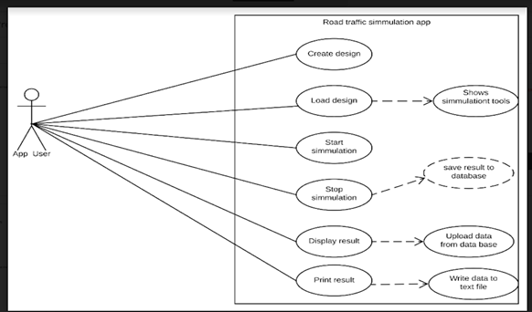
Our process so far
-Use cases description

Slide 7
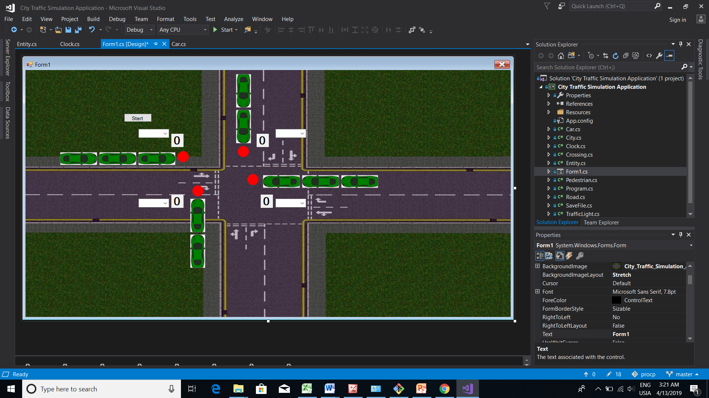
Proof of concepts

Slide 8
Our plans for the remaining weeks
-How many weeks are remaining?
-What is remaining so far for the application to be complete.

Slide 9
Conclusion
Thanks you for your kind attention

