Slide 1
FONTYS UNIVERSITY OF APPLIED SCIENCE DEPARTMENT OF ICT & SOFTWARE
FINAL PRESENTATION
CAR TRAFFIC SIMULATION
Group members
Aktar, Dohlon 3047040
Alex Kersjes 3361616
Gang Ferdinand Dinga 3216861
Fahim 2936968
Alessandro Sandor 2879964

Slide 2
Overview
Problem statement
Project goal
Project deliverables
Our results
Reflection (Our opinion about our result)
The ups and downs of our project
Demo application
Conclusion.

Slide 3
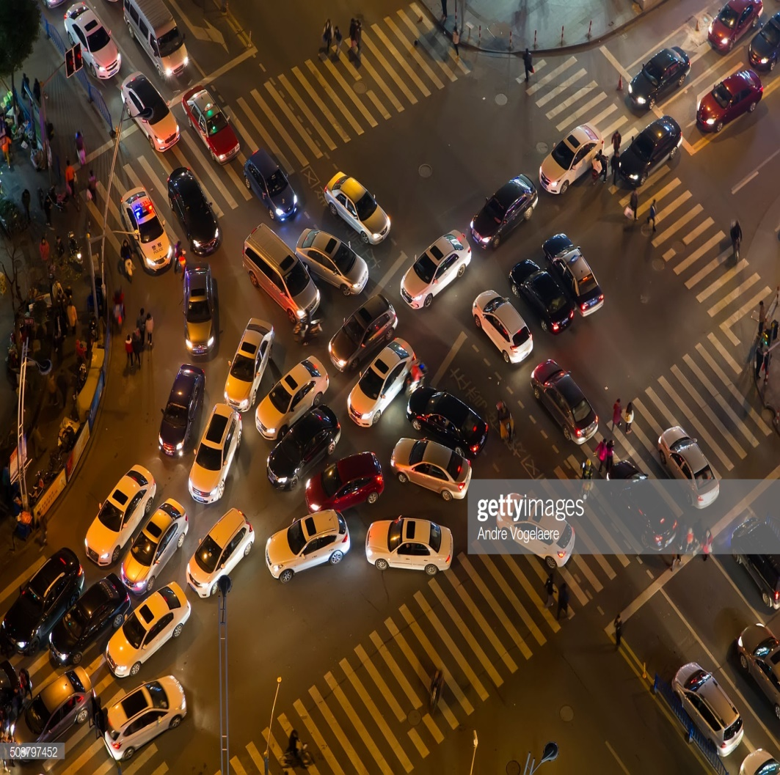

Problem statement

Slide 4
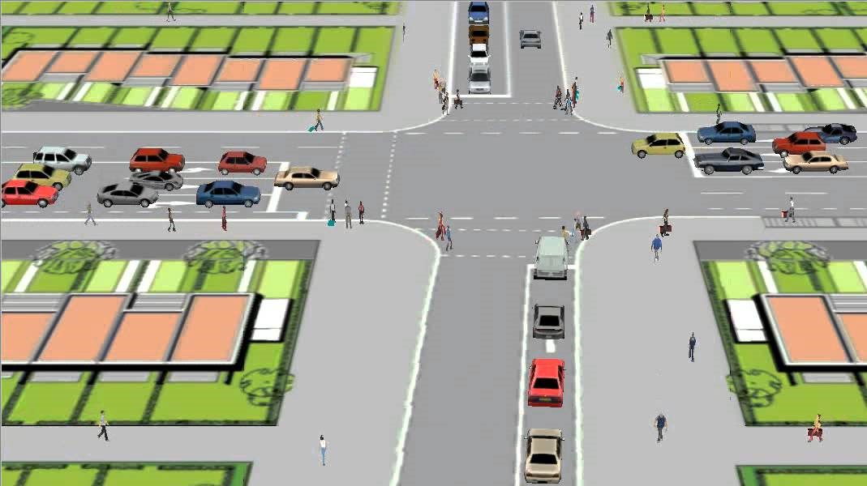
Project goal
Create a software solution package that should
Simulate traffic and pedestrian flow.
Optimize the configuration of roads, crossings and traffic lights via statistics related to how the traffic resolves.
Store simulation models and results in a file
Load previously stored models and results from that file .

Slide 5
Project deliverables
At the end of this project we are expected to deliver
A working application (simulation software) in accordance with the project goals
Documents that contains information about the requirements, design of the system and the process.

Slide 6
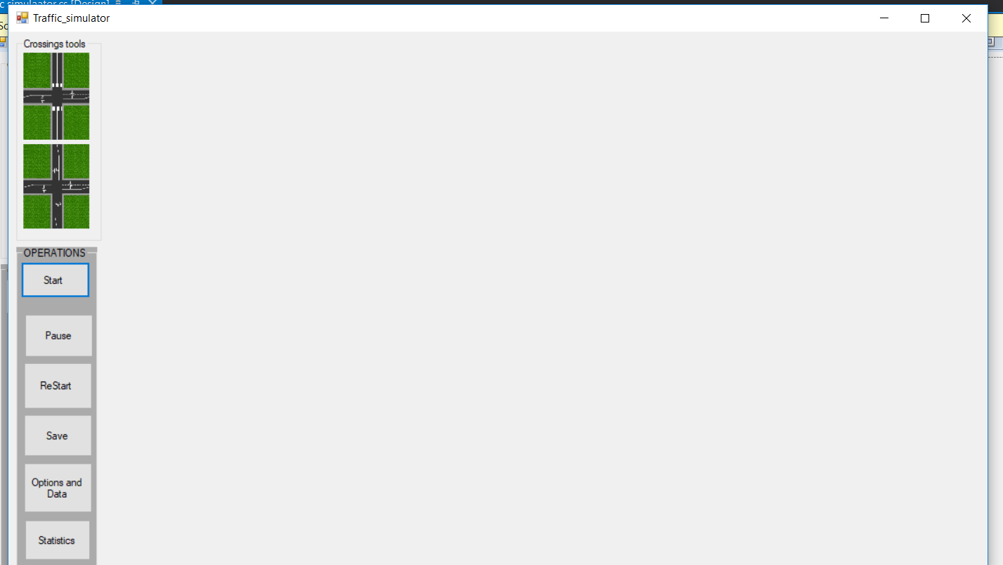
Our results

Slide 7
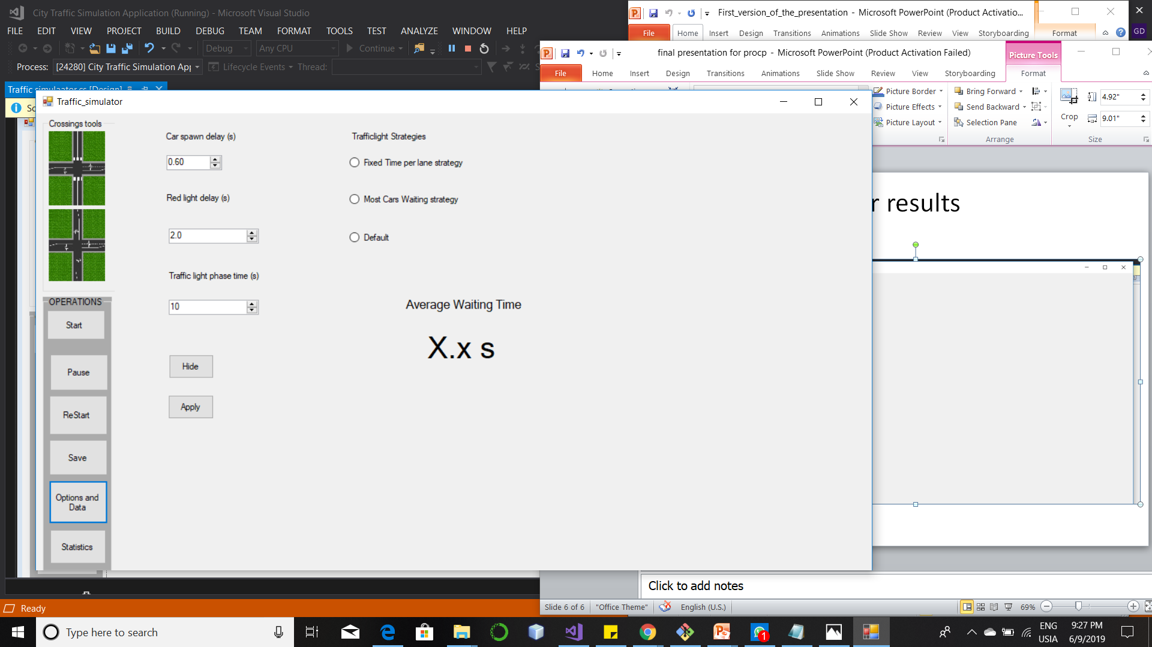
The options

Slide 8
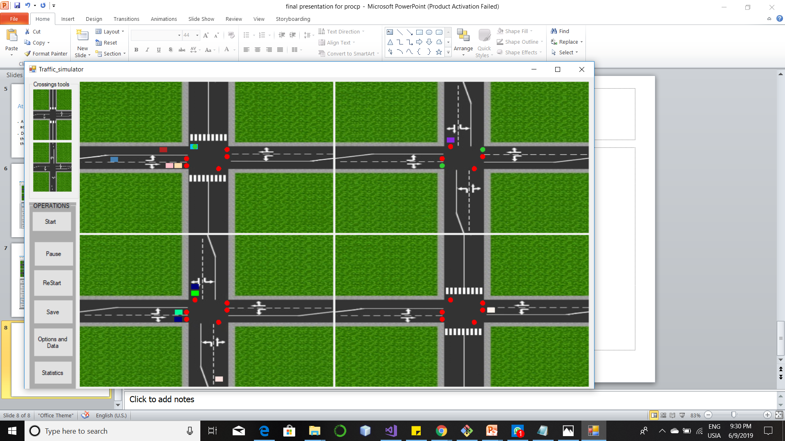
Running simmulation

Slide 9
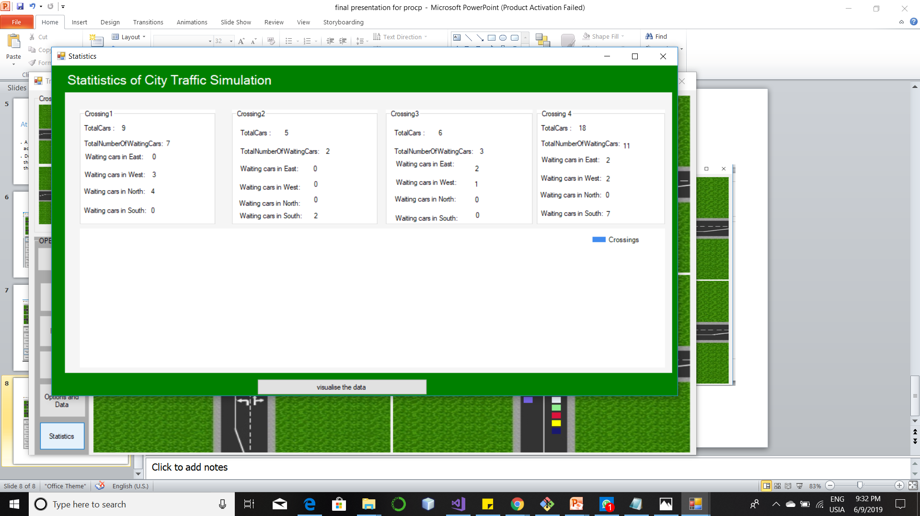
Statistics

Slide 10
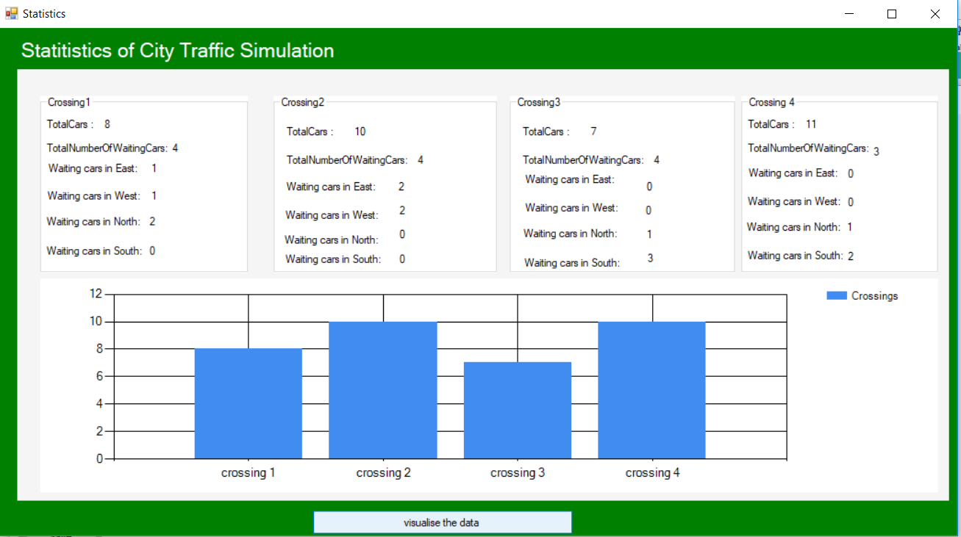
Visualization of statistics

Slide 11
Reflection (Our opinion about our result)
Our opinion about the application
Usability,
Maintainable
Extendable
Our ups for this project
Good team collaboration
Good coaching from our Mentor.
Our downs for the projects
Lack of time
Long period of time to understand each other

Slide 12
Demo Application
See working version of the application.

Slide 13
Conclusion

