Slide 1
FONTYS UNIVERSITY OF APPLIED SCIENCE DEPARTMENT OF ICT & SOFTWARE
CAR TRAFFIC SIMULATION APPLICATION
Group members
Aktar, Dohlon 3047040
Alex Kersjes 3361616
Gang Ferdinand Dinga 3216861
Fahim 2936968
Alessandro Sandor 2879964

Slide 2
Overview
Problem statement
Project goal
Project deliverables
Our processes so far
Proof of concepts
Our plans for the remaining weeks

Slide 3
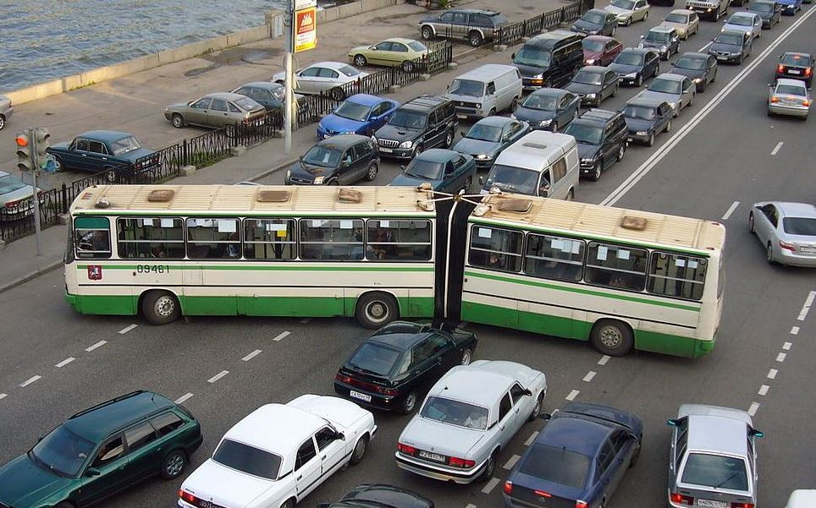
Problem statement
Car traffic
problems in cities

Slide 4
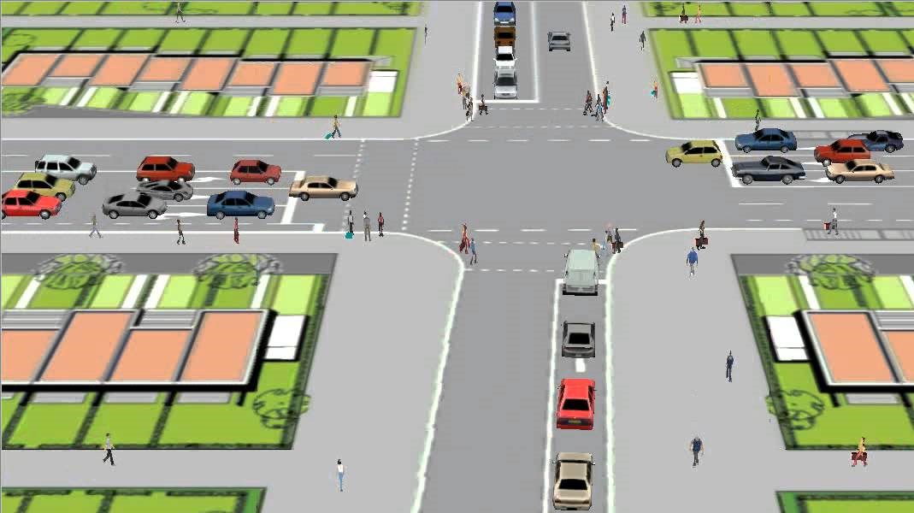
Project goal
Create a software solution .
This software package should
simulate traffic and pedestrian flow.
optimize the configuration of roads, crossings and traffic lights via statistics related to how the traffic resolves.
store simulation models and results in a file
load previously stored models and results from that file .

Slide 5
Project deliverables
At the end of this project we are expected to deliver
A working application (simulation software) in accordance with the project goals
Documents that contains information about the requirements, design of the system and the process.

Slide 6
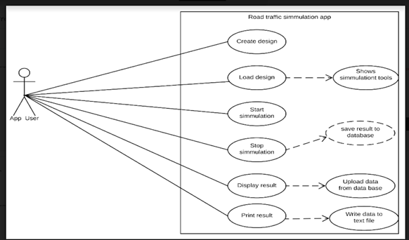
Our process so far
-Use cases description

Slide 7
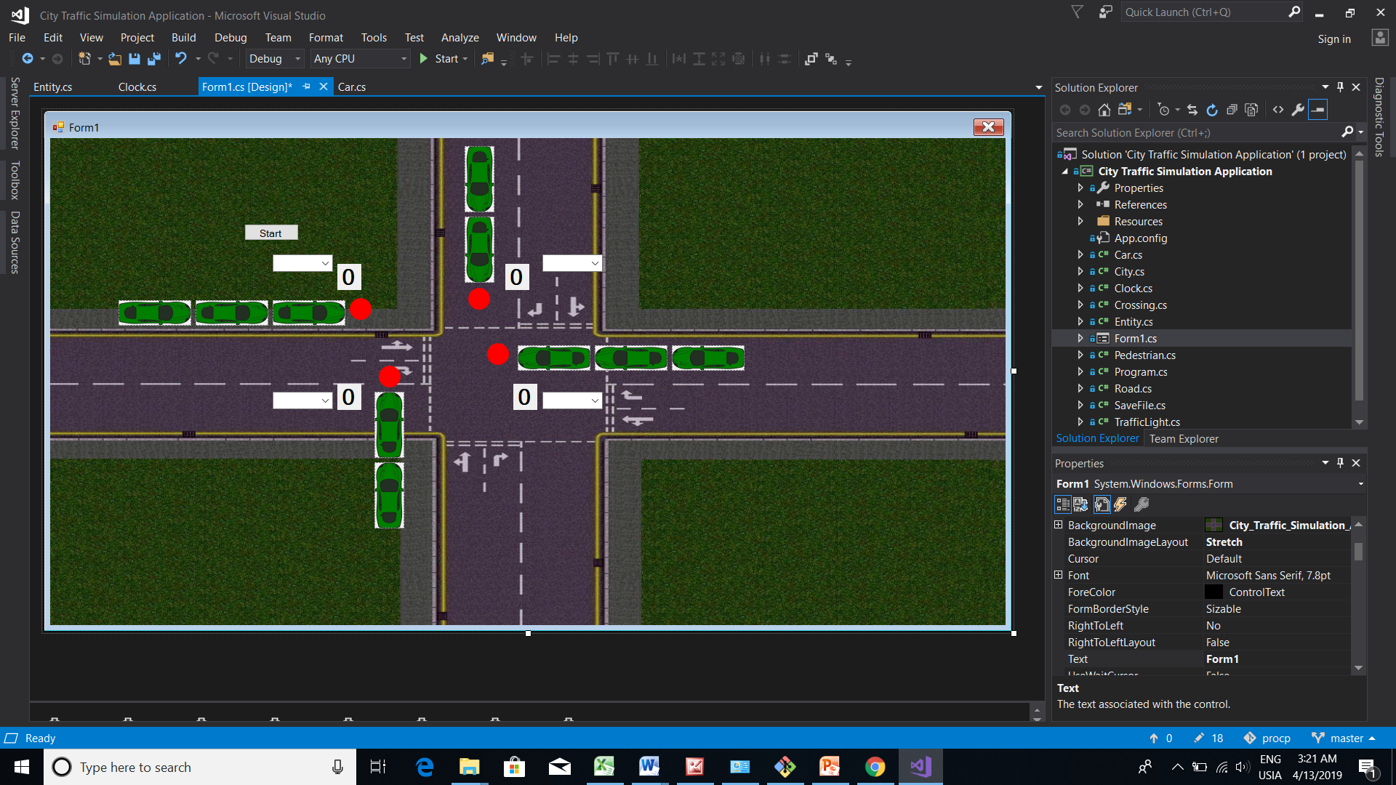
Proof of concepts

Slide 8

Our plans for the remaining weeks
Implement the remaining functionalities
And get a full application that have the all the features that are discribed on our use case

Slide 9
Conclusion
Thanks you for your kind attention

