Slide 1
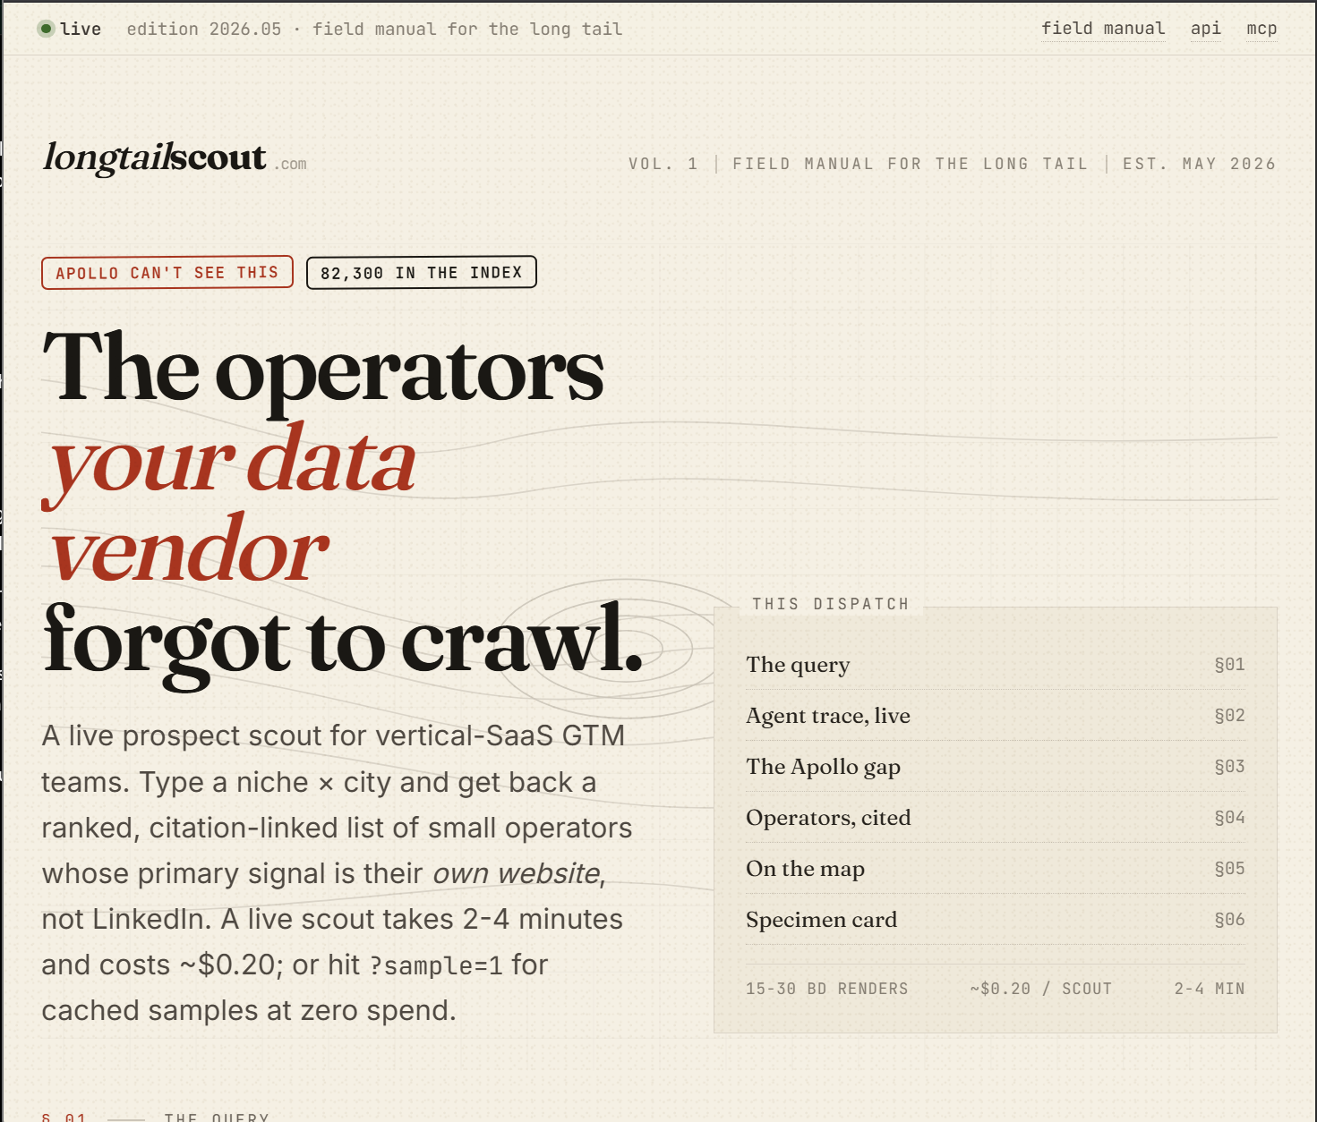
● live edition 2026.05 · field manual for the long tail
submission deck
01
APOLLO CAN'T SEE THIS
82,300 IN THE INDEX
LongTail Scout
.com
Apollo for the long tail.
Live AI prospect scout for the millions of small American businesses Apollo cannot see.
Submission for Bright Data Web Data UNLOCKED hackathon · Track 1, GTM Intelligence · 2026-05-30
Support deck for partner-prize judges. 8 slides, designed for skimming.
https://longtailscout.com
Source: github.com/dholzric/longtail-scout
Live homepage screenshot

Slide 2
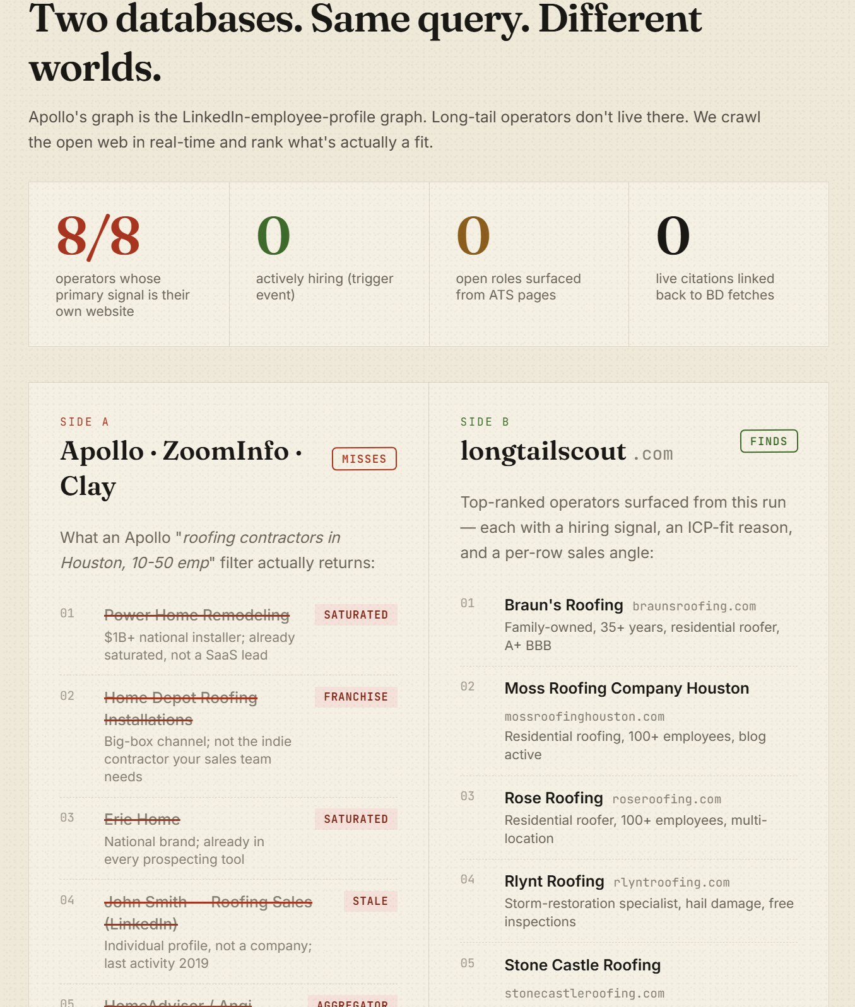
● live edition 2026.05 · field manual for the long tail
the problem
02
The buyer's problem
Why Apollo and ZoomInfo miss the long tail.
GTM teams at ServiceTitan, AccuLynx, JobNimbus, Brightwheel, Jobber, Bambee, and Toast chase the same kind of account: small, local, operator-owned, web-first. Real revenue. Real budget. No LinkedIn corporate page. No Apollo record.
One SDR builds about 10 qualified accounts a day by hand.
$300 per account just to find them, before outreach begins.
Long-tail operators live on their own websites, booking pages, and local web signals — not the LinkedIn employee graph.
10/day
$300
0
qualified accounts built by hand
to find one account
help from Apollo here
Live “Apollo gap” comparison from the product

Slide 3
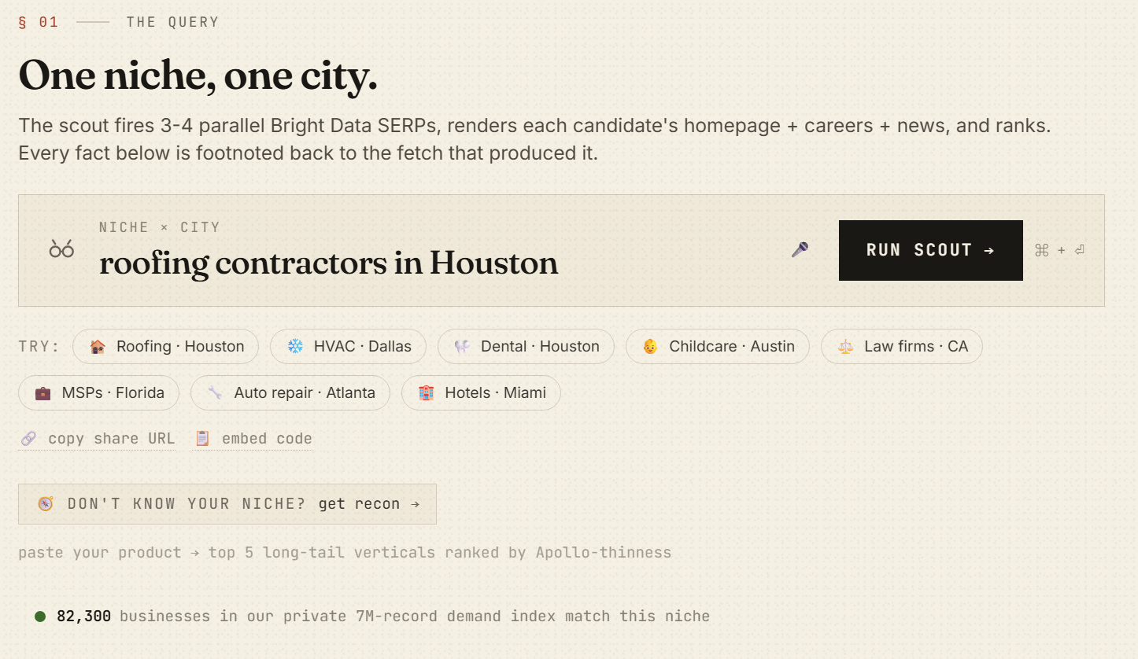
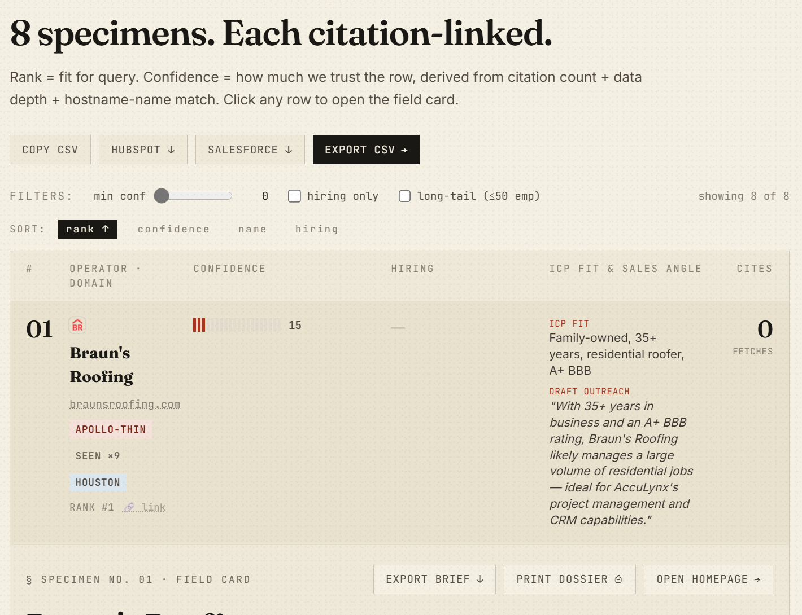
● live edition 2026.05 · field manual for the long tail
the product
03
The product
Type a niche × city query. Get a ranked, cited, evidence-backed list of operators in ~40 seconds.
EXAMPLE QUERY
roofing contractors in Houston
8–10 ranked operators
Company name + homepage URL
Hiring signals scraped from the careers page
Recent activity headlines from press / blog
Live query entry screen
Public-footprint size estimate
One-sentence sales angle generated from scraped facts
Every claim citation-linked to the source URL
~$0.20 a scout — about 1,500× cheaper than the ~$300 an SDR spends by hand.
Per-row drill-down shows underlying Bright Data fetches inline. The on-page map plots operators against a heat layer of every other business in the demand index for that niche.
Ranked specimen list with citations and export options

Slide 4
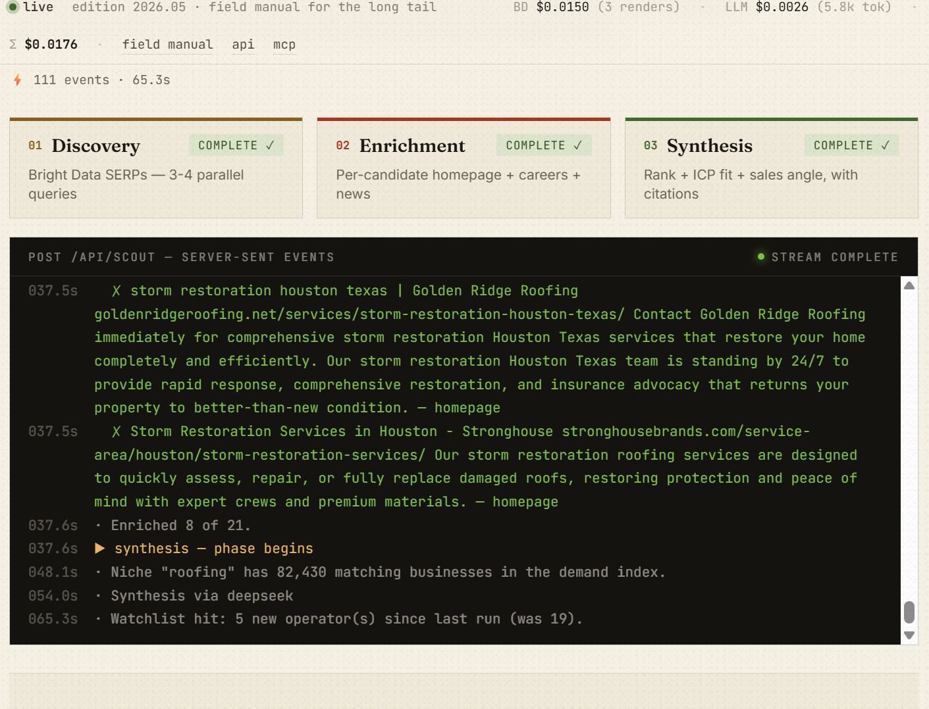
● live edition 2026.05 · field manual for the long tail
bright data pipeline
04
How Bright Data powers it
Three-phase hybrid agent pipeline. Bright Data is the spine.
01 DISCOVERY
LLM fires 4 parallel SERP queries: direct, hiring, news, suppliers.
Brave SERP API → DDG → Bright Data Scraping Browser cascade. BD handles long-tail queries Brave misses.
02 ENRICHMENT
For each candidate: render homepage, careers, and news.
Bright Data Scraping Browser handles JS-heavy ATS pages like Greenhouse, Lever, and Workday.
03 SYNTHESIS
DeepSeek ranks, scores ICP fit, and writes citation-grounded sales angles.
BD-sourced evidence becomes live citations and row-level drill-down traces.
BRIDGE SERVICE
Tiny Playwright bridge on the home server connects to Bright Data's WSS Browser API and exposes /render + /serp + /screenshot as HTTP for the Worker. One BD zone (lts_browser) handles render, SERP, and screenshots with mutex serialization.
Live trace: Discovery → Enrichment → Synthesis, streamed from the worker

Slide 5
● live edition 2026.05 · field manual for the long tail
niche recon
05
The killer differentiator: Niche Recon
The feature Apollo physically cannot replicate.
APOLLO CAN'T SEE THIS
EXAMPLE OUTPUT · PRODUCT = “home services CRM for trades”
Paste a product description. Get the top 5 long-tail verticals to hunt in.
NICHE
BUSINESSES
APOLLO-THIN
Map the product description to candidate verticals via LLM.
electrical
16,666
100% (every one uses ServiceTitan booking)
Cross-reference each vertical against the private 7M-business demand index.
hvac
42,873
86%
Rank by Apollo-thinness: share of businesses with no own-domain website.
Booking platforms, social profiles, and Google pages make operators invisible to Apollo's domain-match enrichment.
pool service
10,752
76%
plumbing
46,264
50%
PLATFORMS THAT HIDE OPERATORS FROM APOLLO
This is the moat. Apollo does not have the demand index. Without the index, this feature does not exist.
Booksy · Boulevard · ServiceTitan · Vagaro · Facebook · Instagram · Yelp · Google Business Profile

Slide 6
● live edition 2026.05 · field manual for the long tail
architecture
06
Architecture
Cloudflare-native, data-powered, and built for live scouting.
Browser
Preact SPA
Cloudflare Worker
(TypeScript)
Brave SERP API
primary
HOSTING / STACK
Cloudflare Workers (paid plan), custom domain via auto-cert, SSE streaming for the live agent trace.
DuckDuckGo HTML
tier 2
Bright Data Scraping Browser
tier 3 render
Demo password gates writes; read paths still require Bearer auth for the demand index.
Bright Data Browser API
screenshots
Frontend: Preact + Tailwind v4 + Vite. Deploy: Wrangler 3.
DeepSeek / OpenRouter
LLM primary / fallback
Cloudflare KV
24h SERP / 7d detail cache
Bridge: playwright-core + cheerio. Tests: Vitest (118 tests).
Cloudflare Cron
daily watchlist refresh
118
24h
7d
SSE
Resend
email digests
tests
SERP cache
detail cache
live trace
Private 7M-business demand index
protected CF endpoint

Slide 7
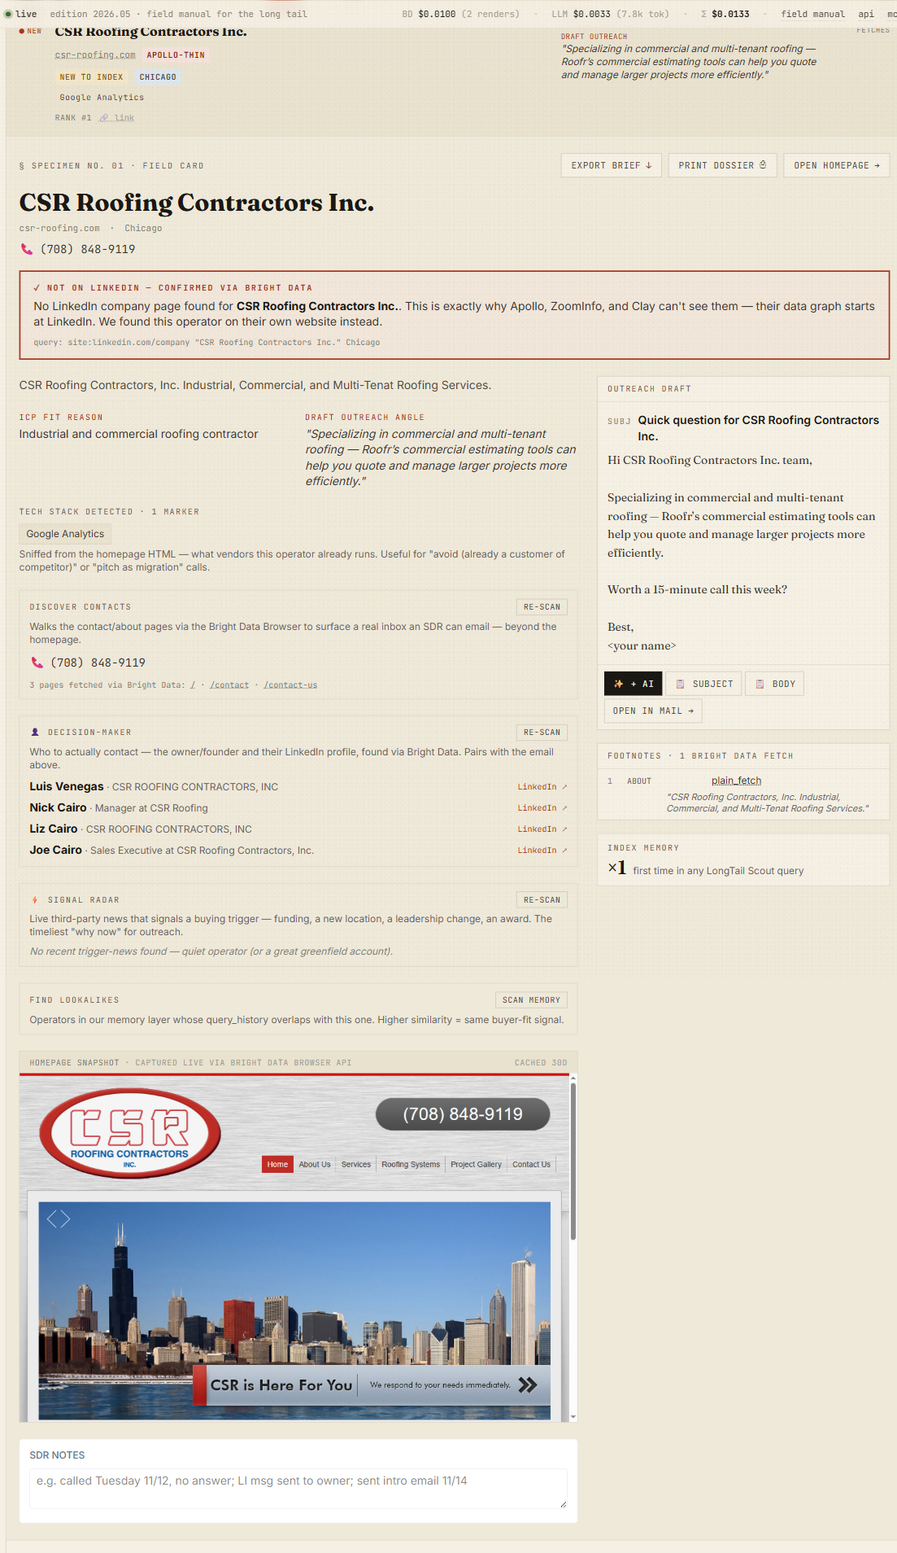
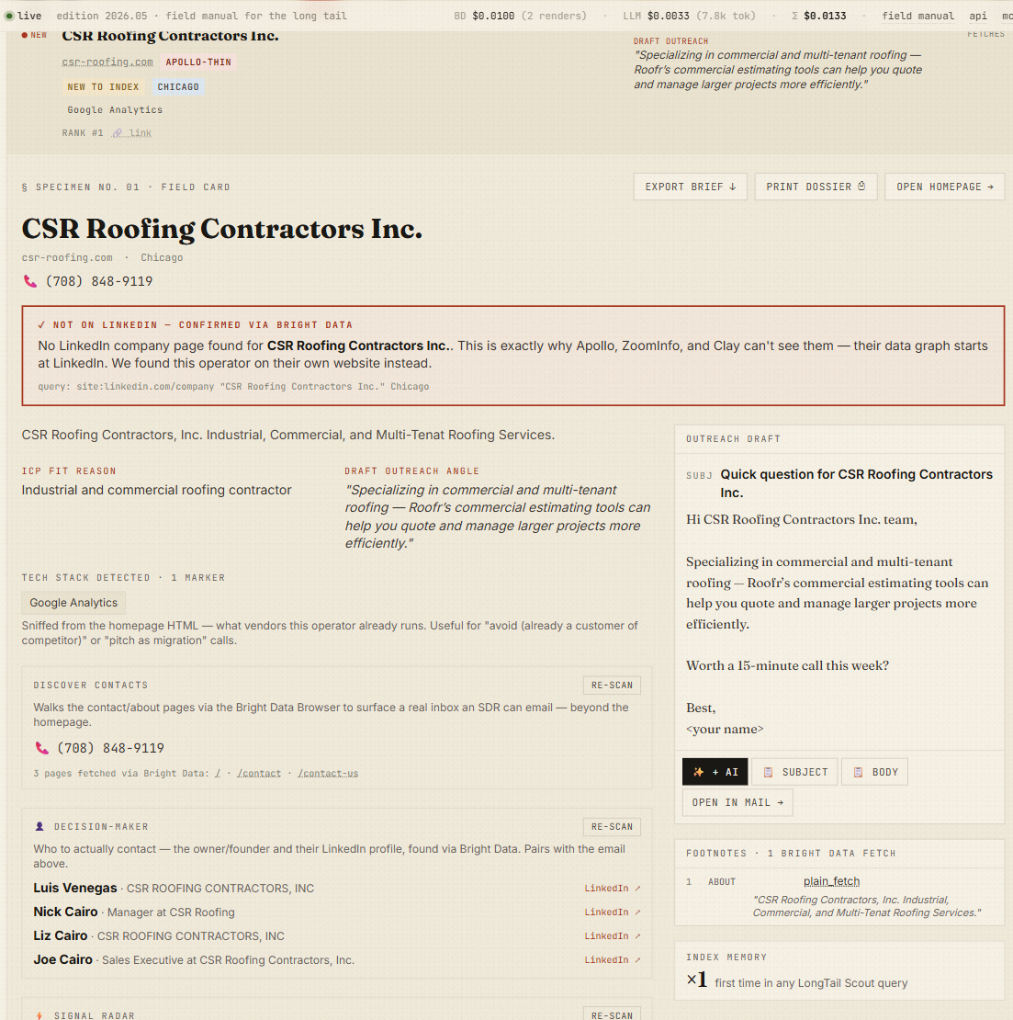
● live edition 2026.05 · field manual for the long tail
mcp / watchlists / security
07
Beyond the demo: MCP, watchlists, security
The find → prove → reach → act loop — production surface that keeps compounding.
MCP SERVER AT /api/mcp
SECURITY
12 tools any MCP-aware client can call:
118 unit tests covering SSRF guards on both the worker and the bridge, HMAC unsubscribe tokens, watchlist PII redaction, platform-host filters, and every new classifier.
scout
niche_recon
Two external code reviews (Codex). 10/10 findings closed. Full live burn-test of all endpoints + MCP tools.
find_businesses
demand_count
operator_screenshot
draft_email
linkedin_check
find_contacts
decision_maker
signal_radar
rank_triggers
account_brief
WATCHLISTS + ALERTS
Save a query. A daily cron refreshes the demand-index count. Resend email digests + Slack / Discord webhooks fire when delta > 0. Every digest has an HMAC-signed unsubscribe link for CAN-SPAM compliance.
Full field card — not on LinkedIn (proven), contacts, decision-maker, outreach
Apollo-blind proof: not on LinkedIn — owner + direct contact via Bright Data

Slide 8
● live edition 2026.05 · field manual for the long tail
next + thanks
08
What's next + thanks
The net-new-account engine for every vertical-SaaS GTM team.
NEXT 30 DAYS
THANKS TO
CRM connectors
HubSpot, Salesforce, Apollo CSV reverse-import
Bright Data
for the Scraping Browser product and the hackathon promo credit
Quality mode
Opt-in BD-bridge enrichment to recover the ~35% of candidates plain-fetch drops
Cloudflare
for Workers, KV, Tunnels, and custom-domain auto-cert
DeepSeek
for cheap, fast tool-use LLM performance — primary all the way
Vertical-tuned prompts
Roofing, HVAC, childcare, EMS — different hiring-signal weights by market
lablab.ai
for running the hackathon
Bright Data MCP Server
Integrate once it is GA, deprecate the Playwright bridge, call BD directly
Live demo: https://longtailscout.com
Source: github.com/dholzric/longtail-scout
Apollo for the long tail.

