Slide 1
Internshipstudio Ethical Hacking

Slide 2
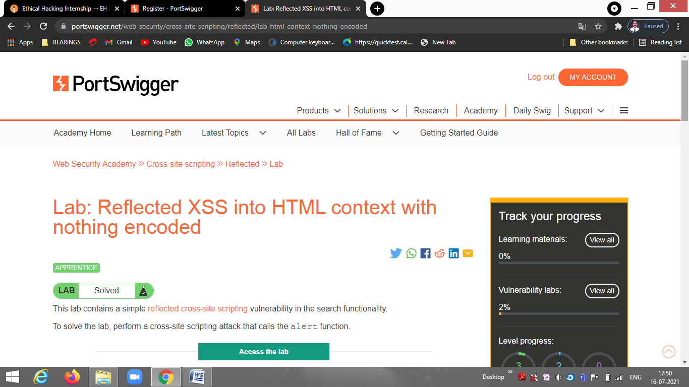
Task 1

Slide 3
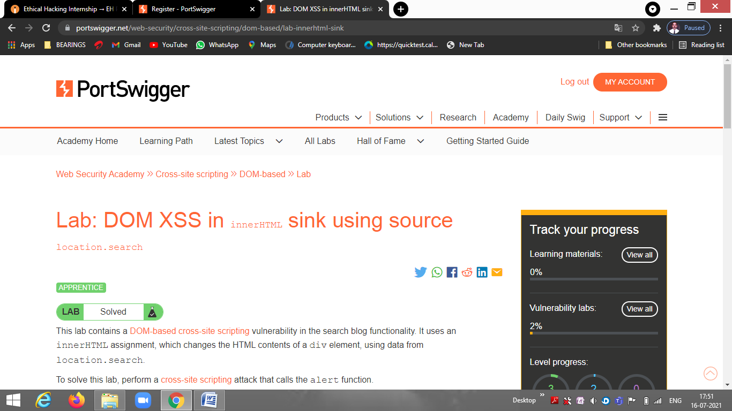

Slide 4
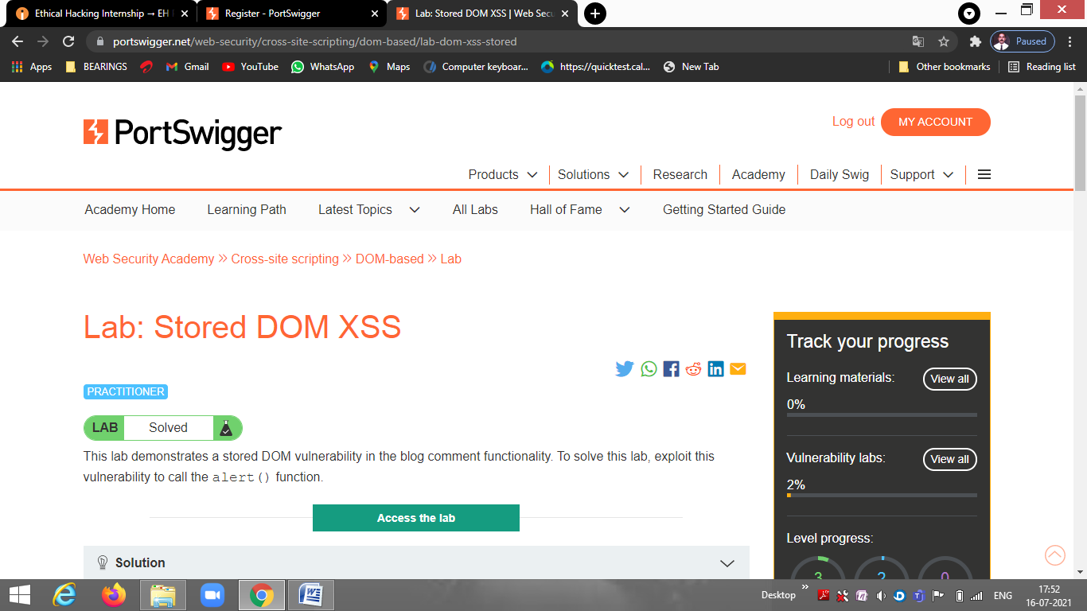

Slide 5
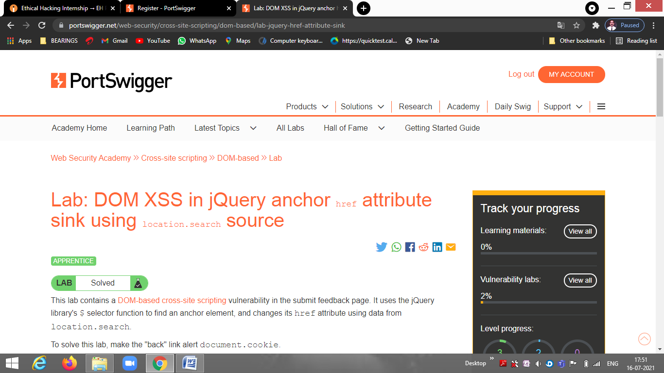

Slide 6
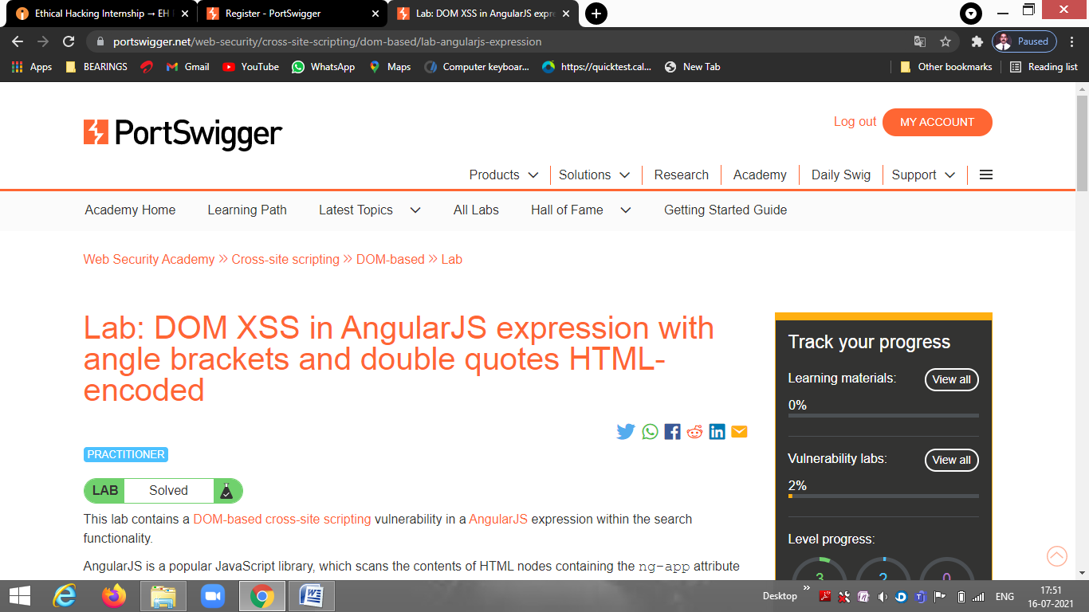

Slide 7
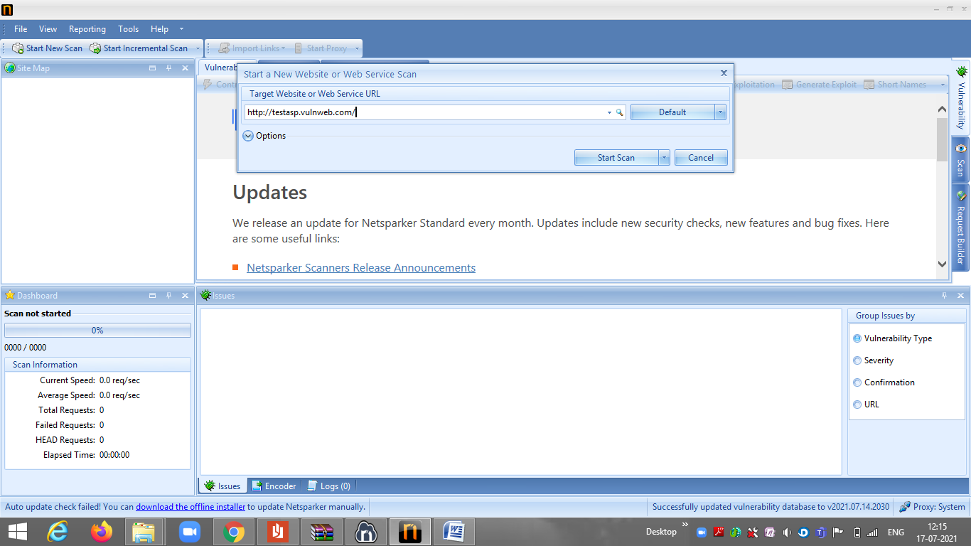
Task 2

Slide 8
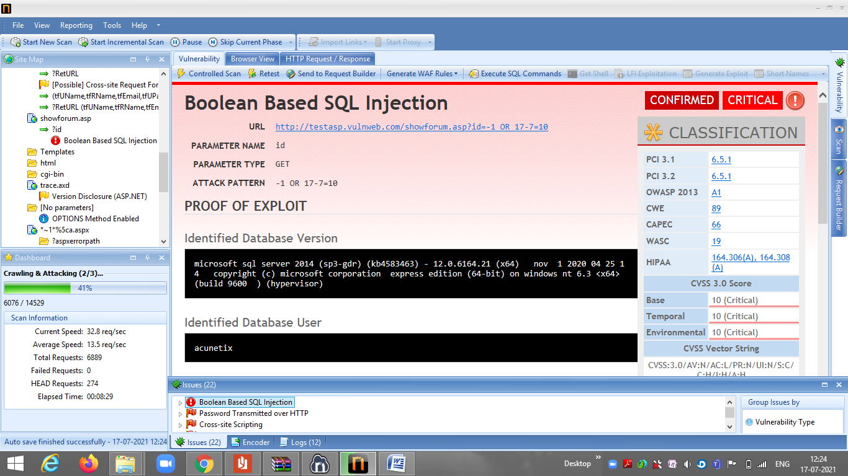

Slide 9
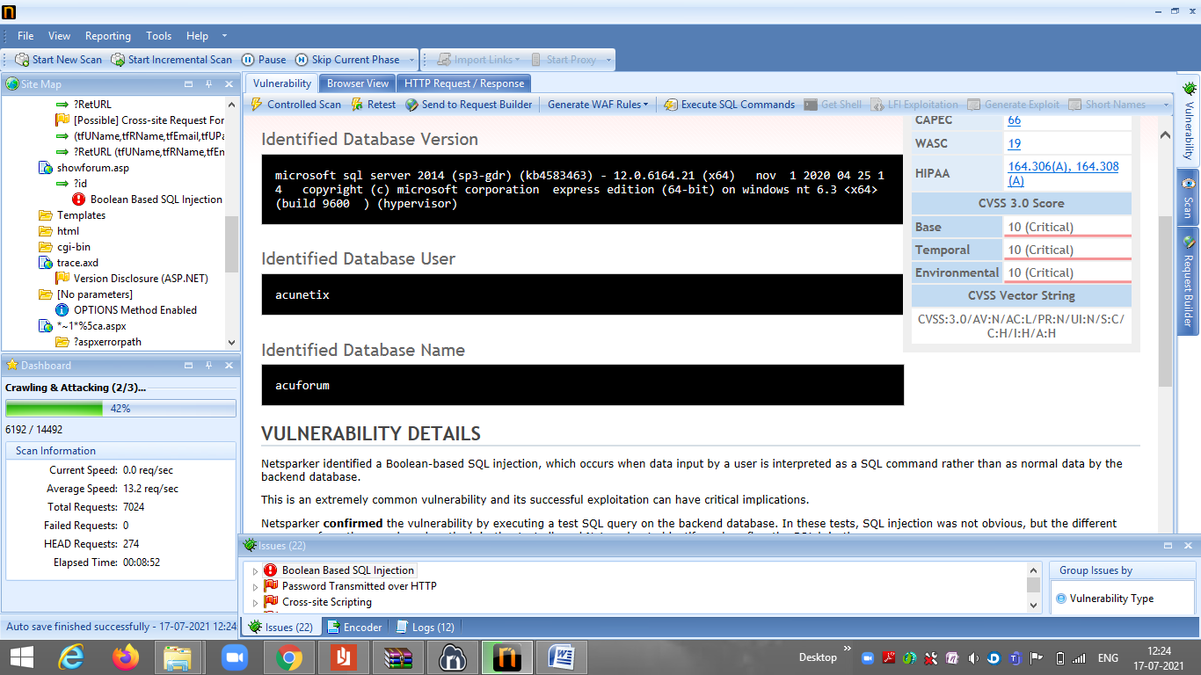

Slide 10
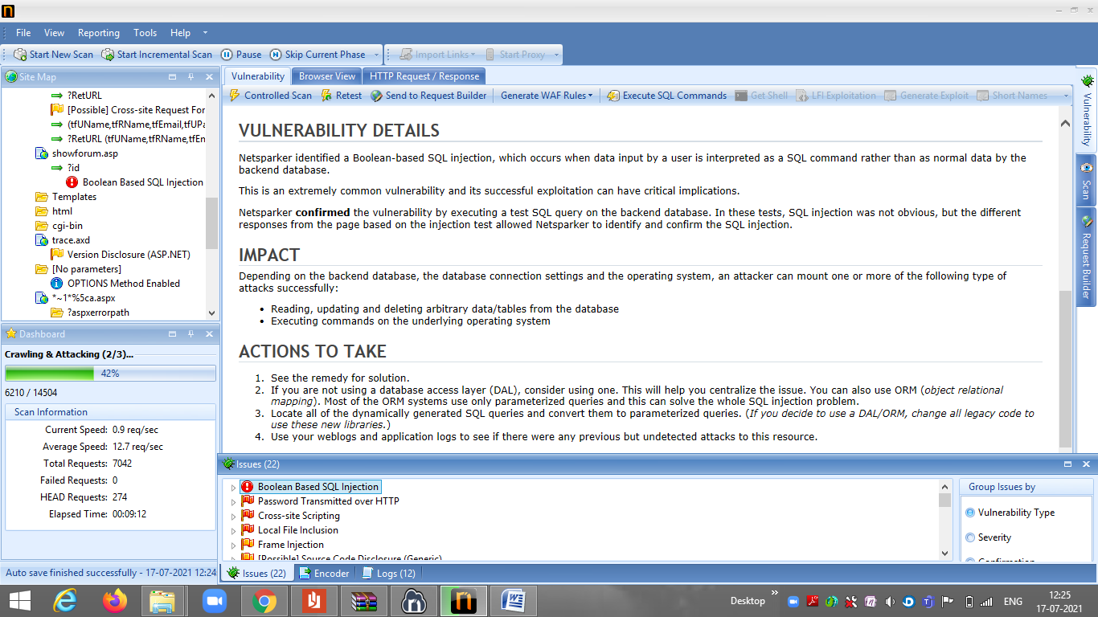

Slide 11
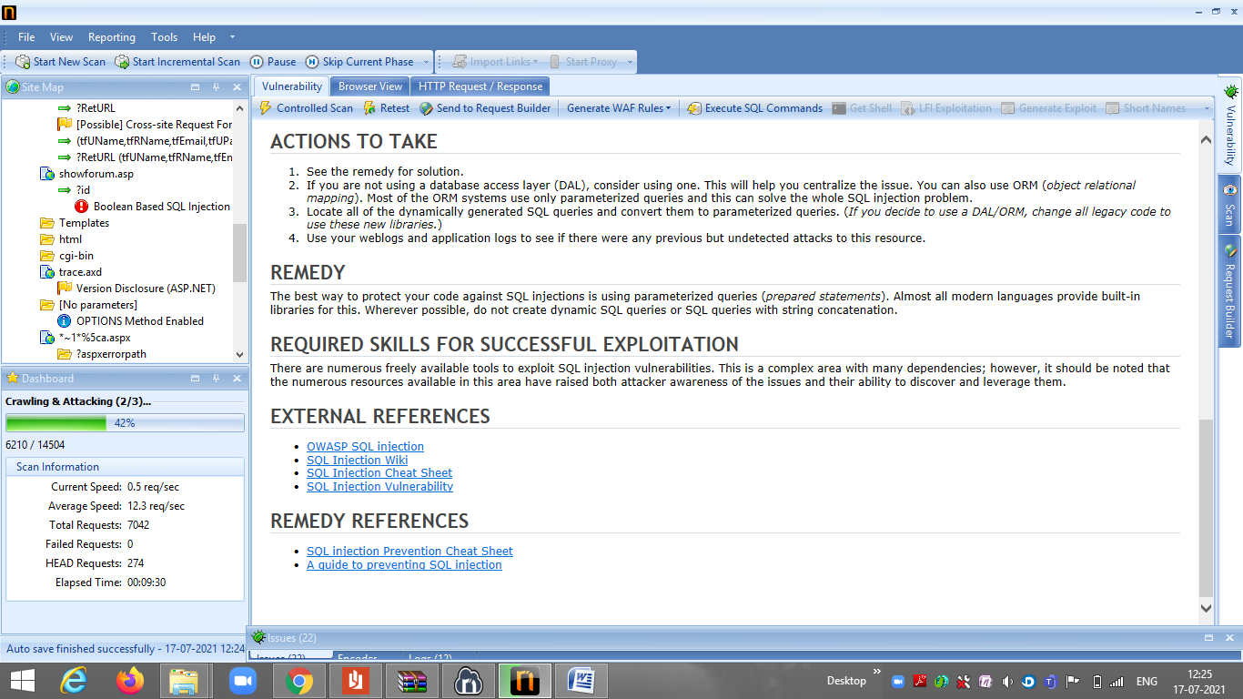

Slide 12
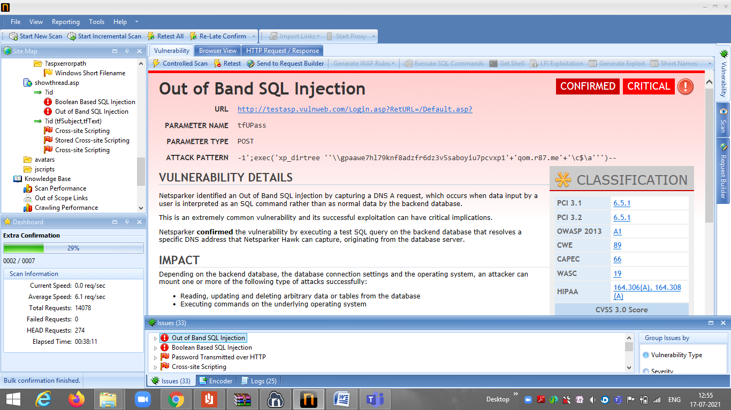

Slide 13
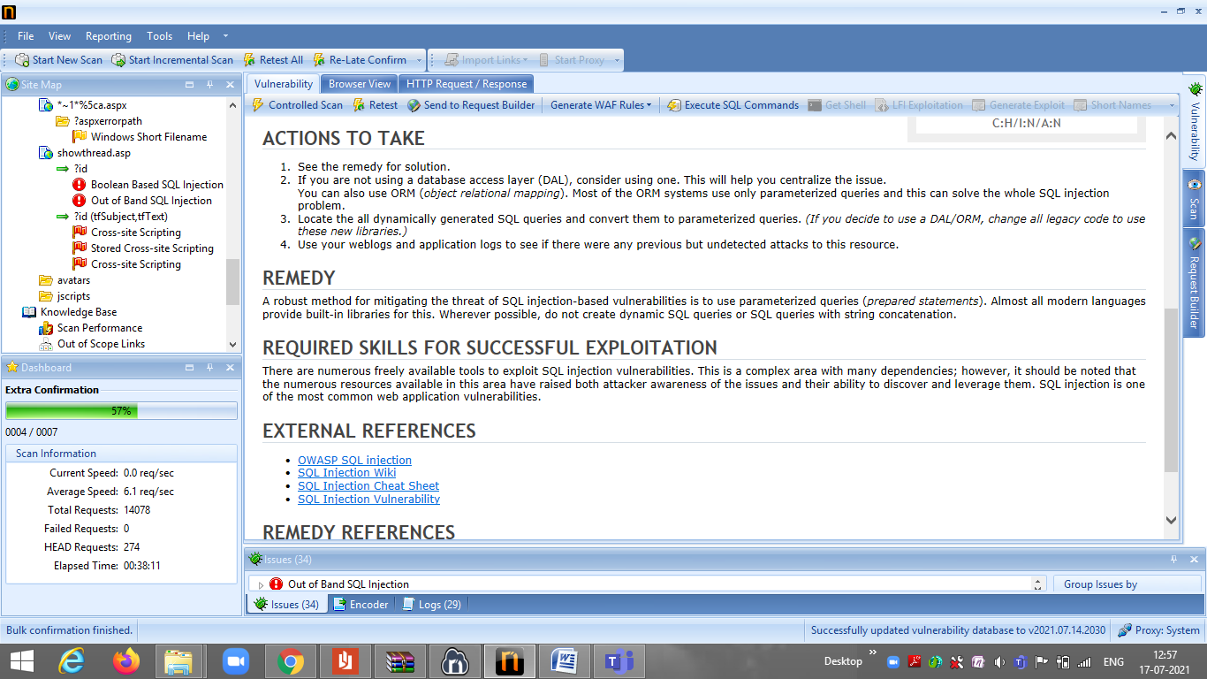

Slide 14
Report:
Title: Out of Band SQL Injection
Domian: http://zero.webappsecurity.com/
Steps to reproduce:
Step 1:Open netsparker.
Step 2: Add Website you want to search to the dialogue box.
Step 3:Define the customization option to scan as per your need
Step 4: It will start scanning it automatically
Step 5: Choose any one of the Critical Vulnerabilities.
Step 6: Write Reports for the vulnerability you wanted to write.

Slide 15
Impact: Blind SQL injections (blind SQLi) occur when a web application is exposed to SQL injection, but its HTTP responses don’t contain the results of the SQL query or any details of database errors. This unlike a regular SQL injection, in which the database error or output of the malicious SQL query is shown in the web application and visible to the attacker.
Summary: This occurs when input by user is interpreted as an SQL command. This vulnerability is confirmed by executing a test SQL query at the backend.

Slide 16
Attacks: An attacker can read, update and delete data from the database. Attacker can execute commands on that specifying OS.
Remedies: We can use Object Rational Mapping. We can also use weblogs and application logs to see if there were any previous but undetected attacks to this resource.
Below are the screenshots of the vulnerability.

Slide 17
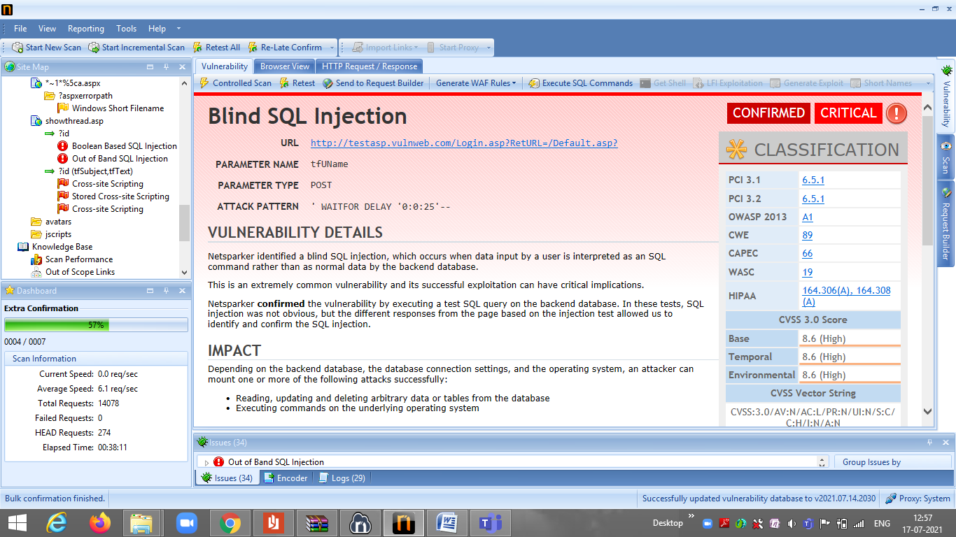

Slide 18
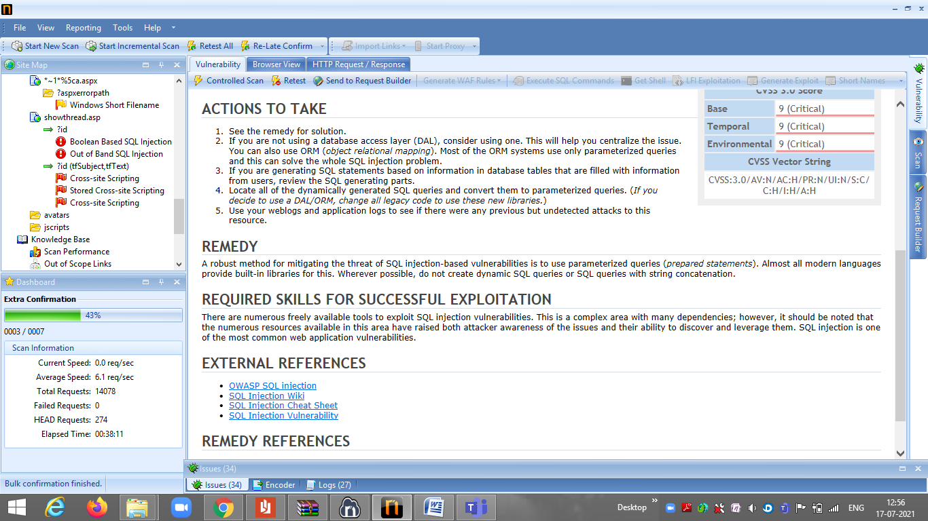

Slide 19
Task 3
Report
Title: Cross Site Scripting
Domain:vulnweb.com
Subdomain: testasp.vulnweb.com
Steps to reproduce:
Step 1: Visit http://testasp.vulnweb.com/
Step 2: On the top menu you will find a search option.
Step 3: Click on it and you will be prompted with the Search box.
Step 4: You can intercept the request in Burp Suite
Step 5: Now you can find different payloads for XSS.
Step 6: Send the request to the intruder and paste all the payloads.
Step 7: Try to find a successful payload for XSS.
Step 8: Prepare a report for it.

Slide 20
Impact: Cross Site Scripting can be harmful for the website. It can lead to leakage of the data.
Remedy: If you want to prevent the vulnerable of cross site scripting then we need to enable noscript in the browser.
Below images are the screenshot of the website which found to be vulnerable.

Slide 21
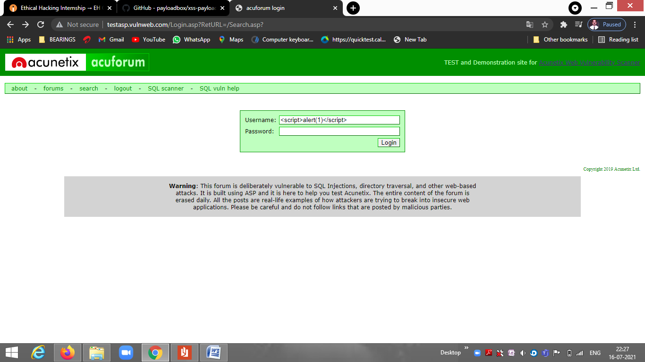

Slide 22
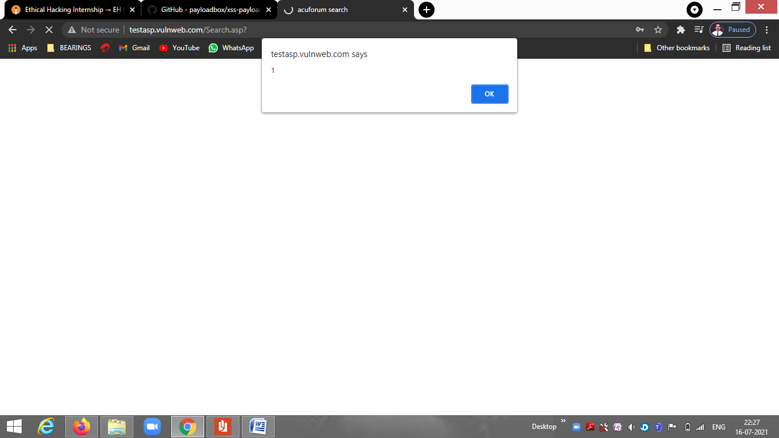

Slide 23
