Slide 1
Employee Data Analysis using Excel
STUDENT NAME: ANBAZHAGAN.S
REGISTER NO: 122203612/asunm148722bcs053
DEPARTMENT: B. Com (Corporate Secretaryship)
COLLEGE: J. H. A. Agarsen College

Slide 2
PROJECT TITLE
Employee Performance Analysis using Excel

Slide 3


AGENDA
Problem Statement
Project Overview
End Users
Our Solution and Proposition
Dataset Description
Modelling Approach
Results and Discussion
Conclusion
3/21/2024 Annual Review

Slide 4

PROBLEM STATEMENT
In the Excel analysis shows Employee performance rating. In this analysis tell there are medium rated employees only more, others rating are not like that.
In the analysis the high and very high level rating is very low and low level rating is second place. We must improve this table.

Slide 5

PROJECT OVERVIEW
.
This project is analyzing the Rating of employees either male or female employees. It is used to find the Employee performance.

Slide 6
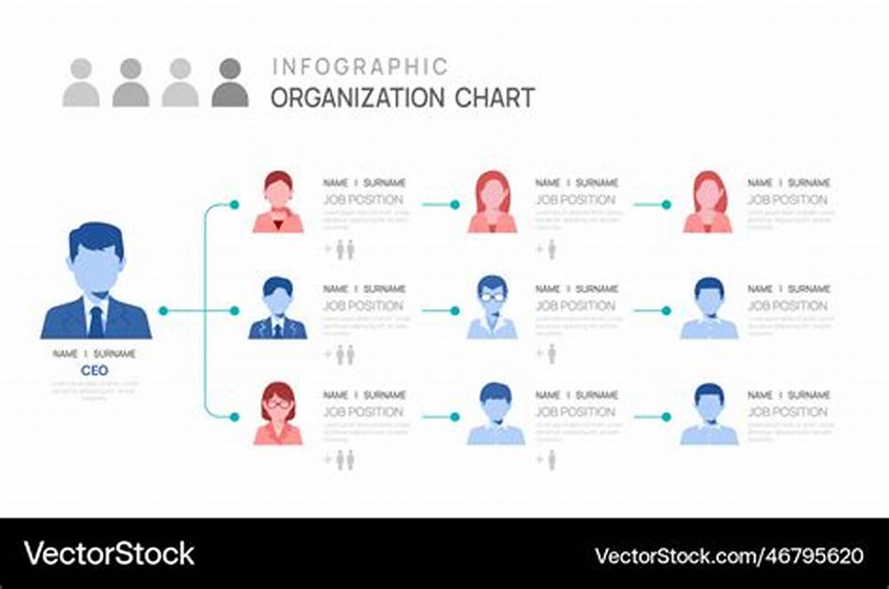

WHO ARE THE END USERS?

Slide 7

OUR SOLUTION AND ITS VALUE PROPOSITION
Conditional formatting – missing
Filter – remove
Formula – Performance level
Pivot Table – Summary
Graph – Data visualization

Slide 8
Dataset Description
Employee dataset I got from kaggle, it has 26 features I am using 9 features. The employee Id in number, name is in text, using employee type, business unit, Employee status, Performance score, Employee rating are used to analyzed.

Slide 9

THE "WOW" IN OUR SOLUTION
Performance Level Column =IFS(Z8>=5,”VERY HIGH’,Z8>=4,”HIGH”,Z8>=3,”MED”,”TRUE”,”LOW”)
3/21/2024 Annual Review
9

Slide 10
MODELLING
Data Collection
1)Kaggle
2)edunet
3)Employee data set
Feature Collection
1)Employee Id
2)Employee type
3)Performance level etc..
Analyze
Pivot table
Graph
Slicer
Editing
Fonts
Filter
Highlight
Formulas
10

Slide 11
RESULTS
11

Slide 12
conclusion
The analysis of employee performance ratings reveals that a majority of employees are rated at medium or low levels. This indicates that while a significant portion of the workforce meets basic expectations, there is room for improvement in achieving higher performance standards. Moving forward, the focus should be on targeted training, support, and motivation to elevate more employees to high-performance levels, thereby enhancing overall productivity and organizational success.

