Slide 1
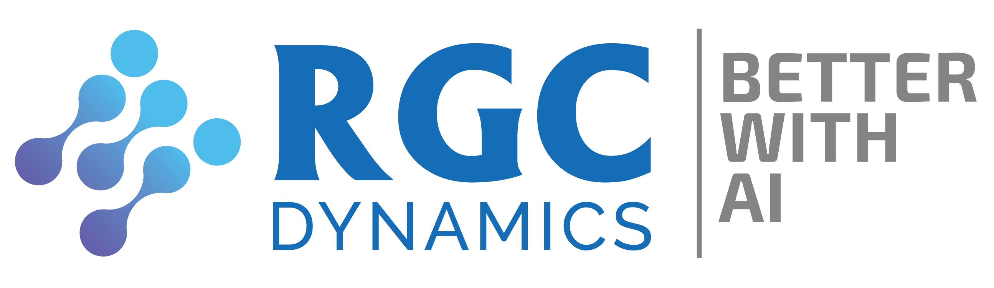
MICROSERVICE
DOCKER
CONTAINERS
KUBERNETS
PYTHON
DATABASE
Session lead By
JULY 17th-2021
VISHNU VP &
4pm to 6pm
SARATH CHANDRAN

Slide 2
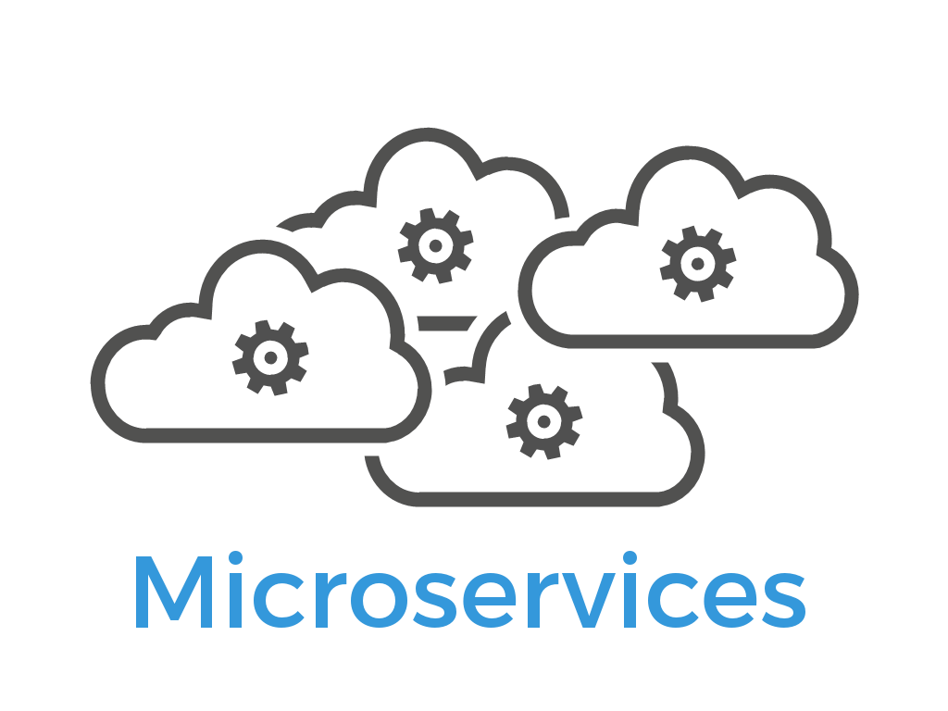
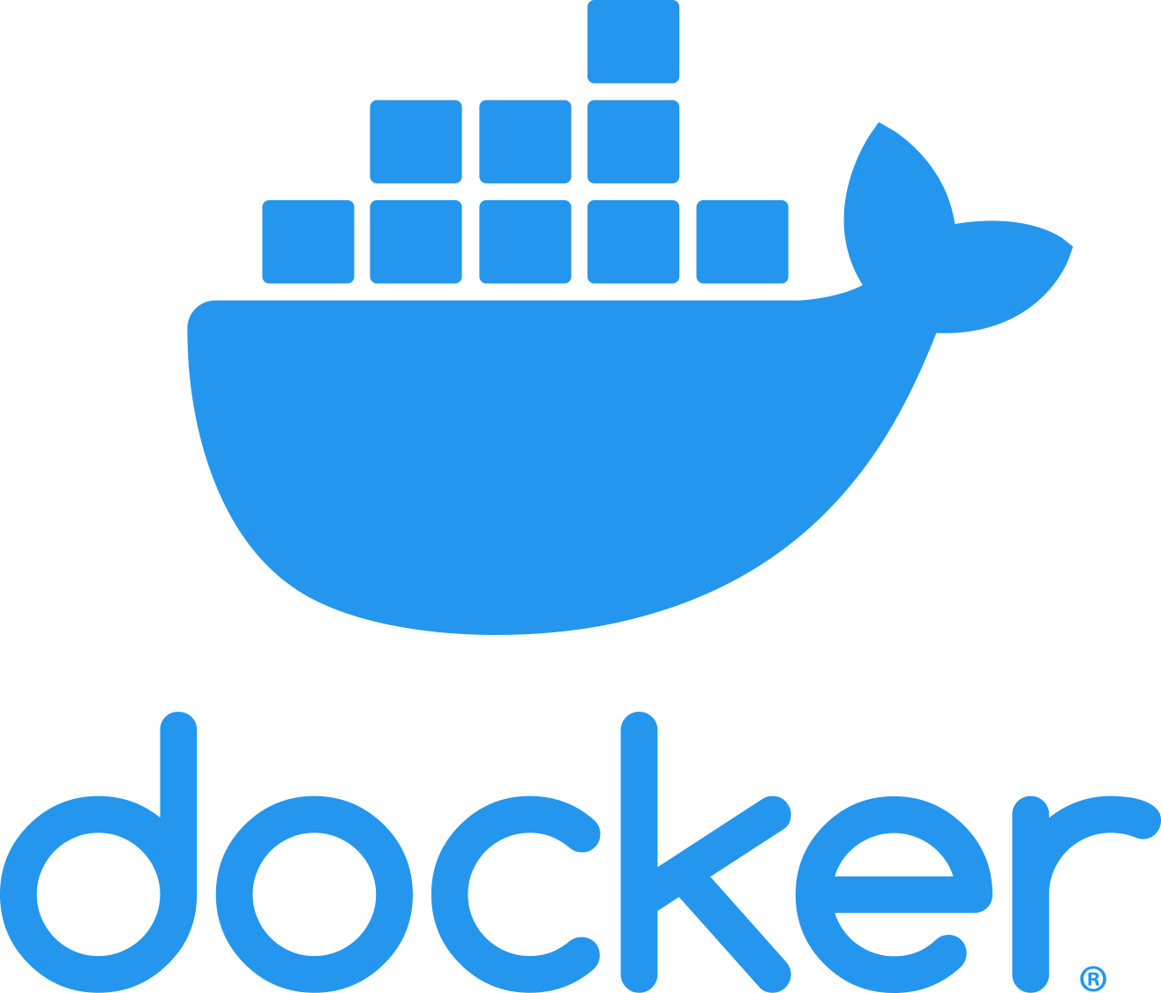
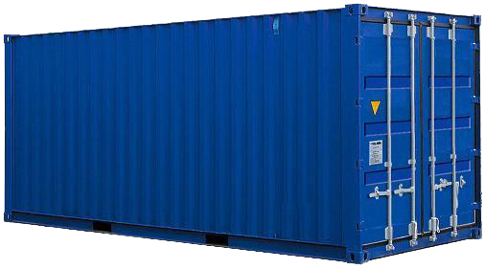
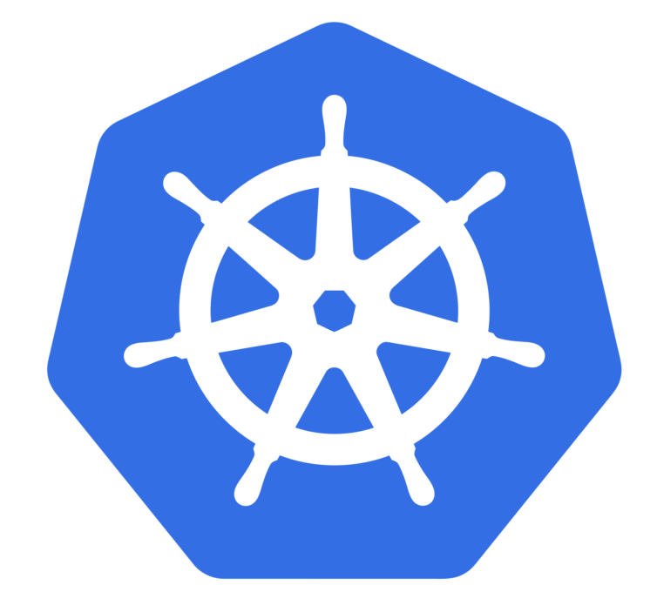
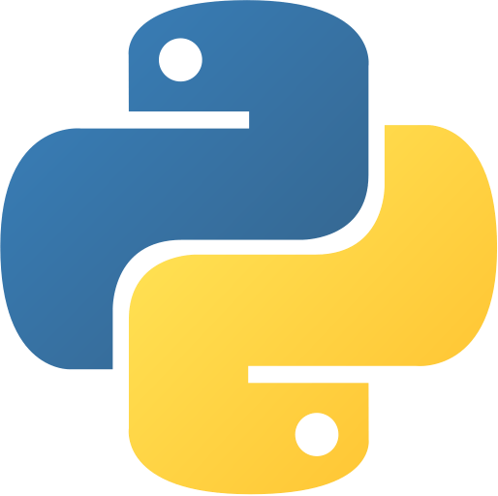
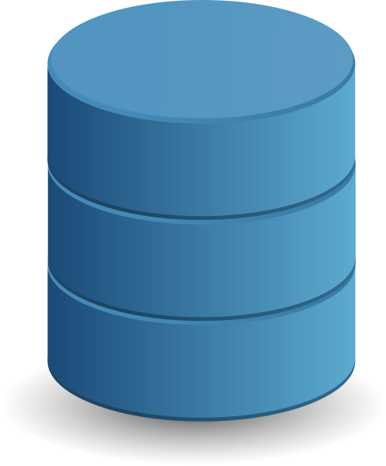
1
2
3
Container
4
5
6
KUBERNETES
python
DB

Slide 3
MICROSERVICE
?
What is Microservice & Why?
Pros. & Cons. of Microservice?
Why we choose Microservice?

Slide 4
MICROSERVICE
What is Microservice?
Software Architecture
Why?
Monolith Architecture

Slide 5
MICROSERVICE
Monolith Architecture
Traditional unified model
Components are combained together

Slide 6
MICROSERVICE
Monolith Architecture
Eg: Ecommerce App.
Products
Customer
Payments
Orders
1
2
1
2
All components are combained together
3
4
3
4
Components
Ecommerce Application
DATABASE

Slide 7
MICROSERVICE
Monolith Architecture Drawbacks!
Difficult to manage large application.
Each modification need a redeployment.
Difficult to adopt new technology for a particular functionality.

Slide 8
MICROSERVICE
Then, Microservice in a sentance...
Service oriented architecture composed of loosely coupled elements

Slide 9
MICROSERVICE
Microservice Architecture
Ecommerce Application
Eg:
Products
Customer
Payments
Orders
Python
Php
Java
.NET
1
2
1
2
3
4
Loosely coupled
3
4
Components
DATABASE
DATABASE
DATABASE
DATABASE
PostgreSQL
MySQL
MongoDB
MariaDB

Slide 10
MICROSERVICE
Aproches to Microservice connections

Slide 11
MICROSERVICE
2. Pros. & Cons.
Better for large complex applications
Continuous updations and delivery without affecting other modules
Loosely coupled modules(Minimal dependencies)
Increase module reusability

Slide 12
MICROSERVICE
2. Pros. & Cons.
Difficulty to maintain a large number of service
More complexity on deployment
Increased memory consumption
Developers must deal with additional complexity

Slide 13
MICROSERVICE
3. Why we choose Microservice?
Because of our project nature.

Slide 14
MICROSERVICE
3. Why we choose Microservice?
PRODCUT
MICROSERVICE
Ecommerce
Inventory
Warehouse

Slide 15
MICROSERVICE
4. Ecommerce Microservice.
Legal units
Marketing
Logistic
User
Payments
Rating & Review
Products
Order Management
Uploads

Slide 16
MICROSERVICE
4. Ecommerce Microservice?
Legal units
Rating & Review
Uploads
User
Payments
Products
Marketing

Slide 17
DOCKER

Slide 18
DOCKER
1. Docker ?
Docker is a Container based technology
Used to Develop, Deploy & Run applications
What is container?
Application Warehouse

Slide 19
DOCKER
Containerized Application
App1
App2
App3
App4
App5
Docker
Host Operating System
Infrastructure
Docker

Slide 20
DOCKER
2. Why Docker?
Virtual Machine
Virtual Machine
Virtual Machine
Containerized Application
App 1
App 2
App 3
App1
App2
App3
App4
App5
Guest OS
Guest OS
Guest OS
Docker
Host Operating System
Infrastructure
Hypervisor
Docker
Infrastructure
Virtual Machine

Slide 21
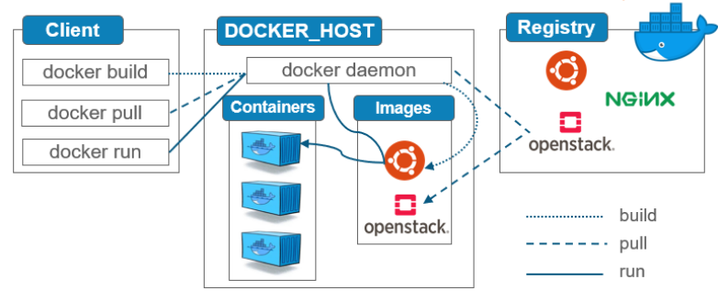
DOCKER
2. How?

Slide 22
DOCKER
Docker Client ?
Docker users
Through Command Line Interace(CLI)

Slide 23
DOCKER
Docker Host?
Environment to run applicaitons
=Where docker is installed.

Slide 24
DOCKER
Docker Images?
A file used to execute code in Docker
Includes : Code, Configuration files, Env. variables, & libraries

Slide 25
DOCKER
Docker Container?
An organized environment to run applicaions.
Only one service per container

Slide 26
DOCKER
Docker Registry ?
Storage and content delivery system

Slide 27
DOCKER
Docker Deamon?
Listener for docker API requests
Communicate with other docker deamons

Slide 28
MICROSERVICE
4. Ecommerce Microservice.
Legal units
Marketing
Logistic
User
Payments
Rating & Review
Products
Order Management
Uploads

Slide 29
MICROSERVICE
4. Microservice with Docker
Legal units
Marketing
Logistic
User
Payments
Rating & Review
Products
Order Management
Uploads

Slide 30

DOCKER
Some best practices?
One Service : One Container
One Container One Database

Slide 31
KUBERNETS
KUBERNETES

Slide 32
KUBERNETS
Kubernetes?
Container orchestration system
For automating, deploying, scaling,
and management of containerized applications
Invented by Google

Slide 33
KUBERNETS
Different Container Orchestration Systems.
Kubernetes
Docker Swarm
Mesos
Nomad
Amazon ECS

Slide 34
KUBERNETS
Why Kubernetes?
Open source
Huge ecosystem
Application runs more stable
Cheaper than its alternatives
Adopted by Amazon EKS and Azure AKS

Slide 35
KUBERNETS
DOCKER
DOCKER
DOCKER
KUBERNETS
DOCKER
DOCKER

Slide 36
KUBERNETS
Docker OR Kubernetes?
Docker is a Container
Kubernetes is Container orchestration.

Slide 37
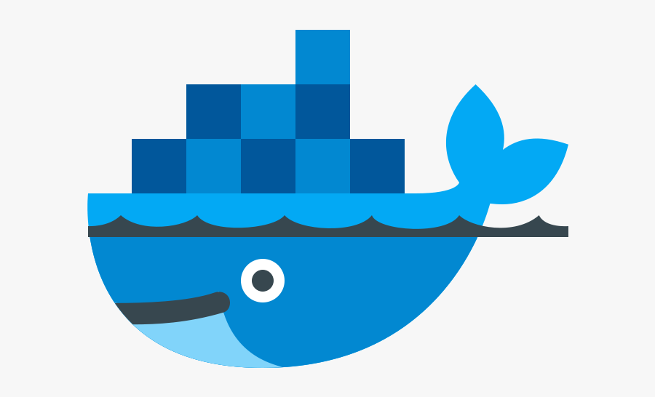
ARCHITECTURE

Slide 38
KUBERNETS ARCHITECURE
Etcd
API Server
Controller
Manager Server
Scheduler
Server
Worker node1
UI
Worker node2
API
CLI
Worker node3
Worker node4
Kubernetes Master
Registry

Slide 39


Slide 40

PYTHON
Guido van Rossum
Dutch Programmer
February 20, 1991
BBC comedy series
-Monty Python's Flying Circus-

Slide 41
PYTHON
Pros. & Cons.
Easy to Read, Learn and Write
Improved Productivity
Free and Open-Source
Vast Libraries Support
Better community

Slide 42
PYTHON
Pros. & Cons.
Slow Speed
Not Memory Efficient
Weak in Mobile Computing
Database Access

Slide 43
PYTHON
Why? General Purpose Programming Language
Web Development
GUI Development
Scientific and Numeric
Business applications
Games Development
Education
Artificial Intelligence
Machine learning
Robotics
Network programming

Slide 44
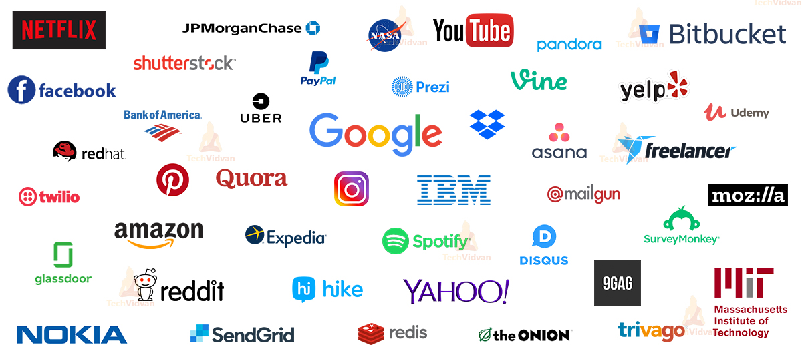
PYTHON

Slide 45
DATABASE

Slide 46
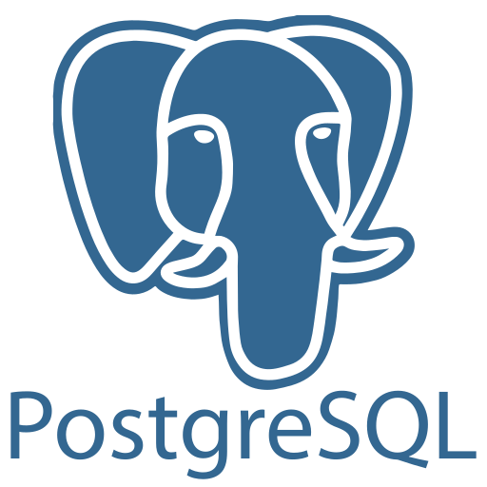


DATABASE
SQL
NoSQL

Slide 47
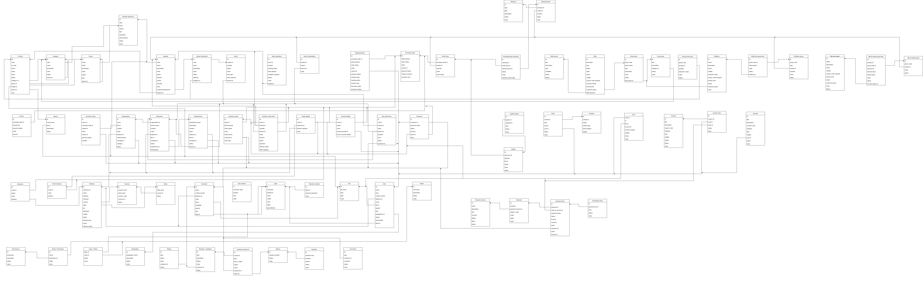
DATABASE
DB Diagram >>

Slide 48
Finally...
Microservice vs Monolith
Docker service & Architecture
Containers
Kubernetes & Architecture
Python
www.programspeaker.com

Slide 49
Any Questions?

Slide 50
Thank you
FROM
Vishnu VP & Sarath Chandran

