Slide 1
Video Wall
By:
Tyler Liden, Philip Sanders, Mark Fisher, Adam Darrah

Slide 2
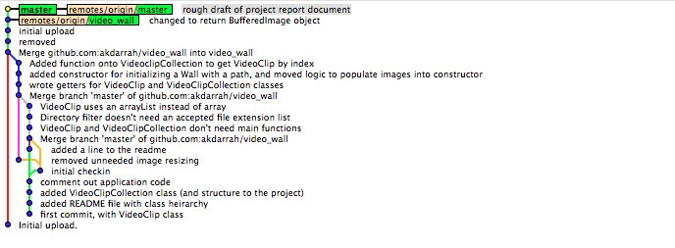
Background Goal
Collaboration was a challenge! (Git)

Slide 3
Software
Java
OpenCV (with Java bindings)

Slide 4
Classes
VideoClip and VideoClipCollection
Wall
VideoFrameViewer
AviLoader

