Slide 1
Midterm Portfolio Presentation
Daniel Horgan

Slide 2
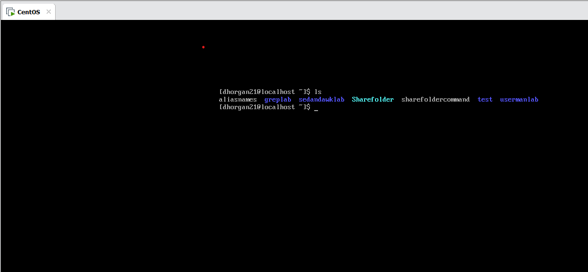
Servers

Slide 3
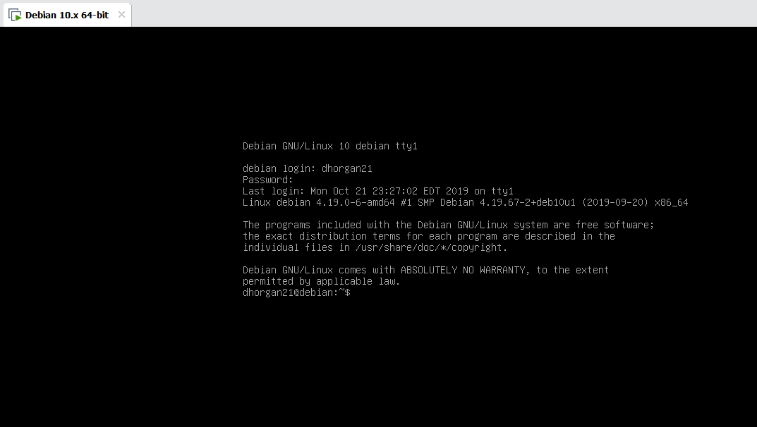

Slide 4
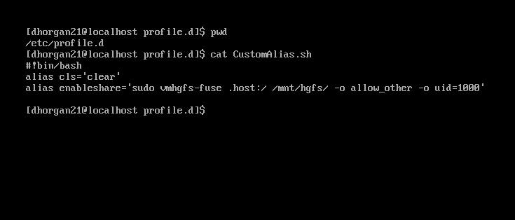
Custom Alias Folder

Slide 5
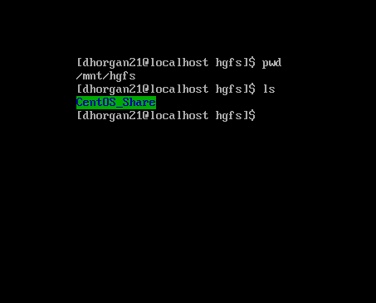
/mnt/hgfs Directory

Slide 6
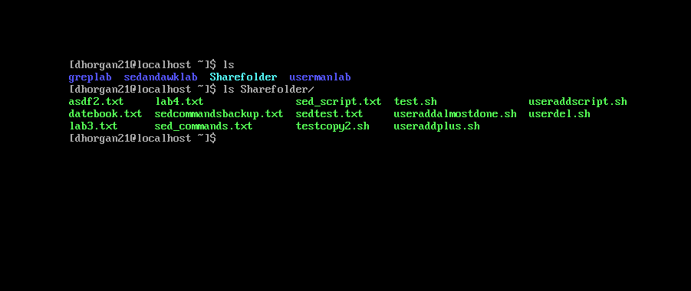
Shared Folder in CentOS

Slide 7
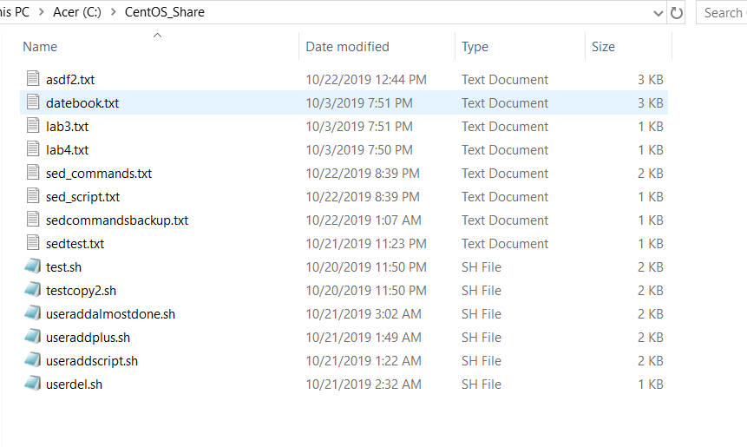
Shared Folder in Windows

Slide 8
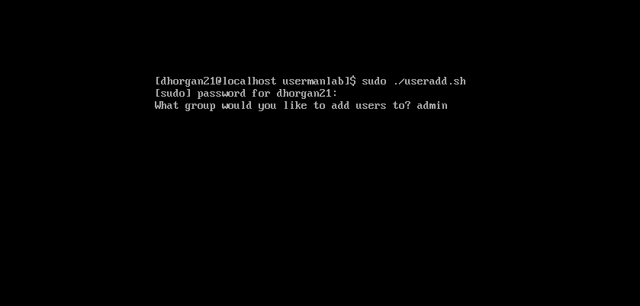
User Add Script

Slide 9
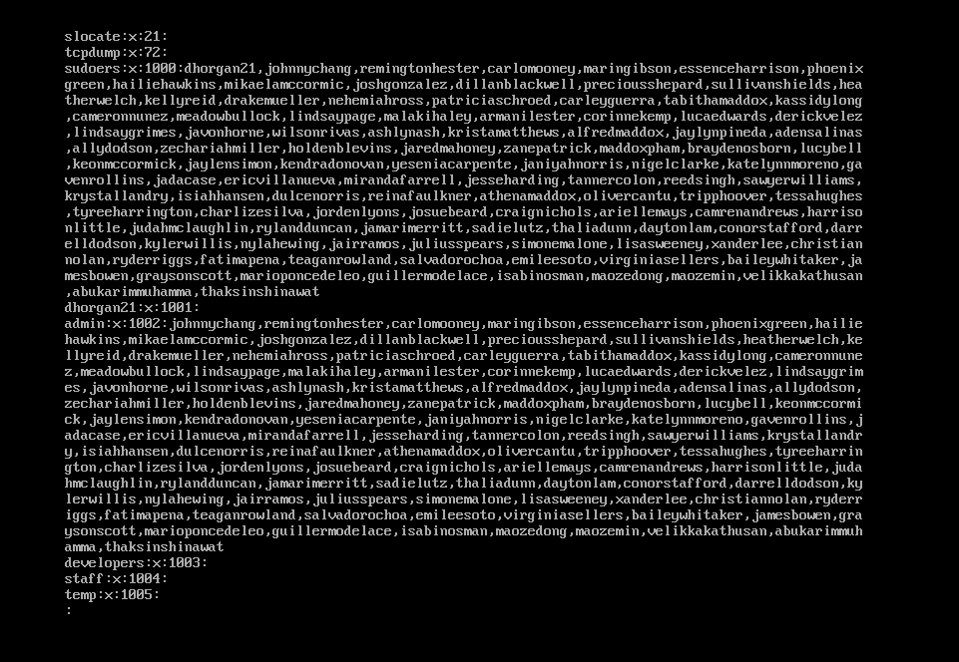
/etc/group Post Useradd

Slide 10

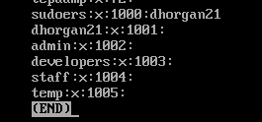
Userdel Script

Slide 11
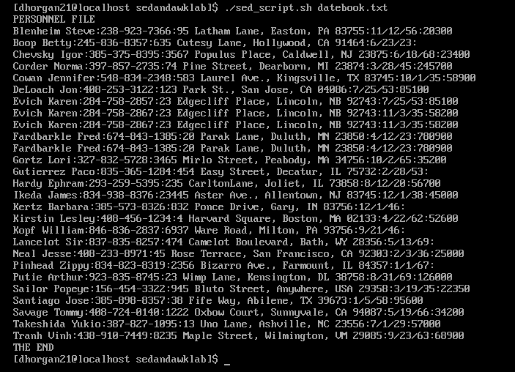
Sed Script Output

Slide 12
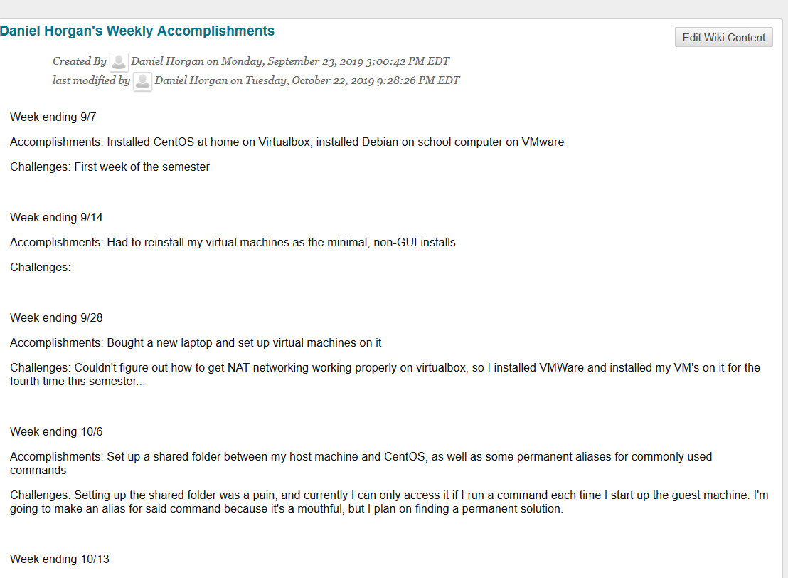
Weekly Accomplishments

Slide 13
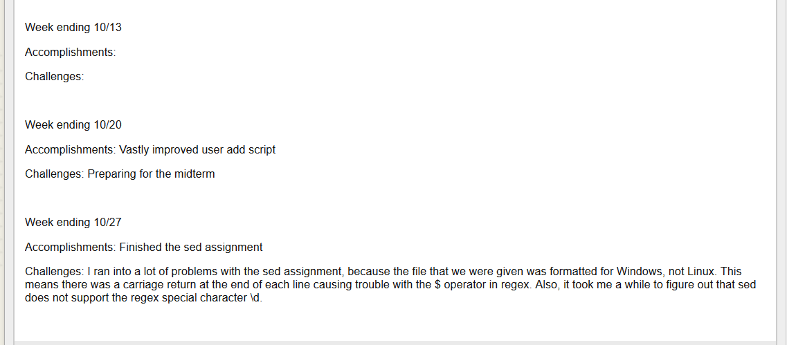

Slide 14
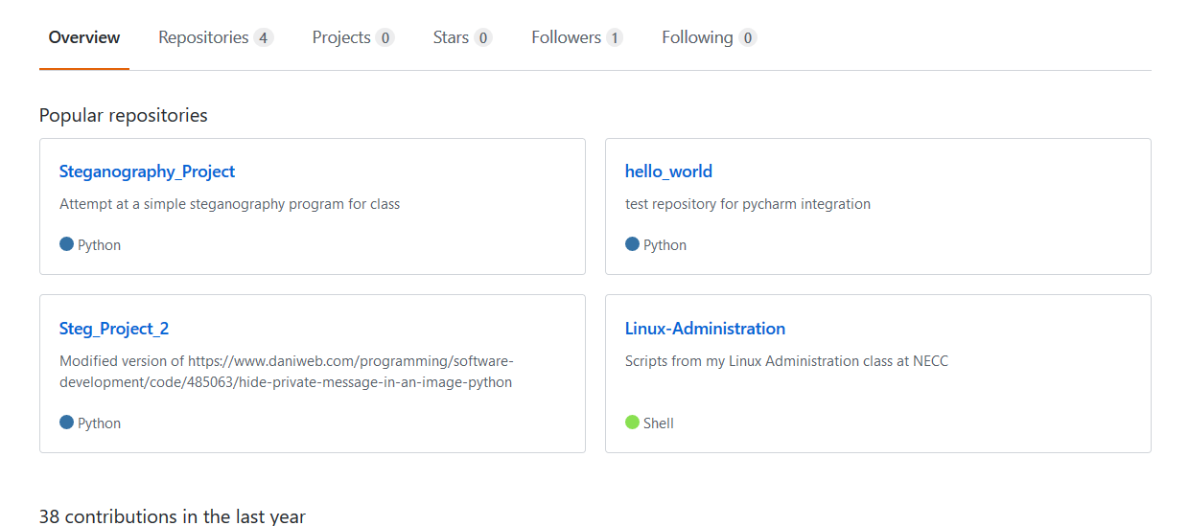
Github:
https://github.com/dhorgan21

