Slide 1
Ek-Kaan

Slide 2
Ek-Kaan

Slide 3

Table of Contents
Introduction
Introduction
Objectives
Use Case Diagram
GAANT Chart
Proposed Output

Slide 4

Introduction
A web chat application utilizing the MERN stack, Tailwind CSS, and DaisyUI is proposed to provide a straightforward and user-friendly platform for real-time messaging.
The application ensures seamless communication with immediate message delivery and synchronization.
It features a clean, intuitive design that prioritizes ease of use and high performance, combining efficient functionality with simple navigation.

Slide 5
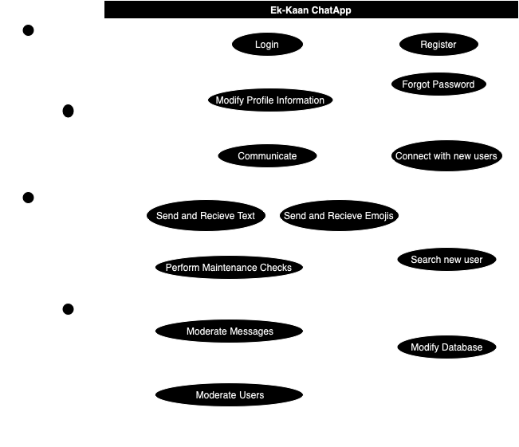
Objectives
Implement instant messaging with real-time updates.
Ensure secure user authentication and profile management.
Create a responsive and intuitive user interface.
Maintain high performance and data security.

Slide 6
Use Case Diagram

Slide 7
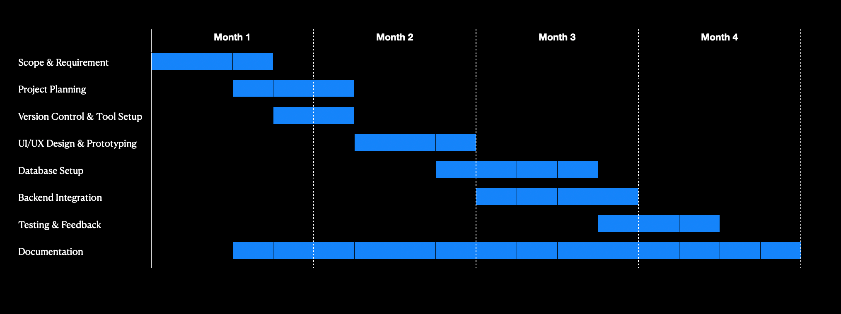
Use Case Diagram

Slide 8
GAANT Chart

Slide 9
GAANT Chart

Slide 10
Proposed Output
Secure User Authentication
Search and Filtering
Intuitive User Interface
Real Time Messaging
Dynamic Interaction Options

