Slide 1
Experimental Comparison of Database Provenance Systems
GProm VS ProvSQL
By: Sri Keshav Katragadda, Revathi Dhotre

Slide 2
Introduction
Provenance Systems: Track and analyze the origins and transformations of data in relational databases.
Objective: Evaluate two provenance systems, ProvSQL and GProM, on performance,functionality, effectiveness and capabilities.
Significance: Database provenance is crucial for accountability, debugging, and understanding data derivations.
Notes:
"Let me start with an introduction. Provenance systems help us track and analyze the origins and transformations of data in relational databases."
"The main objective of this study is to evaluate ProvSQL and GProM based on their performance, functionality, effectiveness, and capabilities."

Slide 3
Tool Introduction
ProvSQL is the latest provenance system, which was first introduced at
Provenance Week in 2018. It uses semi-rings to compute provenance polynomials,
which are made particularly descriptive by user-defined aliases.
Perm uses annotation propagation and query rewriting to determine provenance
and is also the predecessor of GProM, which implements an approach
to generate provenance game graphs.
Notes:
ProvSQL, introduced in 2018, uses semi-rings for provenance polynomials with customizable aliases. Perm, the predecessor of GProM, uses annotation propagation and query rewriting, while GProM generates provenance game graphs.

Slide 4
Dataset:
Source: Real-world flight information.
Purpose: Analyze provenance systems under realistic conditions.
Divided into Three Sizes for Testing:
Small: 500,000 rows.
Medium: 1,000,000 rows.
Large: 3,000,000 rows.
Testing Scenarios: Evaluate performance, scalability, and resource usage across varying dataset sizes.
Notes:
The dataset we used is real-world flight information."
"The purpose of this dataset is to analyze provenance systems under realistic conditions."
"We divided the dataset into three sizes: small with 500,000 rows, medium with 1 million rows, and large with 3 million rows."
"This allowed us to evaluate performance, scalability, and resource usage across varying dataset sizes."

Slide 5
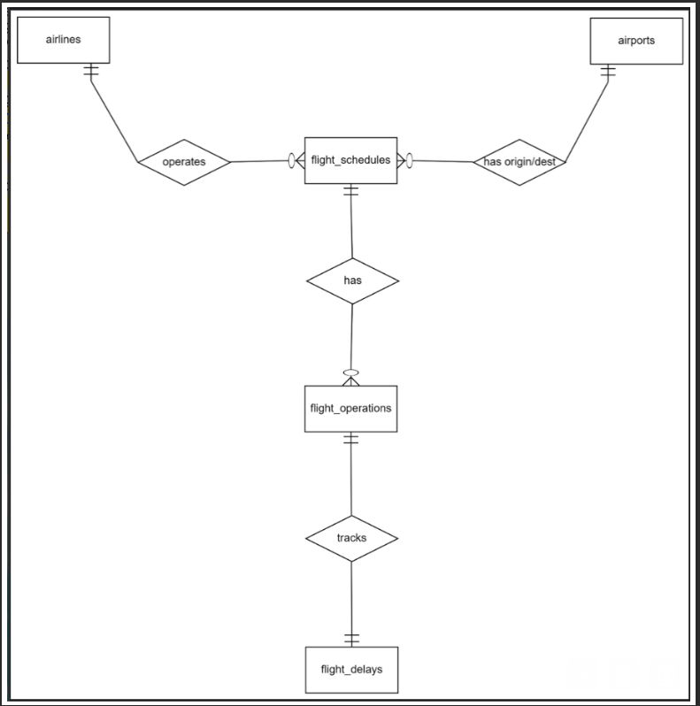
Entity - Relationship Diagram
Notes:
This is the entity-relationship diagram for our dataset."
"It shows the relationships between key entities like airlines, airports, flight schedules, flight operations, and flight delays."
"The diagram highlights how these entities interact, such as tracking flight delays and linking operations with schedules and airlines."

Slide 6
System configuration
Base OS: Ubuntu 22.04 (64 bit) - Oracle Virtualbox
Database: PostgreSQL
Test Environment Specifications:
Base memory: 80GB
Processors: 4
Postgres configuration changes:
effective_cache_size = 4GB -> 40GB
shared_buffers = 128MB --> 4GB
temp_buffers = 8MB --> 4GB
work_mem = 4MB --> 16GB
Notes:
Here is the system configuration used for our experiments."
"We ran tests on using Oracle VirtualBox and PostgreSQL as the database.
"The test environment had 80GB of base memory and 4 processors."
"We also increased PostgreSQL configuration values as suggested by the professor, including the shared buffers, temp buffers, and work memory to better handle large datasets."

Slide 7
EVALUATION CRITERIA
Firstly, focussed on distinguishing the features of each tool to know its capabilities
Tested the queries to see which tools support WHY, HOW and WHERE Provenances
Total of 21 queries were assessed, to test performance metrics on selection, joins, aggregations, grouping and projections, and broad set of combined cases.
Notes:
"Next, we focused on distinguishing the features of each tool to understand their capabilities."
"We tested the queries to check which tools support WHY, HOW, and WHERE provenance."
"A total of 21 queries were assessed to evaluate performance on different operations, like selection, joins, aggregations, grouping, projections, and combined cases."

Slide 8
Feature Comparison
Feature | GProM | ProvSQL
Description | Middleware for provenance management combining SQL/Datalog queries with provenance queries. | PostgreSQL extension implementing provenance using semirings.
Supported DBMS | PostgreSQL, SQLite, Oracle, MonetDB. | PostgreSQL only.
Query Language | SQL and Datalog. | SQL only.
Provenance Types | Supports why and why not provenance queries (provenance games with colored graphs). | Computes provenance using semirings (e.g., counting, Boolean, tropical semirings).
Graph Output | Generates provenance game graphs for why and why-not provenance. | Outputs provenance graphs and formulas with IDs replaced by aliases for better readability.
Semiring Support | Not explicitly supported. | Supports various semirings like counting, tropical, positive Boolean, and user-defined semirings.
Notes:
This table compares the features of GProM and ProvSQL."
"GProM acts as middleware that combines SQL/Datalog queries with provenance queries.
"GProM supports multiple DBMS systems like PostgreSQL, SQLite, and Oracle, while ProvSQL works only with PostgreSQL."
"GProM supports SQL and Datalog, but ProvSQL is limited to SQL."
"For provenance types, GProM supports why and why-not provenance using colored graphs, whereas ProvSQL computes provenance with semirings for better flexibility."

Slide 9
Feature Comparison
Feature | GProM | ProvSQL
Aggregate Functions | Supports aggregates like SUM, MAX, and AVG. | Limited support for aggregates (e.g., MAX, AVG, not supported as of 2021).
Provenance IDs | Not required; directly derives provenance information. | Uses add provenance to assign provenance IDs and create provenance mapping for user aliases.
Implementation | Middleware that translates queries to provenance-enhanced SQL, executed on the backend DBMS. | Extension embedded in PostgreSQL, enhancing its native capabilities.
Visualization | Generates provenance graphs with color-coded nodes for root nodes (depending on query type). | Exports provenance graphs and formulas, which can be visualized using external tools.
Customization | Supports query customization for provenance analysis through SQL or Datalog. | Allows user-defined semirings and provenance mapping customization for enhanced readability.
Notes:
GProM supports common aggregates like SUM, MAX, and AVG, but ProvSQL has limited support for aggregates."
"Implementation-wise, GProM translates queries to provenance-enhanced SQL, while ProvSQL enhances PostgreSQL with embedded extensions."
"Visualization in GProM involves color-coded graphs, whereas ProvSQL focuses on exporting graphs and formulas for external tools."

Slide 10
Feature Comparison
Feature | GProM | ProvSQL
Ease of Installation | Open-source; requires a separate frontend and backend setup. | Open-source; installed as an extension to PostgreSQL.
Documentation | Well-documented with reproducible examples. | Well-documented and continuously updated with new features.
Performance | Performance depends on middleware configuration and backend DBMS. | Performance is tied directly to PostgreSQL and semiring computations.
Best Use Cases | Use for complex queries, transactional provenance, and combined why/why-not provenance requirements. | Use for mathematical representations of provenance (e.g., formulas) and applications needing semirings.
Example Applications | Provenance analysis for debugging, auditing, and compliance in multi-DBMS environments. | Mathematical modeling of provenance for queries in scientific and analytical domains.

Slide 11
CATEGORIES OF QUERIES TESTED

Slide 12
RESULTS
QUERY 8:
SELECT fs.origin_code, a.airline_code, fd.flight_number, MAX(fd.departure_delay) AS max_departure_delay, MAX(fd.arrival_delay) AS max_arrival_delay
FROM flight_delays fd
JOIN flight_operations fo ON fd.operation_id = fo.operation_id
JOIN flight_schedules fs ON fo.schedule_id = fs.schedule_id
JOIN airlines a ON fo.airline_id = a.airline_id
GROUP BY fs.origin_code, a.airline_code, fd.flight_number
HAVING MAX(fd.departure_delay) > 300 OR MAX(fd.arrival_delay) > 300;
Query Code | Query type | Supported by ProvSQL | Supported by GProM
Q1 | Simple Selection | Yes | Yes
Q2, Q6 | Join without Aggregation | Yes | Yes
Q3, Q4,Q5, Q7, Q10, Q12 | Aggregation with join | Yes | Yes
Q8 | Aggregation with join and HAVING clause | No | Yes

Slide 13
RESULTS
Query Code | Query type | Supported by ProvSQL | Supported by GProM
Q9 | Aggregation with join and WHERE clause | Yes | Yes
Q11, Q14, Q15, Q17 | Join with WHERE clause (Without Aggregation) | Yes | Yes
Q13 | Aggregation with WHERE Clause(Without Join) | Yes | Yes
Q16 | Simple Selection with WHERE Clause (without Join) | Yes | Yes

Slide 14
RESULTS
Query Code | Query type | Supported by ProvSQL | Supported by GProM
Q18 | Aggregation with Join, WHERE clause, GROUP BY, ORDERBY | No | Yes
Q19 | Aggregation with Join, GROUP BY, and ORDER BY | No | Yes
Q20 | Aggregation with multiple Joins, GROUP BY, and ORDER BY | No | Yes
Q21 | Aggregation with multiple Joins, GROUP BY, and ORDER BY | No | Yes
QUERY 18:
SELECT fs.origin_code, COUNT(fo.operation_id) AS total_diverted_flights
FROM flight_operations fo
JOIN flight_schedules fs ON fo.schedule_id = fs.schedule_id
WHERE fo.diverted = 1
GROUP BY fs.origin_code
ORDER BY total_diverted_flights DESC;

Slide 15
RESULTS
Query Code | Query type | Supported by ProvSQL | Supported by GProM
Q18 | Aggregation with Join, WHERE clause, GROUP BY, ORDERBY | No | Yes
Q19 | Aggregation with Join, GROUP BY, and ORDER BY | No | Yes
Q20 | Aggregation with multiple Joins, GROUP BY, and ORDER BY | No | Yes
Q21 | Aggregation with multiple Joins, GROUP BY, and ORDER BY | No | Yes
QUERY 19:
SELECT fs.origin_code, AVG(fo.taxi_out) AS avg_taxi_out
FROM flight_operations fo
JOIN flight_schedules fs ON fo.schedule_id = fs.schedule_id
GROUP BY fs.origin_code
ORDER BY avg_taxi_out DESC;

Slide 16
RESULTS
Query Code | Query type | Supported by ProvSQL | Supported by GProM
Q18 | Aggregation with Join, WHERE clause, GROUP BY, ORDERBY | No | Yes
Q19 | Aggregation with Join, GROUP BY, and ORDER BY | No | Yes
Q20 | Aggregation with multiple Joins, GROUP BY, and ORDER BY | No | Yes
Q21 | Aggregation with multiple Joins, GROUP BY, and ORDER BY | No | Yes
QUERY 20:
SELECT fs.origin_code, SUM(fd.delay_weather) AS total_weather_delay
FROM flight_schedules fs
JOIN flight_operations fo ON fs.schedule_id = fo.schedule_id
JOIN FLIGHT_DELAYS fd ON fo.operation_id = fd.operation_id
GROUP BY fs.origin_code
ORDER BY total_weather_delay DESC;

Slide 17
RESULTS
Query Code | Query type | Supported by ProvSQL | Supported by GProM
Q18 | Aggregation with Join, WHERE clause, GROUP BY, ORDERBY | No | Yes
Q19 | Aggregation with Join, GROUP BY, and ORDER BY | No | Yes
Q20 | Aggregation with multiple Joins, GROUP BY, and ORDER BY | No | Yes
Q21 | Aggregation with multiple Joins, GROUP BY, and ORDER BY | No | Yes
QUERY 21:
SELECT fs.destination_code, AVG(fd.arrival_delay) AS avg_arrival_delay
FROM flight_schedules fs
JOIN flight_operations fo ON fs.schedule_id = fo.schedule_id
JOIN flight_delays fd ON fo.operation_id = fd.operation_id
GROUP BY fs.destination_code
ORDER BY avg_arrival_delay DESC;

Slide 18
PERFORMANCE METRICS
(EXECUTION TIME)
GProM performed well compared to ProvSQL
ProvSQL performed well compared to GProM

Slide 19
 | Small Dataset | Medium Dataset | Large Dataset
Query code | ProvSQL (ms) | GProM (ms) | ProvSQL (ms) | GProM (ms) | ProvSQL (ms) | GProM (ms)
Q1 | 4.91725 | 1.509 | 6.026666667 | 1.1855 | 6.772 | 2.093
Q2 | 2.82575 | 5.216 | 3.597333333 | 3.0865 | 4.376 | 7.5395
Q3 | 34,913.30 | 1030.365 | 38097.73933 | 4904.985 | 331200.815 | 5130.4635
Q4 | 211.4025 | 20.363 | 223.6926667 | 21.0945 | 505.297 | 15.6225
Q5 | 330.758 | 226.372 | 360.347 | 339.775 | 4094.747333 | 605.478
Q6 | 2.941 | 3.676 | 3.221666667 | 6.271 | 4.276 | 7.812
Q7 | 172,790.15 | 6751.646 | 235833.9927 | 107871.512 | 1645004.166 | 124693.792
Q8 | N/A | 23625.682 | N/A | 279235.411 | N/A | 699279.6315
Q9 | 10,617.21 | 614.336 | 42090.45433 | 901.5465 | 75595.86267 | 1570.3345

Slide 20
 | Small | Medium | Large
Query code | ProvSQL (ms) | GProM (ms) | ProvSQL (ms) | GProM (ms) | ProvSQL (ms) | GProM (ms)
Q10 | 244,009.66 | 3751.801 | 247843.1797 | 6634.5355 | 2308662.302 | 19381.309
Q11 | 32.727 | 15.834 | 109.305 | 21.514 | 5945.846333 | 57.1965
Q12 | 428,548.14 | 126750.779 | 450880.9397 | 232415.8515 | 2932560.165 | 762460.3615
Q13 | 2,989.11 | 303.467 | 5807.714667 | 602.84 | 38240.23867 | 1304.6615
Q14 | 67.413 | 18.695 | 90.085 | 18.3135 | 158.0626667 | 15.4605
Q15 | 473.329 | 321.248 | 1230.866667 | 401.728 | 6835.058667 | 1031.464
Q16 | 104.646 | 98.904 | 178.8246667 | 171.624 | 532.033 | 203.98
Q17 | 218.93 | 159.862 | 429.2873333 | 228.7205 | 9339.323667 | 358.1015

Slide 21
 | Small | Medium | Large
Query code | ProvSQL (ms) | GProM (ms) | ProvSQL (ms) | GProM (ms) | ProvSQL (ms) | GProM (ms)
Q18 | N/A | 276.218 | N/A | 214.737 | N/A | 649.133
Q19 | N/A | 6632.192 | N/A | 6087.9935 | N/A | 25459.463
Q20 | N/A | 9639.604 | N/A | 10185.6105 | N/A | 46237.386
Q21 | N/A | 9842.146 | N/A | 12787.289 | N/A | 40454.7675

Slide 22
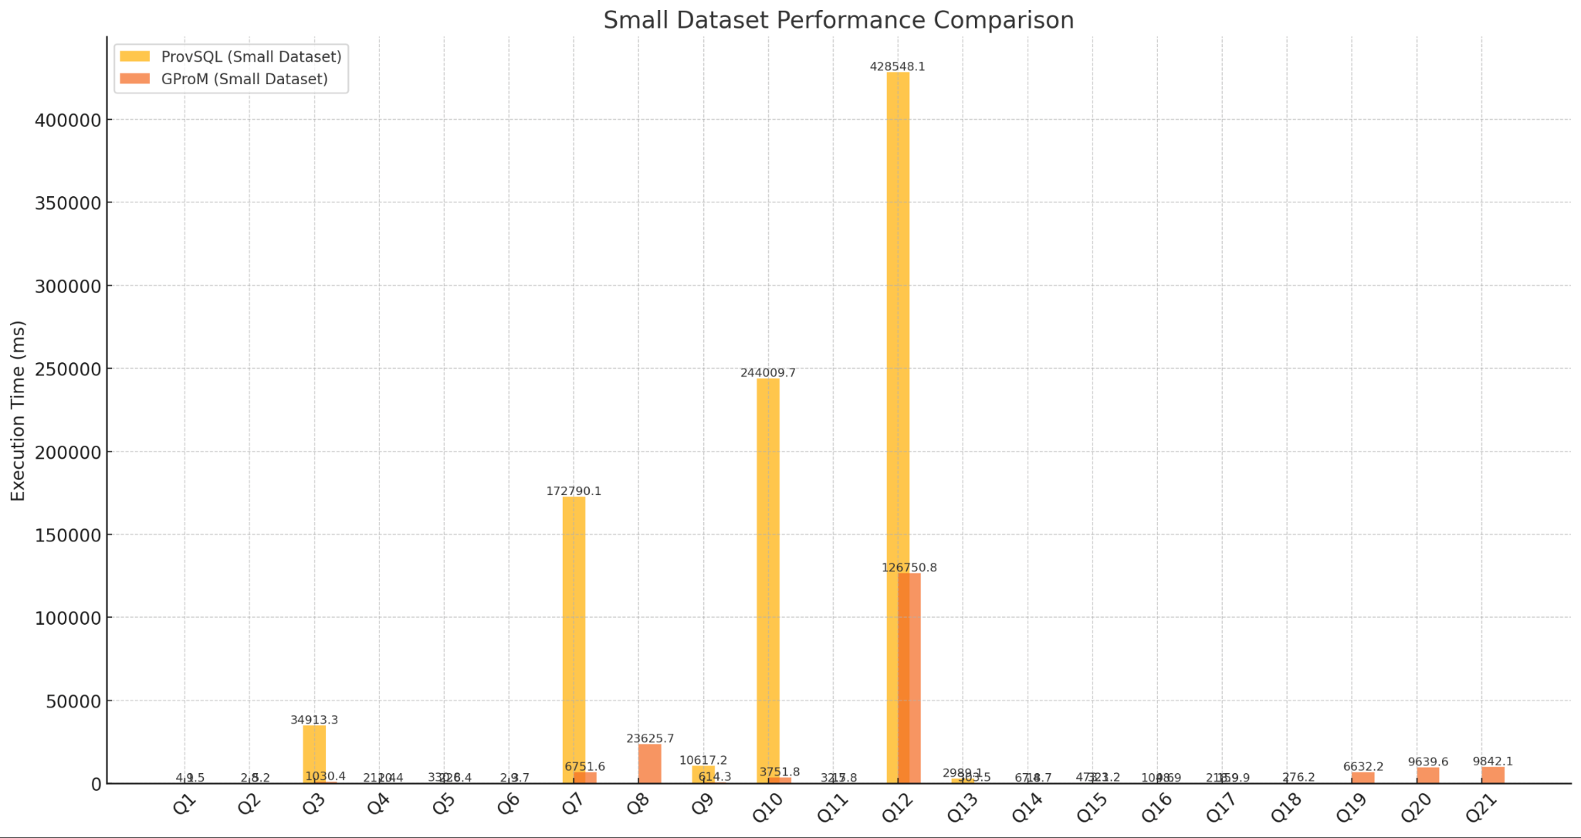
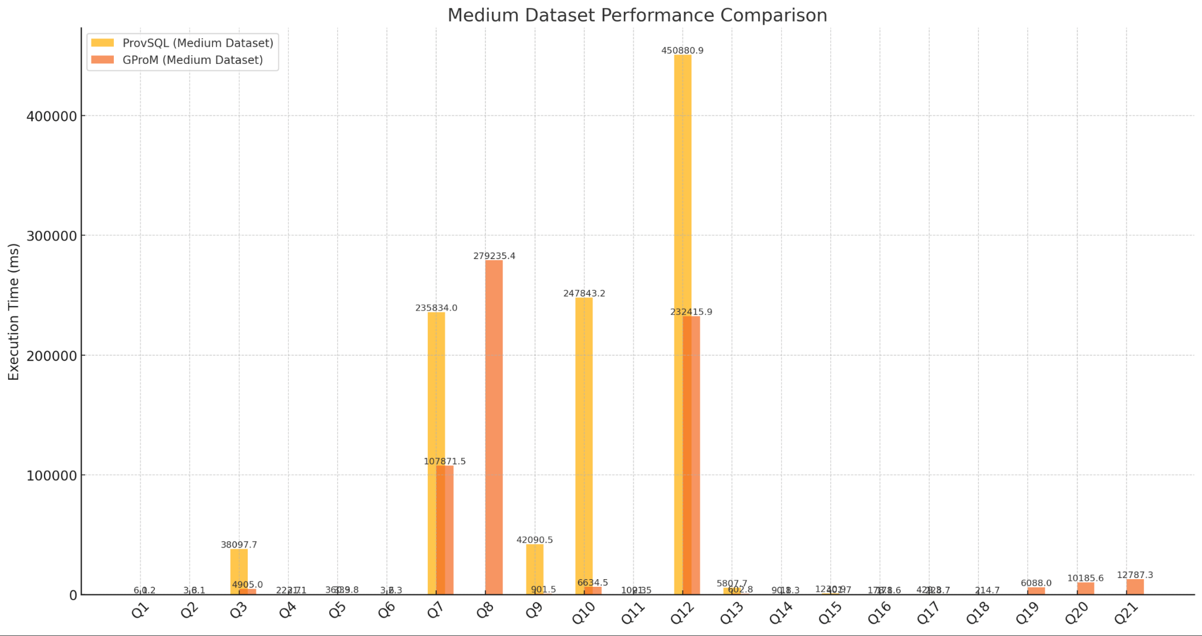
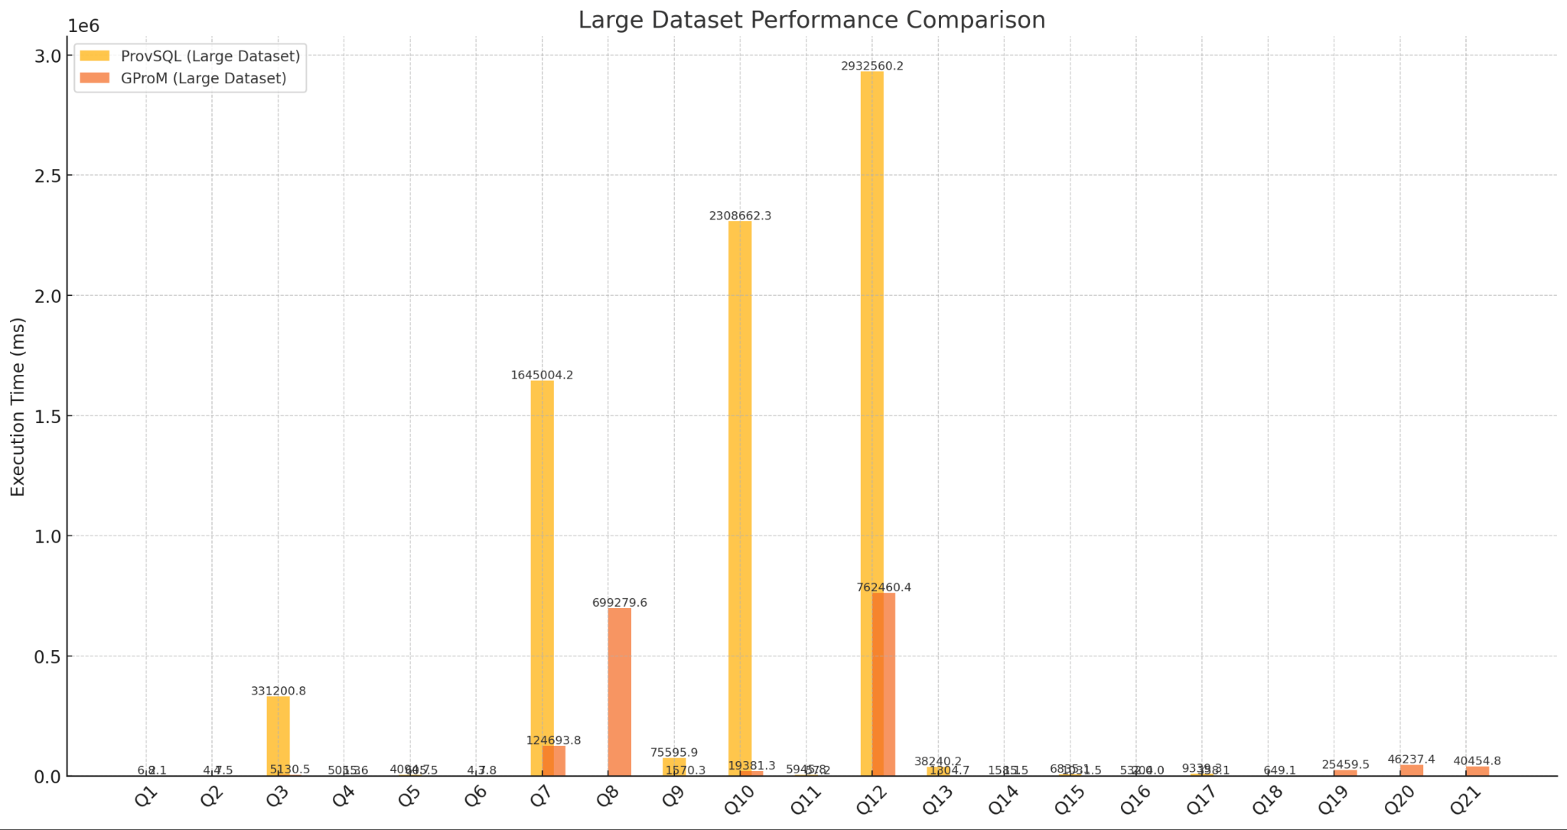

Slide 23
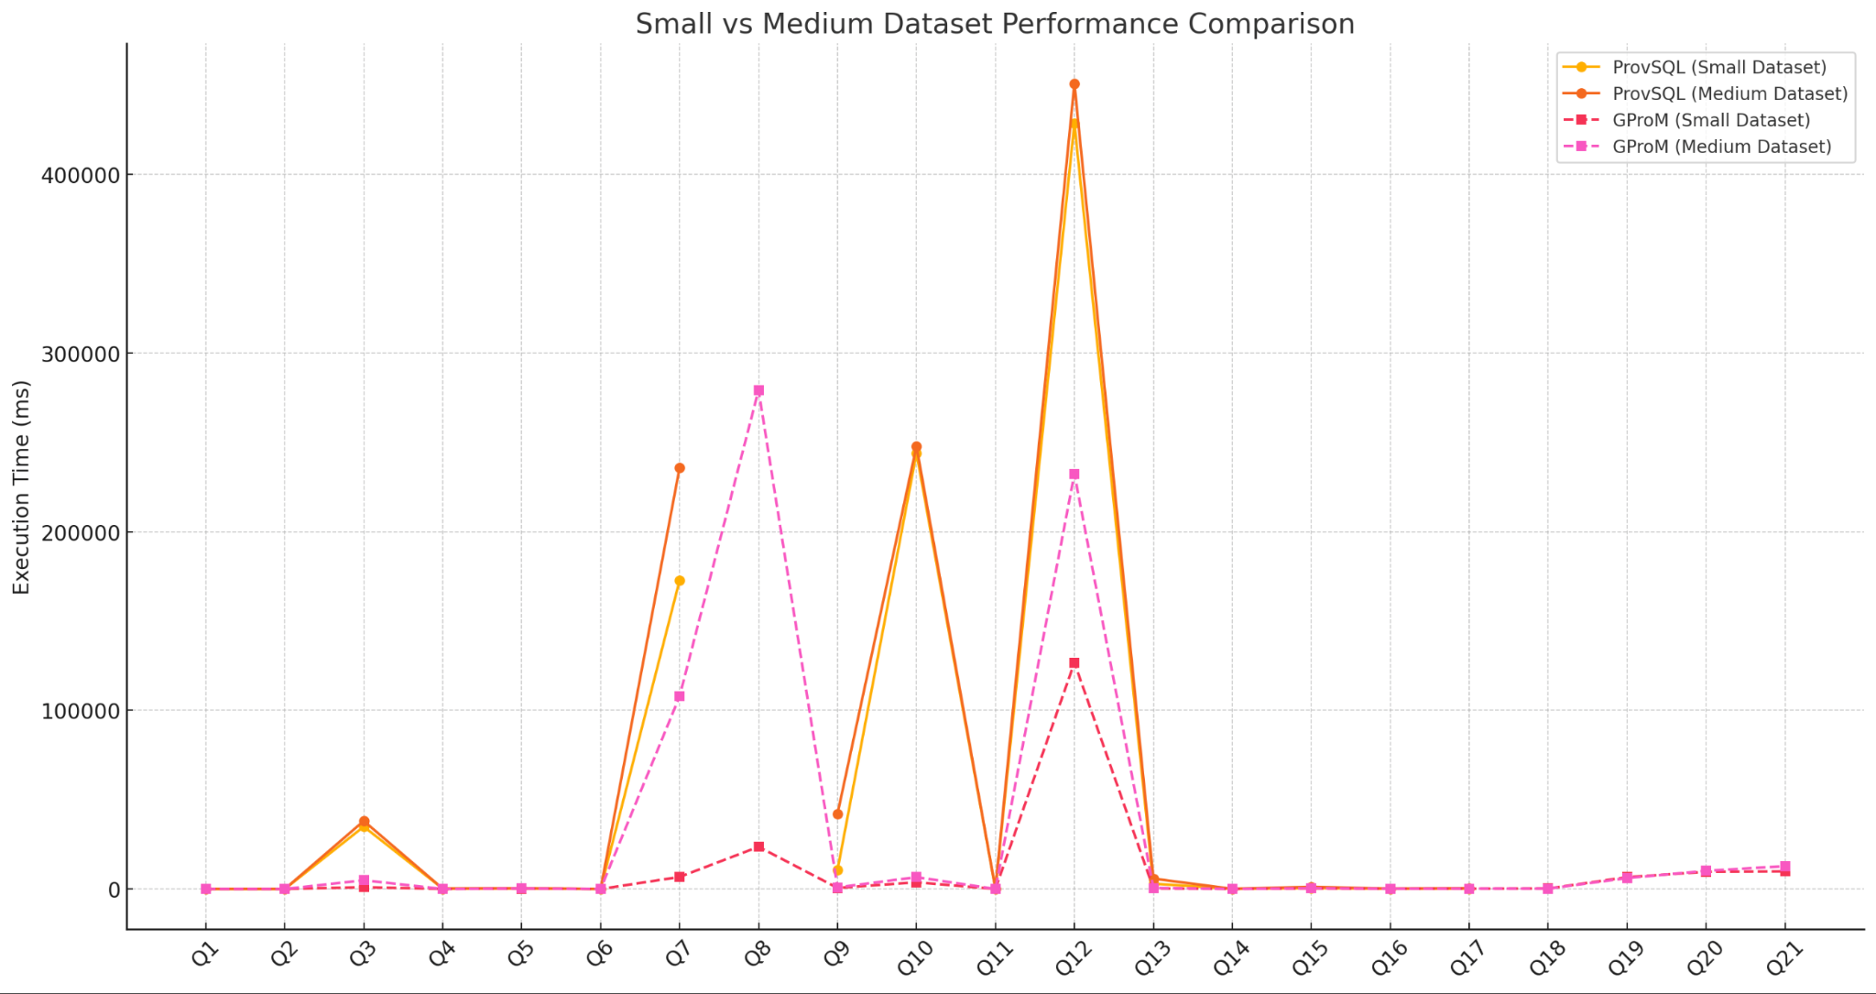
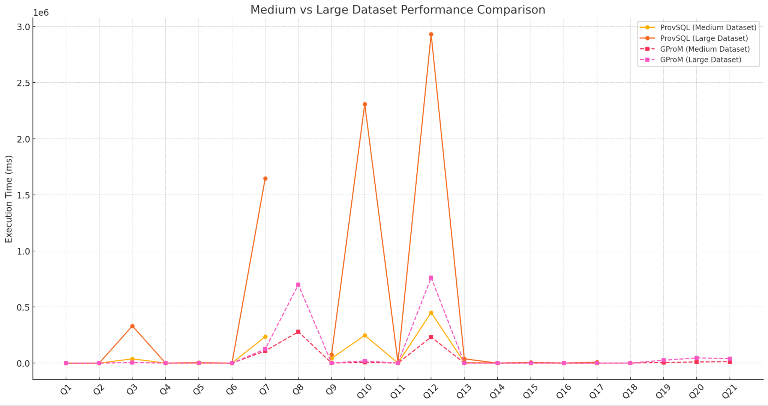
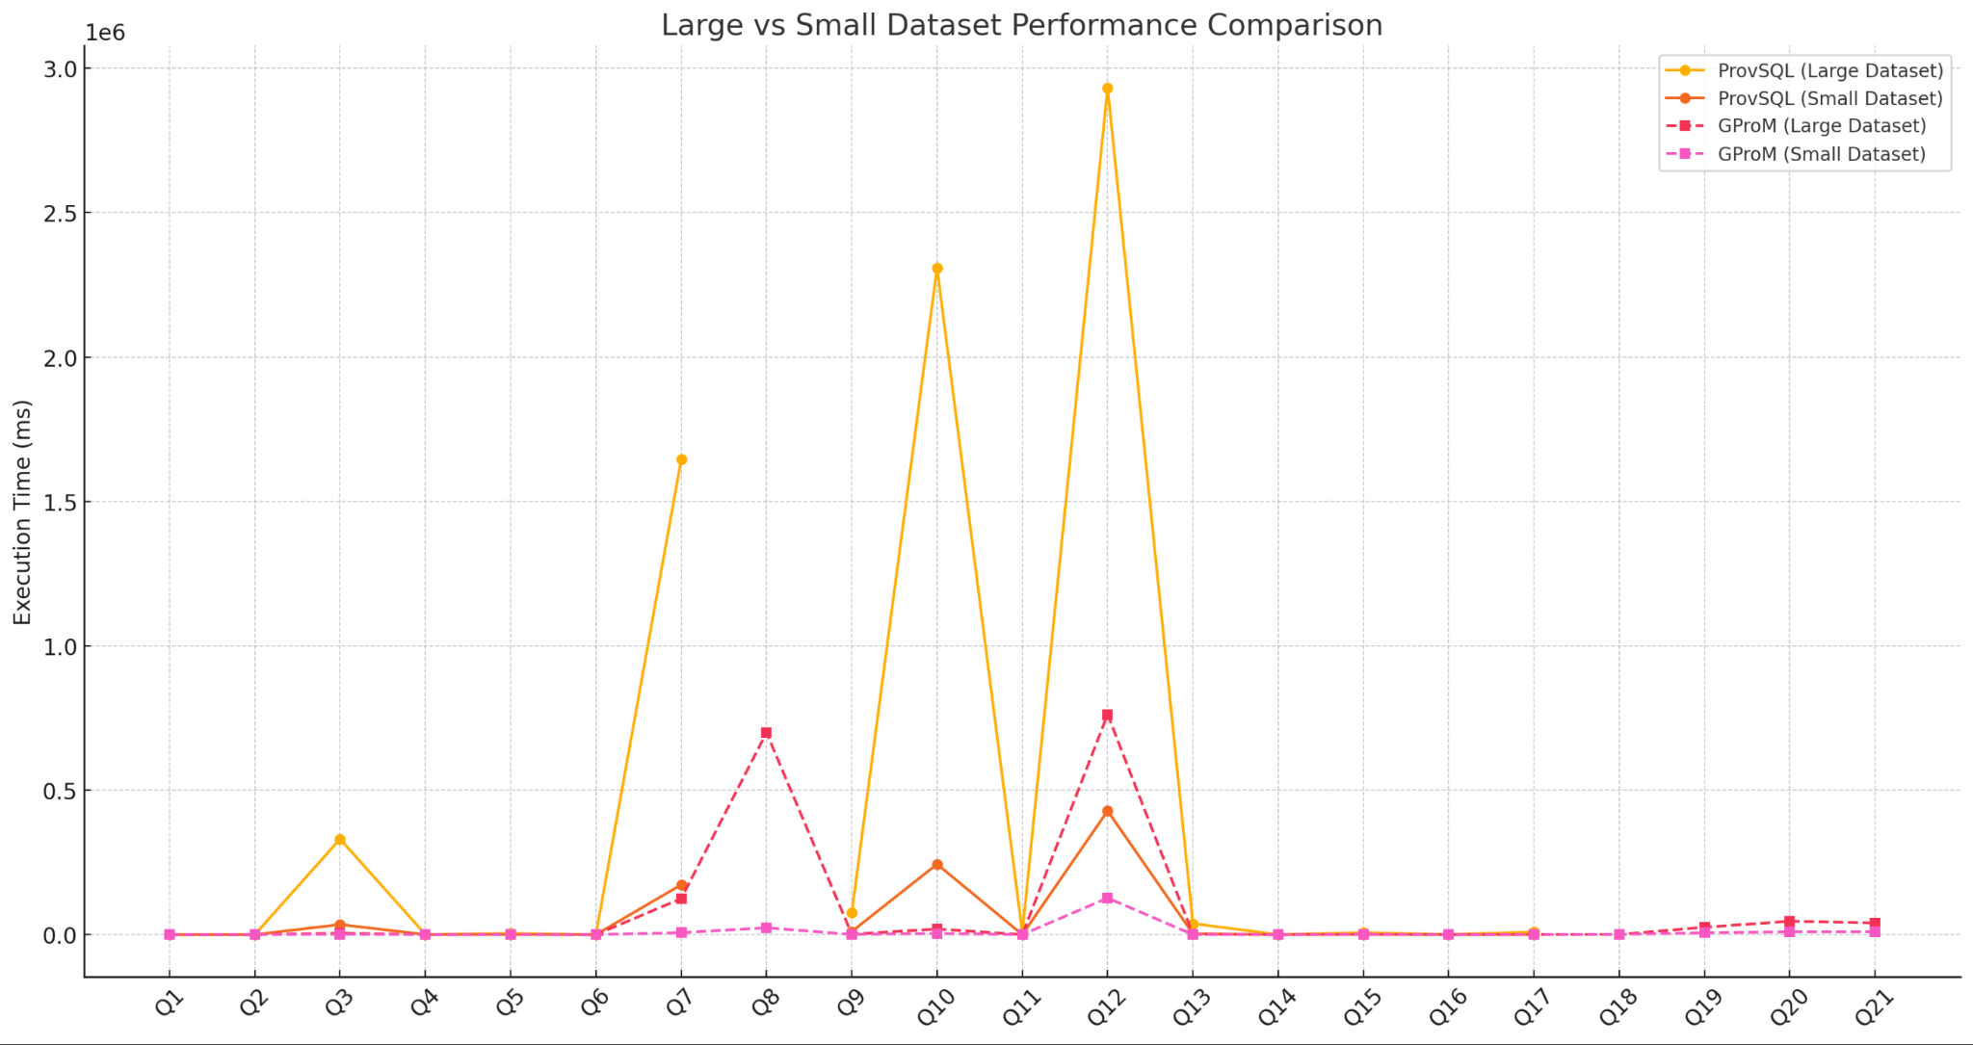

Slide 24
Unsupported Queries in ProvSQL
Overview:
Some queries failed to execute on ProvSQL due to lack of support for certain features or limitations in handling specific query types.
Number of Failed Queries:
5 queries encountered errors.
Reasons for Failure:
Non-terminal aggregates not supported by ProvSQL - 1 Query.
ORDER BY on the result of an aggregate function is not supported by ProvSQL - 4 queries.

Slide 25
Provenance Support
Provenance | GProM | ProvSQL
Where | Yes | Yes
Why | Yes | No
How | Yes | No
Why not | No | Yes
Data Lineage | No | No

Slide 26
Challenges
Installation and Configuration:
Both of us were new to provenance tools. (Harder than it looks)
Setting up ProvSQL and GProM required understanding new tools, debugging, and resolving dependency issues.
Specific issues:
ProvSQL: Architecture mismatches and errors during installation.
GProM: Configuring environment variables and database connections.
Large Dataset Processing:
The Large dataset (3.2 million rows) caused:
Memory bottlenecks during execution.
Excessive execution times for complex queries.
Query Failures:
Some queries failed due to unsupported features (e.g., subqueries in ProvSQL).
Limited Documentation:
Both tools had sparse or difficult-to-follow documentation, leading to delays in understanding usage.

Slide 27
THANK YOU!

Slide 28
GLOSSARY

Slide 29
Database Schema and Relations
TABLE NAME | COLUMNS
airlines | airline_id, airline_code
airports | airport_id, airport_code
flight_delays | delay_id, operation_id, flight_date, airline_code, flight_number, departure_delay, arrival_delay, delay_carrier, delay_weather, delay_security, delay_late_aircraft
flight_operations | operation_id, schedule_id, flight_date, airline_id, airline_code, flight_number, actual_departure, actual_arrival, actual_duration, taxi_out, taxi_in, wheels_off, wheels_on, air_time, cancelled, diverted
flight_schedules | schedule_id, airline_id , airline_code , flight_number, origin_id, origin_code ,destination_id , destination_code, scheduled_departure, scheduled_arrival, scheduled_duration, distance

Slide 30
QUERIES
QUERY CODE | QUERY
Q1 | SELECT * FROM flight_schedules;
Q2 | SELECT fs.flight_number, a.airline_code FROM flight_schedules fs JOIN airlines a ON fs.airline_code = a.airline_code LIMIT 5;
Q3 | SELECT a.airline_code, SUM(fd.departure_delay) AS total_departure_delay, SUM(fd.arrival_delay) AS total_arrival_delay, SUM(fd.delay_carrier) AS total_carrier_delay, SUM(fd.delay_weather) AS total_weather_delay FROM flight_delays fd JOIN flight_operations fo ON fd.operation_id = fo.operation_id JOIN airlines a ON fo.airline_id = a.airline_id WHERE a.airline_code = 'AA' GROUP BY a.airline_code;
Q4 | SELECT a.airline_code, SUM(fs.scheduled_duration) AS total_scheduled_duration FROM flight_schedules fs JOIN airlines a ON fs.airline_id = a.airline_id WHERE a.airline_code = 'UA' GROUP BY a.airline_code;

Slide 31
QUERIES
Q5 | SELECT a.airline_code, COUNT(fo.operation_id) AS total_diverted_flights FROM flight_operations fo JOIN airlines a ON fo.airline_id = a.airline_id WHERE fo.diverted = 1 GROUP BY a.airline_code;
Q6 | SELECT fo.flight_number, fo.actual_duration, fo.taxi_out, fo.air_time, fo.taxi_in, a.airline_code FROM flight_operations fo JOIN airlines a ON fo.airline_id = a.airline_id WHERE fo.operation_id = 101;
Q7 | SELECT fs.origin_code, SUM(fd.departure_delay) AS total_departure_delay, SUM(fd.arrival_delay) AS total_arrival_delay FROM flight_schedules fs JOIN flight_operations fo ON fs.schedule_id = fo.schedule_id JOIN flight_delays fd ON fo.operation_id = fd.operation_id GROUP BY fs.origin_code;
Q8 | SELECT fs.origin_code, a.airline_code, fd.flight_number, MAX(fd.departure_delay) AS max_departure_delay, MAX(fd.arrival_delay) AS max_arrival_delay FROM flight_delays fd JOIN flight_operations fo ON fd.operation_id = fo.operation_id JOIN flight_schedules fs ON fo.schedule_id = fs.schedule_id JOIN airlines a ON fo.airline_id = a.airline_id GROUP BY fs.origin_code, a.airline_code, fd.flight_number HAVING MAX(fd.departure_delay) > 300 OR MAX(fd.arrival_delay) > 300;

Slide 32
QUERIES
Q9 | SELECT fs.destination_code, a.airline_code, COUNT(fo.cancelled) AS total_cancellations FROM flight_operations fo JOIN flight_schedules fs ON fo.schedule_id = fs.schedule_id JOIN airlines a ON fo.airline_id = a.airline_id WHERE fo.cancelled = 1 GROUP BY fs.destination_code, a.airline_code;
Q10 | SELECT a.airline_code, SUM(fo.air_time) AS total_air_time, SUM(fs.distance) AS total_distance FROM flight_operations fo JOIN flight_schedules fs ON fo.schedule_id = fs.schedule_id JOIN airlines a ON fo.airline_id = a.airline_id GROUP BY a.airline_code;
Q11 | SELECT fd.flight_number, fs.origin_code, fs.destination_code, fd.departure_delay, fd.arrival_delay FROM flight_delays fd JOIN flight_operations fo ON fd.operation_id = fo.operation_id JOIN flight_schedules fs ON fo.schedule_id = fs.schedule_id WHERE fs.origin_code = 'JFK' AND fs.destination_code = 'LAX';
Q12 | SELECT a.airline_code, fd.flight_date, SUM(fd.delay_carrier) AS carrier_delay, SUM(fd.delay_weather) AS weather_delay, SUM(fd.delay_nas) AS nas_delay, SUM(fd.delay_security) AS security_delay, SUM(fd.delay_late_aircraft) AS late_aircraft_delay FROM flight_delays fd JOIN flight_operations fo ON fd.operation_id = fo.operation_id JOIN airlines a ON fo.airline_id = a.airline_id GROUP BY a.airline_code, fd.flight_date;

Slide 33
QUERIES
Q13 | SELECT airline_code, SUM(departure_delay + arrival_delay) AS total_delay FROM flight_delays WHERE airline_code = 'AA' GROUP BY airline_code;
Q14 | SELECT fs.origin_code, fs.destination_code FROM flight_schedules fs JOIN airlines a ON fs.airline_id = a.airline_id WHERE a.airline_code = 'UA';
Q15 | SELECT fo.flight_number, fo.flight_date, fo.cancelled, fd.delay_weather, fd.delay_carrier FROM flight_operations fo JOIN flight_delays fd ON fo.operation_id = fd.operation_id WHERE fo.cancelled = 1;
Q16 | SELECT fd.flight_number, fd.departure_delay, fd.delay_carrier, fd.delay_weather, fd.delay_nas FROM flight_delays fd WHERE fd.departure_delay > 300;
Q17 | SELECT fd.flight_number, fs.origin_code, fs.destination_code, fd.departure_delay, fd.arrival_delay FROM flight_delays fd JOIN flight_operations fo ON fd.operation_id = fo.operation_id JOIN flight_schedules fs ON fo.schedule_id = fs.schedule_id WHERE fd.departure_delay > 300 OR fd.arrival_delay > 300;

