Slide 1
COSC 3500 Milestone 2
By Aryan Dhotre
s4985050
Notes:
Hello, my name is Aryan Dhotre, and this is my presentation for COSC3500 Milestone 1.

Slide 2


Forest Fire Cellular Automata
Fig.1. One timestep of forest fire model. Source: [1].
A tree grows on an empty cell with a probability p
A tree ignites with a probability f
A tree will burn if one of its neighbors is on fire
A burning cell turn into an empty cell
[1] “Forest-fire Model.” Accessed: Aug. 27, 2026. [Online]. Available: https://itp.uni-frankfurt.de/~gros/StudentProjects/Projects_2020/projekt_lars_dingeldein/
[2] B. Drossel and F. Schwabl, “Self-organized critical forest-fire model,” Phys. Rev. Lett., vol. 69, no. 11, pp. 1629–1632, Sep. 1992, doi: 10.1103/PhysRevLett.69.1629.
Notes:
The project I've chosen is a cellular-automaton-based forest fire simulation. A cellular automaton is a grid of cells that evolves step by step, where each cell's next state depends only on its current state and the state of its neighbours.
The rules here are simple as shown on the slide
Figure on the top right shows one timestep of that rule set
and on the right you can see it running on a 320 by 320 grid

Slide 3
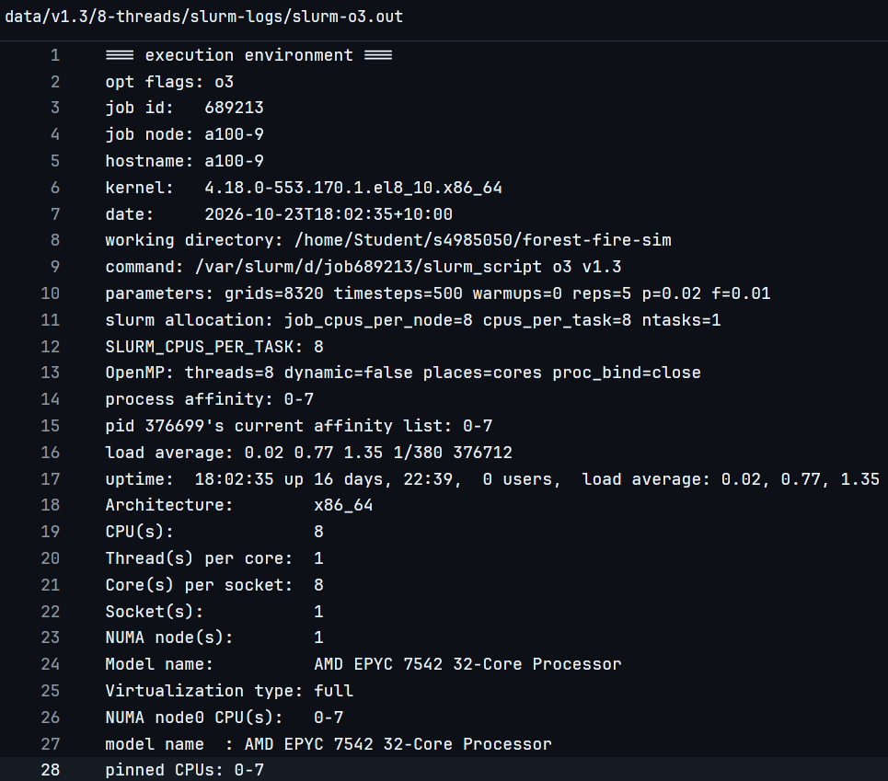
Benchmarking methodology
git
time
tests at o3 , march=native
tests for an 8032x8032 grid size for 500 timesteps
each test ran 5 times, lowest score considered
all tests have a warm up runs before the actual run
slurm script prints the hardware configuration at the start of the job
Notes:
Quick note on methodology before the optimisations. Everything's tracked in git using tags, I try to contain one optimisation per version tag. I compile each version at -O3 with march=native, time it with time, and take the minimum of 5 runs to cut noise.
I run untimed warm up passes first so the first binary tested isn't unfairly penalised by cold caches, and every run uses the same RNG seed, so results are deterministic, but more on that later.
At the start of each job i also print the node configuration in maximum detail to help with debugging later if required , as shown in the image

Slide 4
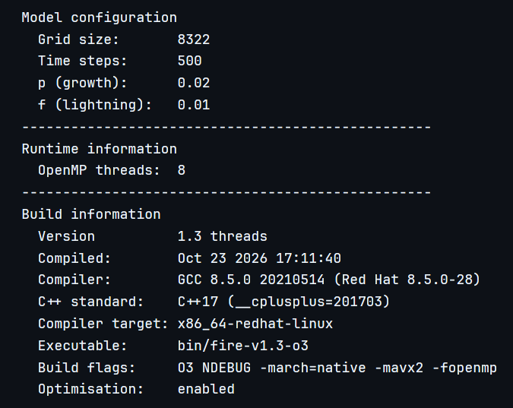
Program startup
Each binary prints which model configuration it's ran with , the version number and version name. It also identifies the gcc and c++ version
Notes:
Each binary also prints its own build info version info, compiler version and build flags flags to stdout, which makes it much easier to tell log files apart later.

Slide 5
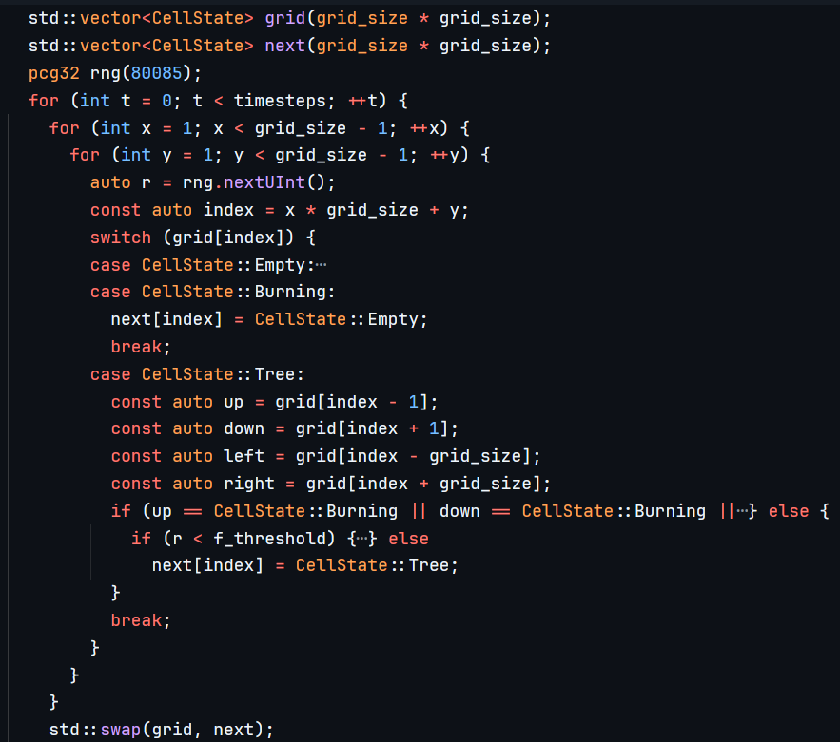
v1.0 - the serial baseline
117.77s to run an 8320x8320 grid for 500 timesteps
compiled at o3 with march=native
Double buffered
Notes:
Let's look at the first version. This was deliberately just to "make it work" version with no thought given to performance yet.
only thing i did was pad the edges of the grid so i didn't have to do boundry checks inside the hot loop
Benchmarking this, something strange started to happen: on the cluster, which runs GCC 8.5, the -O2 build was about 80% slower than -O1, consistently, across every grid size — you can see that in the bar chart.
That's backwards from what you'd expect. I confirmed this wasn't a bug in my benchmarking code by testing the same source on GCC 15 -O1 and -O2 performed comparably — so this looks like a GCC 8.5 code-generation issue specific to this program.
In absolute terms, this baseline processes a 1000-by-1000 grid for 500 timesteps at about 81 million cell updates per second on -O1. I'll come back to that number at the end.

Slide 6
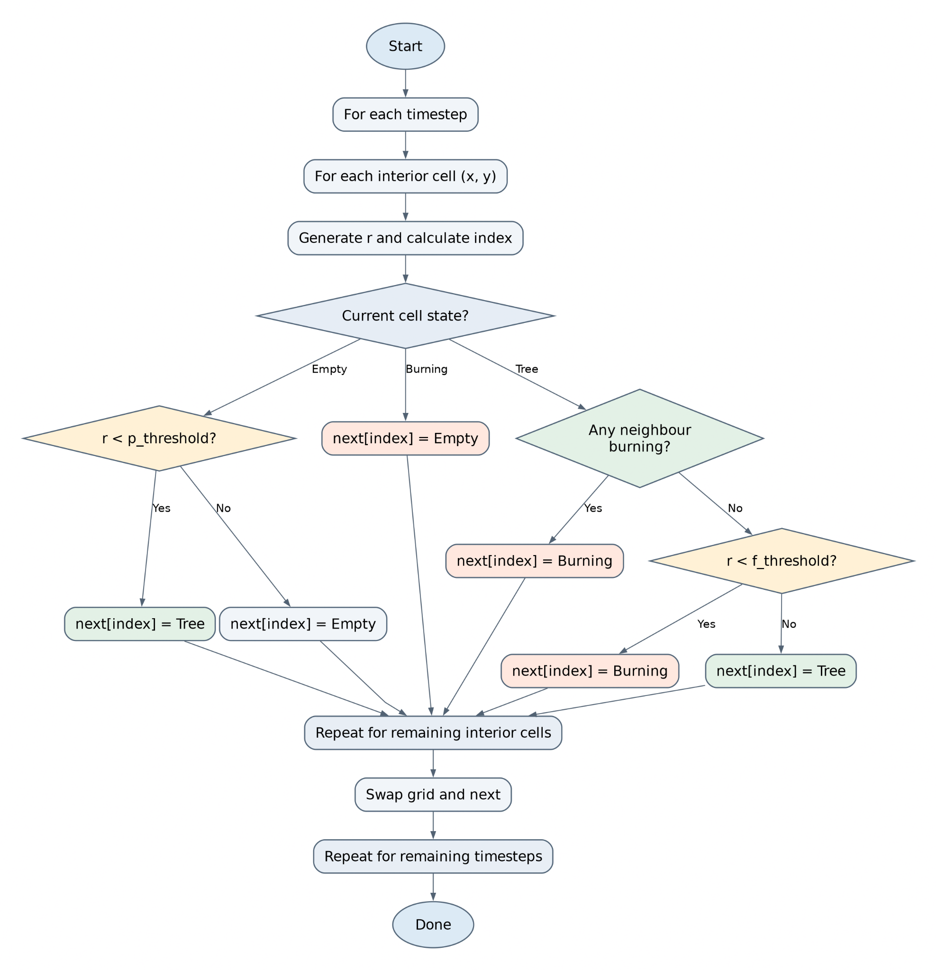
v1.1 - AVX
Notes:
Let's look at the first version. This was deliberately just to "make it work" version with no thought given to performance yet.
only thing i did was pad the edges of the grid so i didn't have to do boundry checks inside the hot loop
Benchmarking this, something strange started to happen: on the cluster, which runs GCC 8.5, the -O2 build was about 80% slower than -O1, consistently, across every grid size — you can see that in the bar chart.
That's backwards from what you'd expect. I confirmed this wasn't a bug in my benchmarking code by testing the same source on GCC 15 -O1 and -O2 performed comparably — so this looks like a GCC 8.5 code-generation issue specific to this program.
In absolute terms, this baseline processes a 1000-by-1000 grid for 500 timesteps at about 81 million cell updates per second on -O1. I'll come back to that number at the end.

Slide 8
AI Disclosure
AI tools like chatgpt5.6-luna and claude-sonnet-5 were used to help with producing this assignment. I used ai tools to
create the the scripts that visualised the simulation and benchmarks
understand and analyze the benchmark data
write slurm scripts to submit jobs
polish my script for the presentation
Notes:
I did use AI to assist me with writing supporting code such as scripts that visualise my simulation for me among other things.

Slide 9
Bibliography
[1] “Forest-fire Model.” Accessed: Aug. 27, 2026. [Online]. Available: https://itp.uni-frankfurt.de/~gros/StudentProjects/Projects_2020/projekt_lars_dingeldein/
[2] B. Drossel and F. Schwabl, “Self-organized critical forest-fire model,” Phys. Rev. Lett., vol. 69, no. 11, pp. 1629–1632, Sep. 1992, doi: 10.1103/PhysRevLett.69.1629.
[3] “The ‘Gru With a Gun’ Meme and the ‘Gru No’ Meme Come From a Doki Doki Literature Club Meme. : r/TheMatpatEffect.” Accessed: Aug. 27, 2026. [Online]. Available:
https://www.reddit.com/r/TheMatpatEffect/comments/1rpku7c/the_gru_with_a_gun_meme_and_the_gru_no_meme_come/
[4] W. Jakob, wjakob/pcg32. (Jul. 23, 2026). C++. Accessed: Aug. 27, 2026. [Online]. Available: https://github.com/wjakob/pcg32
Notes:
And here's the references

