Slide 1


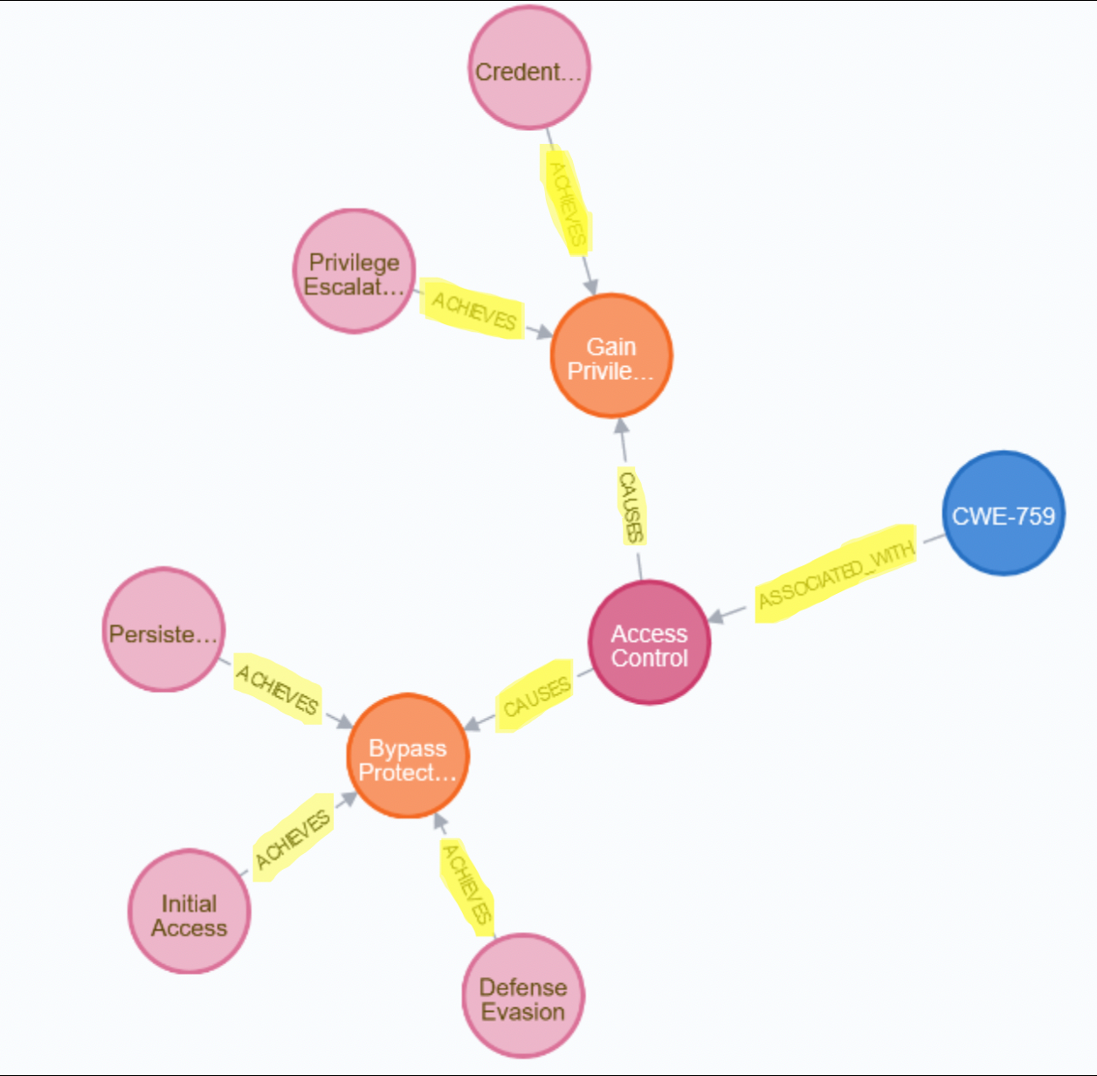

Analyzing Cyber Threats Using Graph Database Technology
Using the ATT&CK Matrix and CWE/SANS to Identify and Analyze Software Weaknesses
Alejandro Zeno-Miranda & Daylyn Hoxie | REU Mentor – Dr. Clemente Izurieta | August 2019
Introduction
Graphing Tactics to CWE
Proof of Concept
Cyber adversaries use many different behaviors when compromising target enterprises.
The MITRE ATT&CK Matrix [1] further divides these behaviors as techniques that may be used to achieve a tactic.
The 2011 CWE/SANS Top 25 Most Dangerous Software Errors [2] identifies common and widespread software security weaknesses.
Connecting an ATT&CK tactic to a CWE through the technical impacts caused by CWEs allows for cause-and-effect analysis of an attack, gives insight into the goals of an attacker’s exploit, and allows for improved prioritization of software weaknesses requiring attention.
Using the Neo4j graph database management system [4], relationships between CWEs and attack tactics can be found in a meaningful and easy-to-read model.
The mapping of attacker tactics to CWE impacts [3] provides a connection between attack tactics and technical impacts, allowing for a mapping from attack tactics to CWEs using the Cypher [4] query language.
Relationships between CWEs provide insight to similar weaknesses a user may want to examine.
A sample database was created to associate all 12 tactics and 244 techniques from ATT&CK Enterprise with the CWE/SANS Top 25 most common CWEs [3].
Connections between the Top 25 CWEs and their related CWEs were created using the ChildOf, CanAlsoBe, ParentOf, MemberOf, CanPrecede, CanFollow, and PeerOf relationships listed [2] on MITRE’s website.
The sample database can be expanded upon to contain all CWEs listed on MITRE and update with MITRE’s updates of CWE and ATT&CK listings.
Conclusion
Keywords
Attack tactics can be linked to exploitable CWEs by way of technical impacts.
The mapping of attack tactics to weaknesses within a graph database provides easy interpretation of cause-and-effect relationships from both developer and operational responder (SecDevOps) perspectives.
Providing connections between attack tactics and weaknesses within a graph database allows for better management of technical debt and prioritization of refactors.
CWE(Common Weakness Enumeration): a community-developed list describing common software security weaknesses.
ATT&CK(Adversarial Tactics, Techniques, and Common Knowledge): MITRE’s knowledge base of threat tactics and techniques used by cyber adversaries.
Technical Impacts: consequences of CWEs that describe resources or information an attacker may exploit.
Technical Debt: the implied cost of the choice of an expedient solution in the short term that may cause difficulty in future changes.
Cypher query providing above result:
MATCH (t:Tactic)-[:ACHIEVES]->(i:Impact)<-[:CAUSES]-(c:Consequence)<-[:ASSOCIATED_WITH]-(w:CWE) WHERE w.id = "CWE-759" RETURN t, i, c, w
References
[1] MITRE ATT&CK. The MITRE Corporation, 25 April, 2019, https://attack.mitre.org.
[2] CWE - Common Weakness Enumeration. The MITRE Corporation, 20 June, 2019, https://cwe.mitre.org.
[3] C. Izurieta, M. Prouty, “Leveraging SecDevOps to Tackle the Technical Debt Associated with Cybersecurity Attack Tactics”, TechDebt’19. Montreal, Canada, May 2019.
[4] Neo4j Graph Platform. Neo4j Inc., 2019, https://neo4j.com.
Future Work
Integrate livestream data to update database
Technical debt quantification from attack behaviors
Prioritization of CWEs based on ease of exploitation
Integrate database with Java for ease of use

