Slide 1
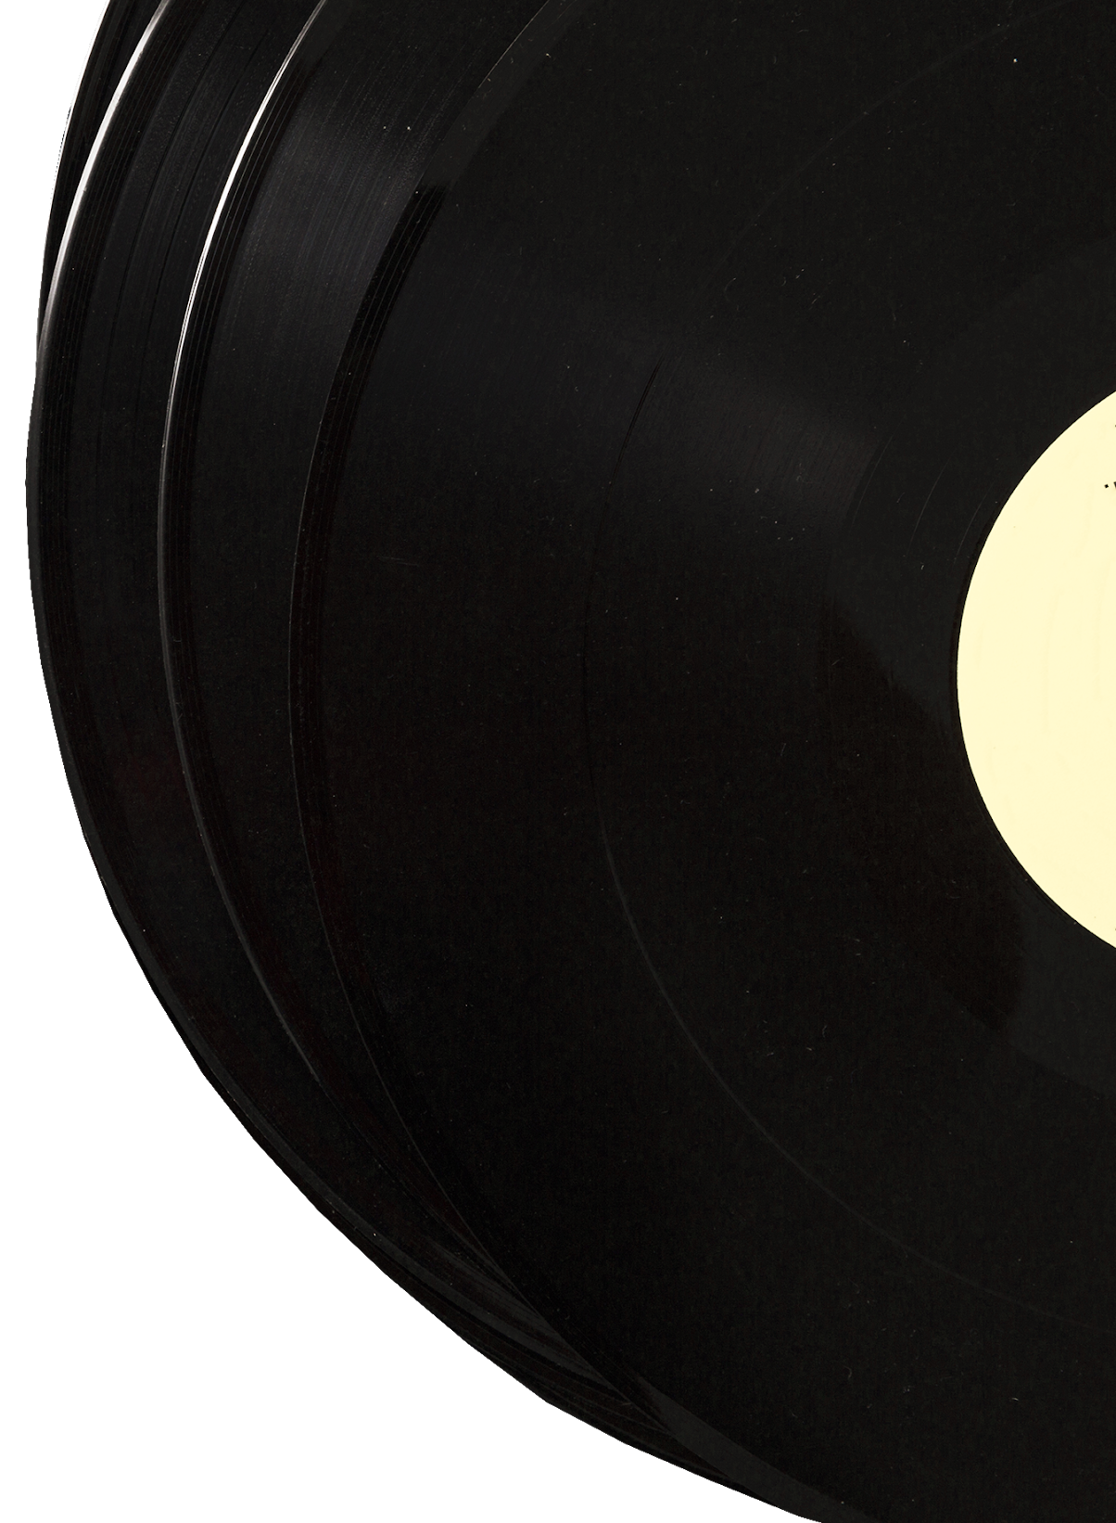
Country Music
Hall of Fame

Slide 2
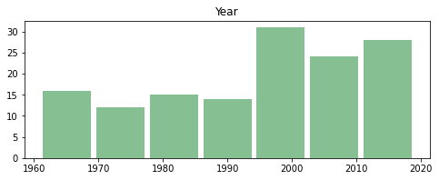
Hall of Fame
Number Inductees per Year

Slide 3
Country Music Hall of Fame
Established in 1961 by the Country Music Association (CMA)
No candidate was elected in 1963 due to insufficient votes
Inductees vary per year, from one to twelve
The Year 2000 had the most inductees

Slide 4
1960’s Inductees
1961 1965 1967 1969
Jimmie Rodgers Ernest Tubb Red Foley Gene Autry
Fred Rose 1966 J.L. Frank
Hank Williams Eddy Arnold Jim Reeves
1962 James R. Denny Stephen H. Sholes
Roy Acuff George d. Hay 1968
1964 Uncle Dave Macon Bob wills
Tex Ritter

Slide 5
1970’s Inductees
1970 1973 1976 1979
The Carter Family Chet Atkins Paul Cohen Hubert Long
Bill Monroe Patsy Cline Kitty Wells Hank Snow
1971 1974 1977
Art Satherley Owen Bradley Merle Travis
1972 Pee Wee King 1978
Jimmie Davis 1975 Grandpa Jones
Minnie Pearl

Slide 6
1980’s Inductees
1980 1982 (cont.) 1986 1989
Johnny Cash Marty Robbins Duke of Paducah Jack Stapp
Connie B. Gay Roy Horton Wesley Rose Cliffie Stone
Sons of the Pioneers 1983 1987 Hank Thompson
1981 Little Jimmy Dickens Rod Brasfield
Grant Turner 1984 1988
Vernon Dalhart Ralph Peer Loretta Lynn
1982 Floyd Tillman Roy Rogers
Lefty Frizzell 1985
Flatt & Scruggs

Slide 7
1990’s Inductees
1990 1993 1996 1998
Tennessee Ernie Ford Willie Nelson Patsy Montana George Morgan
1991 1994 Buck Owens Elvis Presley
Felice & Boudleaux Merle Haggard Ray Price E.W. Wendell
1992 1995 1997 Tammy Wynette
George Jones Roger Miller Harlan Howard 1999
Frances Preston Jo Walker-Meador Brenda Lee Johnny Bond
Cindy Walker Dolly Parton
Conway Twitty

Slide 8
2000’s Inductees
2000 2001 (cont.) 2001 (cont.) 2004
Charley Pride Homer & Jethro Webb Pierce Jim Foglesong
Faron Young Waylon Jennings 2002 Kris Kristofferson
2001 The Jordanaires Bill Carlisle 2005
Bill Anderson Don Law Porter Wagoner Alabama
The Delmore Bros. The Louvin Bros. 2003 DeFord Bailey
The Everly Bros. Ken Nelson Floyd Cramer Glen Campbell
Don Gibson Sam Phillips Carl Smith

Slide 9
2000’s Inductees (cont.)
2006 2008 2009 (cont.)
Harold Bradley Tom T. Hall Charlie McCoy
Sonny James Emmylou Harris
George Strait The Statler Bros.
2007 Ernest Stoneman
Ralph Emery 2009
Vince Gill Roy Clark
Mel Tillis Barbara Mandrell

Slide 10
2010’s Inductees
2010 2012 2014 2016
Jimmy Dean Garth Brooks Hank Cochran Fred Foster
Ferlin Husky Hargus Robbins Mac Wiseman Charlie Daniels
Billy Sherrill Connie Smith Ronnie Milsap Randy Travis
Don Williams 2013 2015 2017
2011 Kenny Rogers Jim Ed Browns Alan Jackson
Bobby Braddock Bobby Bare The Brown’s Jerry Reed
Reba McEntire Jack Clement Oak Ridge Boys Don Schlitz
Jean Shepard Grady Martin

Slide 11
2010’s Inductees (cont.)
2018 2019
Ricky Skaggs Brooks & Dunn
Dottie West Ray Stevens
Johnny Gimble Jerry Bradley
Don Williams

Slide 12
2020’s Inductees
2020
Dean Dillon
Marty Stuart
Hank Williams Jr.

