Slide 1
Insaid gcd Term 1 EDA Project
Car Sales data set EDA Analysis and Observations
- DHAVAL PARIKH

Slide 2
DataSET Description
Collected from car sale advertisements for study/practice purposes in 2016.
Created with real raw data which has all inconvenient moments (as NA’s for example).
Contains data for more than 9.5K cars sale in Ukraine.
Most of them are used cars so it opens the possibility to analyze features related to car operation.
At the end of the day we should look at this data as a subset from all Ukrainian car fleet.

Slide 3
DataSET Description
Dataset contains 9576 rows and 10 variables with essential meanings:
car: manufacturer brand
price: seller’s price in advertisement (in USD)
body: car body type
mileage: as mentioned in advertisement (‘000 Km)
engV: rounded engine volume (‘000 cubic cm)
engType: type of fuel (“Other” in this case should be treated as NA)
registration: whether car registered in Ukraine or not
year: year of production
model: specific model name
drive: drive type

Slide 4
Preliminary Analysis
Categorical Data variables
Total number of cars : 87
Total number of bodyTypes : 6
Total number of engTypes : 4
Types of registrations (Ukraine or outside) : 2
Total number of drives : 3 (Has NAN's)
Total number of models : 888
Range of years is : 63 years.
Earliest year is : 1953 and Latest year is : 2016

Slide 5
Preliminary Analysis
Continuous Data Variables
Price:
Range : 0 – 547800 USD (Has 0’s)
Mean: 15633.32 and Median: 9200
Mileage:
Range 0 – 999 (Has 0’s but if car is new this can be Zero)
Mean: 138.86 and Median: 128
Engine Volume:
Range 0.1 – 99.99 (Has NaN’s and invalid values)
Mean: 2.64 and Median: 2.0

Slide 6
Pre-Processing
Data Issues and cleaning strategy
Variable "drive" has "NaN" values and should be cleaned.
Total number of models : 888 (Highly cardinal and need to sanitize the data or decide whether to use and how to use this variable.)
“price” has zeros and need to sanitize this variable and if required drop the data.
After removing Zeros from Price, it has a very high standard deviation thus will require to categorize in price buckets to effectively analyze this variable.
“mileage” would depend on how many year old the vehicle is thus would require to create a derived columns Age and annual mileage depicting average annual mileage of the cars.
“mileage” has values starting from 0 , where as valid values should be greater than 0 miles for used cars.
"engV" column has "NaN"s and also some incorrect data thus would require cleaning of data to replace/drop, NaN and incorrect data.

Slide 7
Pre-Processing
We plan to achieve following based on observations after analyzing initial dataset.
Remove the duplicates
Sanitize the "price" column by replacing/dropping Zero's for this column.
Sanitize "drive" column by replacing/dropping NaN values.
Sanitize "engV" column by replacing/dropping NaN and invalid values.
Sanitize "mileage" column where valid values should be greater than 0 miles unless its a new car (Year = 2016).
Add derived columns based on age, age groups, engV categories, price categories, mileage/year and mileage/year categories.

Slide 8
Pre-Processing
For Achieving above we will take the following approach.
Create a copy of the original dataframe.
perform following to cleanse the copy of the dataframe
Drop duplicates.
Try to set missing/invalid values for "mileage", "price","engV" & "drive" based on similar "car", "model", "year" values.
Drop records which still have NaNs/Zeros for "price","engV" or "drive" columns.
Drop records where mileage is Zero and year is not "2016"
Add Derived columns for age, age_Group, engV_cat, price_cat etc. for grouping the data.
Add derived column mileage/year (mpy) and categories for mileage/year (mpy_cat).
Review the final dataframe.
Make the copy as primary dataframe for further analysis.

Slide 9
Post Cleaning and pre-processing
After preprocessing following are the observations.
age has 399 / 4.4% zeros - This is valid in cases where car is new.
mileage has 251 / 2.8% zeros - This is possible where car is new
mpy has 399 / 4.4% zeros - this is derived column from mileage and Age thus this is expected.
car has a high cardinality: 83 distinct values
model has a high cardinality: 839 distinct values

Slide 10
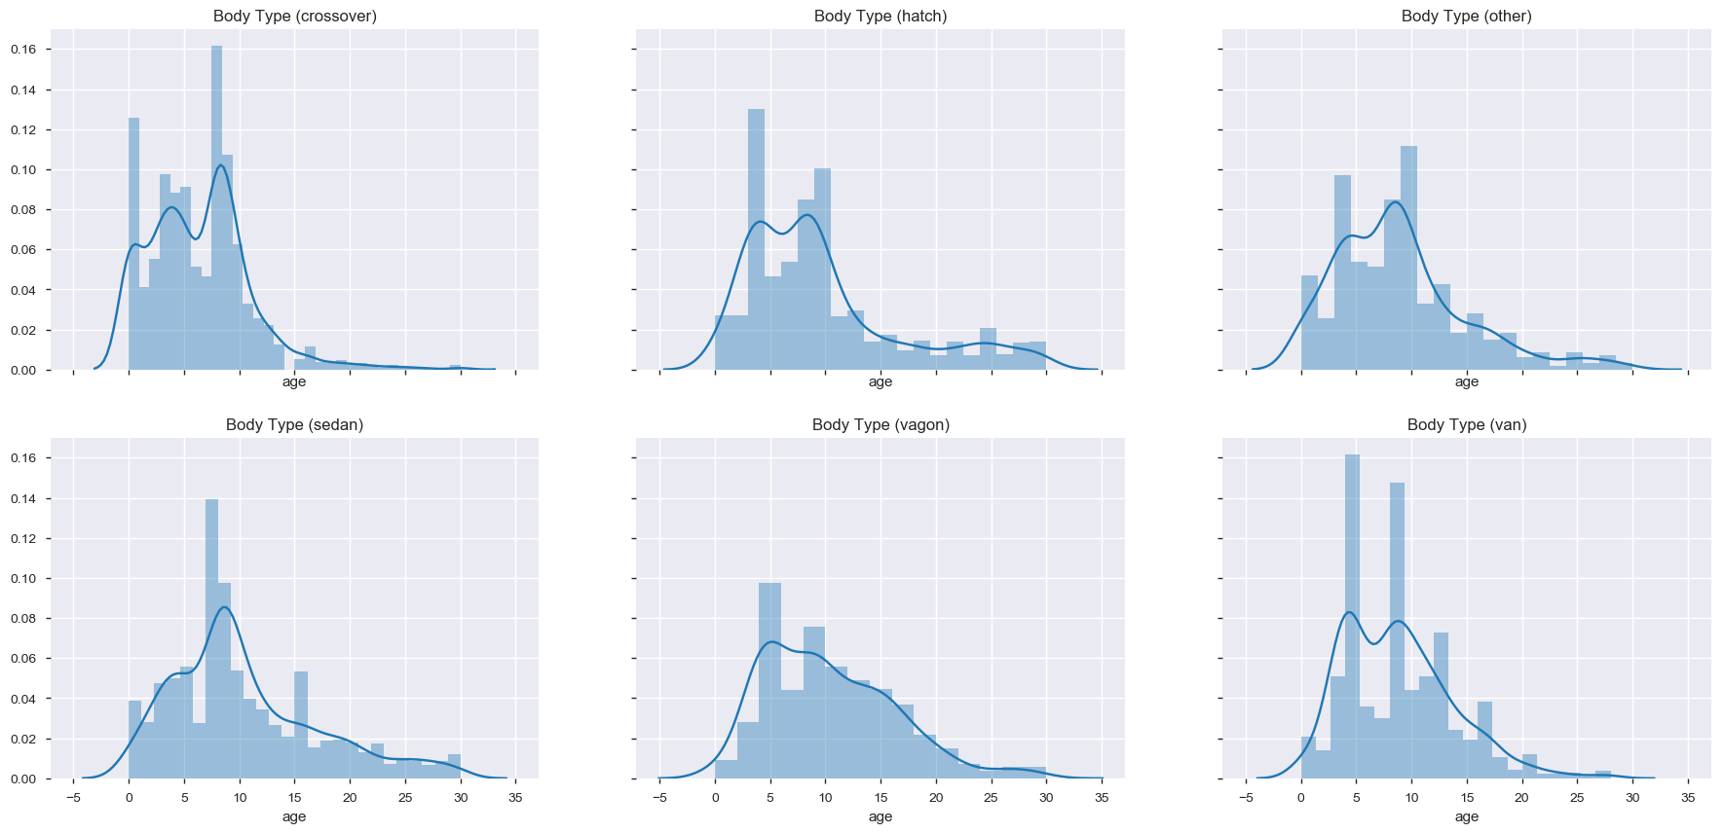
Data analysis and observations
Age distribution for each body type where age is less than 30.
Observations :
People change the crossovers more frequently than other car types.
Normally Sedan cars are changed after 8 years of car age.
Van, Vagon and Hatch cars are changed at much lower age (5-8 years)
Over all most cars are sold between the age of 4-10 years.

Slide 11
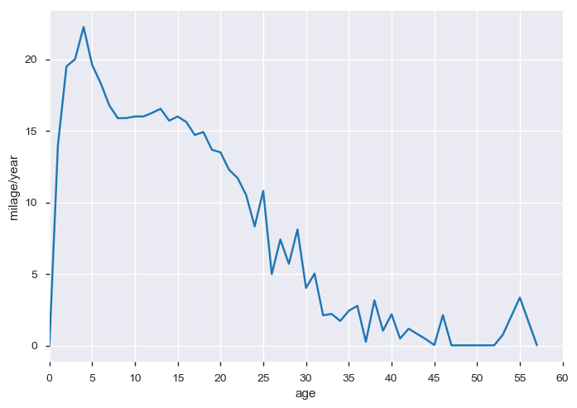
Data analysis and observations
Relation between Age of the car and mileage/year
Most newer cars have higher milage per year
Mileage/year increases till 4 year old cars and gradually reduces for cars older than 4 years.
Mileage/year reduces to less than 5000 miles/year after 30 years of age.
People tend to use the new cars more and as the car becomes older the usage of the car gradually decreases.

Slide 12
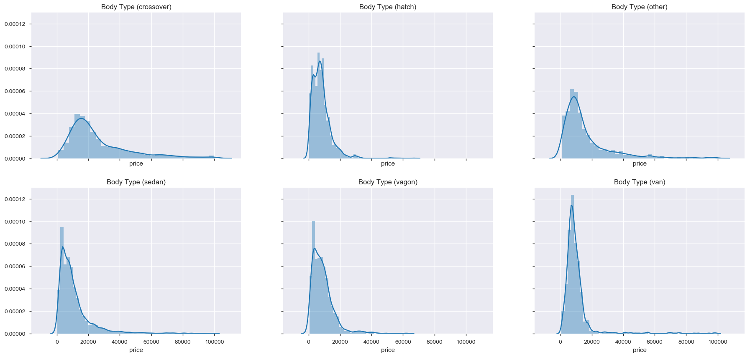
Data analysis and observations
Price Distribution per body type where price is not Extreme.
Observations :
Crossovers have overall better average resale price compared to other cars.
Sedan and Vagons have relatively lowest average resale price.
Crossover and Sedans have wider price ranges.
Cars from Some manufacturers seems to have better resale value compared to others

Slide 13
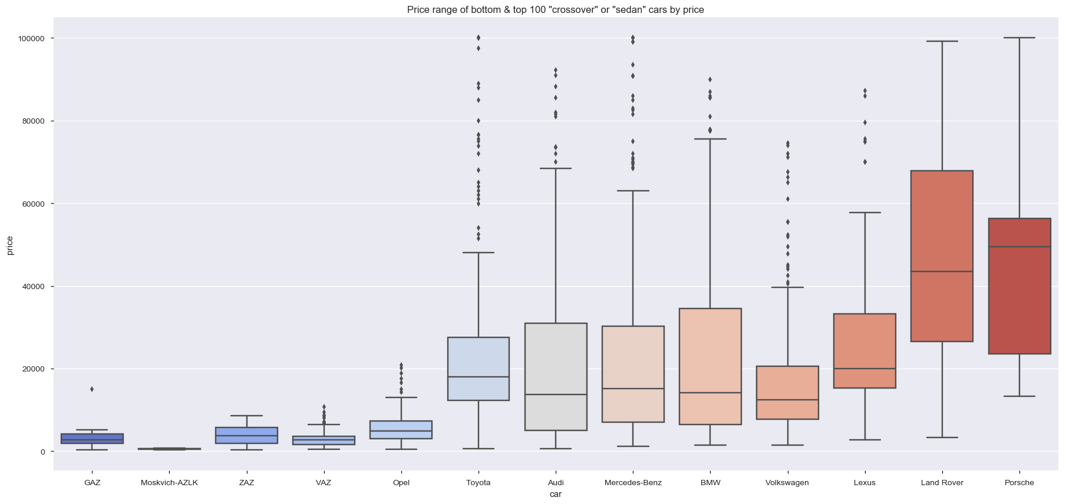
Data analysis and observations
Check if Car Manufacturer has relation to the resale value of the car in crossover and sedan types
Observation :
Graph shows that in crossover and Sedan cars, Cars from "Audi", "BMW", "Mercedes-Benz", "Lexus", "Volkswagon", "Land Rover", "Porsche" etc. are in much higher price range as compared to cars from "GAZ", "Vaz", "ZAZ", "Moskvich-AZLK", "Opel" etc.
Thus it seems that Resale value for Crossover and Sedan cars does depend on manufacturer and prices of European and Japanese cars is substantially higher than Russian cars.

Slide 14
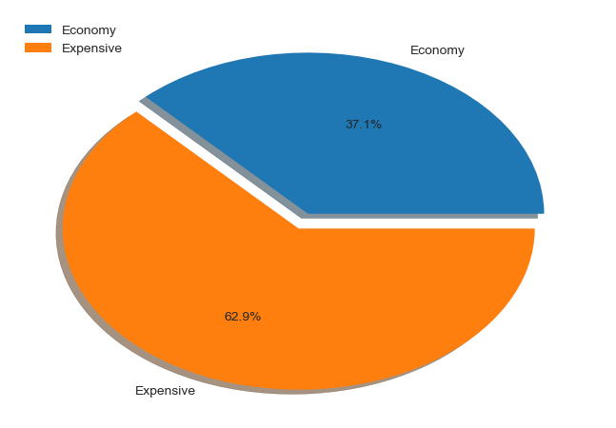
Data analysis and observations
Cars from which manufacturers sale more? expensive or economy?
Observation :
For crossover/Sedan cars the market in not price sensitive, rather Car Manufacturer is of higher importance

Slide 15
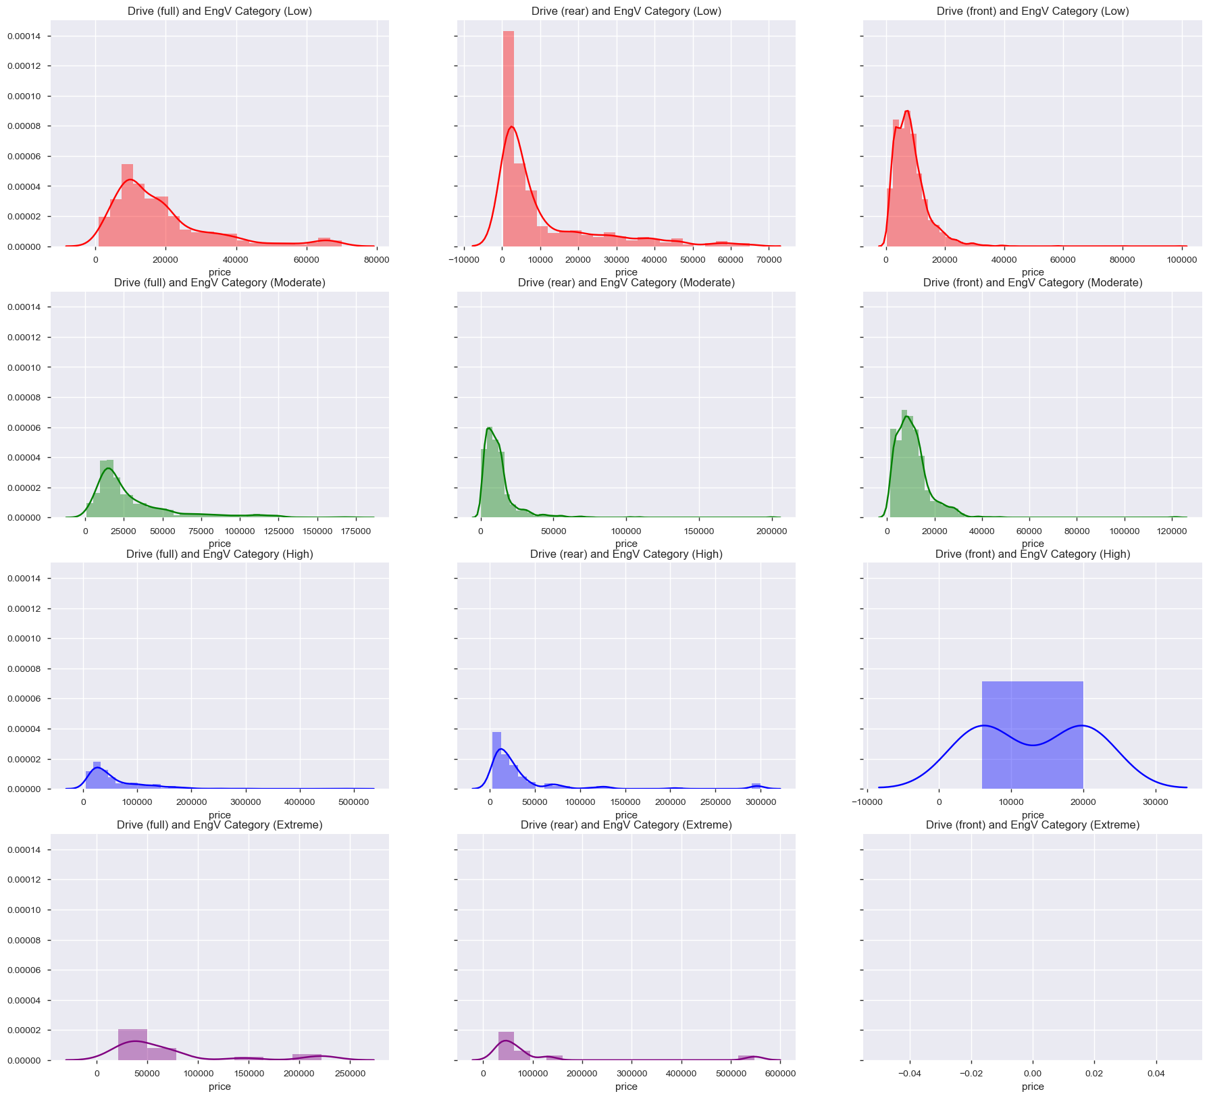
Data analysis and observations
Price Distribution based on drive type and engine volume categories.
Observations:
Most cars with front drive are of Low or Moderate Engine Volume.
High and Extreme Engine volume cars are generally Front or Full drive types.
Full Drive cars are expensive in the respective engine volume categories.
Notes:
e.g.
for Low Engine Volume cars, Full Drive cars have median price ~10000 USD with higher standard diviation where as Front and Rear Drive have median price ~5-6000 USD with lower SD.
for Moderate Engine Volume cars, Full Drive cars have median price ~18-20000 USD with higher standard diviation where as Front and Rear Drive have median price ~10000 USD with lower SD.
for High Engine Volume cars, Full Drive cars have median price ~25-30000 USD with higher standard diviation where as Rear Drive have median price ~10000 USD with lower SD. (Very few cars with Fornt drive)
for Extreme Engine Volume cars, Very few cars thus ignored.

Slide 16
Data analysis and observations
Price Distribution based on drive type and engine volume categories.
Observations:
Most cars with front drive are of Low or Moderate Engine Volume.
High and Extreme Engine volume cars are generally Front or Full drive types.
Full Drive cars are expensive in the respective engine volume categories.
Notes:
e.g.
for Low Engine Volume cars, Full Drive cars have median price ~10000 USD with higher standard diviation where as Front and Rear Drive have median price ~5-6000 USD with lower SD.
for Moderate Engine Volume cars, Full Drive cars have median price ~18-20000 USD with higher standard diviation where as Front and Rear Drive have median price ~10000 USD with lower SD.
for High Engine Volume cars, Full Drive cars have median price ~25-30000 USD with higher standard diviation where as Rear Drive have median price ~10000 USD with lower SD. (Very few cars with Fornt drive)
for Extreme Engine Volume cars, Very few cars thus ignored.

Slide 17
Data analysis and observations
Price Distribution based on drive type and engine volume categories.
Observations:
Most cars with front drive are of Low or Moderate Engine Volume.
High and Extreme Engine volume cars are generally Front or Full drive types.
Full Drive cars are expensive in the respective engine volume categories.
Notes:
e.g.
for Low Engine Volume cars, Full Drive cars have median price ~10000 USD with higher standard diviation where as Front and Rear Drive have median price ~5-6000 USD with lower SD.
for Moderate Engine Volume cars, Full Drive cars have median price ~18-20000 USD with higher standard diviation where as Front and Rear Drive have median price ~10000 USD with lower SD.
for High Engine Volume cars, Full Drive cars have median price ~25-30000 USD with higher standard diviation where as Rear Drive have median price ~10000 USD with lower SD. (Very few cars with Fornt drive)
for Extreme Engine Volume cars, Very few cars thus ignored.

Slide 18
Data analysis and observations
Price Distribution based on drive type and engine volume categories.
Observations:
Most cars with front drive are of Low or Moderate Engine Volume.
High and Extreme Engine volume cars are generally Front or Full drive types.
Full Drive cars are expensive in the respective engine volume categories.
Notes:
e.g.
for Low Engine Volume cars, Full Drive cars have median price ~10000 USD with higher standard diviation where as Front and Rear Drive have median price ~5-6000 USD with lower SD.
for Moderate Engine Volume cars, Full Drive cars have median price ~18-20000 USD with higher standard diviation where as Front and Rear Drive have median price ~10000 USD with lower SD.
for High Engine Volume cars, Full Drive cars have median price ~25-30000 USD with higher standard diviation where as Rear Drive have median price ~10000 USD with lower SD. (Very few cars with Fornt drive)
for Extreme Engine Volume cars, Very few cars thus ignored.

Slide 19
Hypothesis Validation
Dataset contains 9576 rows and 10 variables with essential meanings:
car: manufacturer brand
price: seller’s price in advertisement (in USD)
body: car body type
mileage: as mentioned in advertisement (‘000 Km)
engV: rounded engine volume (‘000 cubic cm)
engType: type of fuel (“Other” in this case should be treated as NA)
registration: whether car registered in Ukraine or not
year: year of production
model: specific model name
drive: drive type

Slide 20
Hypothesis Validation
Dataset contains 9576 rows and 10 variables with essential meanings:
car: manufacturer brand
price: seller’s price in advertisement (in USD)
body: car body type
mileage: as mentioned in advertisement (‘000 Km)
engV: rounded engine volume (‘000 cubic cm)
engType: type of fuel (“Other” in this case should be treated as NA)
registration: whether car registered in Ukraine or not
year: year of production
model: specific model name
drive: drive type

Slide 21
Hypothesis Validation
Dataset contains 9576 rows and 10 variables with essential meanings:
car: manufacturer brand
price: seller’s price in advertisement (in USD)
body: car body type
mileage: as mentioned in advertisement (‘000 Km)
engV: rounded engine volume (‘000 cubic cm)
engType: type of fuel (“Other” in this case should be treated as NA)
registration: whether car registered in Ukraine or not
year: year of production
model: specific model name
drive: drive type

Slide 22
Hypothesis Validation
Dataset contains 9576 rows and 10 variables with essential meanings:
car: manufacturer brand
price: seller’s price in advertisement (in USD)
body: car body type
mileage: as mentioned in advertisement (‘000 Km)
engV: rounded engine volume (‘000 cubic cm)
engType: type of fuel (“Other” in this case should be treated as NA)
registration: whether car registered in Ukraine or not
year: year of production
model: specific model name
drive: drive type

Slide 23
Hypothesis Validation
Dataset contains 9576 rows and 10 variables with essential meanings:
car: manufacturer brand
price: seller’s price in advertisement (in USD)
body: car body type
mileage: as mentioned in advertisement (‘000 Km)
engV: rounded engine volume (‘000 cubic cm)
engType: type of fuel (“Other” in this case should be treated as NA)
registration: whether car registered in Ukraine or not
year: year of production
model: specific model name
drive: drive type

Slide 24
Conclusion
Dataset contains 9576 rows and 10 variables with essential meanings:
car: manufacturer brand
price: seller’s price in advertisement (in USD)
body: car body type
mileage: as mentioned in advertisement (‘000 Km)
engV: rounded engine volume (‘000 cubic cm)
engType: type of fuel (“Other” in this case should be treated as NA)
registration: whether car registered in Ukraine or not
year: year of production
model: specific model name
drive: drive type

Slide 25
Bibliography

