Slide 1
Machine Learning 1 Project
Used Car sales – Price Prediction
Submitted By : Dhaval Parikh

Slide 2
Dataset Description
Dataset is taken from Term1 Project datasets.
Collected from car sale advertisements for study/practice purposes in 2016.
Created with real raw data which has all inconvenient moments (as NA’s for example).
Contains data for more than 9.5K cars sale in Ukraine.
Most of them are used cars so it opens the possibility to analyze features related to car operation.
At the end of the day we should look at this data as a subset from all Ukrainian car fleet.
Dataset contains 9576 rows and 10 variables with essential meanings:
car: manufacturer brand
price: seller’s price in advertisement (in USD)
body: car body type
mileage: as mentioned in advertisement (‘000 Km)
engV: rounded engine volume (‘000 cubic cm)
engType: type of fuel
registration: whether car registered in Ukraine or not
year: year of production
model: specific model name
drive: drive type

Slide 3
Data Processing
Data Issues.
price has zero values which needs to be considered as NaN.
engV and drive has NaN Values.
There are duplicate observations.
Data Cleansing
Replaced price and engV with mean value for same car and model.
Replaced drive with mode.
Dropped duplicates by keeping only first.
Dropped Remaining NaNs.

Slide 4
Data Preparation
Dummys for Categorical data.
Drop Outliers
Scaling Variables for standardization.
Feature Selection based on iterations and correlation between variables.

Slide 5
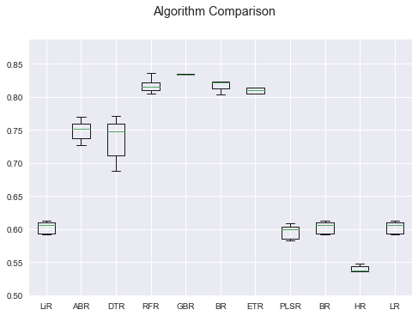
Evaluated Multiple Regression Algorithms
Compared following based on R² - Values
LinearRegression
AdaBoostRegressor
DecisionTreeRegressor
RandomForestRegressor
GradientBoostingRegressor
BaggingRegressor
ExtraTreesRegressor
PLSRegression
BayesianRidge
HuberRegressor
Lasso
polynomialFeatures with LinearRegression

Slide 6
Narrowed Down to 5 Regression Algorithms
 | MAE | MSE | RMSE | R2 | ADJ_R2
LiR | 6238.519 | 8.72E+07 | 9339.896 | 0.589282 | 0.587874
RFR | 3440.476 | 3.90E+07 | 6248.425 | 0.816177 | 0.815546
GBR | 3336.98 | 3.47E+07 | 5889.556 | 0.836686 | 0.836126
BR | 3388.508 | 3.74E+07 | 6119.041 | 0.823711 | 0.823106
Poly | 3489.995 | 3.61E+07 | 6012.105 | 0.829818 | 0.814309
Based on R² - Values
"LinearRegression“
"RandomForestRegressor"
"GradientBoostingRegressor“
"BaggingRegressor",
polynomialFeatures with LinearRegression

Slide 7
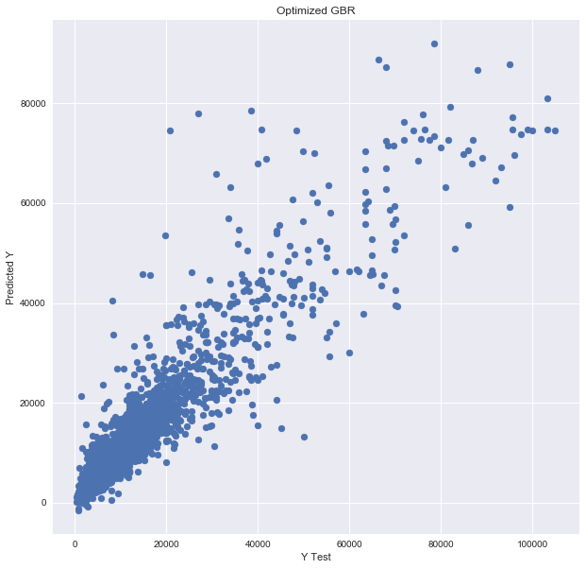
Based on all Parameters Narrowed to GBR for final Model
As can be seen
Most predictions are clustered around 45 deg. Line which means Predicted values are close to actual.
Some predictions are scattered for higher prices due to
Fewer observations in the original dataset.
Outliers in the extremely high priced cars.
Post Optimization
RMSE : 5721.934082264436
R2 : 0.8458494048274824

Slide 8
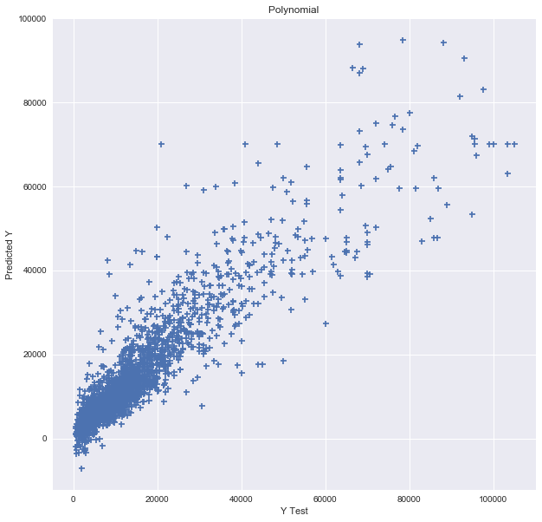
Based on all Parameters Also Evaluated Polynomial Regression for final Model
As can be seen
Predictions are very similar to the ones in GBR
Similar observations for higher prices due to
Fewer observations in the original dataset.
Outliers in the extremely high priced cars.
Post Optimizations
RMSE : 6012.105230147659
R2 : 0.829818380549723

Slide 9
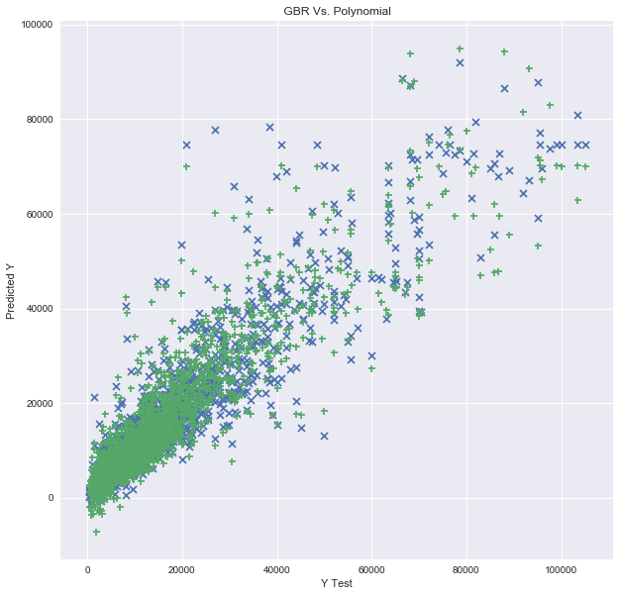
Compression between GBR and Polynomial
X – GradientBoostingRegressor
+ - Polynomial
Observations
Polynomial results are better at lower prices though it has more negative price predictions.
GBR on the Contrary has lesser negative price predictions and are better at extremely high prices

Slide 10
Conclusion
Based on evaluated Models
One option is to use dual model approach
For lower priced cars we can use the Polynomial Regression Model for prediction.
For High and Extremely high priced cars use GradientBoostingRegressor for prediction.
Other option is single model approach.
Over all Polynomial is less complex model compared to GradientBoostingRegressor.
Would be simpler to explain.
Has comparable results to the GradientBoostingRegressor thus we could use Polynomial for single model approach.
As the RMSE is in the range of 6000, we should provide the prediction price range as follows (as higher variance is for highly priced car category)
Range for price < 10k → ± 1000
Range for price between 10K and 50K → ± 4000
Range for price > 50K → ± 6000

