Slide 1
Machine Learning II Project
Human Activity Recognition – Multiclass Classification
Submitted By : Dhaval Parikh

Slide 2
Dataset Description
Dataset has data from 2 sensors and corresponding Activity performed by human when the readings were taken.
Accelerometer
Gyroscope
Total 562 Features.
6 activities. (LAYING, STANDING, SITTING, WALKING, WALKING_UPSTAIRS, WALKING_DOWNSTAIRS)

Slide 3
Data Processing
Data Composition.
All Features are of float datatype
No Null values in the Dataset
No Cleansing required for the data,
Scaling of the data is required as the Data is in different ranges.

Slide 4
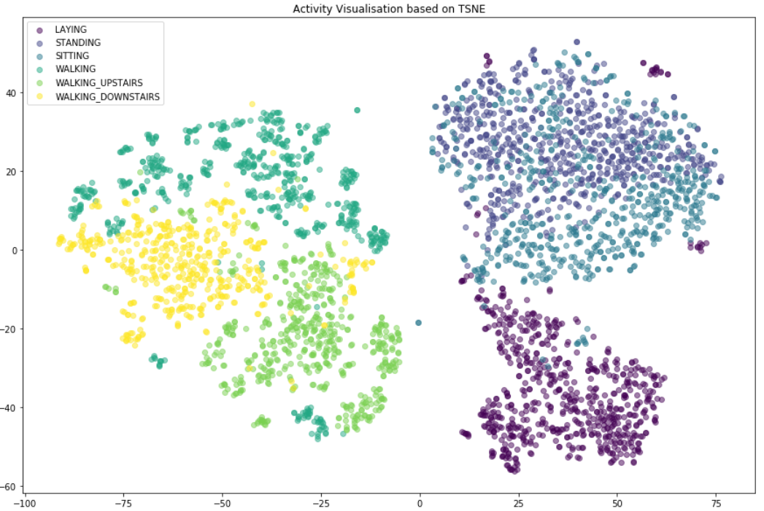
Data Visualization
Based on TSNE it can be seen that the activities are well separable.

Slide 5
Data Preparation
Based on Following techniques reduced the features as the dataset has large number of Features
PCA
DecisionTreeClassifier
ExtraTreeClassifier
RendomForrestClassifier
LinearSVC

Slide 6
Data Preparation
Selection of reduced dataset based on Simple DecissionTreeClassifier.
Based on the following Choose “RandomForestClassifier” based feature selection for further analysis
Method | Number of features | Model Performance
 |  | Accuracy | Precision | Recall | Time | Rank
PCA | 64 | 80.95% | 80.70% | 80.48% | 461 ms | 6
DecisionTreeClassifier | 44 | 93.35% | 93.09% | 93.07% | 235 ms | 2
RandomForestClassifier | 126 | 93.35% | 93.27% | 93.25% | 539 ms | 1
ExtraTreeClassifier | 69 | 93.13% | 92.80% | 92.80% | 248 ms | 3
LinearSVC | 155 | 91.91% | 91.65% | 91.76% | 743 ms | 4
Original DataSet | 562 | 91.70% | 91.49% | 91.65% | 2.28 s | 5

Slide 7
Evaluated Multiple Classification Algorithms
Classifier | Time | Accuracy | Precision | Recall | Rank
KNN | 67 ms | 95.79% | 95.97% | 95.85% | 2
SVC | 1.61 s | 96.67% | 96.80% | 96.74% | 1
DTC | 250 ms | 89.70% | 89.34% | 89.24% | 6
RFC | 47 ms | 85.27% | 85.73% | 85.20% | 7
ABC | 4.06 s | 53.37% | 30.94% | 50.00% | 8
GNB | 24 ms | 90.25% | 90.40% | 90.18% | 5
QDA | 568 ms | 94.57% | 94.92% | 94.80% | 3
OVRC | 1.44 s | 90.47% | 90.30% | 90.21% | 4
Compared following based on Accuracy, Precision and Recall - Values
KNeighborsClassifier
SVC
DecisionTreeClassifier
RandomForestClassifier
AdaBoostClassifier
GaussianNB
QuadraticDiscriminantAnalysis
OneVsRestClassifier
Based on the above evaluation choose SVC for further tuning.

Slide 8
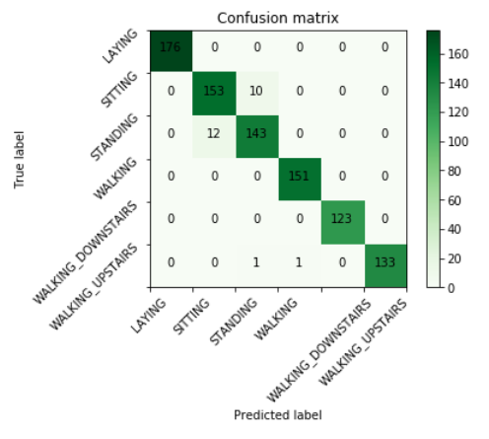
Model Tuning and Refining
Further Hyper parameter tuning of SVC Model using GridSearchCV.
Best estimator Parameters
C : 100
Kernel : RBF
Accuracy: 97.34%
Precision: 97.48%
Recall: 97.44%

Slide 9
Conclusion
Based on evaluated Models and Feature Selection it was noticed that the Feature selection in this case improved the model accuracy as well as reduced the training time.
As can be seen from the above analysis, we can predict the Human Activity based on the provided Sensor data with very high precision (~97.5%) and accuracy(~97.3%).
Final model is providing better predictions for Test Dataset compared to Train dataset which indicates that the model is not overfitted and is still able to generalize.

