Slide 1
Insaid gcd Term 1 EDA Project
Car Sales data set EDA Analysis and Observations
Prepared by - DHAVAL PARIKH

Slide 2
DataSET Description
Collected from car sale advertisements for study/practice purposes in 2016.
Created with real raw data which has all inconvenient moments (as NA’s for example).
Contains data for more than 9.5K cars sale in Ukraine.
Most of them are used cars so it opens the possibility to analyze features related to car operation.
At the end of the day we should look at this data as a subset from all Ukrainian car fleet.

Slide 3
DataSET Description
Dataset contains 9576 rows and 10 variables with essential meanings:
car: manufacturer brand
price: seller’s price in advertisement (in USD)
body: car body type
mileage: as mentioned in advertisement (‘000 Km)
engV: rounded engine volume (‘000 cubic cm)
engType: type of fuel (“Other” in this case should be treated as NA)
registration: whether car registered in Ukraine or not
year: year of production
model: specific model name
drive: drive type

Slide 4
Hypothesis Validation
Hypothesis 1 : Used car price reduces as Age increase.
for lower age groups, the distributions are skewed towards higher price with Platy/Meso kurtic distribution as compared to higher age groups where distributions are skewed towards lower prices with leptokurtic distribution in their respective Price categories.
this indicates that age does have impact on the price for lower priced cars.
Most cars in Extreme price category are in age groups 0-3 years. Very few cars are more than 6 years.
Most cars grater than 30 years age are in low price category.
As the age of the car increases the median price value reduces for Low, Moderate and High price categories,
But for Extreme price category the reverse trend can be seen i.e.
for 0-1 year cars median price is ~110000 USD
for 1-3 year cars median price is ~130000 USD
for 3-6 year cars median price is ~200000 USD
Assumption: as the extreme price category the cars are new we can ignore this category for this analysis
Based on the above observations it is clear that the Price of the car reduces as the age of the car increases. Thus we accept this hypothesis

Slide 5
Hypothesis Validation
Hypothesis 2 : Used car price increases as Engine Volume increases.
Baased on analysis median Engine Volume increases as the price category increases.
Thus we accept this Hypothesis.
Hypothesis 3 : Used car price decreases as Mileage of the car increases
Based on the analysis higher the mileage price is lower.
Though mileage/year does not seem to impact the price greatly.
Thus we can accept this hypothesis.

Slide 6
Hypothesis Validation
Hypothesis 4 : Used car price is dependent on drive type.
Most cars with front drive are of Low or Moderate Engine Volume.
High and Extreme Engine volume cars are generally Front or Full drive types.
Full Drive cars are expensive in the respective engine volume categories. e.g.
for Low Engine Volume cars, Full Drive cars have median price ~10000 USD with higher standard diviation where as Front and Rear Drive have median price ~5-6000 USD with lower SD.
for Moderate Engine Volume cars, Full Drive cars have median price ~18-20000 USD with higher standard diviation where as Front and Rear Drive have median price ~10000 USD with lower SD.
for High Engine Volume cars, Full Drive cars have median price ~25-30000 USD with higher standard diviation where as Rear Drive have median price ~10000 USD with lower SD. (Very few cars with Fornt drive)
for Extreme Engine Volume cars, Very few cars thus ignored.
Based on the above analysis we can say that full drive type cars are more expensive than Front or Rear drive type cars. thus we accept this hypothesis

Slide 7
Hypothesis Validation
Hypothesis 5 : Used car price is dependent on Body type.
For Crossover/Sedan cars the market in not price sensitive, rather make of the car is of higher importance
Crossovers have overall better average resale price compared to other cars.
Crossover and Sedans have wider price ranges. (Some make of the cars seems to have better resale value compared to others)
crossover and Sedan cars, cars from "Audi", "BMW", "Mercedes-Benz", "Lexus", "Volkswagon", "Land Rover", "Porsche" etc. are in much higher price range as compared to cars from "GAZ", "Vaz", "ZAZ", "Moskvich-AZLK", "Opel" etc.
Sedan and Vagons have relatively lowest average resale price.
Assumption Ignoring the Extreme Priced cases for this analysis as these are outliers
Based on the above observations we can conclude that the Body type does have impact on car price and thus we accept the hypothesis.

Slide 8
Hypothesis Validation
Hypothesis 6 : Milage/year for the car increases over years.
Based on the available data, it is proved that mileage/year does increase for cars less than 4 years of age but for older cars the milage/year decreases and cars older than 30 years have substentially lower mileage/year compared to newer cars.
Thus rejecting this hypothesis.

Slide 9
Conclusions
Based on the analysis we can say that price of the used car depends on Age, Engine volume, Mileage, Body type and drive type.
New Cars are used more as compared to Older cars.
Crossover cars are more frequently changed compared to other cars.

Slide 10
Detailed ANALYSIS

Slide 11
Preliminary Analysis
Categorical Data variables
Total number of cars : 87
Total number of bodyTypes : 6
Total number of engTypes : 4
Types of registrations (Ukraine or outside) : 2
Total number of drives : 3 (Has NAN's)
Total number of models : 888
Range of years is : 63 years.
Earliest year is : 1953 and Latest year is : 2016

Slide 12
Preliminary Analysis
Continuous Data Variables
Price:
Range : 0 – 547800 USD (Has 0’s)
Mean: 15633.32 and Median: 9200
Mileage:
Range 0 – 999 (Has 0’s but if car is new this can be Zero)
Mean: 138.86 and Median: 128
Engine Volume:
Range 0.1 – 99.99 (Has NaN’s and invalid values)
Mean: 2.64 and Median: 2.0

Slide 13
Pre-Processing
Data Issues and cleaning strategy
Variable "drive" has "NaN" values and should be cleaned.
Total number of models : 888 (Highly cardinal and need to sanitize the data or decide whether to use and how to use this variable.)
“price” has zeros and need to sanitize this variable and if required drop the data.
After removing Zeros from Price, it has a very high standard deviation thus will require to categorize in price buckets to effectively analyze this variable.
“mileage” would depend on how many year old the vehicle is thus would require to create a derived columns Age and annual mileage depicting average annual mileage of the cars.
“mileage” has values starting from 0 , where as valid values should be greater than 0 miles for used cars.
"engV" column has "NaN"s and also some incorrect data thus would require cleaning of data to replace/drop, NaN and incorrect data.

Slide 14
Pre-Processing
We plan to achieve following based on observations after analyzing initial dataset.
Remove the duplicates
Sanitize the "price" column by replacing/dropping Zero's for this column.
Sanitize "drive" column by replacing/dropping NaN values.
Sanitize "engV" column by replacing/dropping NaN and invalid values.
Sanitize "mileage" column where valid values should be greater than 0 miles unless its a new car (Year = 2016).
Add derived columns based on age, age groups, engV categories, price categories, mileage/year and mileage/year categories.

Slide 15
Pre-Processing
For Achieving above we will take the following approach.
Create a copy of the original dataframe.
perform following to cleanse the copy of the dataframe
Drop duplicates.
Try to set missing/invalid values for "mileage", "price","engV" & "drive" based on similar "car", "model", "year" values.
Drop records which still have NaNs/Zeros for "price","engV" or "drive" columns.
Drop records where mileage is Zero and year is not "2016"
Add Derived columns for age, age_Group, engV_cat, price_cat etc. for grouping the data.
Add derived column mileage/year (mpy) and categories for mileage/year (mpy_cat).
Review the final dataframe.
Make the copy as primary dataframe for further analysis.

Slide 16
Post Cleaning and pre-processing
After preprocessing following are the observations.
age has 399 / 4.4% zeros - This is valid in cases where car is new.
mileage has 251 / 2.8% zeros - This is possible where car is new
mpy has 399 / 4.4% zeros - this is derived column from mileage and Age thus this is expected.
car has a high cardinality: 83 distinct values
model has a high cardinality: 839 distinct values

Slide 17
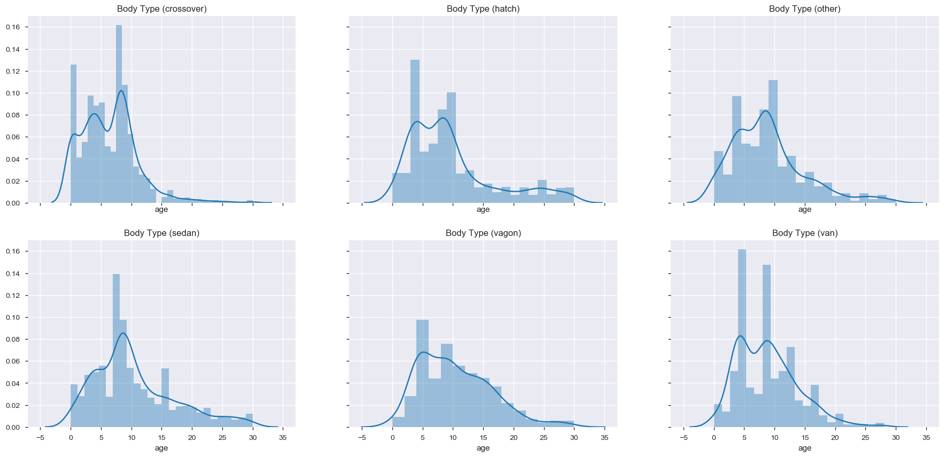
Data analysis and observations
Age distribution for each body type where age is less than 30.
Observations :
People change the crossovers more frequently than other car types.
Normally Sedan cars are changed after 8 years of car age.
Van, Vagon and Hatch cars are changed at much lower age (5-8 years)
Over all most cars are sold between the age of 4-10 years.

Slide 18
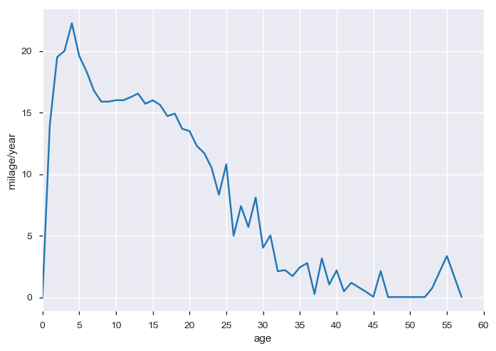
Data analysis and observations
Relation between Age of the car and mileage/year
Most newer cars have higher milage per year
Mileage/year increases till 4 year old cars and gradually reduces for cars older than 4 years.
Mileage/year reduces to less than 5000 miles/year after 30 years of age.
People tend to use the new cars more and as the car becomes older the usage of the car gradually decreases.

Slide 19
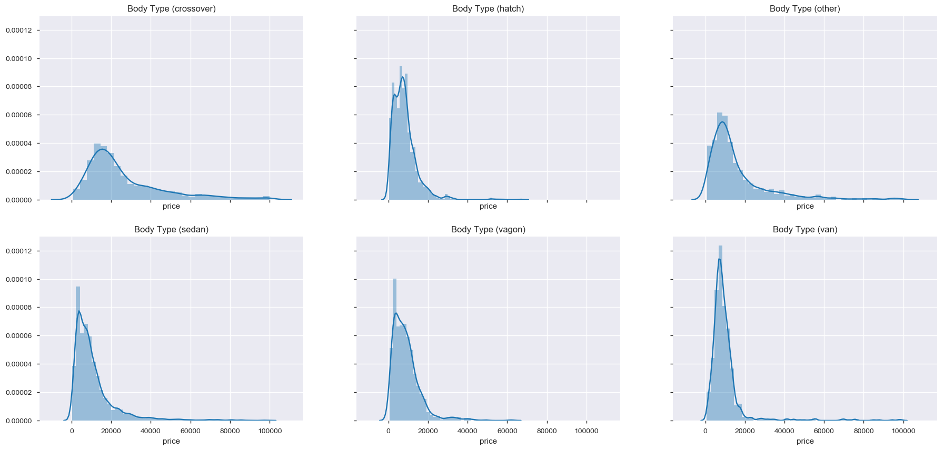
Data analysis and observations
Price Distribution per body type where price is not Extreme.
Observations :
Crossovers have overall better average resale price compared to other cars.
Sedan Van and Vagons have relatively lowest average resale price.
Crossover and Sedans have wider price ranges.
Cars from Some manufacturers seems to have better resale value compared to others

Slide 20
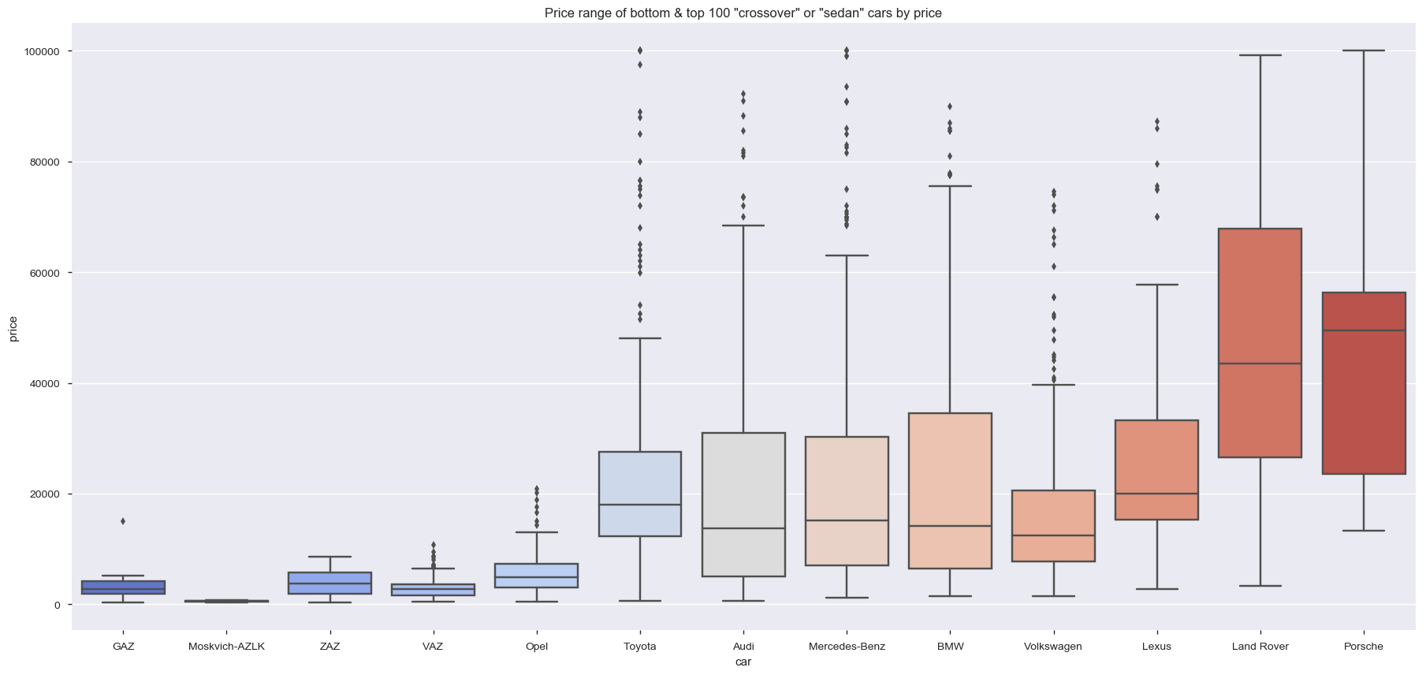
Data analysis and observations
Check if Car Manufacturer has relation to the resale value of the car in crossover and sedan types
Observation :
Graph shows that in crossover and Sedan cars, Cars from "Audi", "BMW", "Mercedes-Benz", "Lexus", "Volkswagon", "Land Rover", "Porsche" etc. are in much higher price range as compared to cars from "GAZ", "Vaz", "ZAZ", "Moskvich-AZLK", "Opel" etc.
Thus it seems that Resale value for Crossover and Sedan cars does depend on manufacturer and prices of European and Japanese cars is substantially higher than Russian cars.

Slide 21
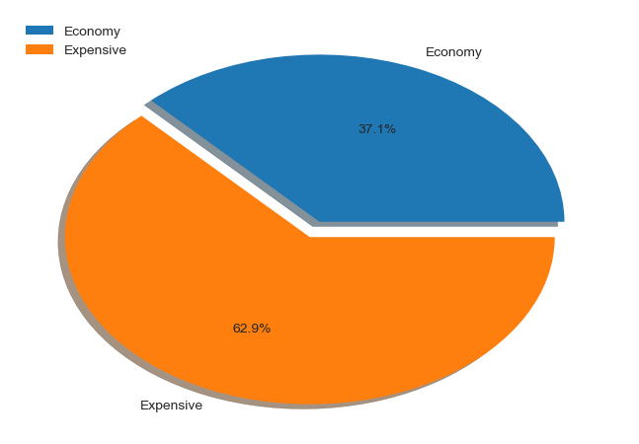
Data analysis and observations
Cars from which manufacturers sale more? expensive or economy?
Observation :
For Crossover and Sedan cars the market in not price sensitive, rather Car Manufacturer is of higher importance

Slide 22
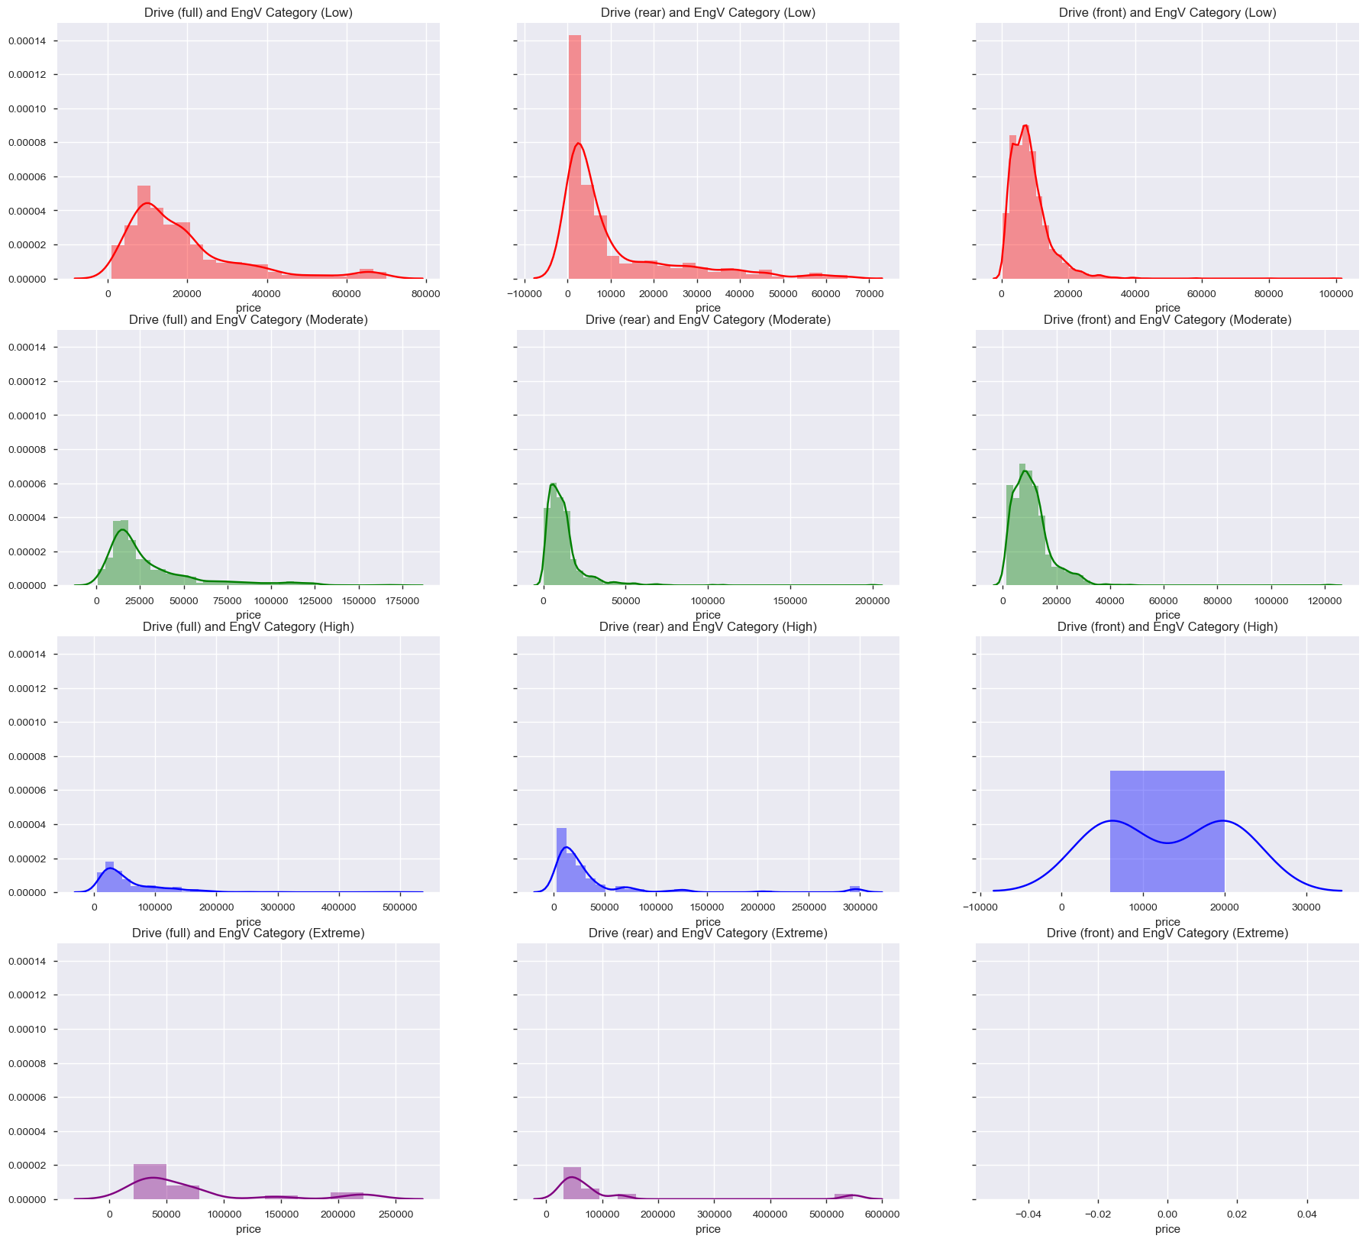
Data analysis and observations
Price Distribution based on drive type and engine volume categories.
Observations:
Most cars with front drive are of Low or Moderate Engine Volume.
High and Extreme Engine volume cars are generally Rear or Full drive types.
Full Drive cars are expensive in the respective engine volume categories.
Notes:
e.g.
for Low Engine Volume cars, Full Drive cars have median price ~10000 USD with higher standard diviation where as Front and Rear Drive have median price ~5-6000 USD with lower SD.
for Moderate Engine Volume cars, Full Drive cars have median price ~18-20000 USD with higher standard diviation where as Front and Rear Drive have median price ~10000 USD with lower SD.
for High Engine Volume cars, Full Drive cars have median price ~25-30000 USD with higher standard diviation where as Rear Drive have median price ~10000 USD with lower SD. (Very few cars with Fornt drive)
for Extreme Engine Volume cars, Very few cars thus ignored.

Slide 23
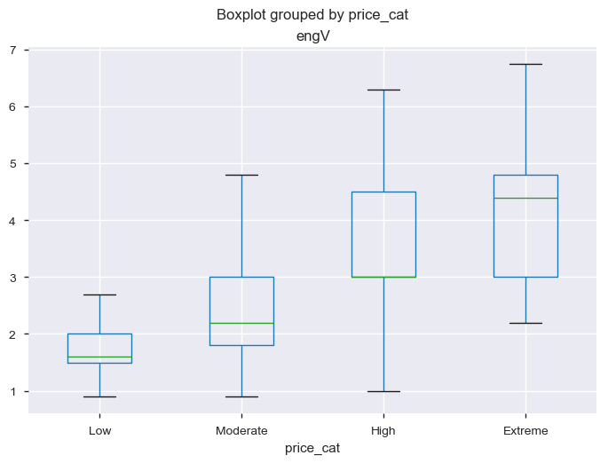
Data analysis and observations
Price category and engine volume relation.
Observation:
Above chart clearly shows that the price is dependent on the engine volume as the median Engine Volume increases as the price category increases.

Slide 24
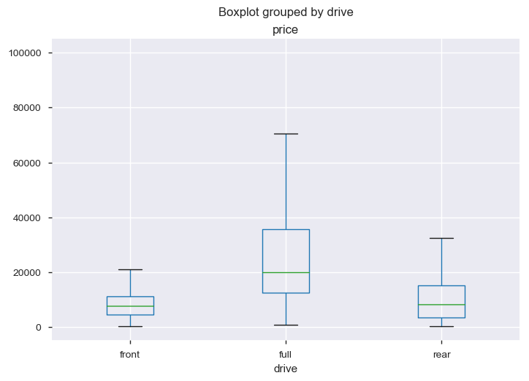
Data analysis and observations
Price and Drive tyoe relataion.
Observation:
Based on the Graph we can say that the car price is relatively higher for full drive cars compared to Front or Rear drive cars

Slide 25
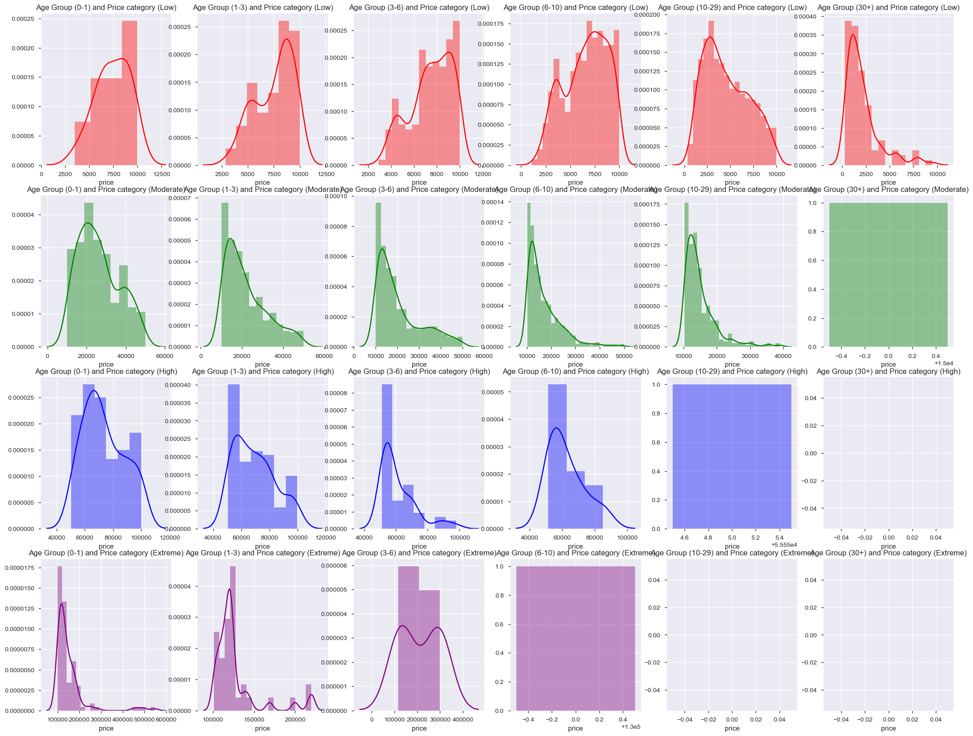
Data analysis and observations
Price distribution based on age groups in various price categories.
Observations:
for lower age groups, the distributions are skewed towards higher price compared to higher age groups where distributions are skewed towards lower prices in their respective Price categories.
this indicates that age does have impact of the price for lower priced cars.
Most cars in Extreme price category are in age groups 0-3 years. Very few cars are more than 3 years.
Most cars grater than 30 years age are in low price category.
As the age of the car increases the median price value reduces for Low, Moderate and High price categories,
But for Extreme price category the reverse trend can be seen
Notes:
.

Slide 26
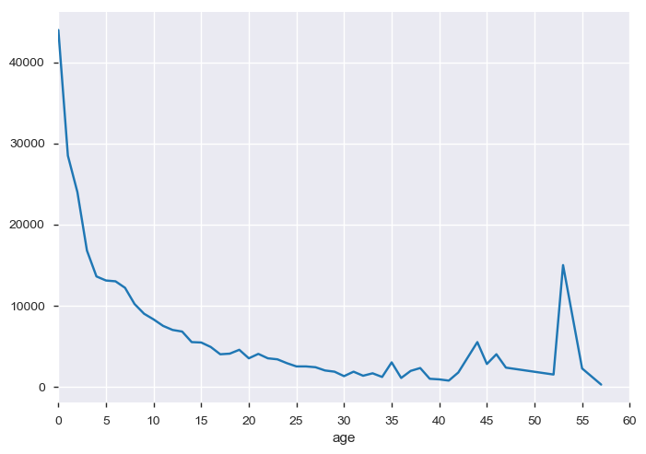
Data analysis and observations
Price trend over age of the car
Observation:
As the age of the car increase the price of the car decreases baring some vary old cars which may have antique value.

Slide 27
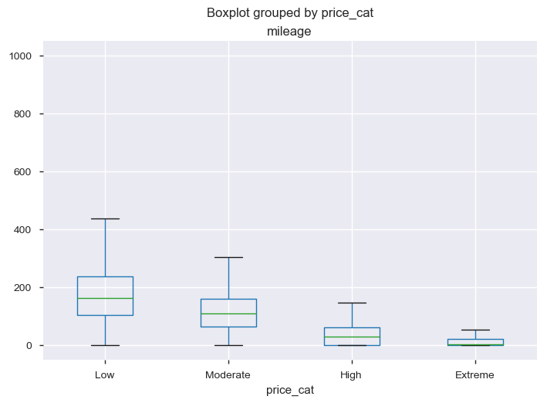
Data analysis and observations
Price relationship with mileage
Observation:
Higher the mileage lower the price category, which implies that price reduces with increase in mileage
Notes:
e.g.
for Low Engine Volume cars, Full Drive cars have median price ~10000 USD with higher standard diviation where as Front and Rear Drive have median price ~5-6000 USD with lower SD.
for Moderate Engine Volume cars, Full Drive cars have median price ~18-20000 USD with higher standard diviation where as Front and Rear Drive have median price ~10000 USD with lower SD.
for High Engine Volume cars, Full Drive cars have median price ~25-30000 USD with higher standard diviation where as Rear Drive have median price ~10000 USD with lower SD. (Very few cars with Fornt drive)
for Extreme Engine Volume cars, Very few cars thus ignored.

