Slide 2
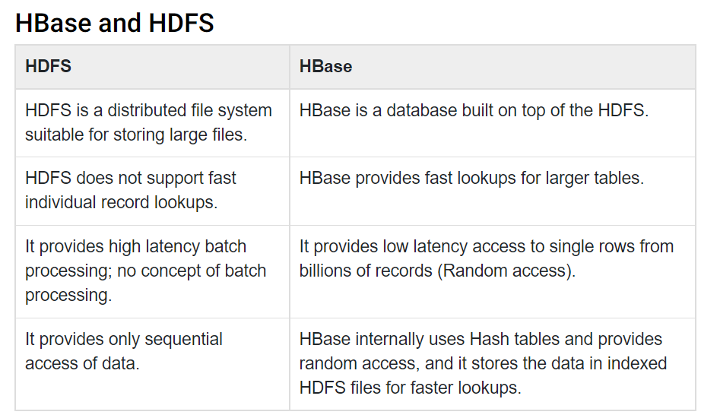

Slide 3
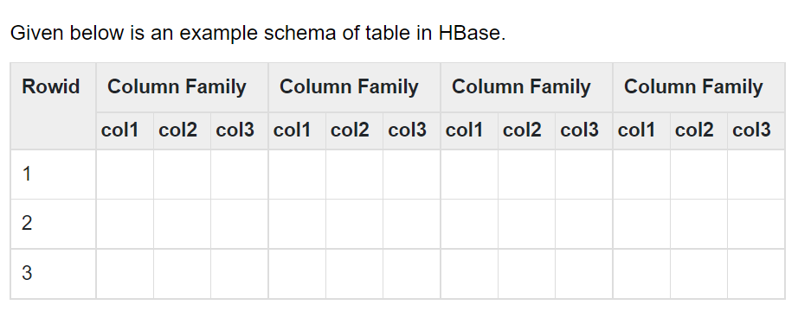

Slide 4
Row-Oriented Database | Column-Oriented Database
It is suitable for Online Transaction Process (OLTP). | It is suitable for Online Analytical Processing (OLAP).
Such databases are designed for small number of rows and columns. | Column-oriented databases are designed for huge tables.

Slide 5
HBase | RDBMS
HBase is schema-less, it doesn't have the concept of fixed columns schema; defines only column families. | An RDBMS is governed by its schema, which describes the whole structure of tables.
It is built for wide tables. HBase is horizontally scalable. | It is thin and built for small tables. Hard to scale.
No transactions are there in HBase. | RDBMS is transactional.
It has de-normalized data. | It will have normalized data.
It is good for semi-structured as well as structured data. | It is good for structured data.

Slide 6
Connection
from starbase import Connection c=Connection("127.0.0.1","8000") ratings=c.table("ratings") if(ratings.exists()): print("dropping") ratings.drop() ratings.create("rating") print("parsing the ml-100") ratingFile=open("D:/2022-2023 Python and Big Data/Big Data Analytics/ml-100k/ml-100k/u.data","r") batch=ratings.batch() for line in ratingFile: (userID,movieID,rating,timestamp)=line.split() batch.update(userID,{'rating':{movieID:rating}}) ratingFile.close() print("committing") batch.commit(finalize=True) print("rating for user id 1") print(ratings.fetch("1")) ratings.drop()

