Slide 1
UE24CS352A · MACHINE LEARNING MINI-PROJECT
Detecting Heart Abnormality Using ECG Features with CART
Pruned CART decision tree vs Random Forest on 279 patient and signal attributes (UCI Arrhythmia).
Team: DHRITI KAMANI(PES1UG24AM085), DHRUV R(PES1UG24AM086)
Reference: Zhou, Garcia & Rajbhandary, “Detecting Heart Abnormality using ECG with CART” (Stanford).
Notes:
Introduce the team and the topic: we classify heart-condition categories from precomputed ECG/patient features. The project compares a pruned CART decision tree (the Stanford paper's method) with a Random Forest. All results shown are from our own code (main.py).

Slide 2
CLINICAL MOTIVATION & AUDITABILITY
Why decision trees for cardiac screening?
Cardiovascular disease is a leading global cause of death. Standard 12-lead ECG is an affordable, ubiquitous, first-line diagnostic test.
Predicting 16 categories from 279 attributes: Class 1 represents normal rhythm, while classes 2–16 capture distinct ventricular, atrial, and conduction abnormalities.
Auditable if-then paths: Unlike opaque neural models, binary tree splits reflect the hierarchical criteria cardiologists use to evaluate waveforms.
Severe class imbalance: Skewed category distributions mean standard accuracy obscures catastrophic false negatives in life-threatening arrhythmias.
02
Notes:
Explain the motivation in one minute. Stress that the model is a classroom experiment, not a diagnostic tool.

Slide 3
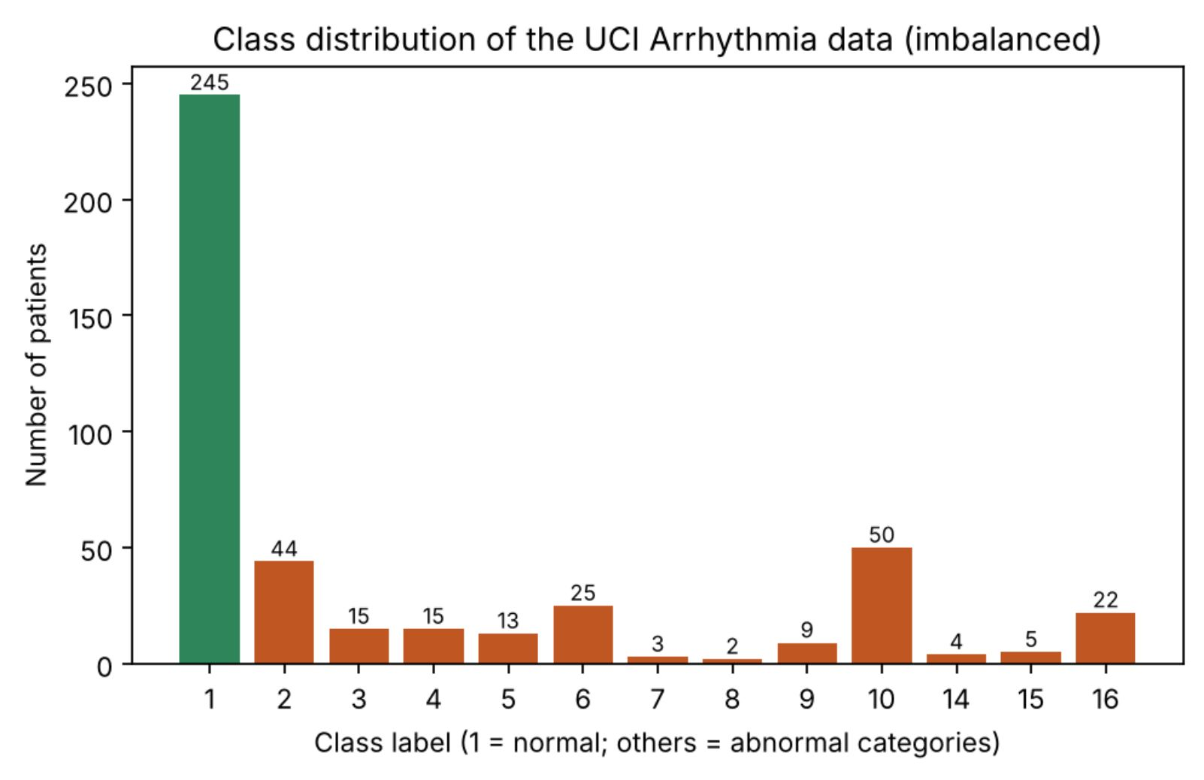
BENCHMARK DATASET
UCI Arrhythmia: 452 patients, 279 features
Class distribution · n = 452
Dimensionality: 452 patient records with 279 continuous and nominal predictors, spanning demographic metrics and 12-lead ECG morphology.
Clinical attributes: First 15 features cover age, sex, height, weight, heart rate, and vector angles (P, QRS, T, T-QRS, J).
Missing data pattern: Feature 14 (f14 = j_angle) is 83.2% missing (376/452 rows). Four other features contain 1–22 missing entries.
Extreme imbalance: Class 1 (normal) accounts for 245 cases (54.2%), while rare arrhythmia classes have as few as 2–5 instances.
Class 1 dominates with 245 rows; classes 7, 8, 14, and 15 contain under 5 patients each.
03
Notes:
State the facts from the UCI documentation. Say that we verify shape, labels and missingness when the file is loaded, and that we decide what to drop from measured missing share, not from column position.

Slide 4
PIPELINE ARCHITECTURE
Leak-free preprocessing and cross-validation workflow
Dropping, imputation and hyper-parameter tuning are all learned strictly from training rows.
01
02
03
04
01 · Load & split
02 · Preprocess
03 · Two models
04 · Final evaluation
Verify shape (452 × 280) and labels. Lock 30% of patients in a stratified test set (seed 42) untouched until final testing.
Inside one Pipeline: drop features >50% missing (f14) and median-impute the rest, learned from training rows only.
CART: 5-fold CV grid over criterion, depth, leaf size and pruning (ccp_alpha). Random Forest: 300 trees.
Score both models once on the 136 held-out test patients, and by 10-fold CV (3 repeats) on all 452 rows.
04
Notes:
Walk through the flow left to right and emphasise: nothing from the test set is used for imputation values, feature dropping or tuning. Dropping and imputation sit inside the scikit-learn Pipeline, so cross-validation re-learns them on each training fold - that is how we avoid data leakage.

Slide 5
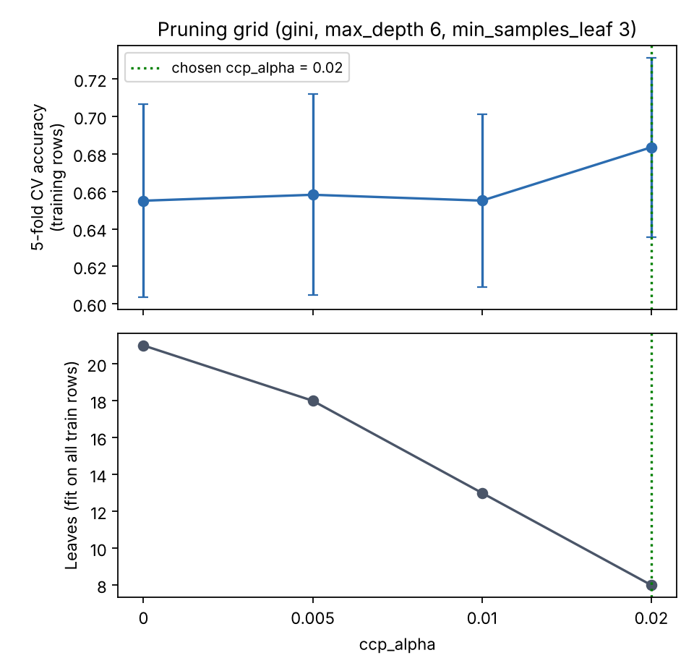
SPLITTING RULE & REGULARIZATION
Pruning grid · 5-fold CV
CART, pruning and Random Forest
Greedy binary splits: CART splits each node on the feature/threshold that most reduces Gini impurity, G = 1 − Σ pₖ² (0 for a pure node). Fully grown trees memorise noise, so the pruning strength ccp_alpha is part of the CV grid {0, 0.005, 0.01, 0.02}; the winner (gini, depth 6, min leaf 3, ccp_alpha 0.02) has 8 leaves. Random Forest averages 300 trees built on bootstrap samples with random feature subsets: lower variance, less readable. scikit-learn ccp_alpha ≠ rpart cp, so the paper’s 0.0001 / 0.027 are not reused.
Chosen ccp_alpha = 0.02 gave the best training-CV accuracy (0.684) and cut the tree from 21 to 8 leaves.
05
Notes:
Explain Gini with a tiny example (pure node = 0). Larger ccp_alpha means a smaller tree; we pick it by 5-fold CV on the training rows (21 leaves unpruned vs 8 at 0.02). Then explain the Random Forest in one sentence: many trees voting. Be ready to say why differences of 1-3 CV points are within noise on 316 rows.

Slide 6
SOFTWARE ENGINEERING STANDARDS
Minimal, reproducible Python project
Stack: Python 3, pandas, scikit-learn, Matplotlib. One script (main.py), an executed notebook (ECG_CART_Analysis.ipynb), a README and requirements.txt.
Run it: python main.py loads the data, tunes CART, trains the Random Forest, evaluates both and saves results.txt plus three figures.
Leak-free by design: Dropping and imputation sit inside a scikit-learn Pipeline, so they are re-learned on training rows only, including inside every CV fold.
06
Notes:
Show the project folder: main.py, the notebook, README, requirements, results.txt and the three figures. Run python main.py live if time allows. Mention the disclaimer printed at the end of the run.

Slide 7
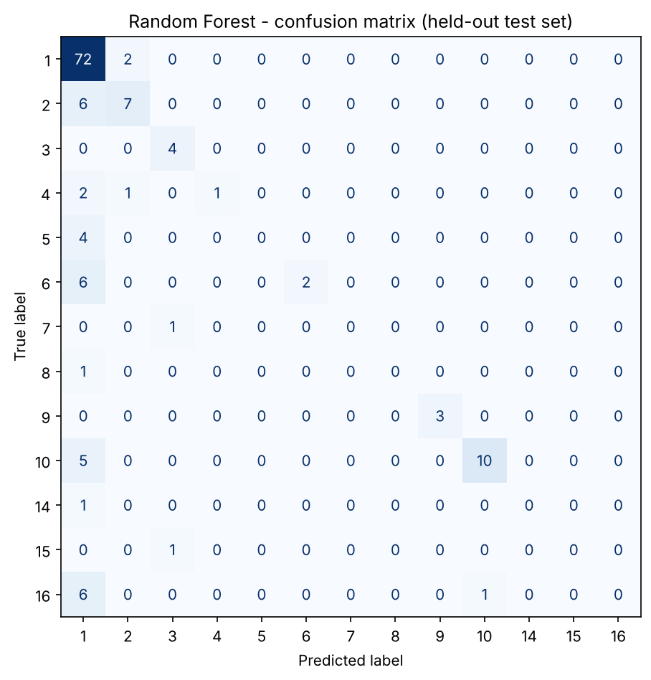
HELD-OUT EVALUATION (N = 136)
Random Forest beats CART; rare classes still fail
Random Forest · test set
FOREST · TEST ACCURACY
FOREST · BALANCED ACC.
0.728
0.360
FOREST · MACRO F1
CART (PRUNED) · ACCURACY
0.369
0.632
10-fold CV accuracy: 0.739
Rare-class dropoff: Classes 5, 7, 8, 14, 15 and 16 have zero recall (class 1: 0.97). CART: macro-F1 0.237, balanced 0.261, CV 0.669. The paper’s ~80% used another protocol – context only.
72 of 74 class 1 cases correct; most rare classes are missed.
07
Notes:
Numbers come from results.txt / the notebook. Random Forest: accuracy 0.728, balanced accuracy 0.360, macro-F1 0.369, 10-fold CV 0.739. Pruned CART: 0.632 / 0.261 / 0.237 / 0.669. The majority baseline is 0.542. Contrast accuracy with macro-F1 and explain why they differ (rare classes). We did NOT reach the paper's ~80%; their protocol differs and we did not tune toward that number.

Slide 8
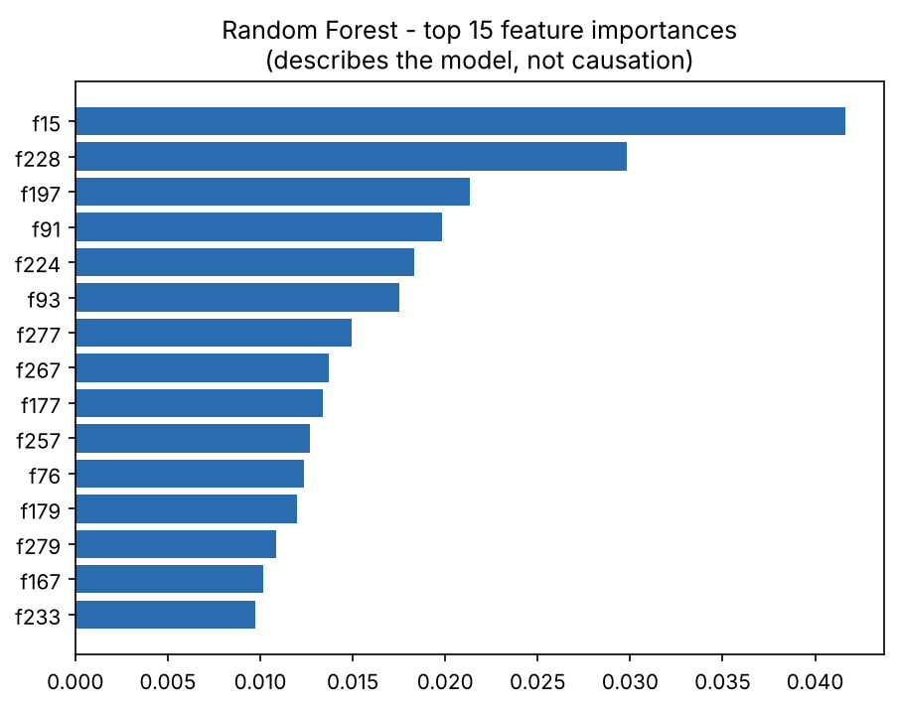
INSPECTION & DECISION RULES
Feature importance reflects model rules, not clinical cause
Random Forest importance
Primary splitting feature: Random Forest ranks heart_rate (f15) first, then V1_qrsa and AVR_t_amp.
Root node: The pruned CART splits first on V1_rprime_amp (R′ amplitude, lead V1); the paper’s tree rooted at heart rate (feature 15). Greedy roots depend on data handling and pruning.
Spread-out importance: The top feature holds only ~4% of the forest’s importance; no single measurement dominates.
Plot labels: f15 = heart_rate (0.042), f228 = V1_qrsa (0.030), f197 = AVR_t_amp (0.021).
Descriptive vs. causal: Gini importance reflects greedy impurity decrease across collinear features, not biological causation.
08
Notes:
Show the bar chart (labels are f-numbers: f15 = heart_rate, f228 = V1_qrsa, f197 = AVR_t_amp, f224 = V1_rprime_amp). Importance is spread thinly across many features. Be explicit: if our top features differ from the paper's, that is a finding, not an error. Importance describes the model, not causation.

Slide 9
CRITICAL APPRAISAL
Limitations & future work
Current study limitations
Prioritized next steps
Only 452 rows; rare classes have 1–8 test cases → unstable per-class metrics.
Single 70/30 split; simple median imputation; precomputed features (no raw waveform).
Historical, single-source data; no external validation; not clinically valid.
Nested CV; class weighting or resampling for rare classes.
Better imputation; calibration; external validation.
09
Notes:
Be candid about weaknesses; examiners reward honesty. We did not reach the paper's ~80% and say so. Link each limitation to what we would do next.

Slide 10
SUMMARY & PROJECT VIVA
CART vs Random Forest: honest results, reproducible code
Methodological rigor: Test patients never influence tuning, imputation or feature dropping. Reported: Random Forest 0.728 accuracy / 0.369 macro-F1; CART 0.632 / 0.237.
Interpretability tradeoff: The pruned CART has 8 readable leaves; the forest is about 10 points more accurate on the test set but not human-auditable. Neither reaches the paper’s ~80% or recovers rare classes.
Reproducible codebase: One script (main.py), an executed notebook and requirements.txt reproduce every number; the 10-fold CV protocol follows the paper.
Thank you!
10
Notes:
Summarise in three sentences, then take questions. Be ready for: Gini, pruning, Random Forest vs one tree, leakage, imputation, confusion matrix, why our accuracy is below the paper's ~80% (different protocol; we did not tune toward it).

