Slide 1


Swami Keshvanand Institute of Technology, Management & Gramothan, Jaipur
(An Autonomous Institute Affiliated to Rajasthan Technical University, Kota)
Industrial Training
Presentation
TOPIC: DEVenue
Submitted To:
Name:- Ms. Himani Thakur
Assistant Professor
Submitted By:
Name:- Aditi Agrawal
Roll No.:- 23ESKCA003

Slide 2
Index
Company Introduction
Certificate
Technology Used
Goal of Training
Project Overview
Working Project
Future Scope
Q&A
SKIT, JAIPUR www.skit.ac.in

Slide 3

Company Introduction
Compucom Software Limited (CSL) is a leading IT solutions and services company headquartered in Jaipur, Rajasthan, India. Established in 1995, CSL specializes in custom software development, web and mobile applications, cloud solutions, and IT consulting. The company is located at IT-14-15, EPIP, Sitapura Industrial Area, Jaipur – 302022, a prominent IT hub in the region. CSL operates primarily from this corporate office and has a global presence, serving clients across multiple industries worldwide. The company emphasizes quality, technology adoption, and customer satisfaction, providing a strong platform for learning and professional growth.
SKIT, JAIPUR www.skit.ac.in

Slide 4
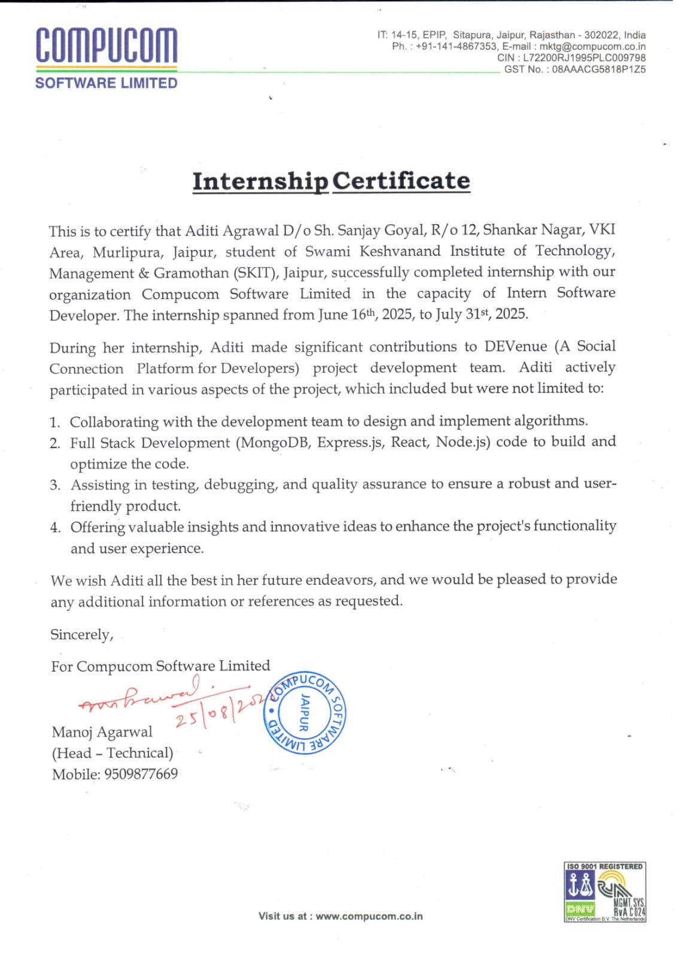

Slide 5





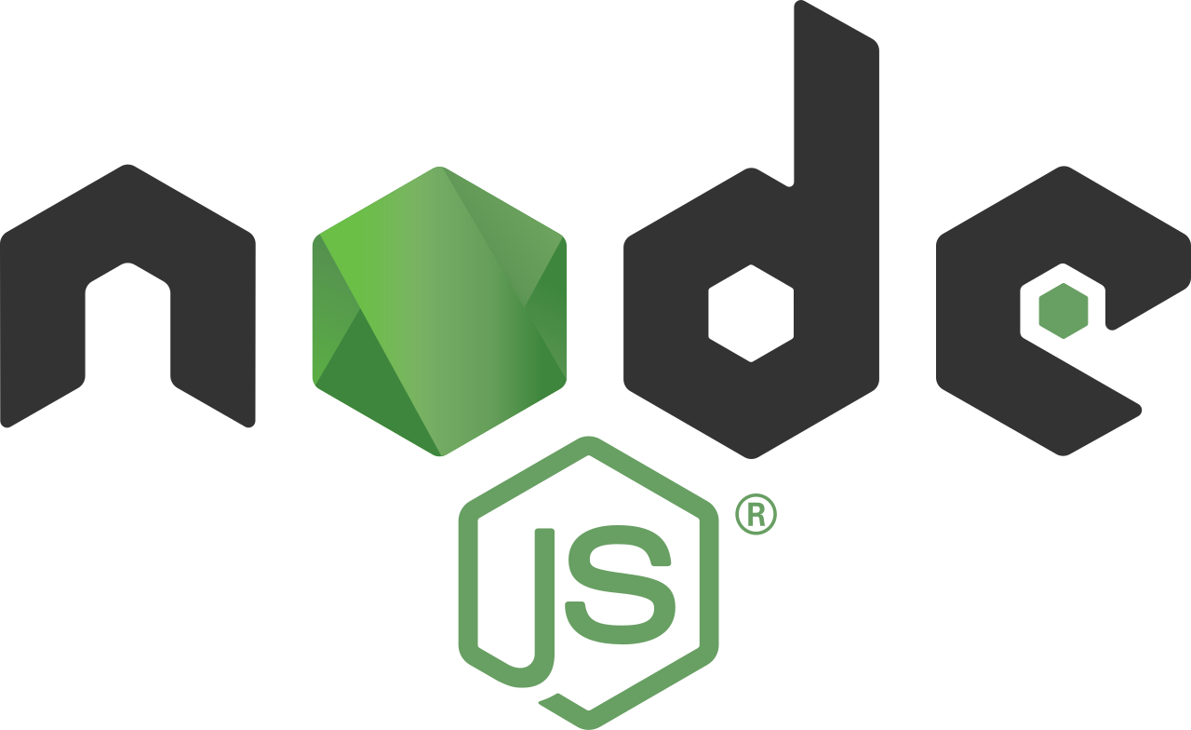







Technology Stack Used
SKIT, JAIPUR www.skit.ac.in

Slide 6
Goal Of Training
To gain hands-on experience with full-stack web development using the MERN stack (MongoDB, Express.js, React.js, Node.js) and Redux for state management.
To learn end-to-end project development, including debugging, testing, and building secure APIs using JWT and bcrypt.js.
To explore real-time features using Socket.io and understand client-server interactions for dynamic applications.
To develop professional skills such as effective teamwork, communication, and collaboration in a project environment.
To strengthen expertise in version control, API testing, and deployment workflows while applying all skills to build DEVenue, a developer-focused networking platform.
SKIT, JAIPUR www.skit.ac.in

Slide 7
DEVenue Overview
DEVenue is a social networking platform built for developers, enabling them to connect, collaborate, and grow together.
It allows users to create profiles, showcase skills, connect with peers, and chat in real time using Socket.io.
Built with the MERN stack, DEVenue provides a clean, responsive interface and secure authentication with JWT and bcrypt.js.
The platform focuses on meaningful networking — helping developers find collaborators for projects, hackathons, and learning communities.
It goes beyond traditional professional platforms by emphasizing skill-based team building and collaboration, not just job connections.
SKIT, JAIPUR www.skit.ac.in

Slide 8
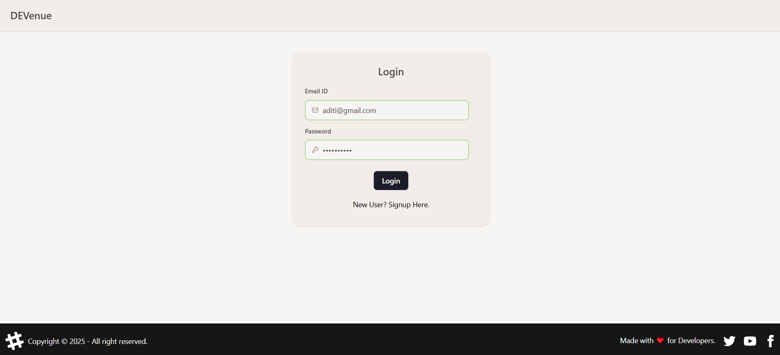
Login SECTION

Slide 9
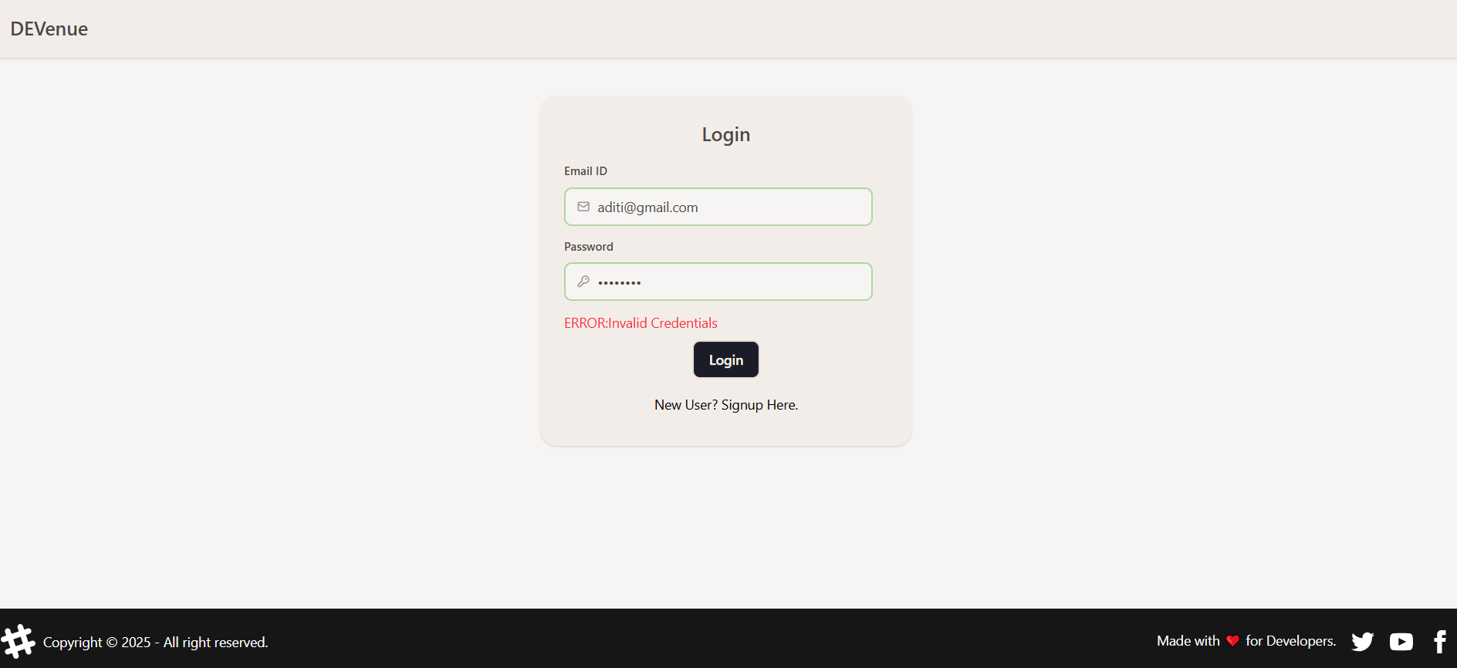
Login SECTION

Slide 10
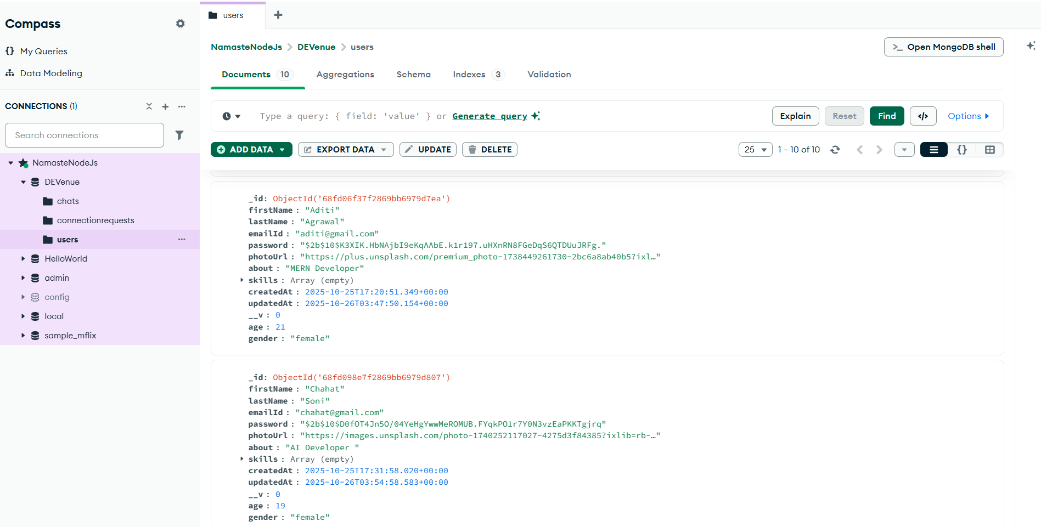

Slide 11
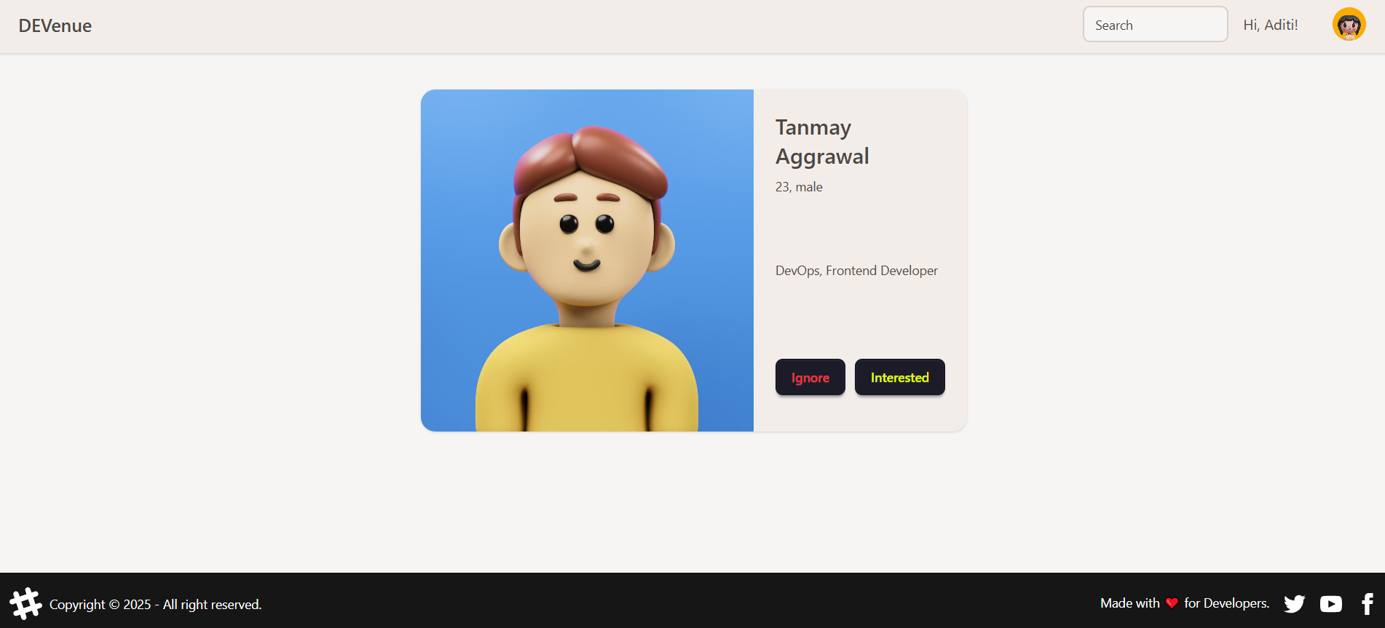
FEED SECTION

Slide 12
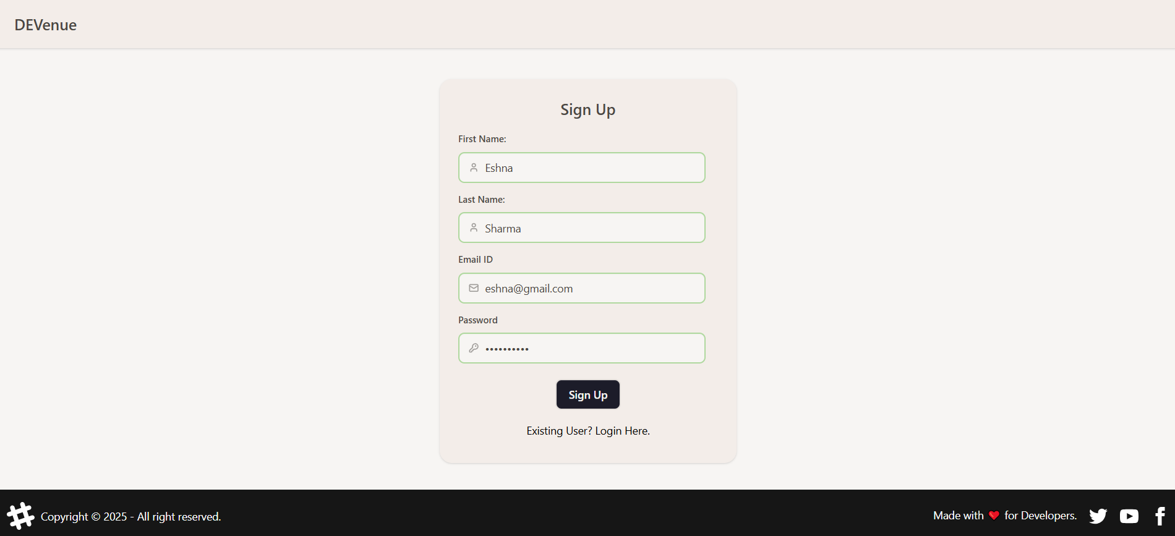
SigN - UP SECTION

Slide 13
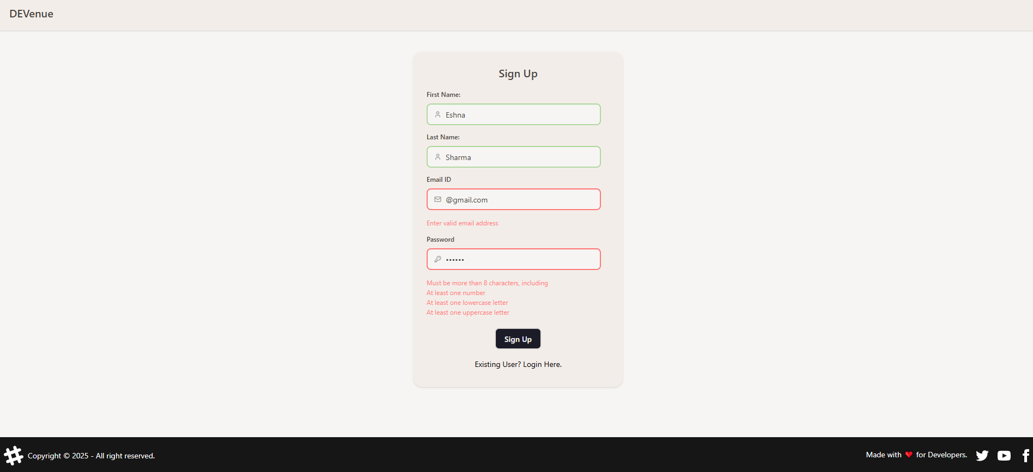
SigN - UP SECTION

Slide 14
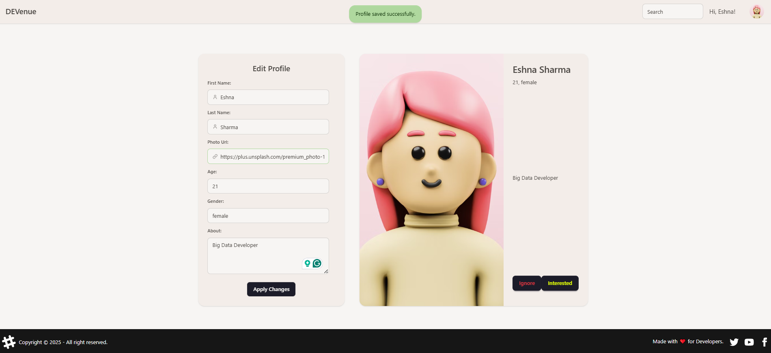
EDIT PROFILE SECTION

Slide 15
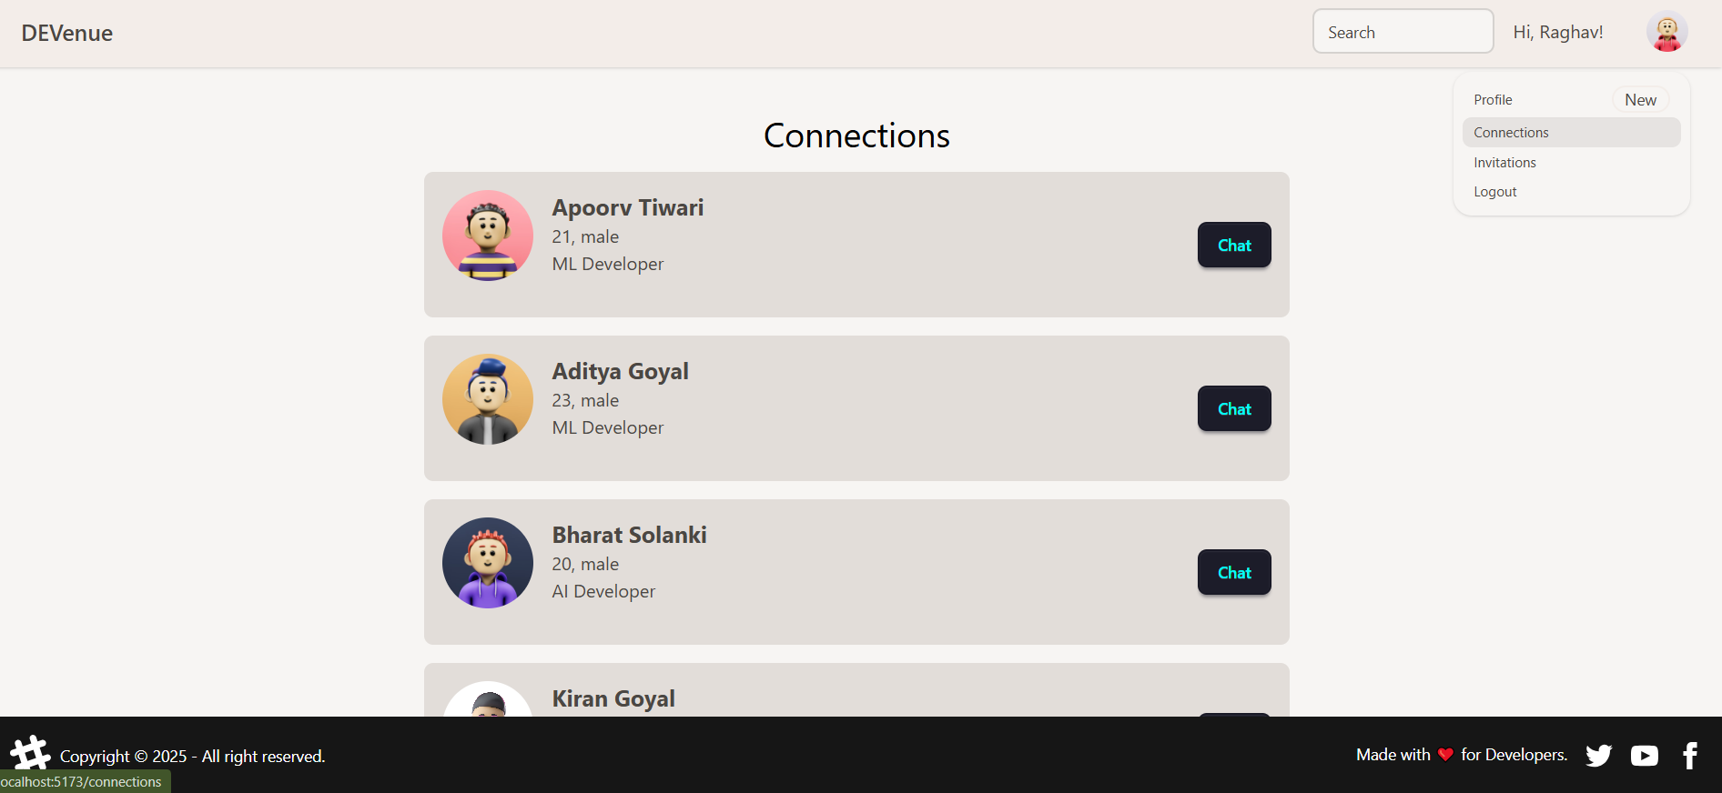
NETWORK SECTION

Slide 16
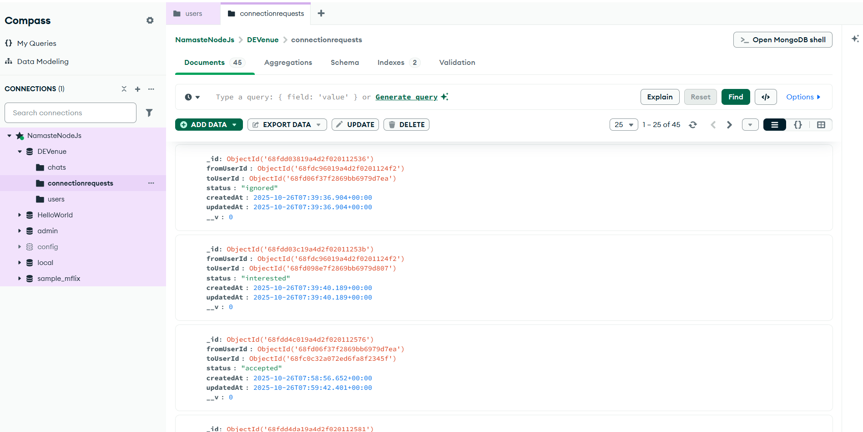

Slide 17
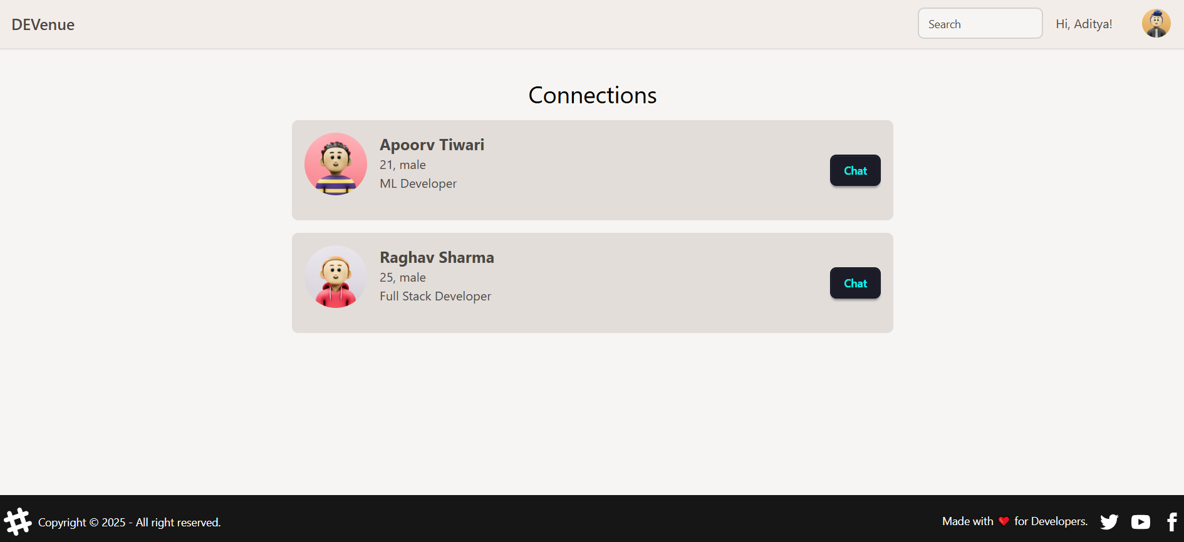
NETWORK SECTION

Slide 18
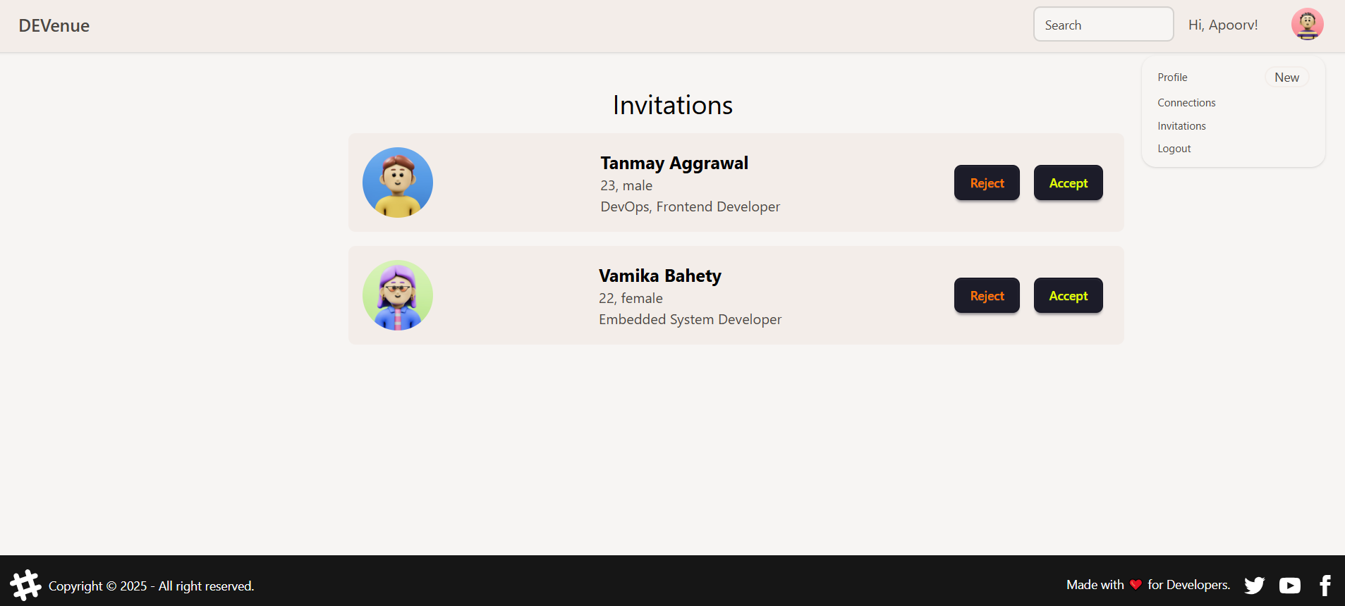
INVITATIONS SECTION

Slide 19
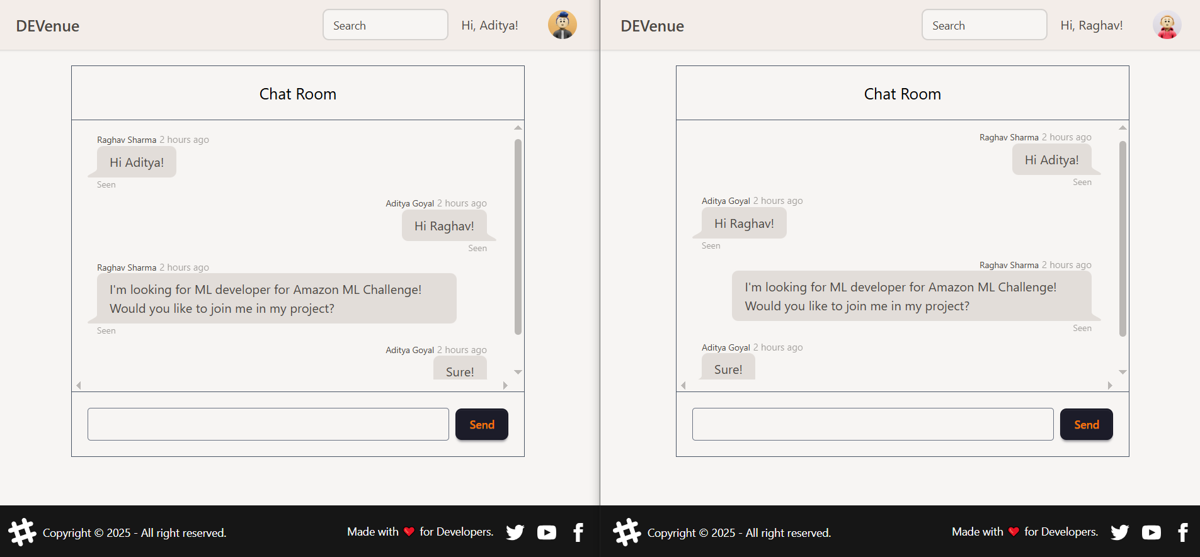
CHAT SECTION

Slide 20
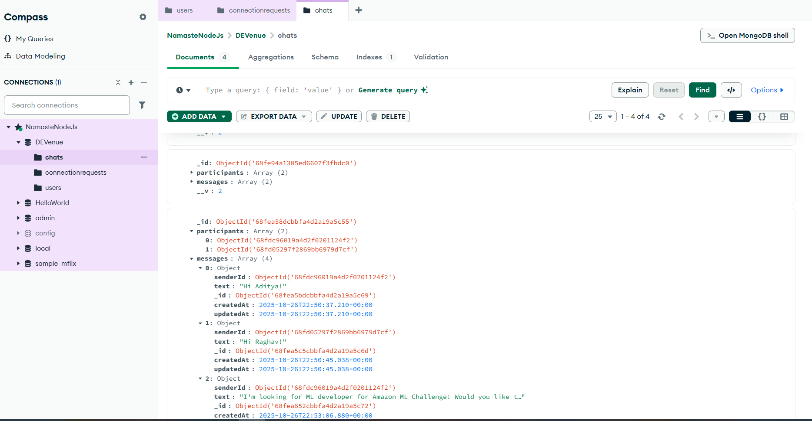

Slide 21
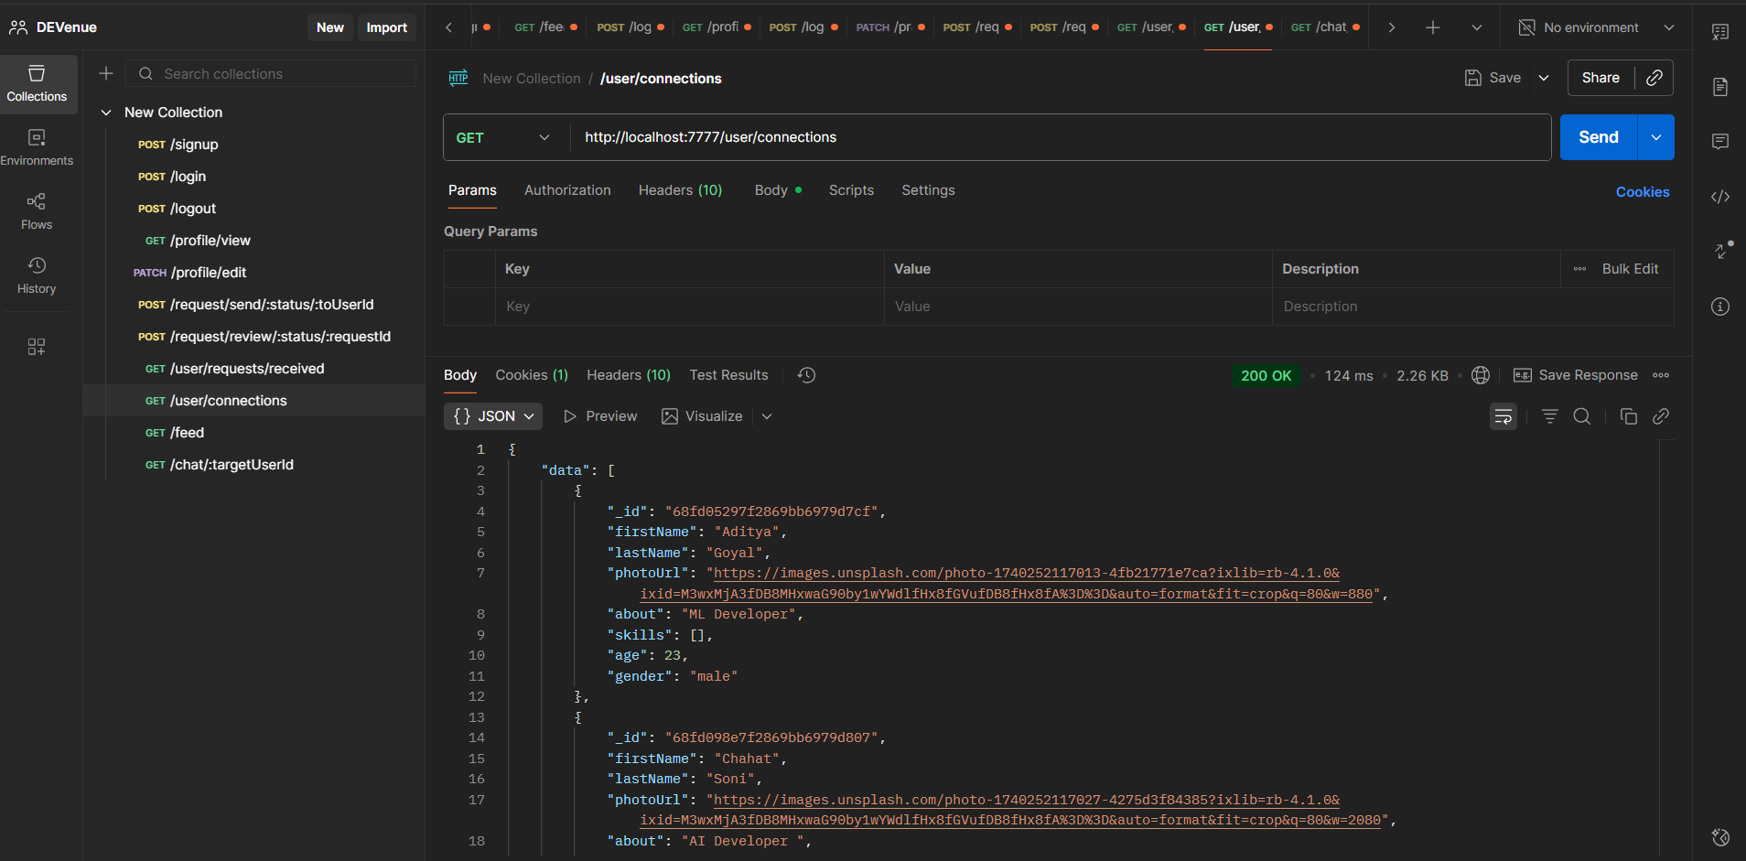
API TESTING

Slide 22
Future Scope
1. Enhanced UI & Personalized Dashboard.
2. Premium Membership Features (Razorpay Integration).
3. Hackathon Collaboration & Smart Team Formation.
4. Developer Portfolio & Project Showcase.
5. Community & Learning Hub.
SKIT, JAIPUR www.skit.ac.in

Slide 23
Q & A
SKIT, JAIPUR www.skit.ac.in

Slide 24
Thank You
SKIT, JAIPUR www.skit.ac.in

