Slide 1


Swami Keshvanand Institute of Technology, Management & Gramothan, Jaipur
(An Autonomous Institute Affiliated to Rajasthan Technical University, Kota)
Industrial Training
Presentation
TOPIC: HelioPulse OS:
Solar Panel Underperformance & Revenue Loss Detector
Submitted To:
Name:- Mr. Shivank Lavania
Assistant Professor
Submitted By:
Name:- Dhritiman Sen
Roll No.:- 23ESKCX029

Slide 2
Index
Company Introduction
Certificate
Technology Used
Goal of Training
Project Overview
Working Project
Future Scope
Q&A
SKIT, JAIPUR www.skit.ac.in

Slide 3
Company / Domain Introduction
Cynbit Technologies is an AI automation and software solutions company headquartered in Jaipur, Rajasthan, India. Officially launched in 2024 after years of groundwork that began in 2021, Cynbit specializes in AI automation and autonomous agents, custom software development, web and mobile applications, cloud solutions (AWS and Azure), and technical SEO and digital marketing. The company is located at 32/115 Pratap Nagar, Jaipur, Rajasthan – 302033, and serves clients across industries from this corporate office, with a global outlook. Alongside its services, Cynbit builds proprietary SaaS products such as Cynbit Studio (career intelligence), Revio (AI review assistant) and TenantEase (property ecosystem), and runs BitElevate- a training program that links academic learning to industry skills through mentorship, real-world projects and placement support. Through its partnership with Manav Seva Trust, it also provides computer and IT teaching in rural areas and government schools. The company emphasizes startup-like speed with enterprise-grade rigor, AI-first thinking and end-to-end ownership from design to deployment, giving interns and trainees a strong platform for learning and professional growth.
SKIT, JAIPUR www.skit.ac.in

Slide 4
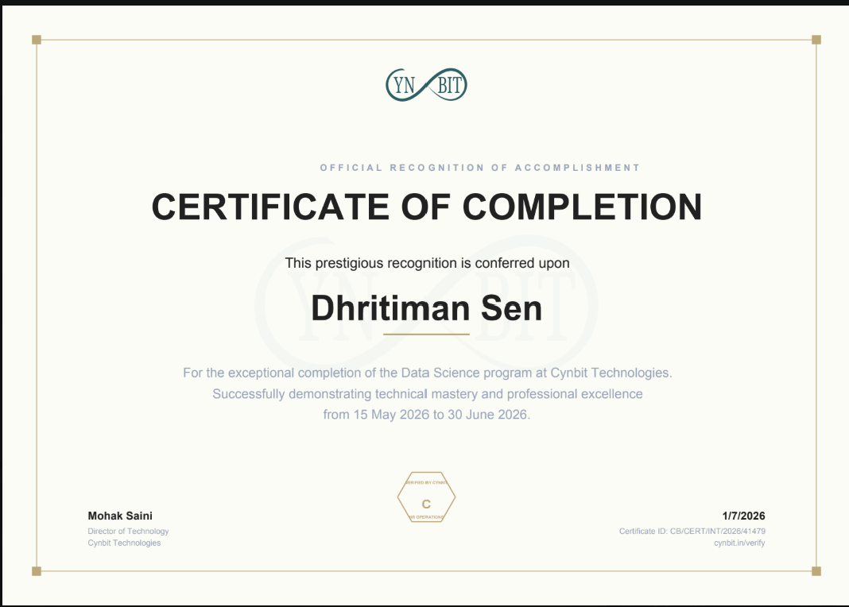
Certificate
SKIT, JAIPUR www.skit.ac.in

Slide 5
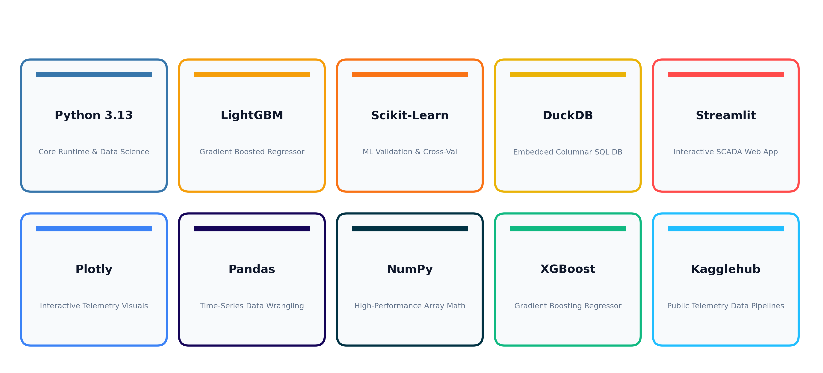
Technology Stack Used
SKIT, JAIPUR www.skit.ac.in

Slide 6
Goal Of Training
1. To gain hands-on expertise in Applied Machine Learning, training LightGBM and Gradient Boosted regression models on high-frequency solar sensor streams.
2. To design an automated anomaly detection engine that disambiguates gradual dust/soiling degradation from sudden electrical inverter tripping.
3. To build a financial loss quantification engine that converts kilowatt deficits into real-world Indian Rupee (₹) losses with actionable maintenance ROI.
4. To integrate an embedded, zero-configuration columnar SQL database (DuckDB) for high-performance telemetry persistence, multi-plant indexing, and audit logging.
5. To develop a bespoke, industrial-grade cleantech SCADA dashboard using Streamlit and Plotly, delivering real-time field dispatch directives.
SKIT, JAIPUR www.skit.ac.in

Slide 7
Project Overview
• HelioPulse OS is an intelligent solar inverter underperformance and revenue loss diagnostic platform engineered specifically for desert and commercial rooftop installations.
• Rather than relying on static generation thresholds, the system uses a trained LightGBM regression model to predict dynamic expected AC power from live meteorological sensors (solar irradiance, module temperature, and ambient temperature).
• By comparing real-time output against predicted capacity, it computes inverter-specific Performance Ratios (PR), pinpoints faulty strings, and classifies anomalies into critical hardware trips versus dust accumulation.
• Crucially, it turns abstract engineering deficits into executive maintenance decisions: calculating exact rupee losses and demonstrating the net financial return (ROI) of washing panel arrays.
• Built with an embedded DuckDB columnar database, the platform features a custom Telemetry Ingestion Hub capable of auto-mapping and ingesting multi-plant SCADA feeds.
SKIT, JAIPUR www.skit.ac.in

Slide 8
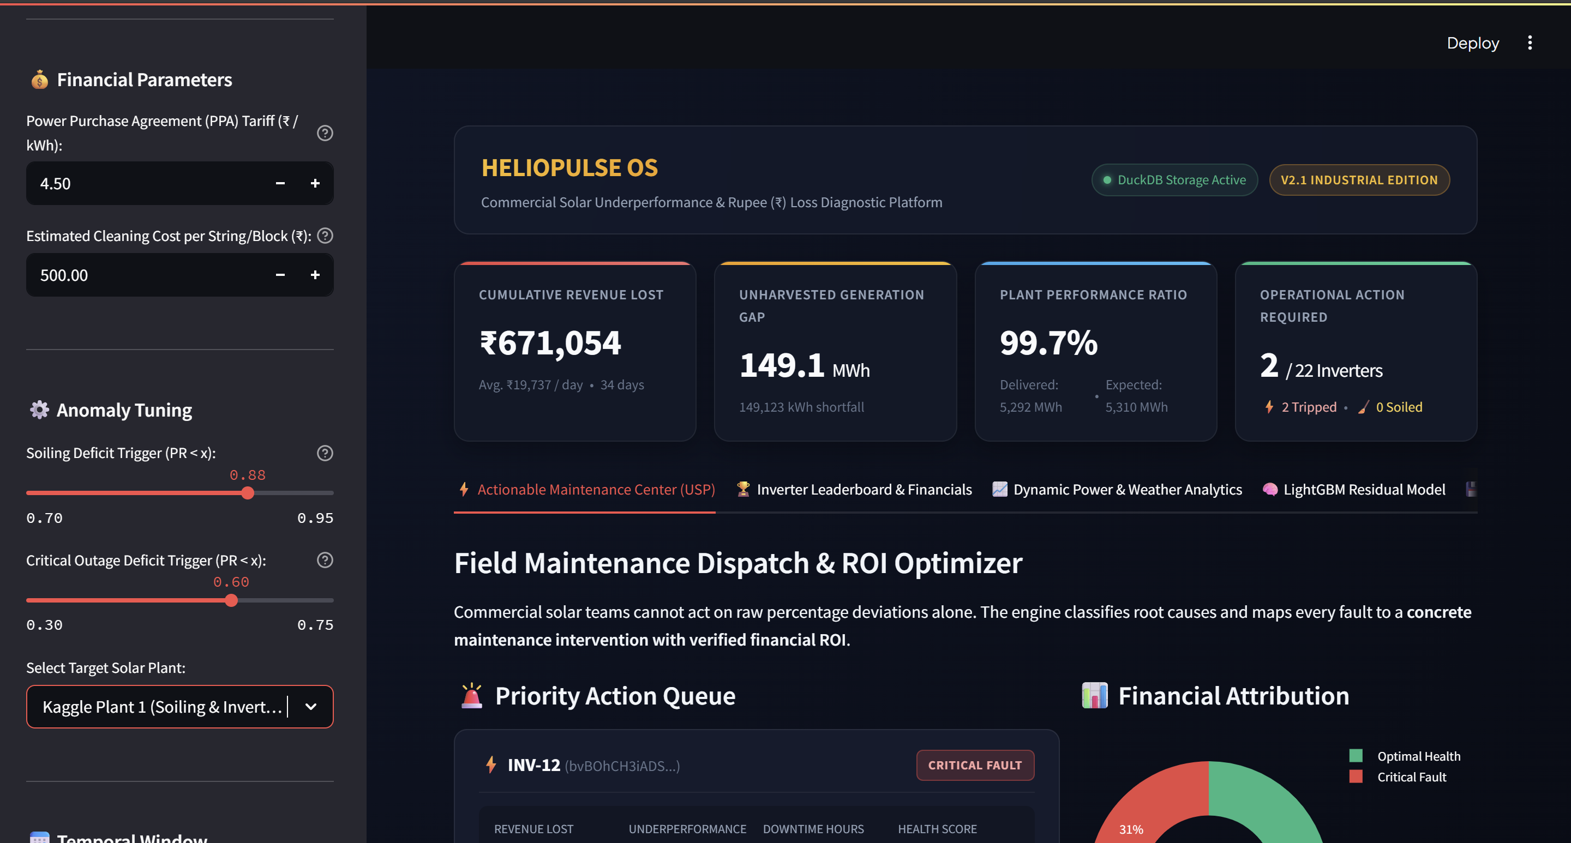
EXECUTIVE OVERVIEW & PLANT KPIS

Slide 9
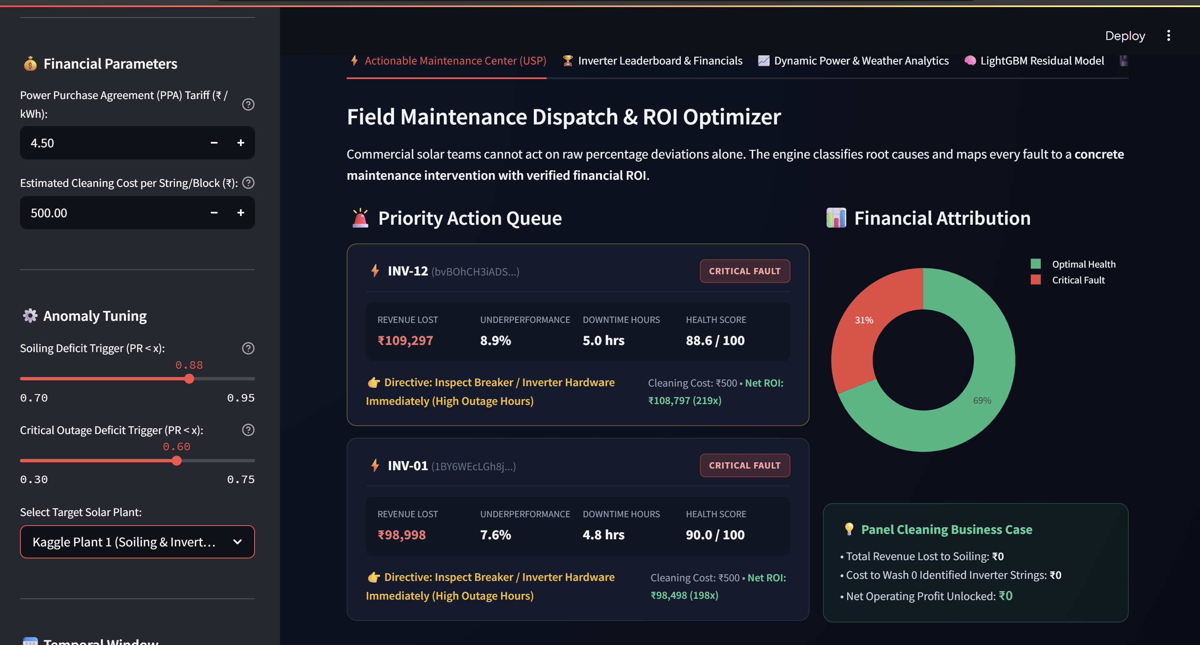
PRIORITY ACTION QUEUE & DIRECTIVES (USP)

Slide 10
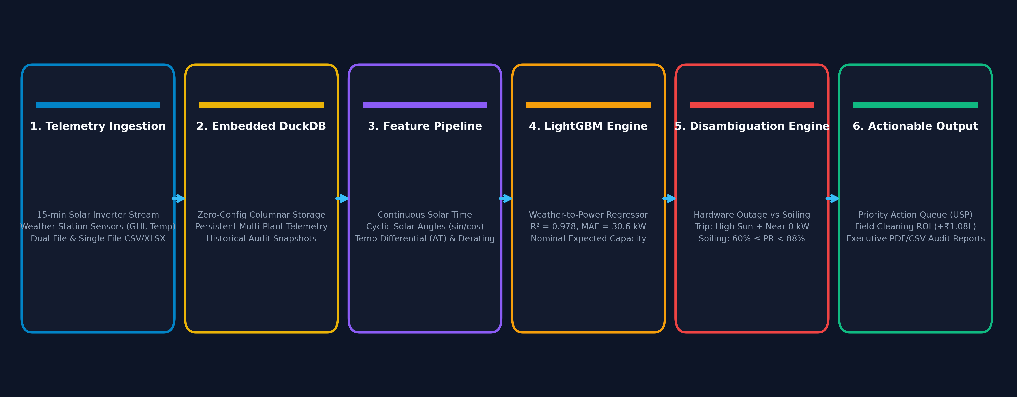
END-TO-END PIPELINE ARCHITECTURE

Slide 11
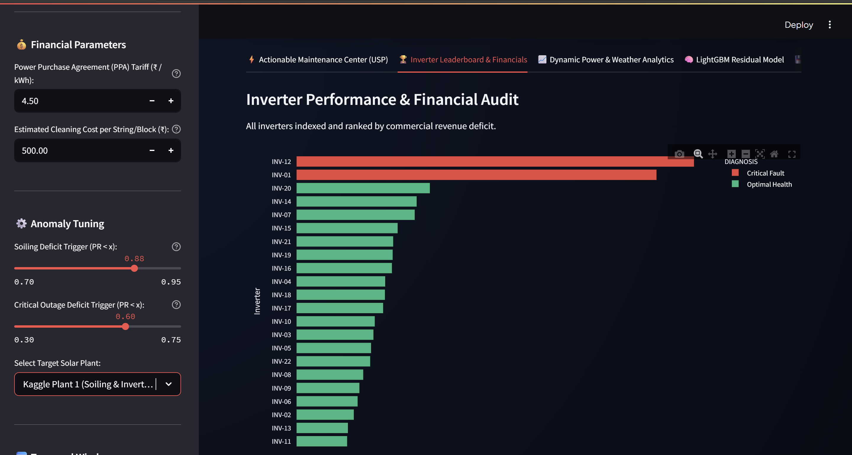
INVERTER REVENUE LOSS LEADERBOARD

Slide 12
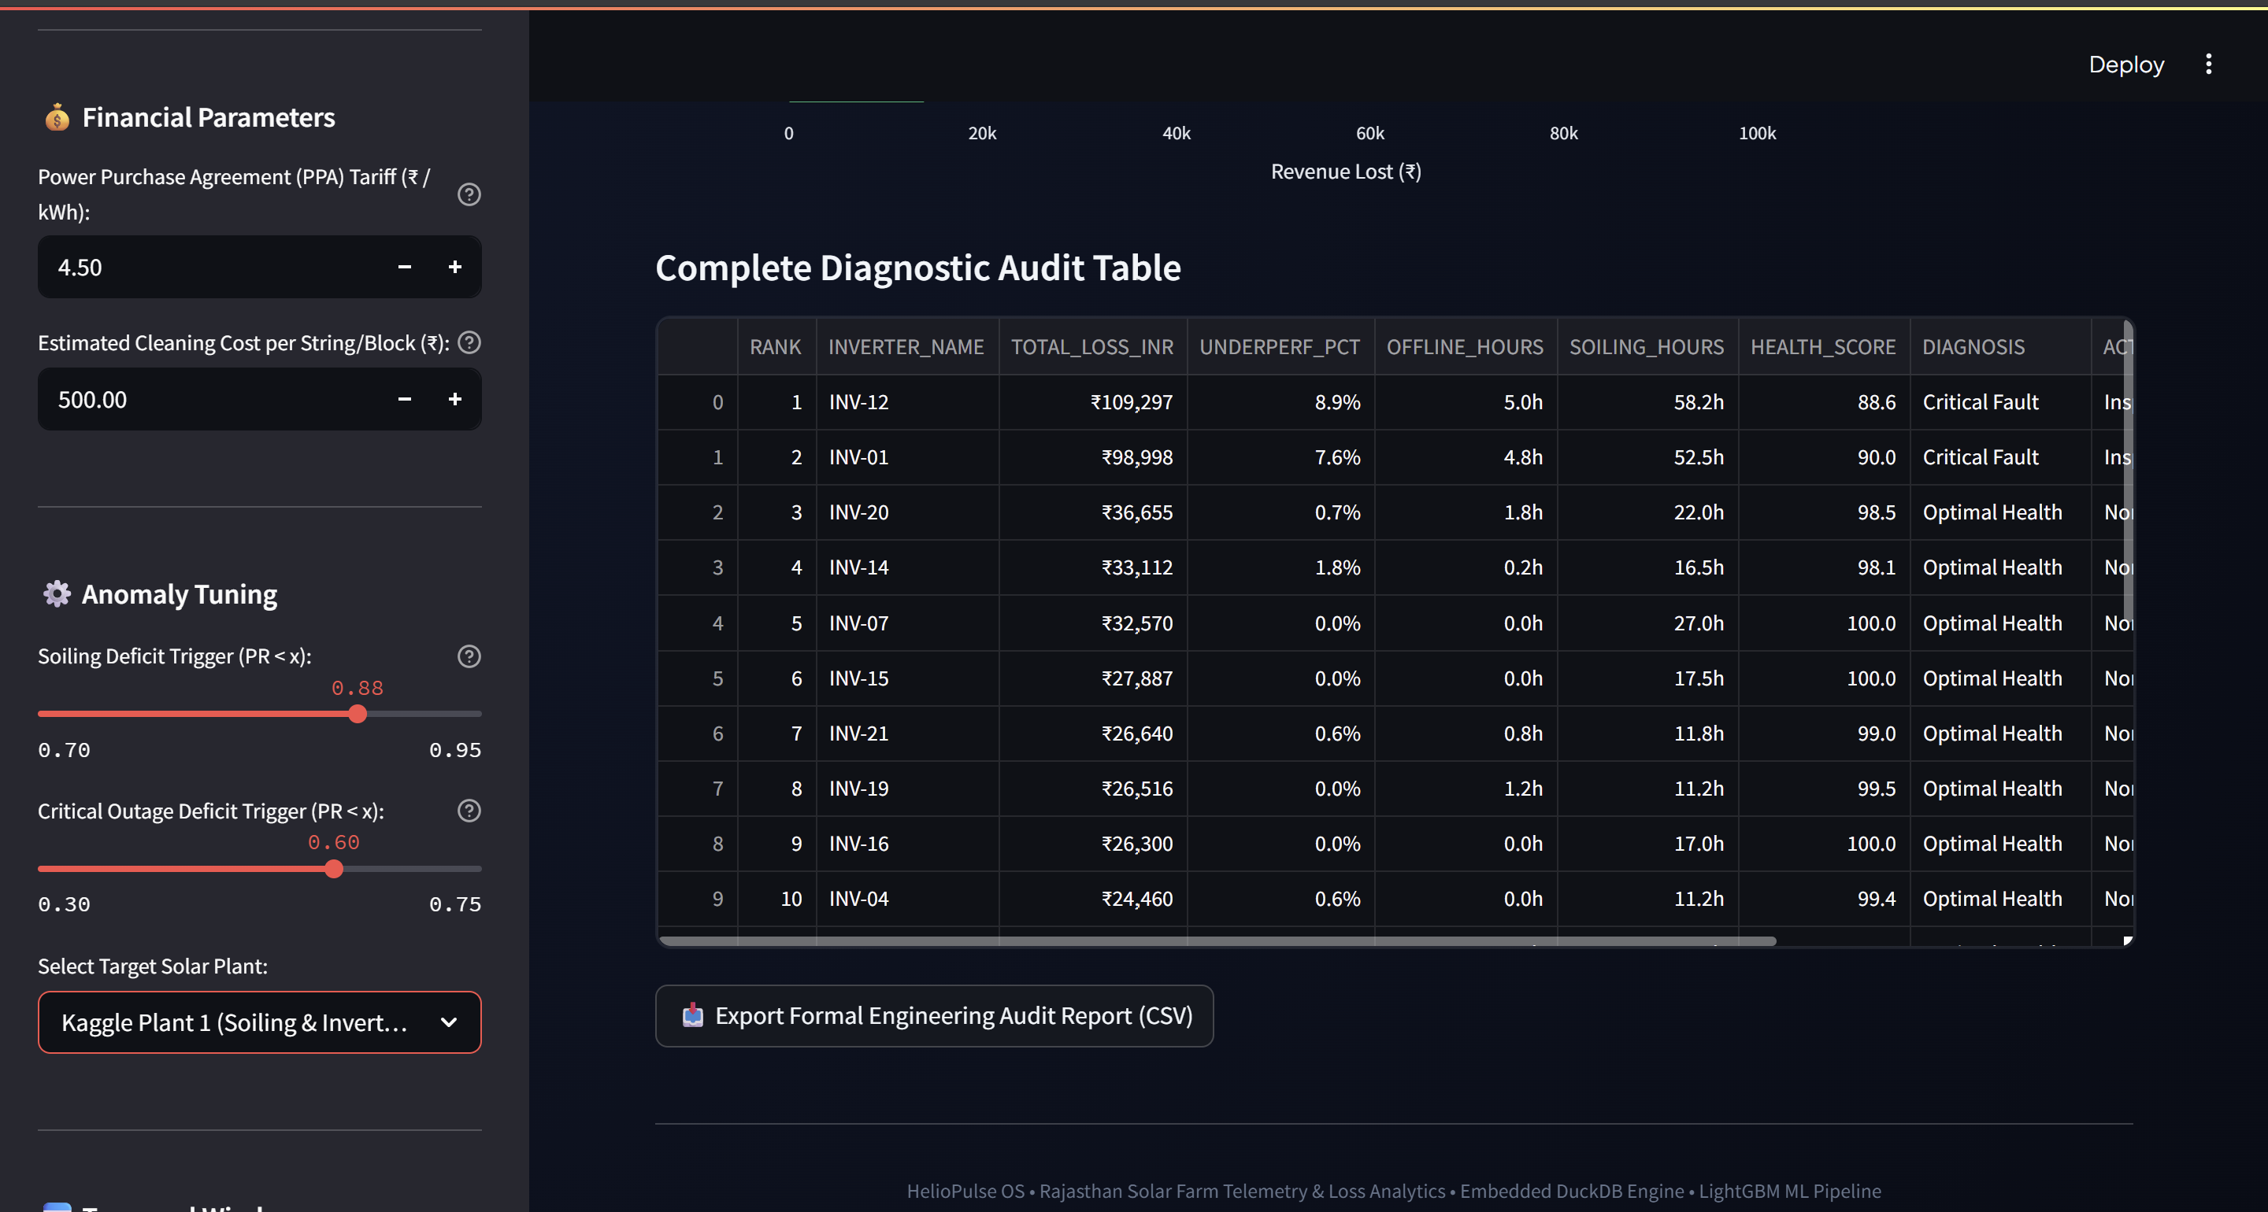
DIAGNOSTIC AUDIT & SCORECARD TABLE

Slide 13
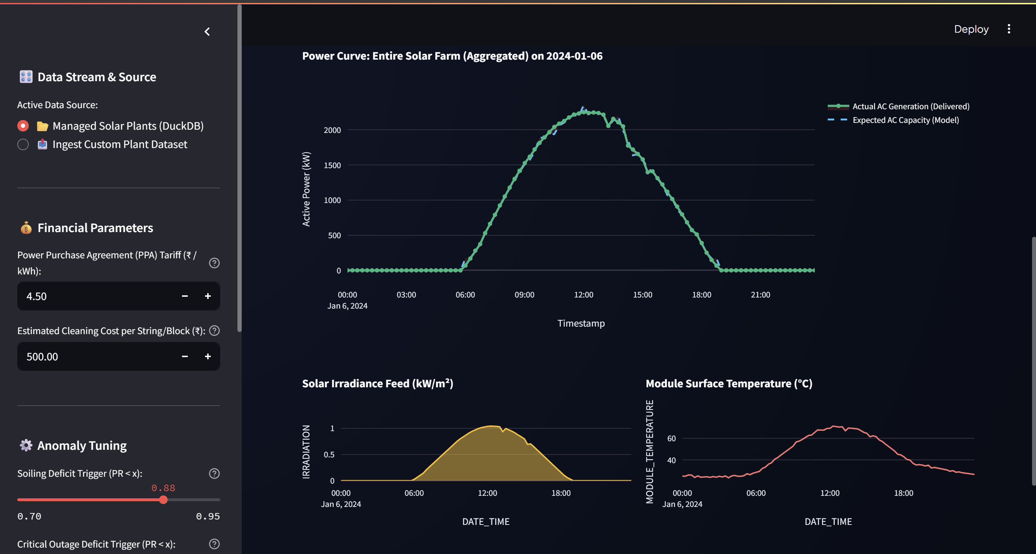
DYNAMIC 15-MIN GENERATION VS EXPECTED CURVES

Slide 14
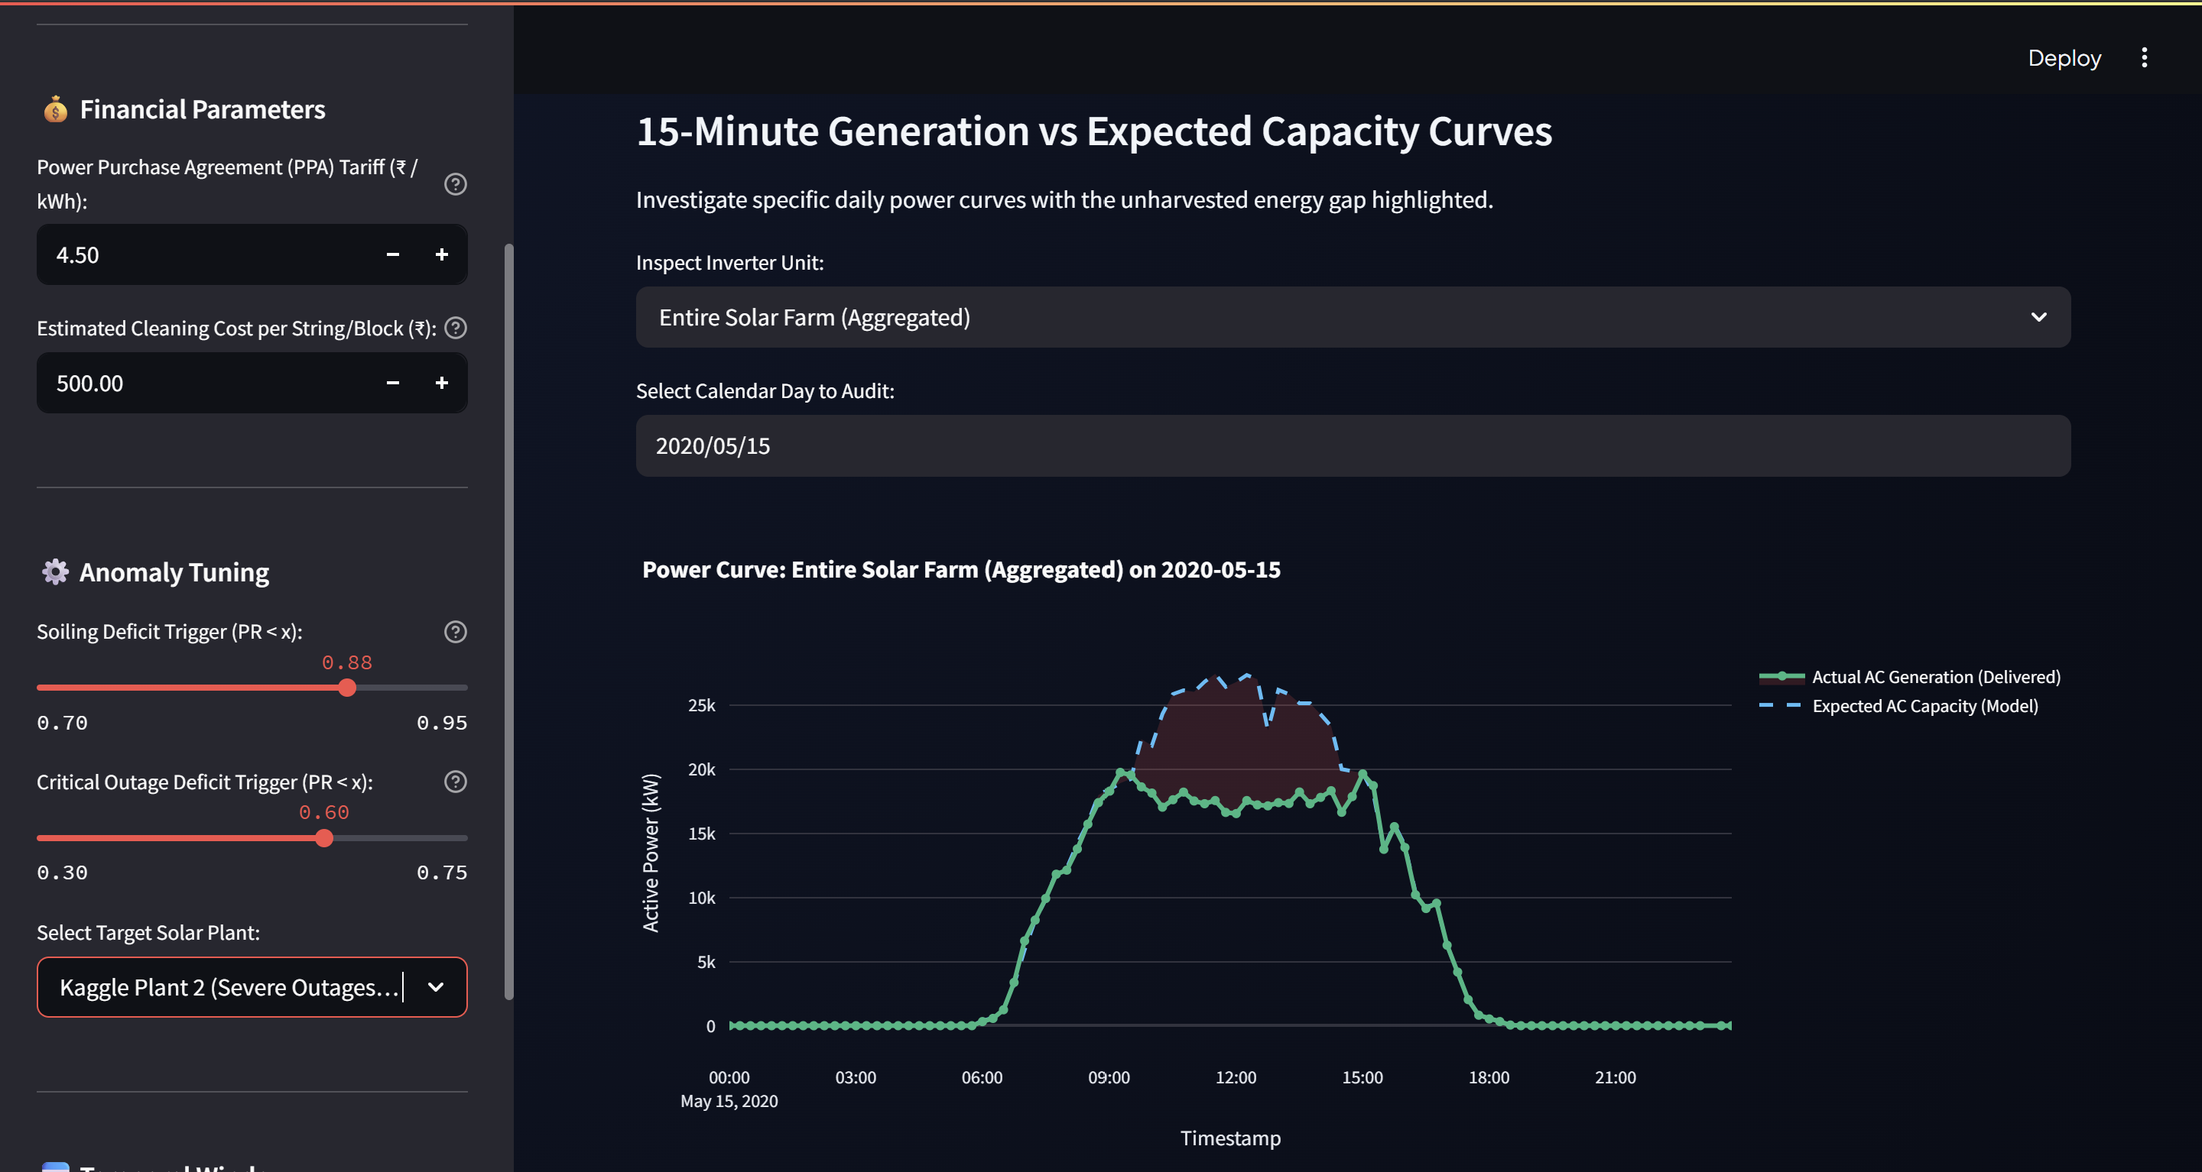
METEOROLOGICAL SENSOR TELEMETRY

Slide 15
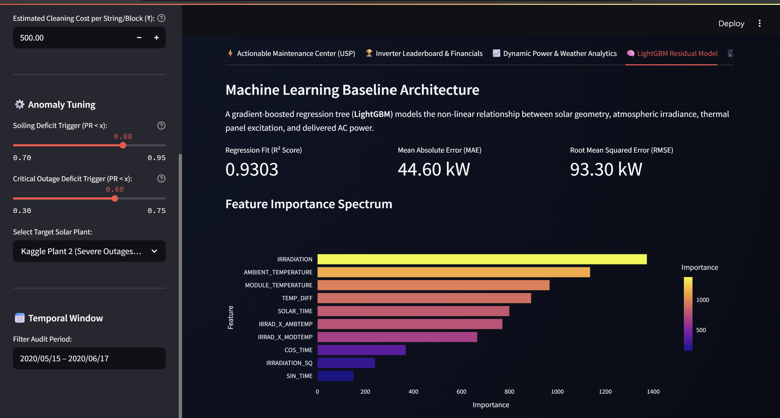
LIGHTGBM REGRESSION & FEATURE IMPORTANCE

Slide 16
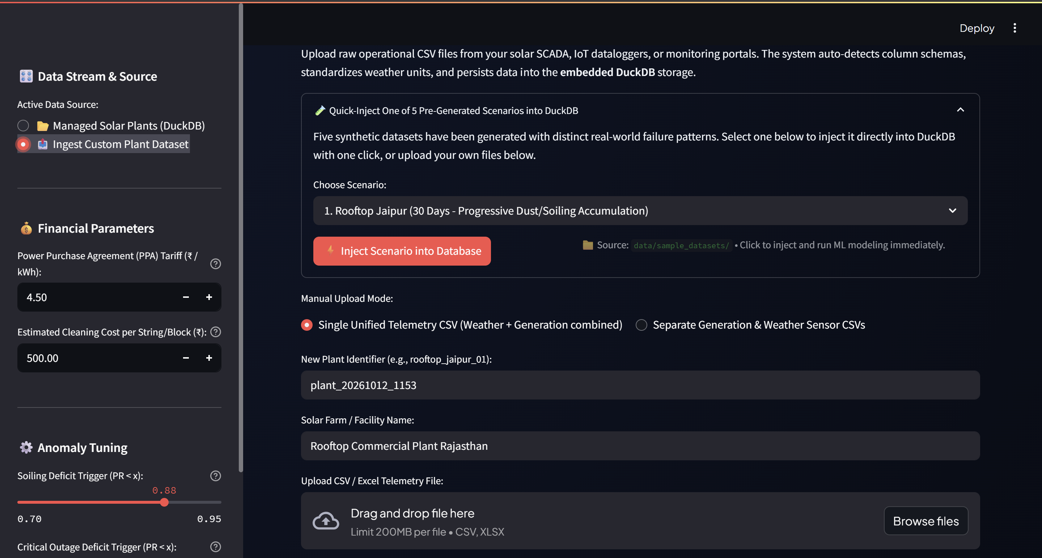
CUSTOM DATASET INGESTION HUB

Slide 17
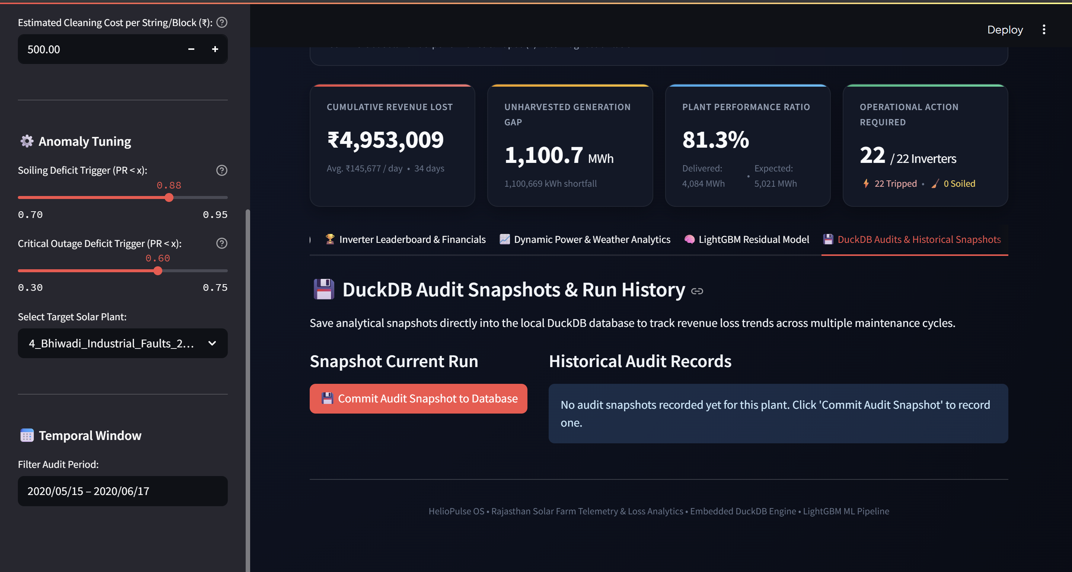
EMBEDDED DUCKDB DATABASE PERSISTENCE

Slide 18
Future Scope
1. Drone Thermography & Aerial RGB Imagery: Integration with computer-vision thermal imaging for automated panel crack, diode bypass, and hotspot localization.
2. Day-Ahead Weather & Generation Forecasting: Live integration with Open-Meteo and solar irradiance APIs to forecast tomorrow's generation and expected grid revenue.
3. Automated Cleaning Schedule Optimization: Dynamic optimization models solving for the exact day when accumulated soiling loss exceeds washing cost.
4. Deep Learning Time-Series Models: LSTM and Temporal Fusion Transformers (TFT) for tracking multi-quarter seasonal dust and monsoon wash cycles.
5. Mobile Field Dispatch Integration: Automated work-order generation with instant WhatsApp and SMS alerts for on-site technician dispatch.
SKIT, JAIPUR www.skit.ac.in

Slide 19
Q & A
SKIT, JAIPUR www.skit.ac.in

Slide 20
Thank You
SKIT, JAIPUR www.skit.ac.in

