Slide 1
Fixing Patient-Flow Bottlenecks at Apollo Hospitals
A department-by-department SQL analysis of waiting times, bed utilisation, readmissions and length of stay
SQL Data Analyst project · MySQL 8 · 4 hospitals · 20 departments · 2,500 admissions · 7,300 bed-day records

Slide 2
The problem: patients get stuck in the system
PROBLEM STATEMENT
Apollo Hospitals wants to fix bottlenecks in how patients move through its hospitals: long waits, beds that stay full for too long, and patients getting readmitted.
I was brought in as a SQL Data Analyst to dig into the operational database and find what is actually going wrong, department by department.
4
20
hospitals
departments
2,500
7,300
admissions
bed-day records
HOW THIS ANALYSIS IS ORGANISED
1 EXPLORE
Q1: tables, keys and how they connect
2 MEASURE
Q2–Q7: volume, waits, length of stay, readmissions
3 COMPARE & RANK
Q8–Q14: beds, subqueries, CTEs, rankings, top 5
4 OPTIMISE
Q15: make the slowest query fast
THE GOAL
Turn 15 SQL questions into 8 business insights an operations team can act on.

Slide 3
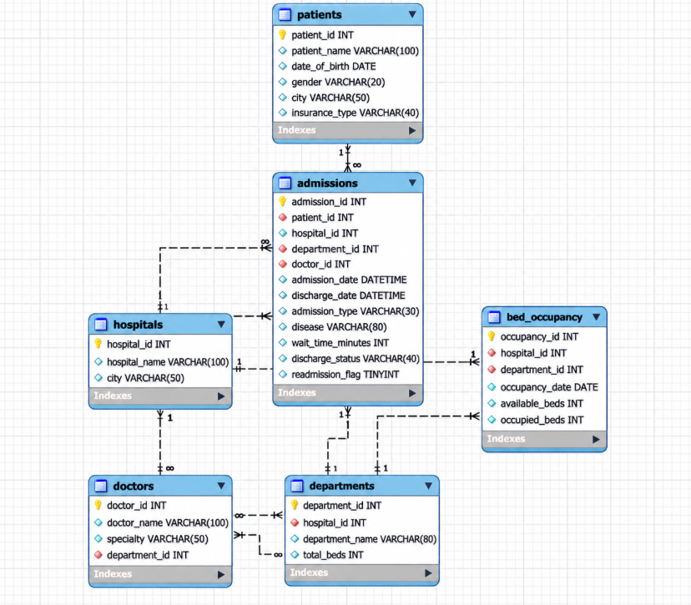
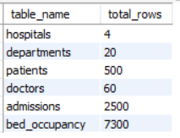
Q1 · Getting to know the database: 6 tables, 8 foreign keys
HOW EVERYTHING CONNECTS
hospitals → departments → doctors: every hospital has 5 departments (20 in total)
admissions is the central table: one row per stay, linked to a patient, hospital, department and doctor
bed_occupancy: one row per department per day (365 × 20 = 7,300 rows)
Watch-out: admissions and bed_occupancy share only department_id, so joining them directly repeats rows (fixed in Q15)
ROW COUNTS (SQL: DESCRIBE each table + UNION ALL COUNT)
TAKEAWAY
Know the keys first, then aggregate big tables separately before joining.

Slide 4
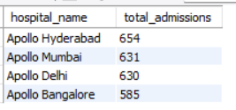
Q2 · Hyderabad is the busiest hospital, but volume is even
PROBLEM
How many admissions has each hospital handled, and which one is busiest?
SQL QUERY
SELECT
h.hospital_name,
COUNT(a.admission_id) AS total_admissions
FROM admissions a
JOIN hospitals h ON a.hospital_id = h.hospital_id
GROUP BY h.hospital_id, h.hospital_name
ORDER BY total_admissions DESC;
APPROACH
JOIN admissions to hospitals, COUNT admissions per hospital, sort from highest to lowest.
KEY RESULT
Hyderabad 654 · Mumbai 631 · Delhi 630 · Bangalore 585.
OUTPUT
TAKEAWAY
Hospital volume is similar, so the bottleneck is inside departments, not at hospital level.

Slide 5
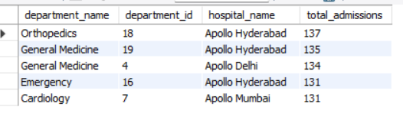
Q3 · Top 5 departments by patient volume
PROBLEM
Total admissions per department, and the top 5 by patient volume.
SQL QUERY
select
d.department_name, d.department_id, h.hospital_name,
count(a.admission_id) as total_admissions
from admissions a
join departments d
on d.department_id = a.department_id
join hospitals h
on h.hospital_id = a.hospital_id
group by d.department_name, d.department_id, h.hospital_name
order by total_admissions desc limit 5;
APPROACH
GROUP BY department_id (not name, because every hospital has the same department names), ORDER BY count DESC, LIMIT 5.
KEY RESULT
Hyderabad Orthopedics 137 · Hyderabad General Medicine 135 · Delhi General Medicine 134 · Mumbai Cardiology 131 · Hyderabad Emergency 131.
OUTPUT
TAKEAWAY
Volume is spread evenly (112 to 137 per department), so volume alone does not explain the bottlenecks.

Slide 6
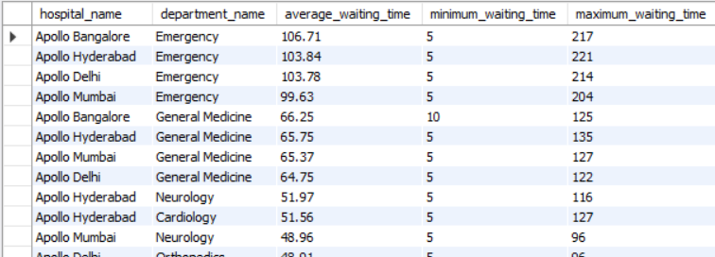
Q4 · Emergency departments keep patients waiting longest
PROBLEM
Average, minimum and maximum wait time per department. Which keeps patients waiting longest on average?
SQL QUERY
select
h.hospital_name,
d.department_name,
ROUND(AVG(a.wait_time_minutes), 2) AS average_waiting_time,
MIN(a.wait_time_minutes) AS minimum_waiting_time,
MAX(a.wait_time_minutes) AS maximum_waiting_time
FROM admissions a
JOIN departments d ON d.department_id = a.department_id
JOIN hospitals h ON h.hospital_id = d.hospital_id
GROUP BY d.department_id, d.department_name, h.hospital_name
ORDER BY average_waiting_time DESC;
APPROACH
AVG, MIN and MAX of wait_time_minutes per department, sorted by the average (the question asks about the average, not the maximum).
KEY RESULT
Bangalore Emergency waits longest: 106.71 min on average. Other Emergency departments: 99.6 to 103.8. General Medicine: about 65.
OUTPUT
TAKEAWAY
All four Emergency departments wait about 100 minutes, far above every other department.

Slide 7
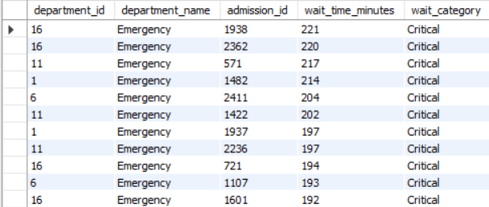
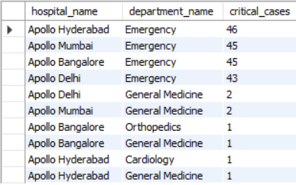
Q5 · Critical waits (120+ min) are almost all in Emergency
PROBLEM
Bucket patients into Low, Moderate, High and Critical wait categories. Which department has the most Critical cases?
QUERY 1 · Bucket every admission (CASE)
QUERY 2 · Count Critical cases per department
select
d.department_id,
d.department_name,
a.admission_id,
a.wait_time_minutes,
case
when wait_time_minutes >= 120 then 'Critical'
when wait_time_minutes >= 60 then 'High'
when wait_time_minutes >= 30 then 'Moderate'
else 'Low'
end as wait_category
from admissions a
join departments d
on d.department_id = a.department_id
order by wait_time_minutes desc;
SELECT
h.hospital_name,
d.department_name,
COUNT(*) AS critical_cases
FROM admissions a
JOIN departments d ON d.department_id = a.department_id
JOIN hospitals h ON h.hospital_id = d.hospital_id
WHERE a.wait_time_minutes >= 120
GROUP BY d.department_id, d.department_name, h.hospital_name
ORDER BY critical_cases DESC;
APPROACH
CASE buckets: Low under 30, Moderate 30–59, High 60–119, Critical 120 or more minutes. Then count Critical cases per department.
KEY RESULT
Low 309 · Moderate 1,045 · High 959 · Critical 187. Most Critical: Hyderabad Emergency (46).
OUTPUT
OUTPUT
TAKEAWAY
179 of the 187 Critical cases sit in the four Emergency departments.

Slide 8
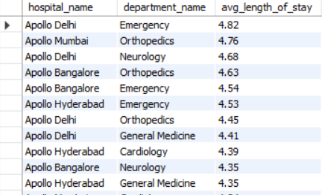
Q6 · Delhi Emergency keeps patients longest (4.82 days)
PROBLEM
Average length of stay per department from admission and discharge dates. Which keeps patients longest?
SQL QUERY
select
h.hospital_name,
d.department_name,
round(avg(datediff(a.discharge_date, a.admission_date)),2) as avg_length_of_stay
from admissions a
join departments d
on d.department_id = a.department_id
join hospitals h
on h.hospital_id = d.hospital_id
group by d.department_name, d.department_id, h.hospital_name
order by avg_length_of_stay desc;
APPROACH
DATEDIFF(discharge_date, admission_date), averaged per department, sorted from longest to shortest.
KEY RESULT
Delhi Emergency 4.82 days · Mumbai Orthopedics 4.76 · Delhi Neurology 4.68. Hospital-wide average: 4.38 days.
OUTPUT
TAKEAWAY
Stays are close across departments; Delhi Emergency leads by a small margin.

Slide 9
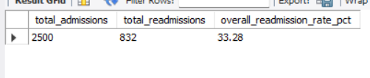
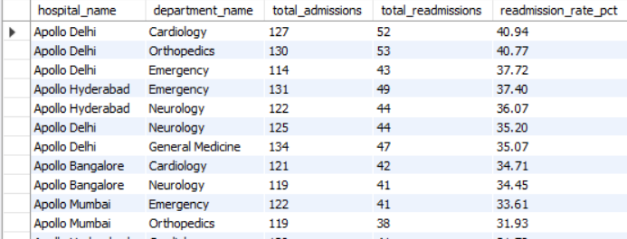
Q7 · One in three admissions is a readmission (33.28%)
PROBLEM
Overall readmission rate, and how it compares department to department.
QUERY 1 · Overall hospital readmission rate
QUERY 2 · Comparing department by department
COUNT(*) AS total_admissions,
SUM(readmission_flag) AS total_readmissions,
ROUND(100 * SUM(readmission_flag) / COUNT(*), 2) AS overall_readmission_rate_pct
FROM admissions;
SELECT
h.hospital_name,
d.department_name,
COUNT(*) AS total_admissions,
SUM(a.readmission_flag) AS total_readmissions,
ROUND(100 * SUM(a.readmission_flag) / COUNT(*), 2) AS readmission_rate_pct
FROM admissions a
JOIN departments d ON d.department_id = a.department_id
JOIN hospitals h ON h.hospital_id = a.hospital_id
GROUP BY d.department_id, d.department_name, h.hospital_name
ORDER BY readmission_rate_pct DESC;
APPROACH
Rate = SUM(readmission_flag) / COUNT(*) × 100, overall and then per department.
KEY RESULT
Overall 33.28% (832 of 2,500). Highest: Delhi Cardiology 40.94%. Lowest: Bangalore General Medicine 27.35%.
OUTPUT
OUTPUT
TAKEAWAY
A 13-point gap between the best and worst department shows readmissions can be reduced.

Slide 10
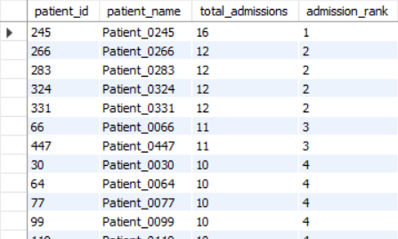
Q8 · Repeat patients: 482 of 498 were admitted more than once
PROBLEM
Find patients admitted more than once and rank them by total admissions.
SQL QUERY
SELECT
p.patient_id,
p.patient_name,
COUNT(a.admission_id) AS total_admissions,
DENSE_RANK() OVER (ORDER BY COUNT(a.admission_id) DESC) AS admission_rank
FROM admissions a
JOIN patients p ON p.patient_id = a.patient_id
GROUP BY p.patient_id, p.patient_name
HAVING COUNT(a.admission_id) > 1
ORDER BY admission_rank, p.patient_id
APPROACH
COUNT admissions per patient, HAVING count > 1, DENSE_RANK() so tied patients share a rank.
KEY RESULT
482 of 498 patients came back at least once. Patient 245 has 16 admissions; next highest is 12.
OUTPUT
TAKEAWAY
Coming back is the norm: a small group of frequent patients drives a lot of volume.

Slide 11
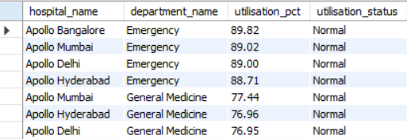
Q9 · Emergency beds run just under the 90% line
PROBLEM
Bed utilisation % per department. Flag anything above 90% as Critical.
SQL QUERY
select
h.hospital_name,
d.department_name,
round(100 * SUM(b.occupied_beds) / SUM(b.available_beds), 2) as utilisation_pct,
case
when 100 * SUM(b.occupied_beds) / SUM(b.available_beds) > 90 then 'Critical'
else 'Normal'
end as utilisation_status
from bed_occupancy b
join departments d
on d.department_id = b.department_id
join hospitals h
on h.hospital_id = b.hospital_id
group by d.department_name,d.department_id, h.hospital_name
order by utilisation_pct desc;
APPROACH
SUM(occupied) / SUM(available) × 100 per department over the year, with a CASE flag for above 90%.
KEY RESULT
No department averages above 90%. Emergency is at 88.7 to 89.8% (Bangalore 89.82%); General Medicine about 77%; others 66 to 68%.
OUTPUT
TAKEAWAY
Emergency has no buffer: it crosses 90% on 167 to 190 of 365 days.

Slide 12
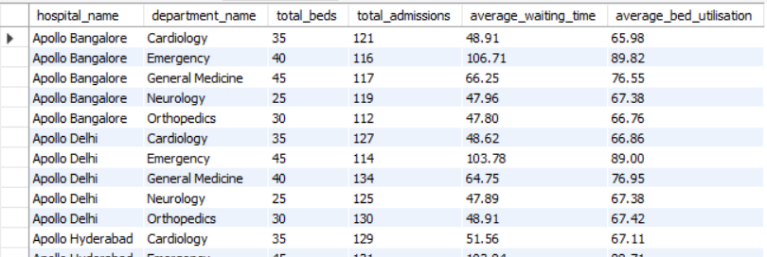
Q10 · Department report: volume, waiting and beds together
PROBLEM
Build a department-level report with hospital, department, total beds, admissions, average wait and bed utilisation, using multi-table JOINs.
SQL QUERY
SELECT
h.hospital_name,
d.department_name,
d.total_beds,
COUNT(DISTINCT a.admission_id) AS total_admissions,
ROUND(AVG(a.wait_time_minutes), 2) AS average_waiting_time,
ROUND(100 * SUM(b.occupied_beds) / SUM(b.available_beds), 2) AS average_bed_utilisation
FROM admissions a
JOIN departments d ON d.department_id = a.department_id
JOIN hospitals h ON h.hospital_id = a.hospital_id
JOIN bed_occupancy b ON b.department_id = a.department_id
GROUP BY d.department_id, h.hospital_name, d.department_name, d.total_beds
ORDER BY h.hospital_name, d.department_name;
APPROACH
JOIN admissions, departments, hospitals and bed_occupancy. COUNT(DISTINCT) is needed because the bed join repeats every admission.
KEY RESULT
20-row report. Example: Delhi Emergency has 45 beds, 114 admissions, 103.78 min wait and 89.00% utilisation.
OUTPUT
TAKEAWAY
One table puts volume, waiting and capacity side by side for each department.

Slide 13
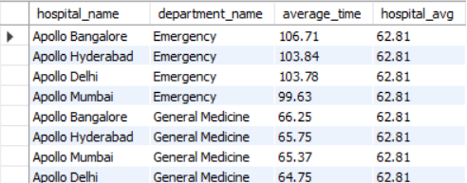
Q11 · 8 departments wait longer than the hospital-wide average
PROBLEM
Which departments have an average wait time higher than the hospital-wide average? Use a subquery.
SQL QUERY
SELECT
h.hospital_name,
d.department_name,
ROUND(AVG(a.wait_time_minutes), 2) AS average_time,
(SELECT ROUND(AVG(wait_time_minutes), 2) FROM admissions) AS hospital_avg
FROM admissions a
JOIN departments d ON d.department_id = a.department_id
JOIN hospitals h ON h.hospital_id = a.hospital_id
GROUP BY d.department_id, d.department_name, h.hospital_name
HAVING AVG(a.wait_time_minutes) > (
SELECT AVG(wait_time_minutes) FROM admissions
)
ORDER BY average_time DESC;
APPROACH
A subquery returns the hospital-wide average (62.81 min); HAVING keeps only departments above it.
KEY RESULT
8 departments: all 4 Emergency (99.6 to 106.7 min) and all 4 General Medicine (64.8 to 66.3 min).
OUTPUT
TAKEAWAY
Emergency is far above average; General Medicine is only just above it.

Slide 14
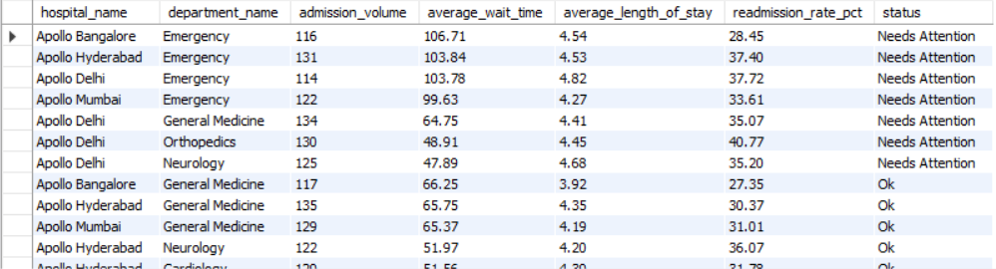
Q12 · CTE flags 7 departments that need attention
PROBLEM
Build a CTE with volume, wait, length of stay and readmission rate per department, and flag which need attention.
SQL QUERY
with department_stats as (
select
h.hospital_name,
d.department_name,
count(a.admission_id) as admission_volume,
round(avg(a.wait_time_minutes),2) as average_wait_time,
round(avg(datediff(a.discharge_date, a.admission_date)),2) as average_length_of_stay,
ROUND(100 * SUM(a.readmission_flag) / COUNT(a.admission_id), 2) as readmission_rate_pct
from admissions a
join departments d on d.department_id = a.department_id
join hospitals h on h.hospital_id = a.hospital_id
group by h.hospital_id, h.hospital_name ,d.department_id, d.department_name
)
select
*,
case
when (average_wait_time > (select AVG(wait_time_minutes) FROM admissions))
+ ( readmission_rate_pct >(select 100 * SUM(readmission_flag) / COUNT(*) FROM admissions))
+ ( average_length_of_stay >(select avg(datediff(discharge_date, admission_date)) from admissions))
>=2
then 'Needs Attention'
else 'Ok'
end as status
from department_stats
order by status, average_wait_time desc;
APPROACH
CTE department_stats holds the 4 measures. Flag = worse than the hospital-wide average on at least 2 of 3 measures (wait, stay, readmission).
KEY RESULT
7 flagged: all 4 Emergency, plus Delhi General Medicine, Delhi Orthopedics and Delhi Neurology.
OUTPUT
TAKEAWAY
Delhi has 4 of the 7 flagged departments.

Slide 15
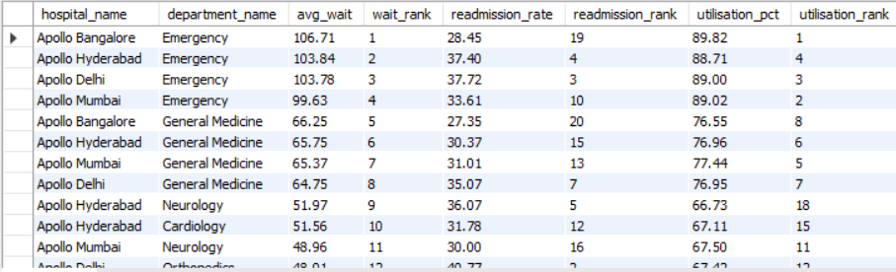
Q13 · Ranking departments: the worst one differs by measure
PROBLEM
Rank departments on wait time, readmission rate and bed utilisation.
SQL QUERY
with admission_stats as(
select department_id,
round(avg(wait_time_minutes),2) as avg_wait,
ROUND(100 * SUM(readmission_flag) / COUNT(*), 2) AS readmission_rate
from admissions
group by department_id
),
bed_stats as(
select department_id ,
round(100 * SUM(occupied_beds) / SUM(available_beds), 2) as utilisation_pct
from bed_occupancy
group by department_id
)
select
h.hospital_name,
d.department_name,
s.avg_wait,
dense_rank() over(order by s.avg_wait desc ) as wait_rank,
s.readmission_rate,
dense_rank() over(order by s.readmission_rate desc) as readmission_rank,
b.utilisation_pct,
dense_rank() over(order by b.utilisation_pct desc) as utilisation_rank
from departments d
join hospitals h on h.hospital_id = d.hospital_id
join admission_stats s on s.department_id = d.department_id
join bed_stats b on b.department_id = d.department_id
order by wait_rank, readmission_rank, utilisation_rank;
APPROACH
DENSE_RANK() OVER (ORDER BY measure DESC) for each measure, so rank 1 is the worst and ties share a rank. Two CTEs keep the big tables apart.
KEY RESULT
Bangalore Emergency: rank 1 on wait and on utilisation, but rank 19 on readmissions. Delhi Cardiology: rank 1 on readmissions.
OUTPUT
TAKEAWAY
The worst department is different for each measure, so one hospital-wide fix will not work.

Slide 16
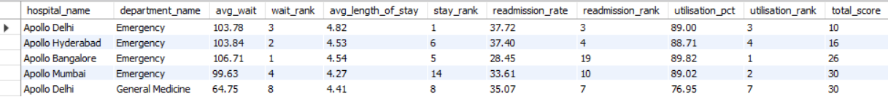
Q14 · Top 5 departments with the worst overall patient flow
PROBLEM
Combine wait time, length of stay, readmission rate and bed utilisation into one query that surfaces the top 5 worst departments.
SQL QUERY
with admission_stats as (
select department_id,
round(avg(wait_time_minutes),2) as avg_wait,
round(avg(datediff(discharge_date, admission_date)),2) as avg_length_of_stay,
round(100 * SUM(readmission_flag) / COUNT(*), 2) AS readmission_rate
from admissions
group by department_id
),
bed_stats as(
select
department_id,
round(100 * SUM(occupied_beds) / SUM(available_beds), 2) as utilisation_pct
from bed_occupancy
group by department_id
),
ranked as (
select
h.hospital_name,
d.department_name,
s.avg_wait,
dense_rank() over(order by s.avg_wait desc) as wait_rank,
s.avg_length_of_stay,
dense_rank() over(order by s.avg_length_of_stay desc ) as stay_rank,
s.readmission_rate,
dense_rank() over(order by s.readmission_rate desc ) as readmission_rank,
b.utilisation_pct,
dense_rank() over(order by b.utilisation_pct desc ) as utilisation_rank
from departments d
join hospitals h on h.hospital_id = d.hospital_id
join admission_stats s on s.department_id = d.department_id
join bed_stats b on b.department_id = d.department_id
)
select
*,
(wait_rank + stay_rank + readmission_rank + utilisation_rank) as total_score
from ranked
order by total_score
limit 5;
APPROACH
Rank all 4 measures (1 = worst), add them into total_score, sort ascending (lowest total = worst) and take the top 5.
KEY RESULT
Delhi Emergency 10 · Hyderabad Emergency 16 · Bangalore Emergency 26 · Delhi General Medicine 30 · Mumbai Emergency 30.
OUTPUT
TAKEAWAY
Delhi Emergency is the clear number one priority: top 3 on three measures and first on length of stay.

Slide 17
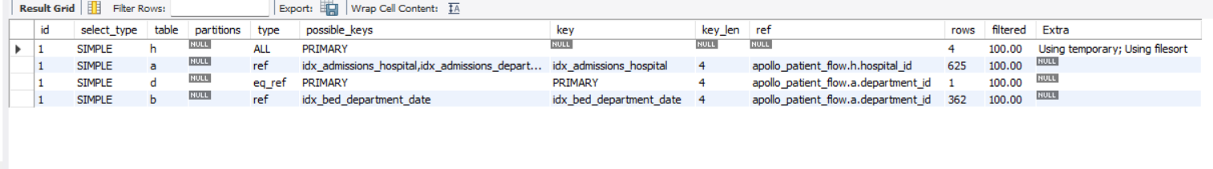
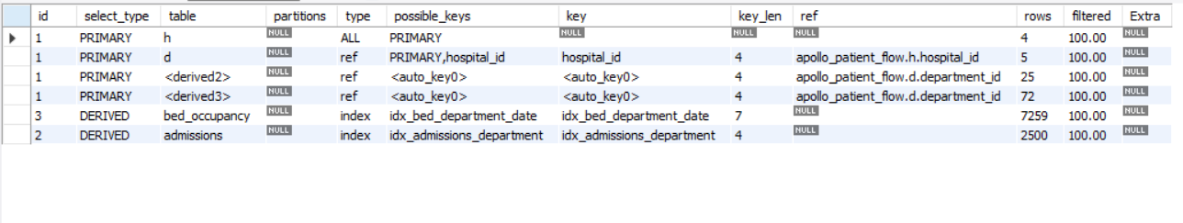
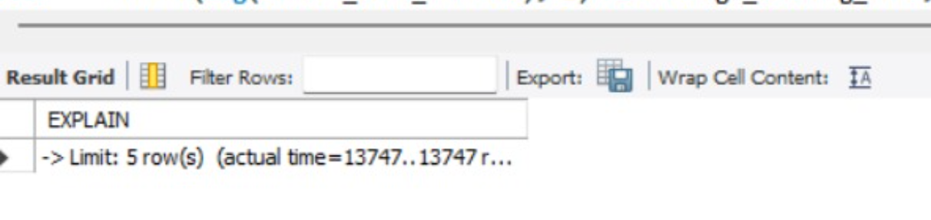
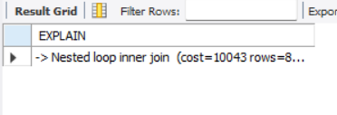
Q15 · Query optimisation: from ~905,000 joined rows to 20
BEFORE: the Q10 query joins admissions to bed_occupancy directly
AFTER: summarise each table first, then join 20-row results
Every admission is paired with ~362 bed-day rows: 4 × 625 × 1 × 362 ≈ 905,000 rows
Plan shows Using temporary; Using filesort
COUNT(DISTINCT) is needed to undo the repeated rows
EXPLAIN ANALYZE: 13,747 ms (13.7 s) for 20 result rows
Each big table is read once (2,500 and 7,259 rows) inside a CTE
Joins use 20-row summaries: no temporary table or filesort
Plain COUNT(*), identical results (2,500 admissions, same averages)
Indexes were not the problem (every join already used one); the shape of the query was
Metric | Before | After
Rows from bed_occupancy | ≈ 905,000 (362 per admission) | 7,259, read once
Temporary table + filesort | Yes | No
COUNT(DISTINCT) needed | Yes | No
Lesson: reduce the data first, then join.

Slide 18
Business insights 1–4: wait time, beds and readmissions
INSIGHT 1 · WAIT TIME
INSIGHT 2 · BED UTILISATION
FINDING
Emergency is the waiting-time bottleneck.
EVIDENCE
ER average wait is 99.6 to 106.7 min vs 62.8 hospital-wide; 179 of 187 Critical waits (120+ min) are in Emergency.
BUSINESS IMPACT & ACTION
Add a fast-track triage lane and peak-hour ER staffing. Track the % of ER patients waiting over 120 min.
FINDING
Emergency beds have no surge buffer.
EVIDENCE
ER utilisation is 88.7 to 89.8% for the year and above 90% on 167 to 190 of 365 days.
BUSINESS IMPACT & ACTION
Any spike becomes boarding and longer waits. Set a surge-bed / overflow protocol that triggers at 85% occupancy.
INSIGHT 3 · CAPACITY IMBALANCE
INSIGHT 4 · READMISSIONS
FINDING
Capacity is used unevenly.
EVIDENCE
Cardiology, Neurology and Orthopedics run at 66 to 68% and General Medicine about 77%, vs about 89% in Emergency.
BUSINESS IMPACT & ACTION
Beds sit idle elsewhere while ER is full. Agree flexible beds and an ER-to-ward transfer pathway.
FINDING
One in three admissions is a readmission.
EVIDENCE
33.28% overall (832 of 2,500). Delhi Cardiology 40.94% and Delhi Orthopedics 40.77% vs 27.35% in Bangalore General Medicine.
BUSINESS IMPACT & ACTION
Introduce discharge checklists and 7-day follow-up calls, starting with Delhi Cardiology and Orthopedics; copy Bangalore General Medicine practices.

Slide 19
Business insights 5–8: root causes, stay length and patients
INSIGHT 5 · DIFFERENT ROOT CAUSES
INSIGHT 6 · LENGTH OF STAY
FINDING
Waiting and readmissions are separate problems.
EVIDENCE
Bangalore ER has the longest wait (106.7 min) and fullest beds (89.8%) but a low readmission rate (28.45%, rank 19 of 20).
BUSINESS IMPACT & ACTION
Use flow fixes for Emergency and discharge-quality fixes for Cardiology and Orthopedics, not one hospital-wide programme.
FINDING
Delhi Emergency keeps patients longest.
EVIDENCE
4.82 days vs 4.38 hospital-wide (+10%), with 89% bed utilisation and a 103.8 min wait.
BUSINESS IMPACT & ACTION
Long stays tie up scarce ER beds and feed the queue. Run daily discharge-readiness rounds and track average stay.
INSIGHT 7 · DELHI CONCENTRATION
INSIGHT 8 · REPEAT PATIENTS
FINDING
Delhi holds most of the problems.
EVIDENCE
4 of 7 Needs Attention departments are in Delhi; Delhi Emergency scores 10 on the combined ranking (next best 16).
BUSINESS IMPACT & ACTION
Delhi is the best place to pilot the turnaround plan before rolling it out to the other hospitals.
FINDING
Most patients come back.
EVIDENCE
482 of 498 admitted patients had 2 or more admissions; one patient has 16 (next highest 12).
BUSINESS IMPACT & ACTION
A small group of frequent patients drives volume. Set up care-management plans for patients with 5+ admissions.

Slide 20
What the operations team should do next
# | Action | Where first | KPI to track
1 | Fast-track triage lane + peak-hour ER staffing | All 4 Emergency departments (Bangalore and Hyderabad first) | % ER patients waiting over 120 min; ER average wait
2 | Surge-bed / overflow protocol at 85% occupancy | Emergency | Days above 90% utilisation (167 to 190 now)
3 | Flexible beds + ER-to-ward transfer pathway | Cardiology, Neurology, Orthopedics (about 67% used) | Utilisation gap between ER and wards
4 | Discharge checklist + 7-day follow-up call | Delhi Cardiology and Orthopedics | Readmission rate (33.28% baseline)
5 | Daily discharge-readiness rounds | Delhi Emergency | Average length of stay (4.82 days baseline)
6 | Care-management for frequent patients (5+ admissions) | All hospitals | Share of repeat admissions
NEXT STEP
Pilot the full package at Delhi Emergency (worst combined score), track the KPIs for a quarter, then roll out to the other hospitals. Thank you.

