Slide 1
IoT-Based Air Quality and Pollution Monitoring Dashboard
Dharshini R
B.E. Computer Science and Engineering
PSNA College of Engineering and Technology

Slide 2
Project Overview
IoT-based environmental monitoring system
ESP32, DHT22 and simulated MQ135
Real-time monitoring
ThingSpeak cloud integration

Slide 3
Problem Statement
High cost of traditional monitoring systems
Need for affordable real-time monitoring
Cloud-based data visualization

Slide 4
Objectives
Monitor temperature and humidity
Classify air quality
Generate alerts
Upload data to cloud

Slide 5
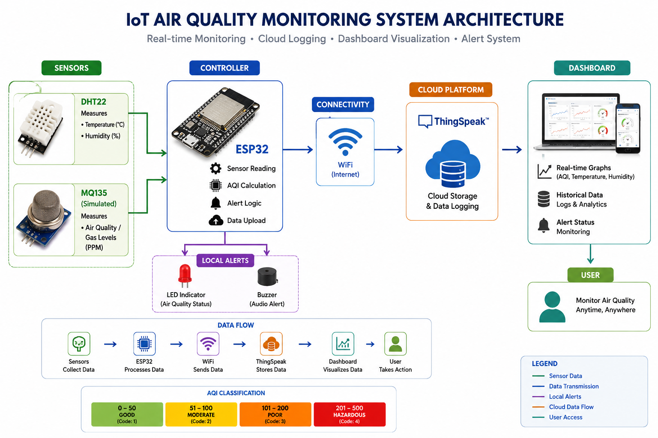
System Architecture
Sensing Layer → Processing Layer → Communication Layer → Cloud Analytics Layer

Slide 6
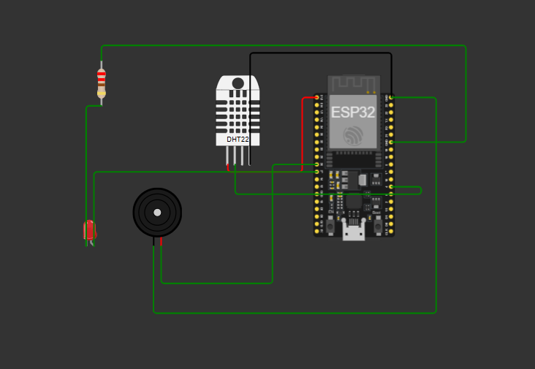
Hardware & Software Components
ESP32, DHT22, MQ135 (simulated), LED, Buzzer
Arduino IDE, Wokwi, ThingSpeak, GitHub

Slide 7
Methodology
Acquire Data → Process → Classify → Alert → Upload → Visualize

Slide 8
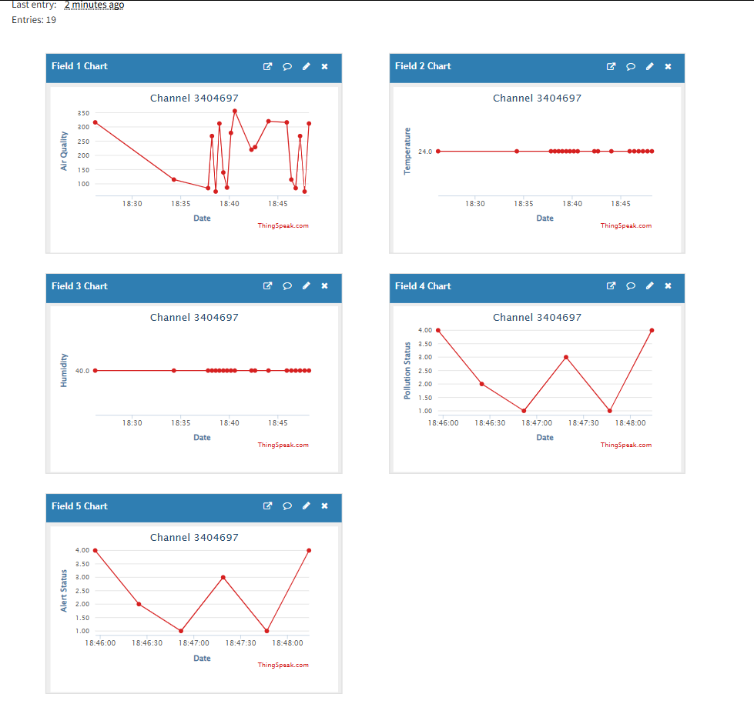
ThingSpeak Dashboard & Results
Real-time charts, historical analytics, CSV export and alert monitoring

Slide 9
Applications & Future Enhancements
Smart Cities, Industry, Research
ML Prediction, Mobile App, SMS/Email Alerts

Slide 10
Placement Relevance
ESP32 Programming
IoT Architecture
Cloud Integration
Dashboard Development

Slide 11
GitHub Repository
IoT-Air-Quality-Monitoring-Dashboard
Code, datasets, documentation and screenshots

Slide 12
Conclusion & Thank You
Complete end-to-end IoT monitoring solution.
Thank You

