Slide 1


School of Computer Science and Engineering
Department of Computer Science and Engineering
Web-Based Chess Game with AI Bot
Submitted By:
Dhruv Singh
2427030595
Supervised By:
Harshika Mathur

Slide 2
Project Overview
01
02
Introduction
Literature Review
Background on chess engines and web-based platforms
Classical algorithms and existing platforms
03
04
Problem Statement
Objectives
Core challenge and objectives
Implementation goals
05
06
Methodology
Results
Technologies and implementation approach
Current achievements and outcomes
07
08
Future Scope
References
Deep learning integration plans
Sources and documentation
Notes:
2

Slide 3

Introduction
What is a Chess Engine?
A chess engine is specialized software that calculates and evaluates chess moves. It uses algorithms to analyze the board, simulate future positions, and select optimal moves based on evaluation functions.
Why AI in Strategic Games?
AI transforms how we learn and play chess, offering opponents across all skill levels. These systems validate algorithms and push the boundaries of what computers can achieve in strategic thinking.
Project Overview
This project delivers a complete web-based chess platform featuring an intelligent AI opponent. The system validates moves, detects checks and checkmates, and manages game states while providing a foundation for future deep learning enhancements.
Notes:
3

Slide 4
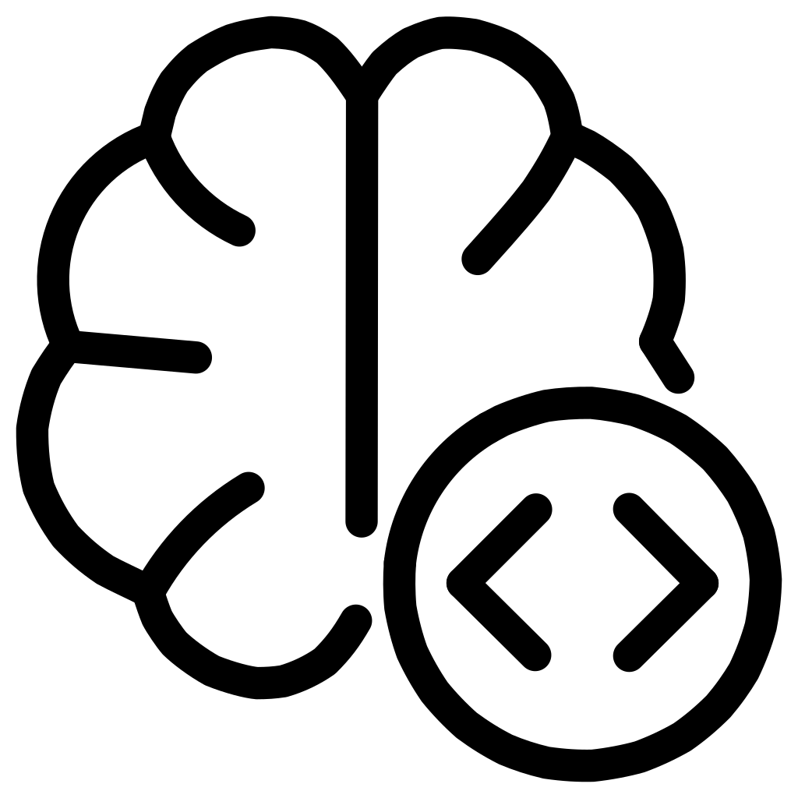


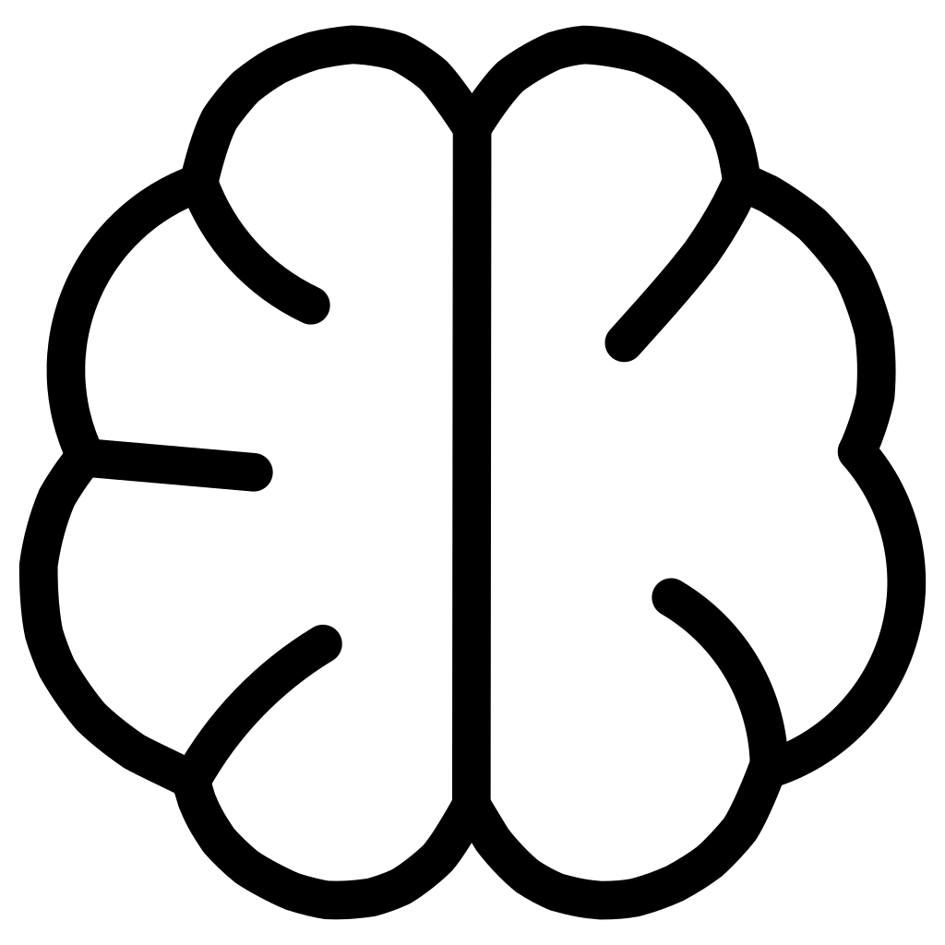
Literature Review
Classical Algorithms
Rule-Based vs ML
Minimax explores all possible moves recursively, assuming optimal opponent play. Alpha-Beta Pruning improves efficiency by eliminating branches that won't influence the decision, significantly reducing computation time.
Rule-based systems use hand-coded evaluation functions with material values and positional rules. Machine learning approaches learn evaluation patterns from games data, improving through training and experience.
Existing Platforms
Future Potential
Platforms like Lichess and Chess.com provide extensive databases, tutorials, and opponents. They use established chess engines (Stockfish, Komodo) combined with scalable infrastructure for millions of users.
Deep learning can process board positions as tensors, learning evaluation functions from game databases rather than manual coding. Neural networks have shown remarkable improvement in engines like AlphaZero.
Notes:
4

Slide 5
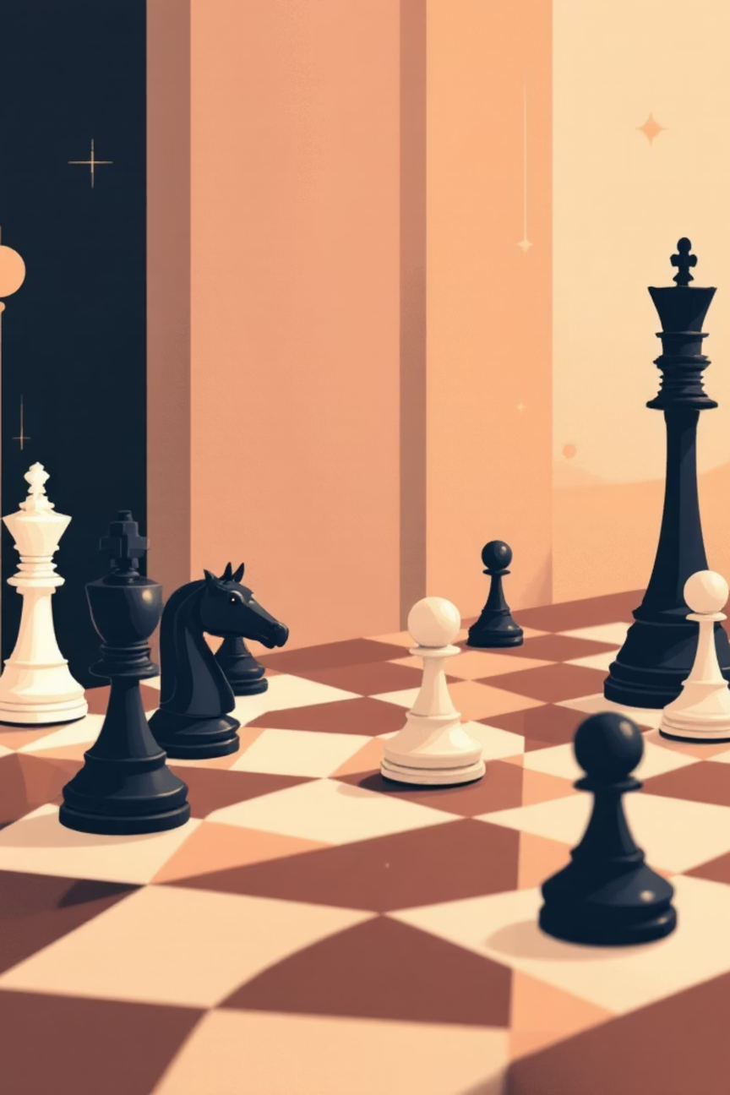
Problem Statement
Develop a web-based chess application with an intelligent AI bot, with deep learning enhancement.
Notes:
5

Slide 6
Project Objectives
1
2
Build Web Chess Platform
Implement AI Engine
Develop complete front-end interface using HTML/CSS for rendering chess boards and capturing user moves
Code Minimax algorithm with Alpha-Beta pruning for intelligent move generation and game analysis
3
4
Validate Game Rules
Prepare for Deep Learning
Ensure correct implementation of chess rules including legal move validation, check detection, and game state management
Structure codebase to support future neural network implementation using Lichess database for training
Notes:
6

Slide 7
Proposed Methodology
Frontend Layer
HTML/CSS structure and styling for rendering the chess board, pieces, and user interface
Backend Layer
Flask handles HTTP requests, game state persistence, and API endpoints for move
processing
Chess Logic
python-chess library manages move generation, validation, and game state tracking
Move Validation
Ensures all moves follow chess rules and updates game state for checks and captures
AI Decision Engine
Evaluation function scores positions, Minimax selects optimal moves through recursive
tree search
Notes:
7

Slide 8
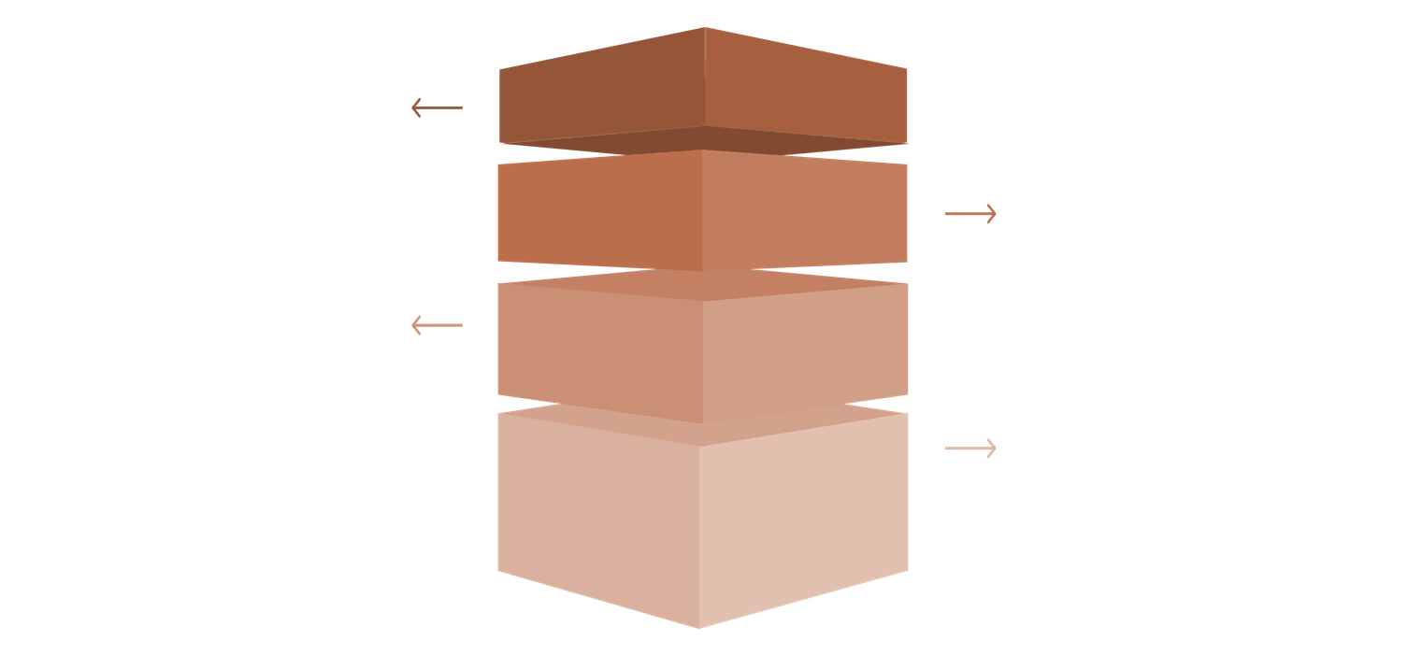
AI Working & Future Scope
Current Implementation
Future Deep Learning Plans
  Generates all legal moves from current position
  Evaluates positions using material and positional factors
  Minimax selects best move through recursive tree search
  Train neural network using Lichess database with millions of games
  Convert board states to tensor representations for neural networks
  Implement neural evaluation function instead of hand-coded heuristics
  Improve performance and accuracy beyond classical algorithms
Minimax Tree Visualization
Root Node
Current position, begin recursive search.
Level 1
Three child moves generated and evaluated.
Level 2
Two leaf positions per child with scores.
Evaluation
Leaf scores propagated via minimax recursion.
Notes:
8

Slide 9
Results & Outcome
Current Achievements
  Working web chess application deployed
  AI bot functions correctly with game rules
  Complete legal move validation
  Check and checkmate detection implemented
  Codebase on GitHub with documentation
  Flask backend handling game states
Next Goals
  Deep learning neural network integration
  Research paper drafting for publication
  Partial deployment on cloud infrastructure
  Performance testing and analysis
  Strengthen codebase for production use
Notes:
9

Slide 10
References
Flask Documentation
python-chess Documentation
Flask documentation for web application framework and Flask-API extension
python-chess library documentation for move generation and game state management
Lichess Open Database
Research Papers
Lichess database for game data and chess positions
Research papers on Minimax algorithms, Alpha-Beta pruning, and deep learning approaches for chess AI
Acknowledgements
Special thanks to my guide and department for their support and guidance throughout this project.
Notes:
10

Slide 11
Thank You

