Slide 1


Carpe diem Maxim Danilov
2023
D.I. mag. Maxim Danilov, wP soft Gmbh. maxim@wpsoft.at @danilovmy

Slide 2
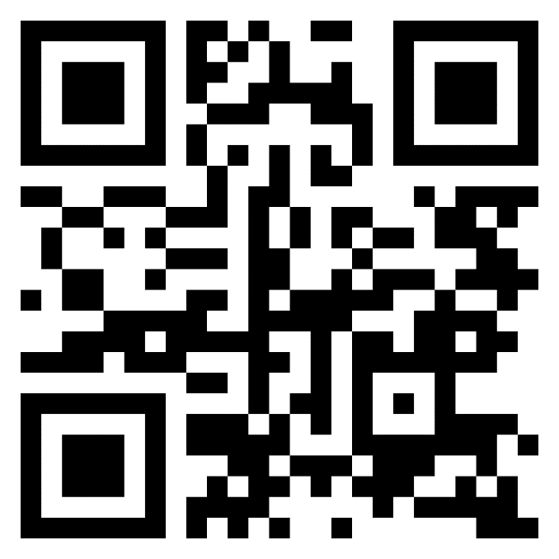
Who I Am
Maxim Danilov, 25 years in software development
10 years Assembly, 9 years python.
Speaker on conferences
All my talks on: https://bitbucket.org/danilovmy/

Slide 3


Thanks to companies:
digitalization in the camping industry in the EU

Slide 4
Special thanks to Persons who support me:
Anastasia Senn – design
Pavel Pilikin - development
Martin Achenrainer – testing
My family: Elena, Maja & Mark

Slide 5
Today I have a talk about generators.
In preparation for this talk, I reviewed my past:
Why I am here?
What I did, to be here?

Slide 6
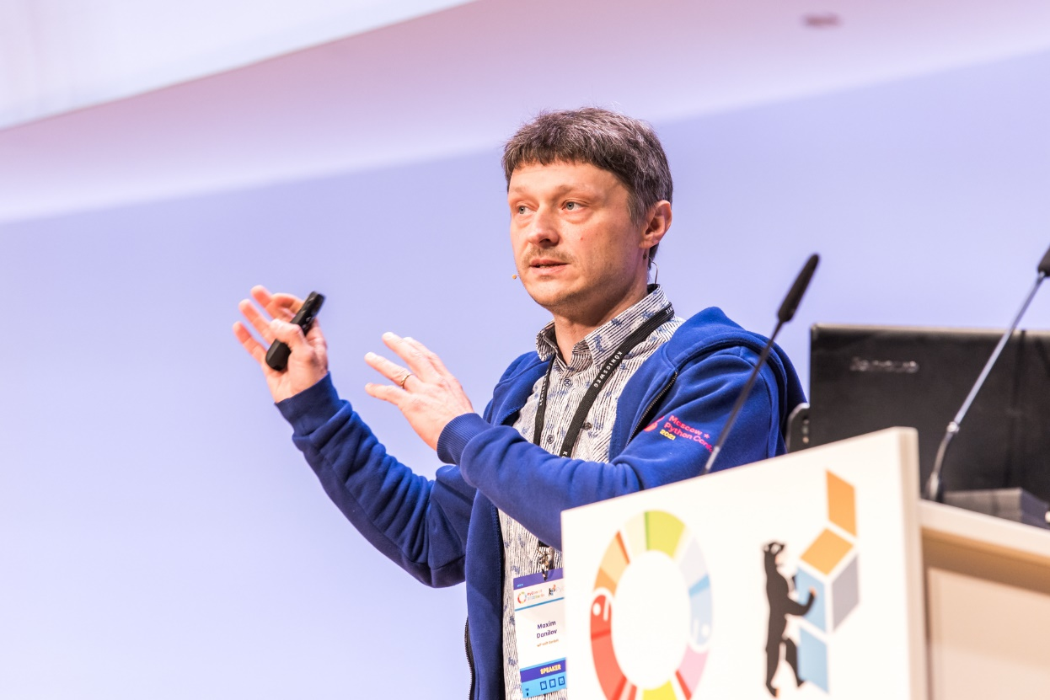
PyCon DE 2022, april

Slide 7
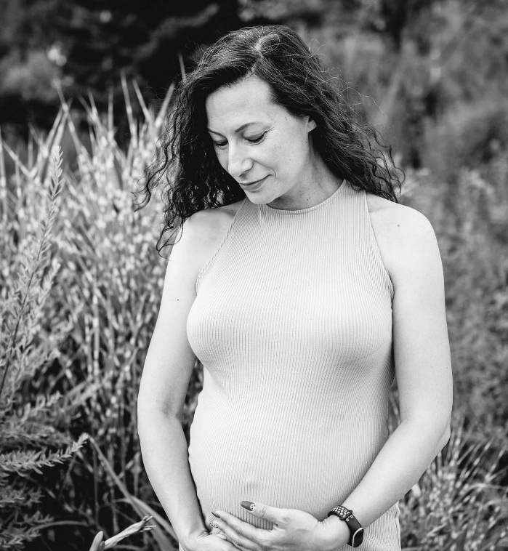
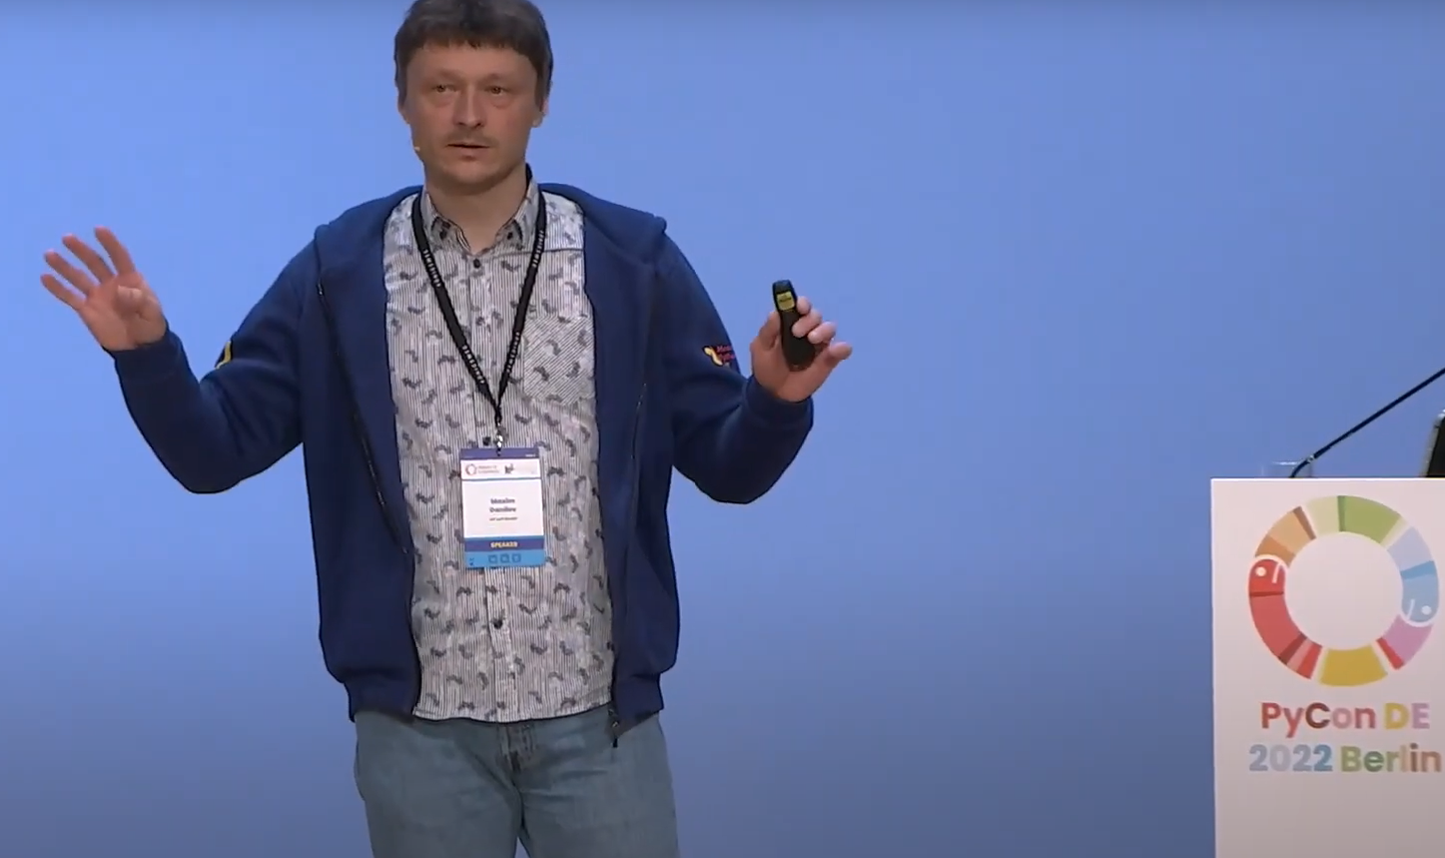
PyCon DE 2022, april

Slide 8
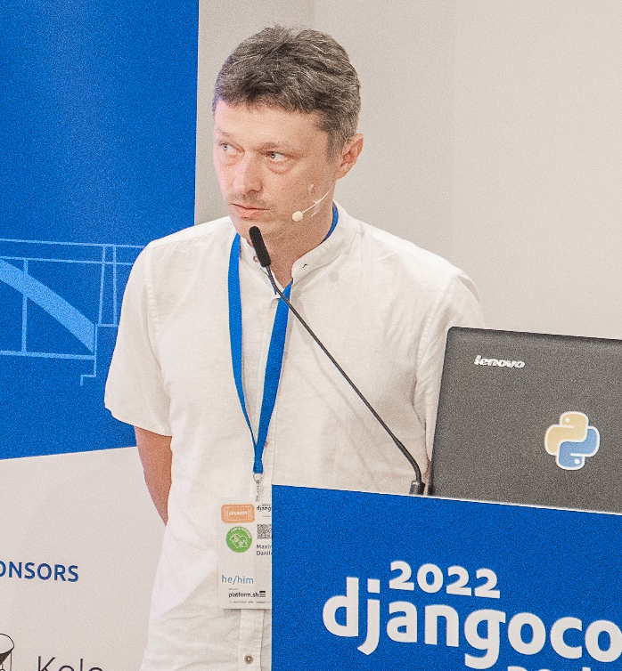
Django Con eu 2022, september

Slide 9
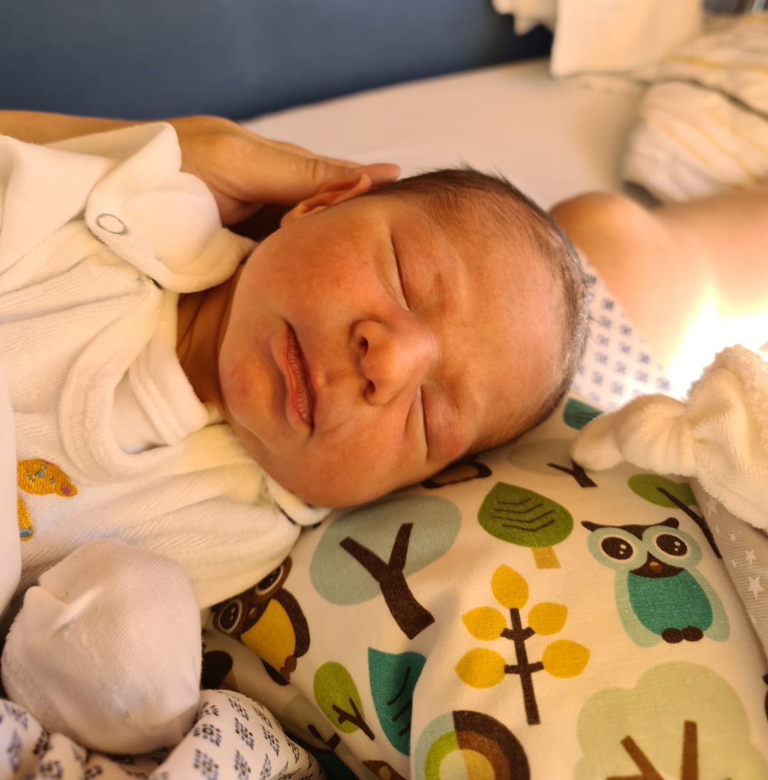
Django Con eu 2022, september

Slide 10
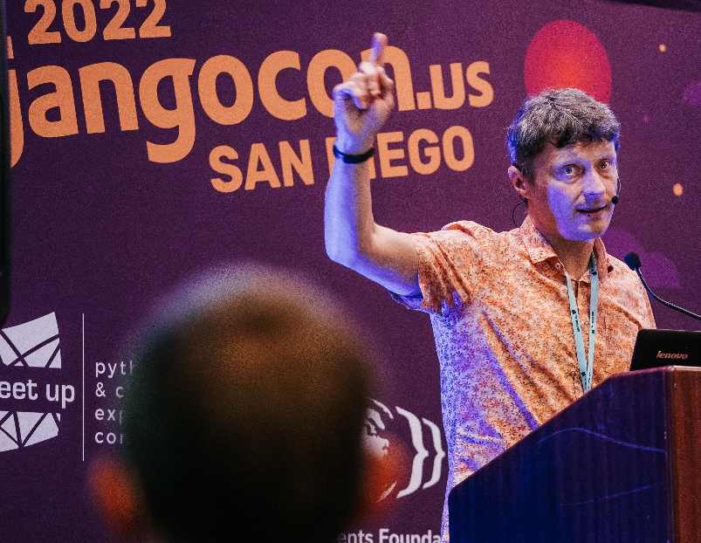
Django Con us 2022, Oktober

Slide 11
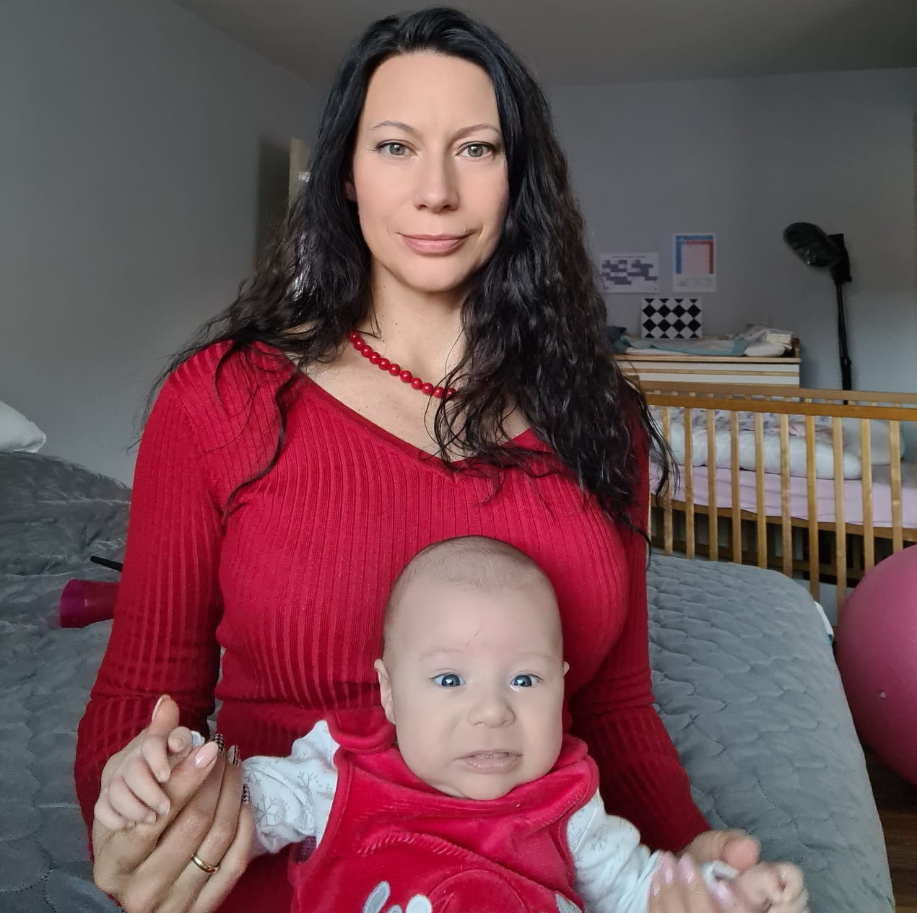
Django Con us 2022, Oktober

Slide 12
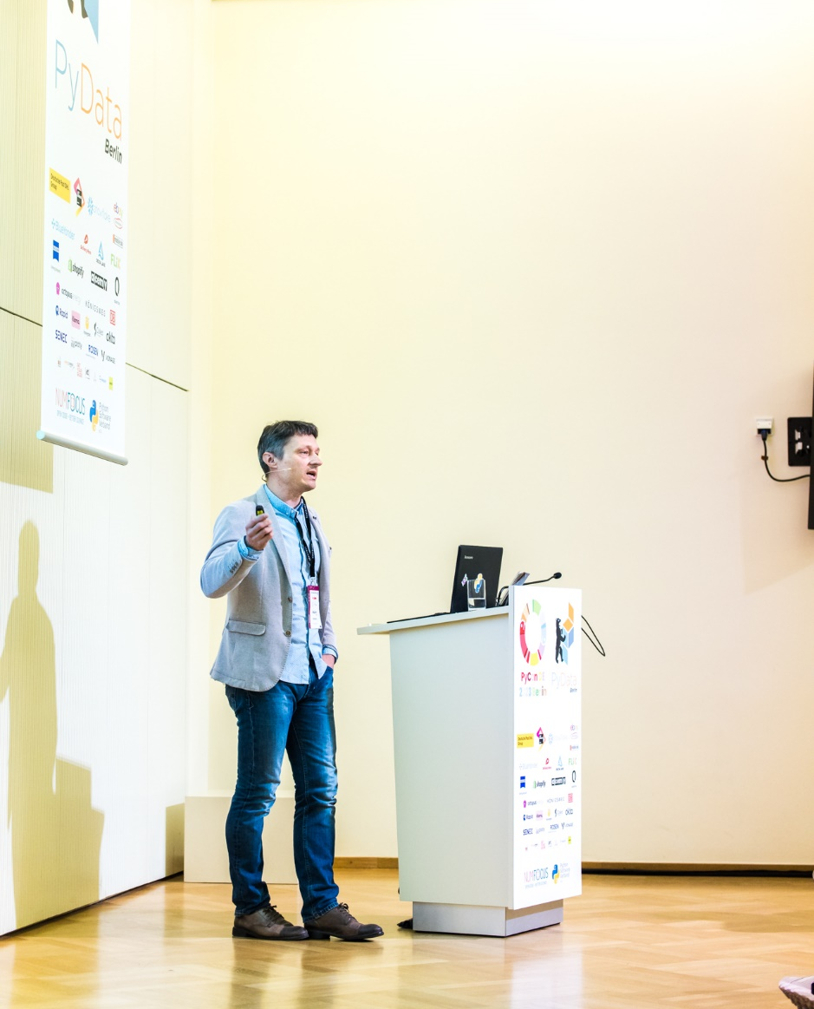
Py Con DE 2023, April

Slide 13
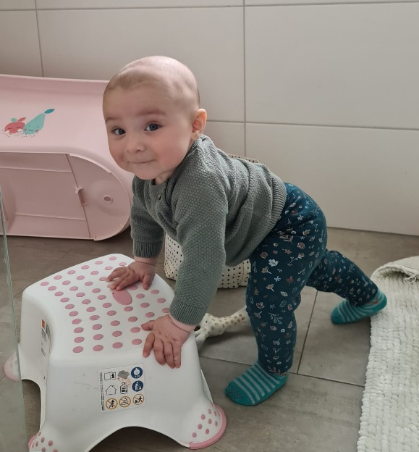
Py Con DE 2023, April

Slide 14
Py Con IT 2023, May
I am hier

Slide 15
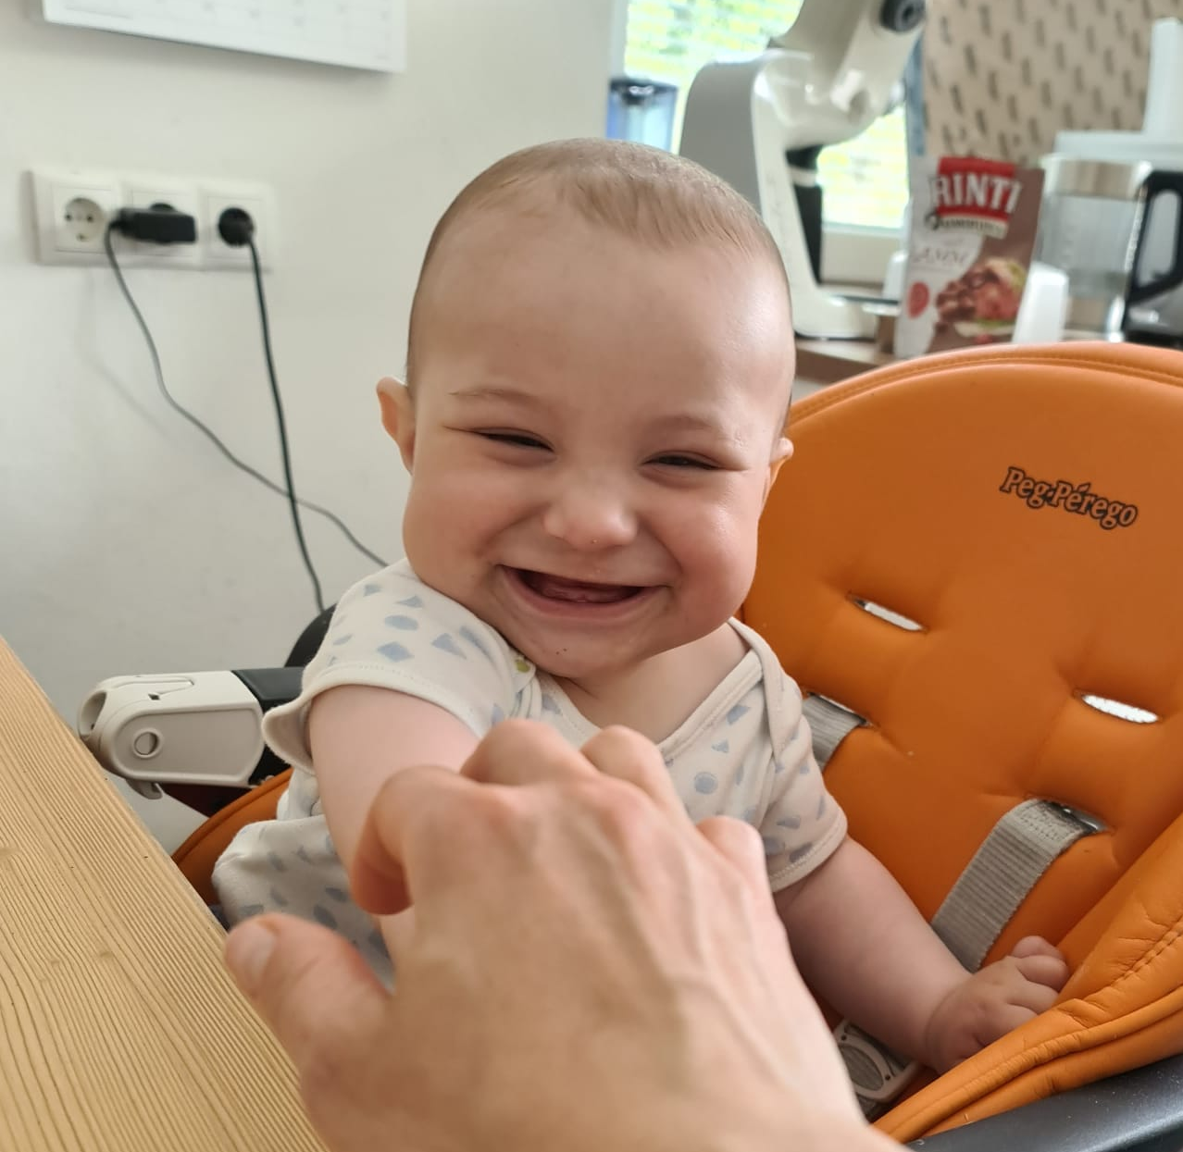
Py Con IT 2023, May

Slide 16
Let's take python built-in ITER() (PEP 234)
iter(collable, sentinel)
# stop if collable() == sentinel

Slide 17
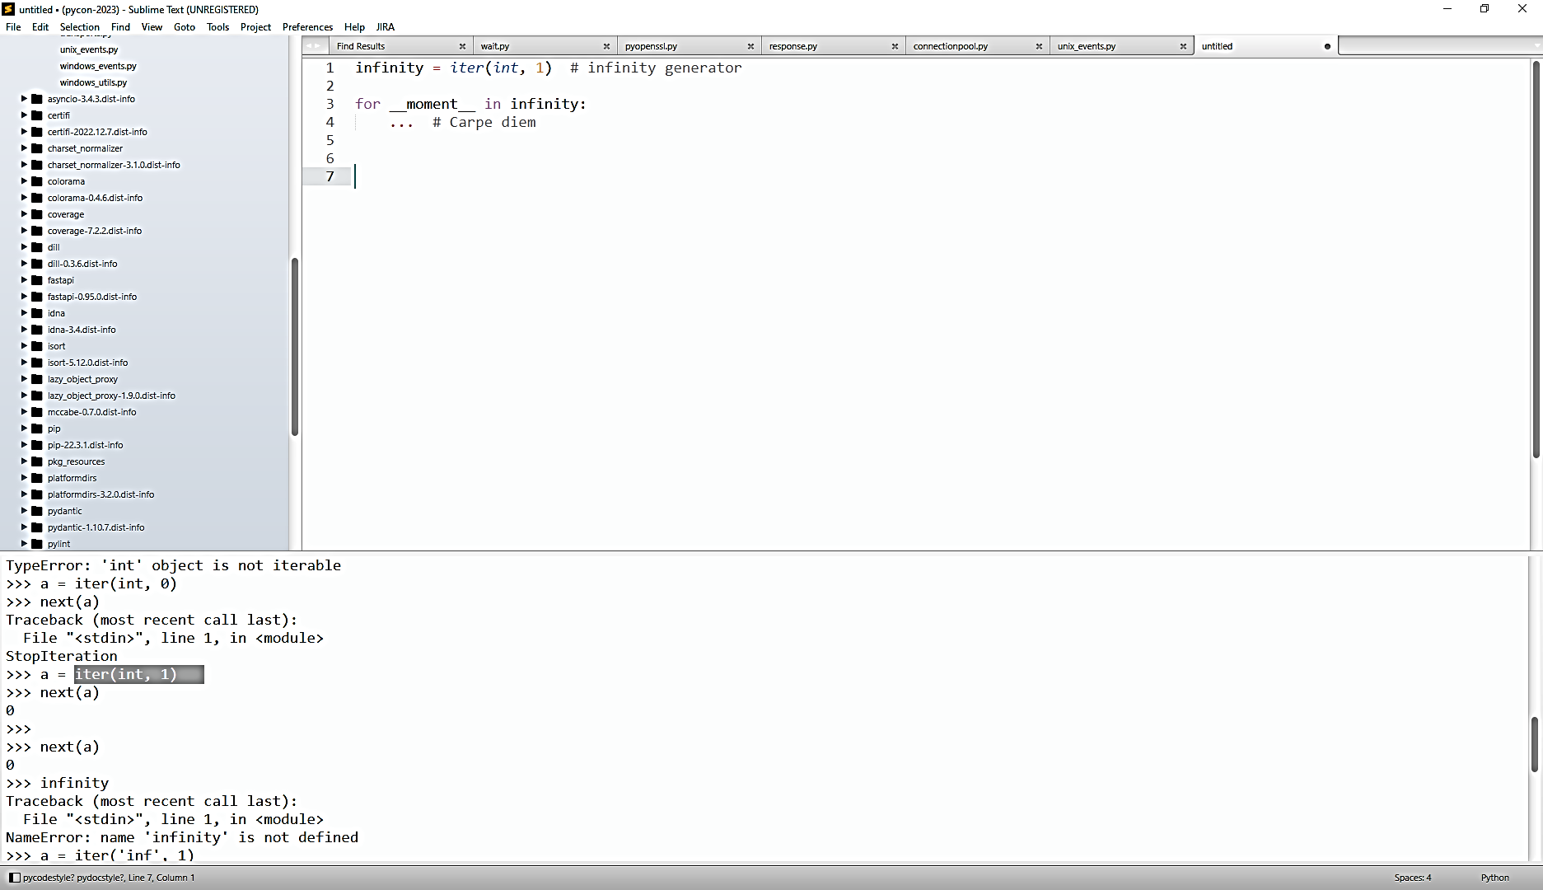
We can create infinity generator.
Profit: better than itertools infinity generators

Slide 18
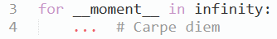
Declare Loop of our life:
Profit: stay in the moment ☺

Slide 19

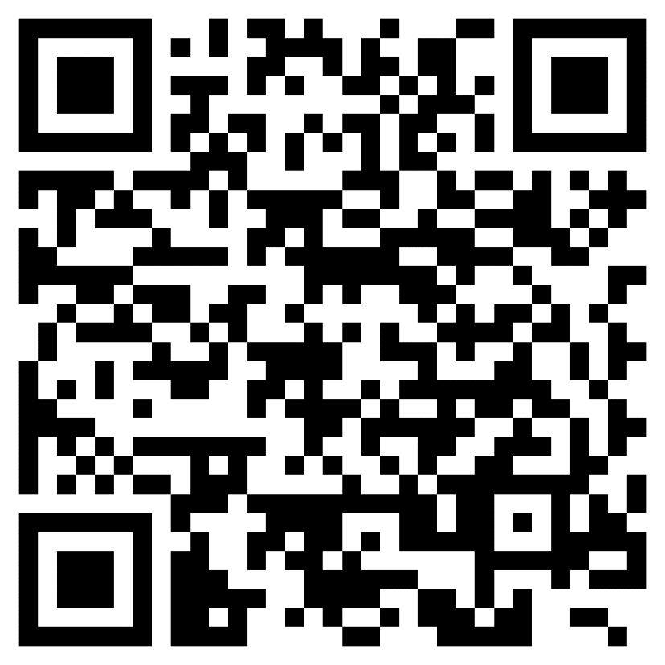
THANK YOU FOR YOUR ATTENTION!
Maxim Danilov
maxim@wpsoft.at
Next Talk on Europython 2023,
17-23 July in Prague..
D.I. mag. Maxim Danilov, wP soft Gmbh. maxim@wpsoft.at @danilovmy
27.05.2023
19

