Slide 1
Python Interpreter, Types, Operations
Dr. Dhruba Jyoti Kalita

Slide 2
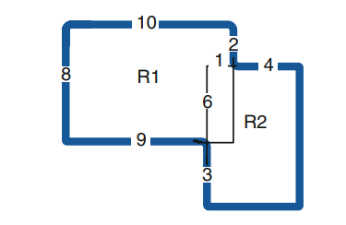
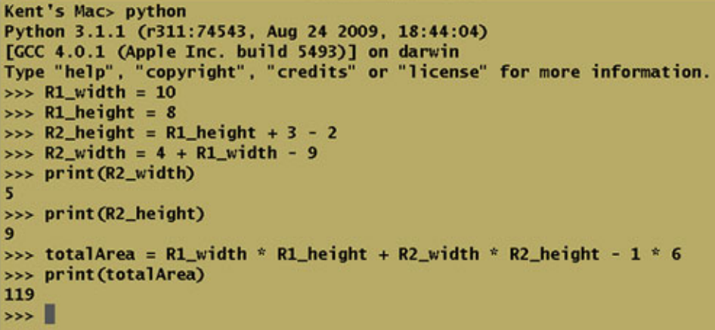
A Simple Program
Compute the Area of the following Shape (Overlapping Regular Polygon)

Slide 3
Types of values
Each value in Python is called an object. Each object is of a particular type.
There are several data types in Python. These include
- integer (called int in Python),
-float,
-Boolean (called bool in Python),
-string (called str in Python),
-list, tuple, set, dictionary (called dict in Python)
-None.

Slide 4
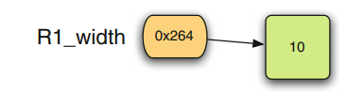
Reference Type and Assignment Statements
A reference is a pointer that points to an object. A pointer is the address of an object.
An assignment statement makes a reference point to an object.

Slide 5
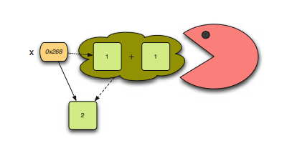
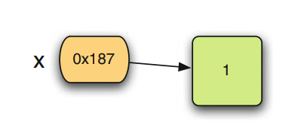
More on reference type
x=1 # do something with x
x=x+1
The garbage collector reclaims the space in memory occupied by unreferenced objects so the space can be used later.

Slide 6
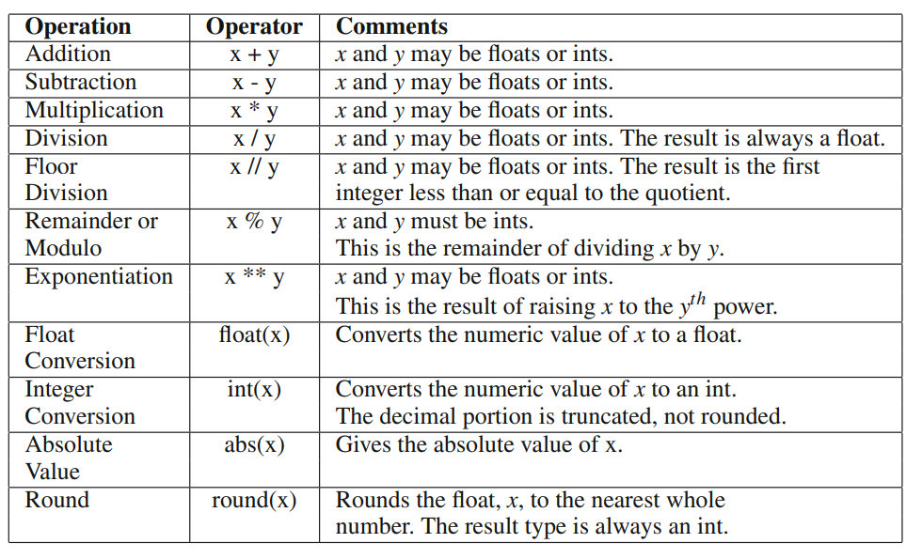
Numeric Operations in Python

Slide 7

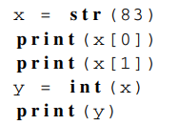
Strings
A string is a sequence of characters.
Convert Integer to a string.

Slide 8
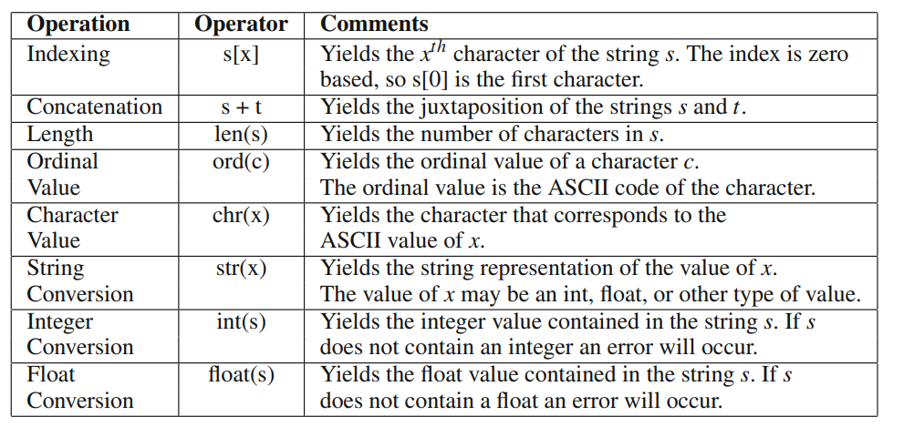
String Operations

Slide 9

Getting Input

Slide 10
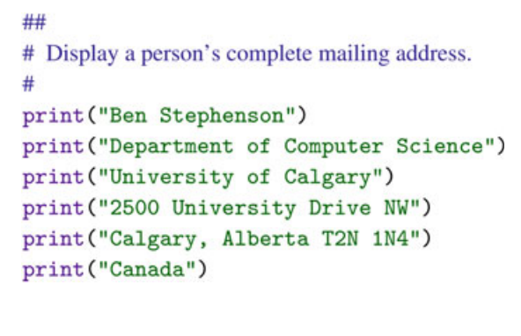
Few Examples

Slide 11
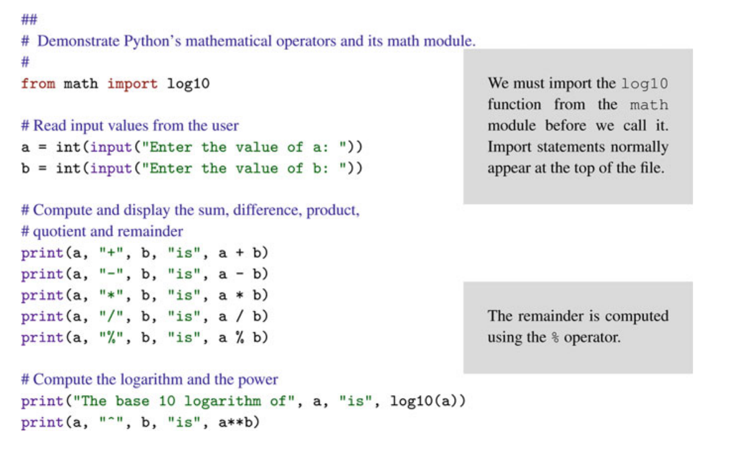

Slide 12
