Slide 1
Python Strings and Other Operations
Dr. Dhruba Jyoti Kalita

Slide 2
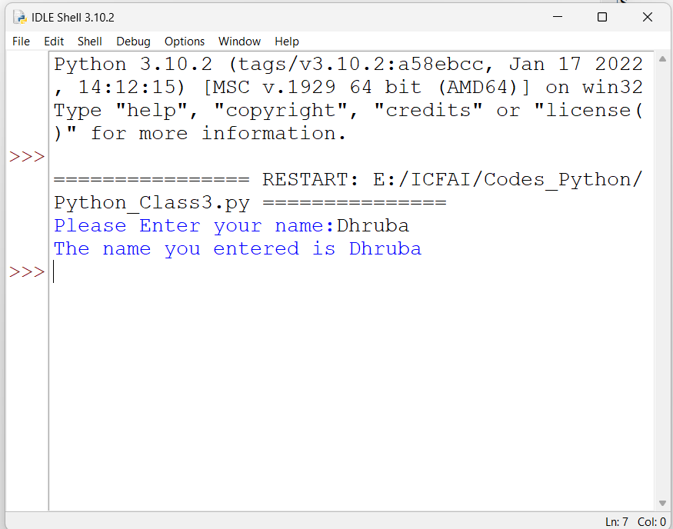

Getting the input

Slide 3
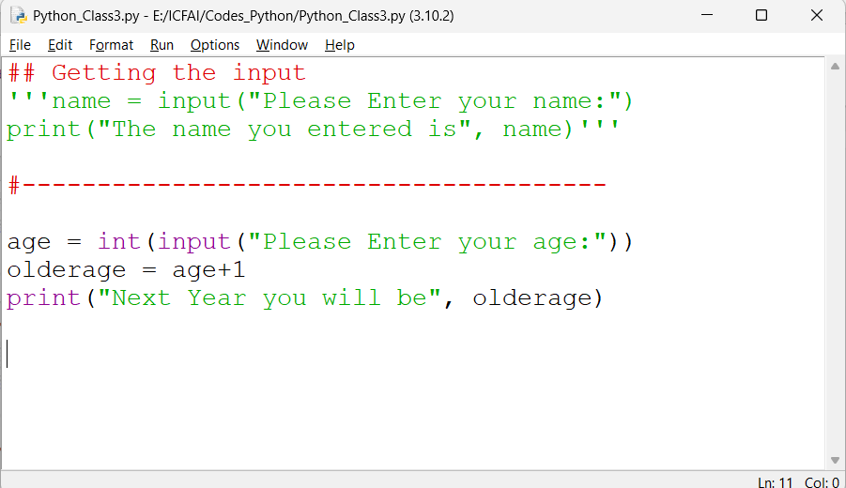
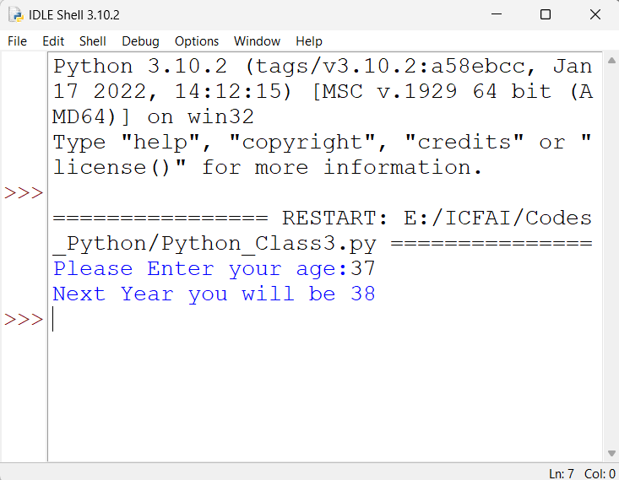

Slide 4

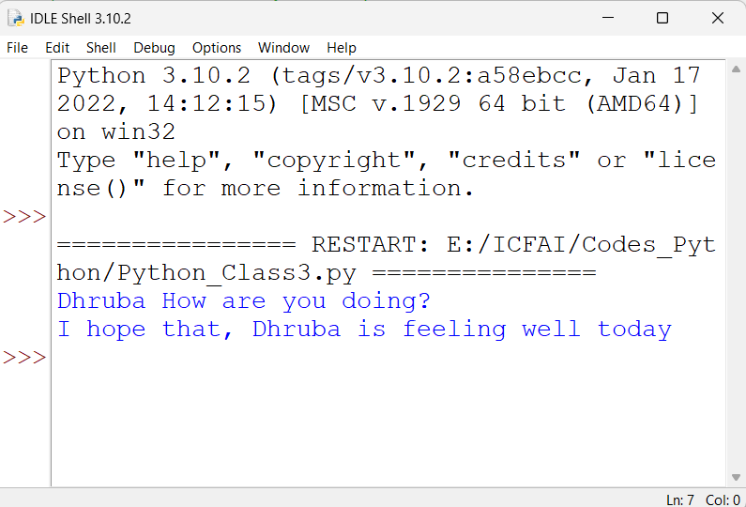
Formatting output

Slide 5

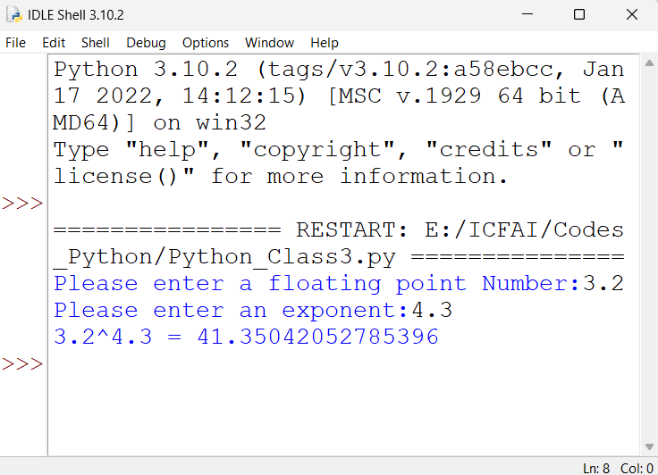

Slide 6



Slide 7

Some more on strings

Slide 8



Slide 9



