Slide 1
Basics of Python
Dr. Dhruba Jyoti Kalita
ICFAI University, Tripura
Reference: https://ocw.mit.edu/courses/

Slide 2
Aspects of Languages
Syntax
- English: “Boy a am I”
“I am a boy”
- Programming language: “hi”5
3.2 * 5
Static Semantics
- English: "I are hungry"
- Programming language: 3 + “hi”

Slide 3
Aspects of Languages
Semantics:
- It is the meaning associated with a syntactically correct string of symbols with no static semantic errors
- programming languages: have only one meaning but may not be what programmer intended

Slide 4
Various Errors
Syntactic Errors:
Static Semantic Errors:
Different Meaning than what programmer intended”

Slide 5
Python Programs
A program is a sequence of definitions and commands
- definitions evaluated
- commands executed by Python interpreter in a shell
commands (statements) instruct interpreter to do something
We will use an environment- Python 3.12.1

Slide 6
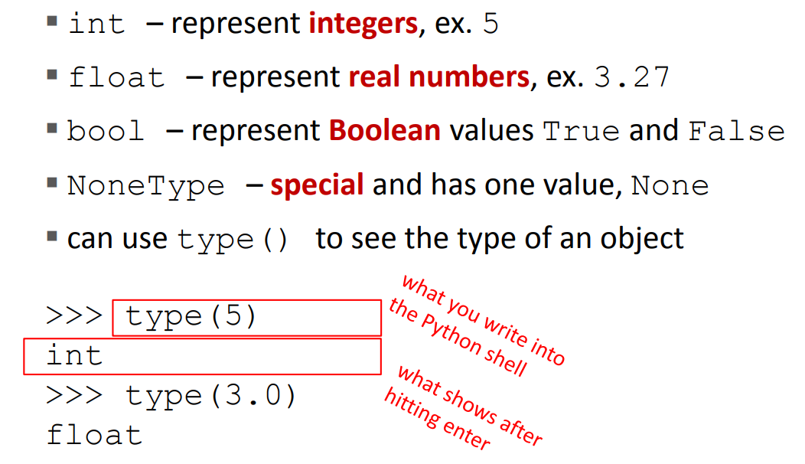
Scalar Objects

Slide 7
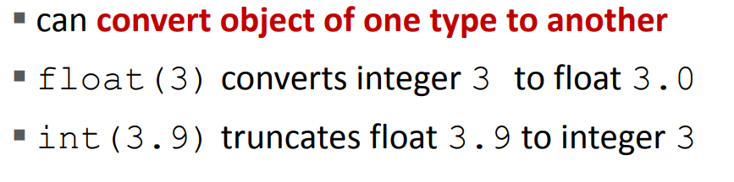
Type Conversions (CAST)

Slide 8
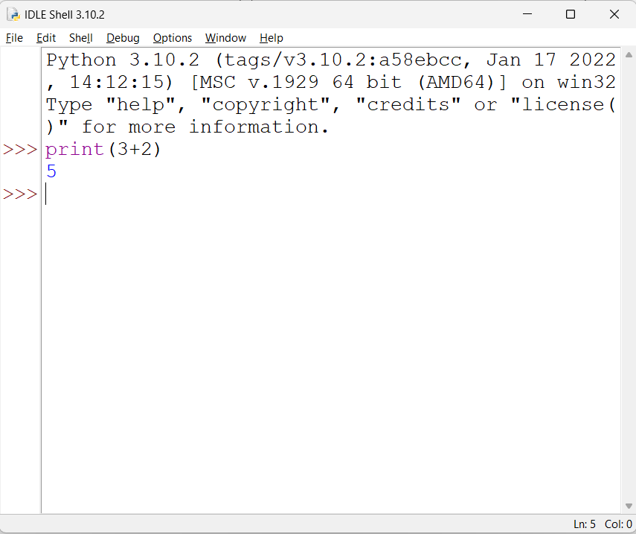
Printing To Console

Slide 9
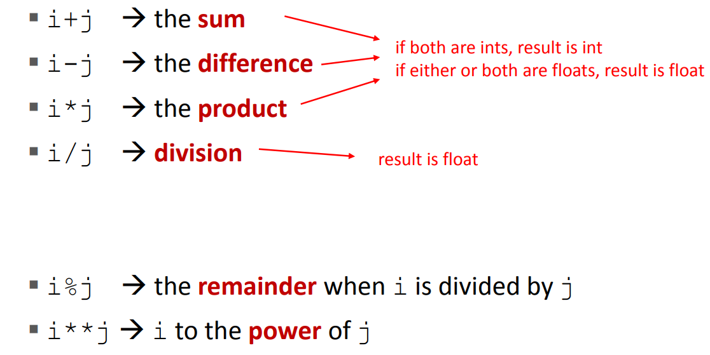
Expressions
Operators on ints and floats
Syntax for a Simple Expression
- <Object> <Operator> <Object>

Slide 10
Simple Operators
parentheses used to tell Python to do these operations first
operator precedence without parentheses
◦ **
◦ *
◦ /
◦ + and – executed left to right, as appear in expression

Slide 11
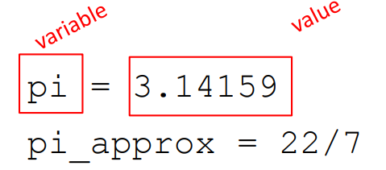
Binding Variables and Values
Assignment

Slide 12
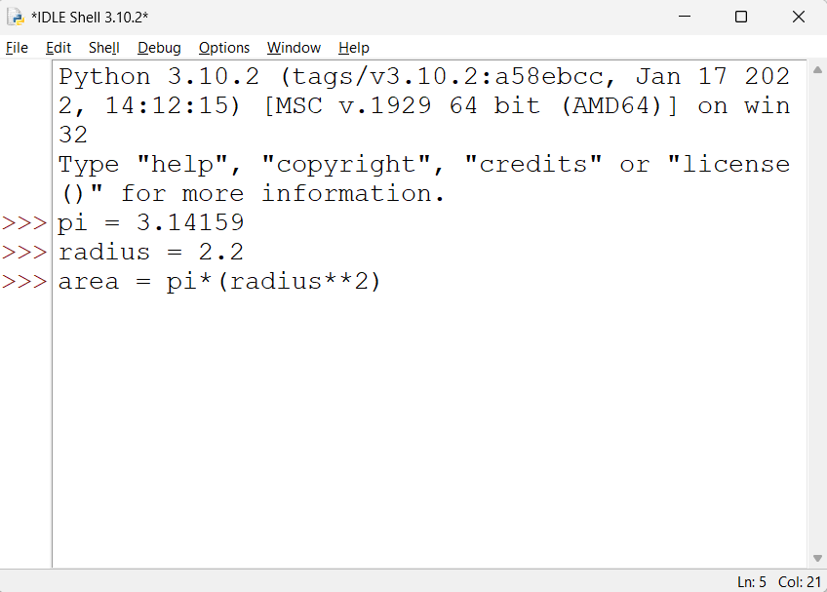
Abstracting Expressions

Slide 13
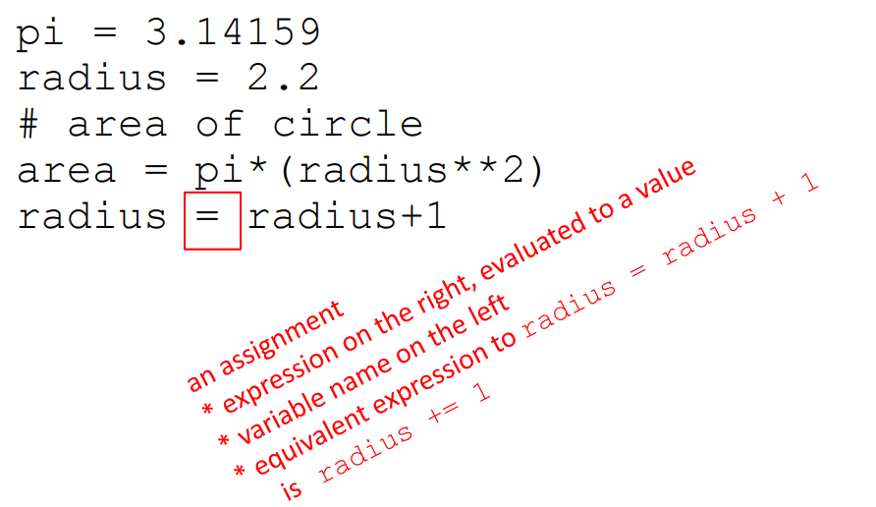
Programming vs Math
in programming, you do not “solve for x”

Slide 14
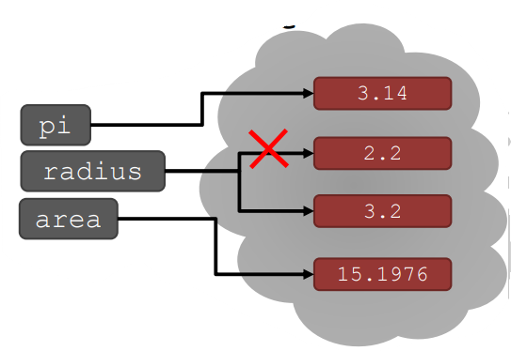
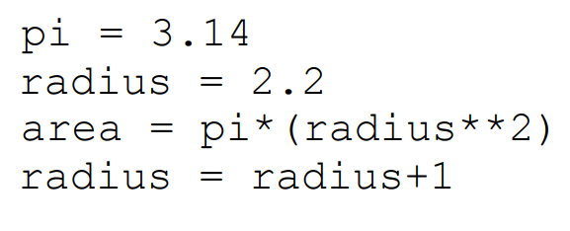
Binding in Python

