Slide 1
Python List
Dr. Dhruba Jyoti Kalita

Slide 2

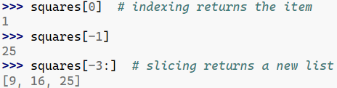
Note: Built in Sequence Type. Supports indexing

Slide 3


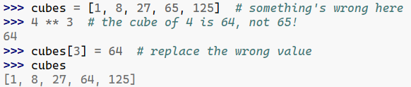

Slide 4

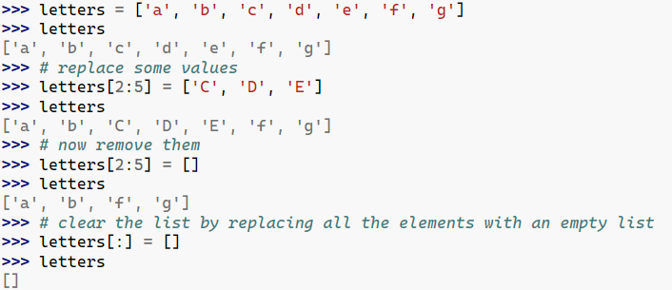
Note: Unlike strings, which are immutable, lists are a mutable type

Slide 5

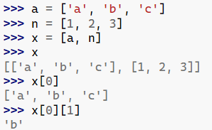

Slide 6
Examples 1
Write a program that reads integers from the user and stores them in a list. Your program should continue reading values until the user enters 0. Then it should display all of the values entered by the user (except for the 0) in order from smallest to largest, with one value appearing on each line.
Examples 2
Write a program that reads integers from the user and stores them in a list. Use 0 as a sentinel value to mark the end of the input. Once all of the values have been read your program should display them (except for the 0) in reverse order, with one value appearing on each line.

