Slide 1
Plotting With Python
Dhruba Jyoti Kalita

Slide 2
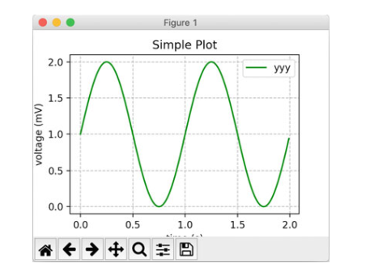
Introduction
Matplotlib is a Python graphing and plotting library that can generate a variety of different types of graph or char in a variety of different formats.
It can be used to generate line charts, scatter graphs, heat maps, bar charts, pie charts and 3D plots. It can even support animations and interactive displays.

Slide 3
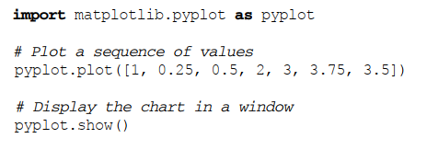
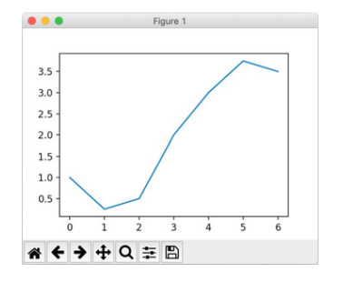
Example1: create a simple line graph for a set of x and y coordinates you can use the matplotlib.pyplot.plot function

Slide 4
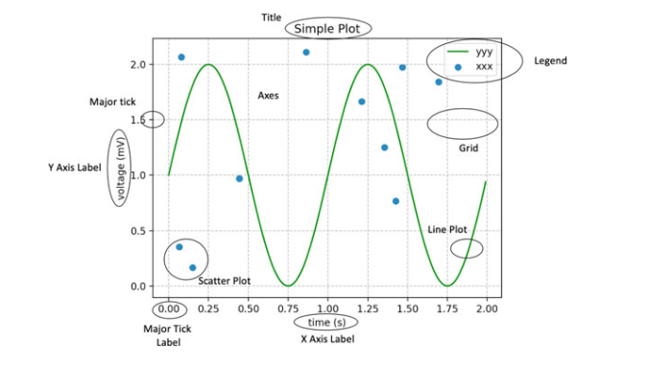
Various Plot Components:

Slide 5
• Axes An Axes is defined by the matplotlib.axes.Axes class. It is used to maintain most of the elements of a figure namely the X and Y Axis, the Ticks, the Line plots, any text and any polygon shapes.
• Title This is the title of the whole figure.
• Ticks (Major and Minor) The Ticks are represented by the class matplotlib.axis.Tick. A Tick is the mark on the Axis indicating a new 5.2 Matplotlib 37 value. There can be Major ticks which are larger and may be labeled. There are also minor ticks which can be smaller (and may also be labelled).
• Tick Labels (Major and Minor) This is a label on a Tick.
• Axis The maplotlib.axis.Axis class defines an Axis object (such as an X or Y axis) within a parent Axes instance. It can have formatters used to format the labels used for the major and minor ticks. It is also possible to set the locations of the major and minor ticks.
• Axis Labels (X, Y and in some cases Z) These are labels used to describe the Axis.
• Plot types such as line and scatter plots. Various types of plots and graphs are supported by Matplotlib including line plots, scatter graphs, bar charts and pie charts.
• Grid This is an optional grid displayed behind a plot, graph or chart. The grid can be displayed with a variety of different line styles (such as solid or dashedlines), colours and line widths.

Slide 6
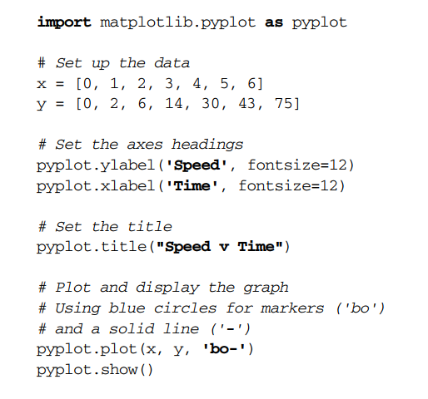
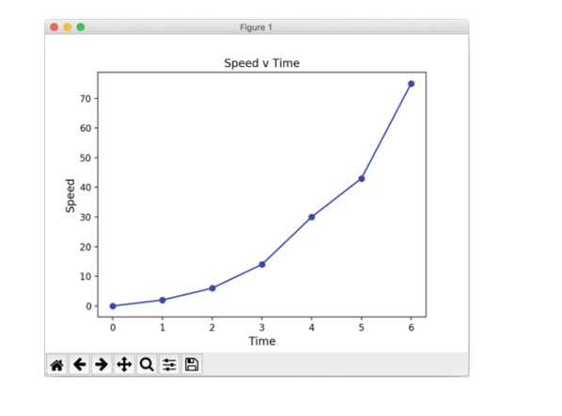
Line Graph:

Slide 7
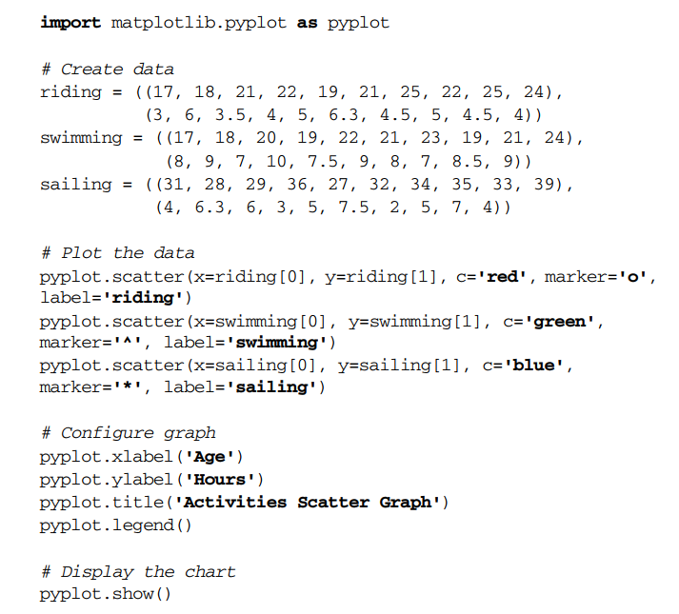
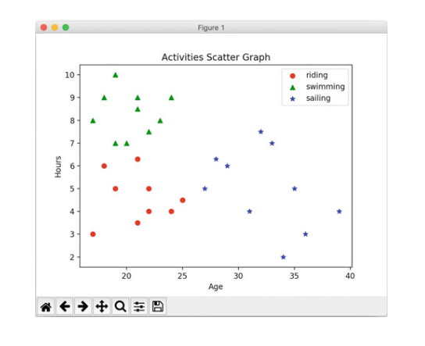
Scattered Graph

Slide 8
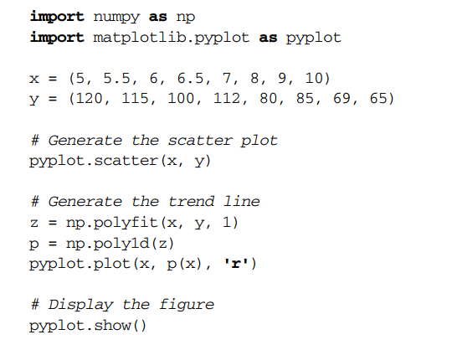
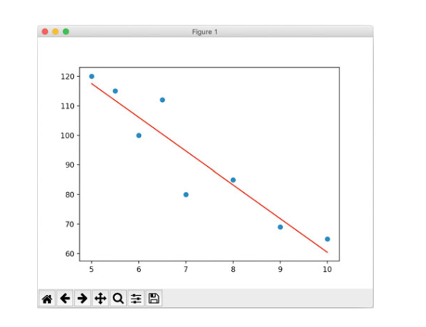

Slide 9
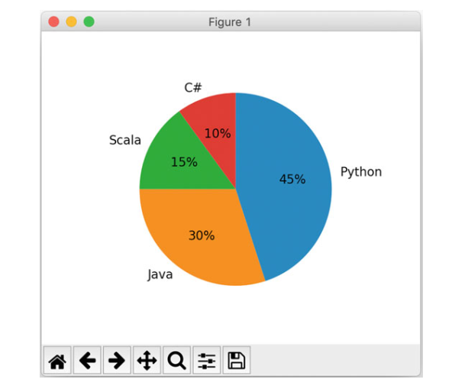
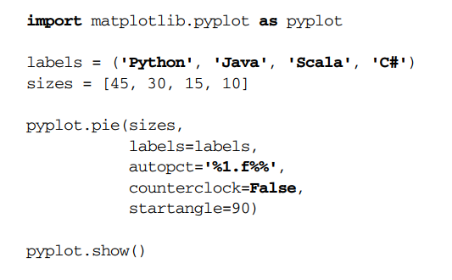
Pie Charts

Slide 10
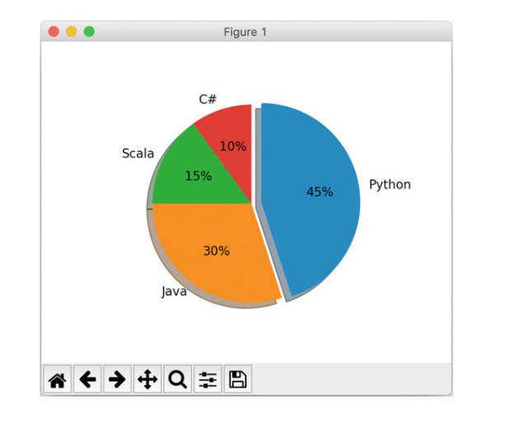
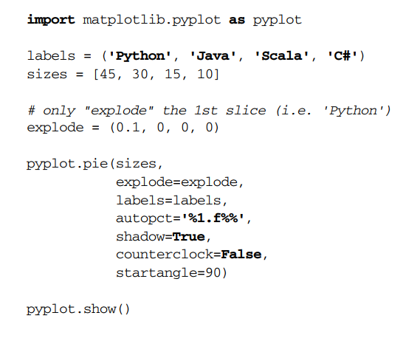

Slide 11
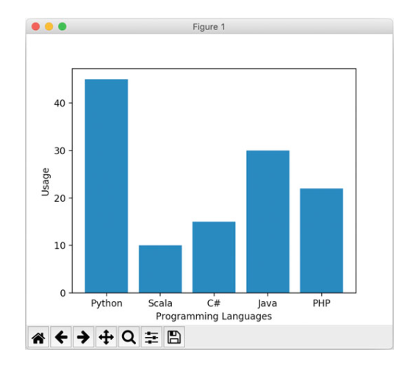
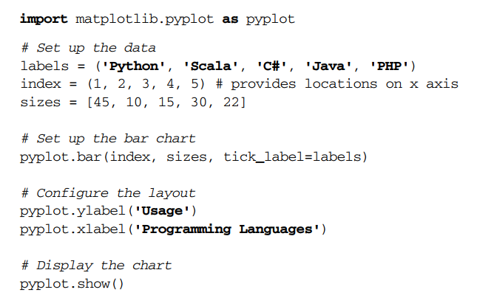
Bar Charts

Slide 12
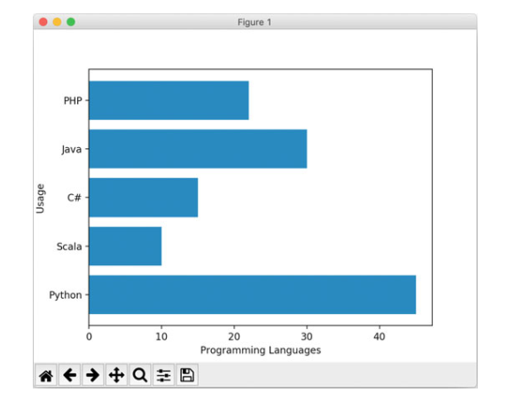

Slide 13
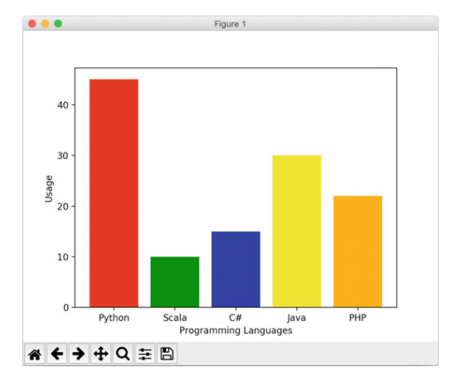


Slide 14
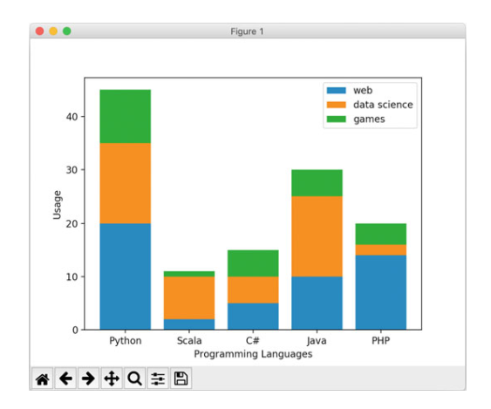
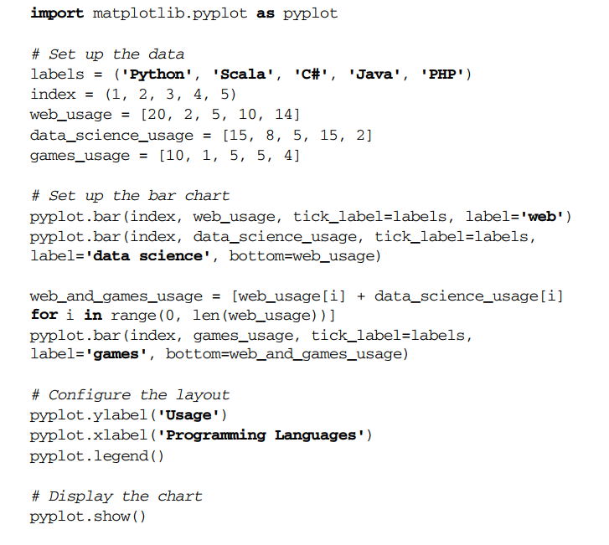
Stacked Bar Charts

Slide 15
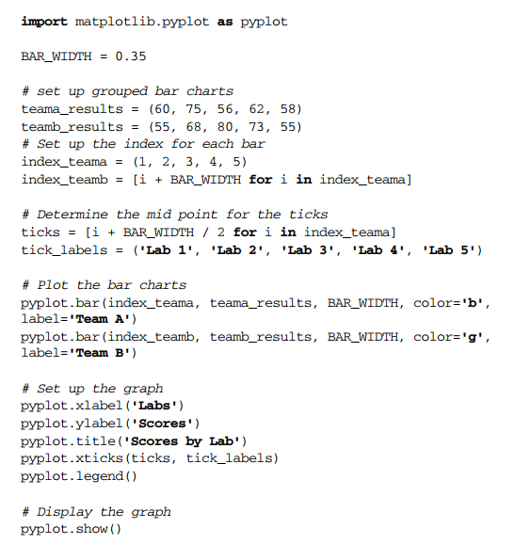
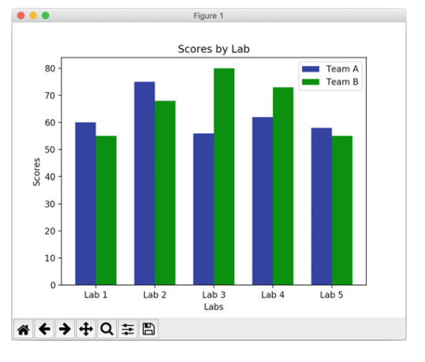
Grouped Bar Charts

Slide 16
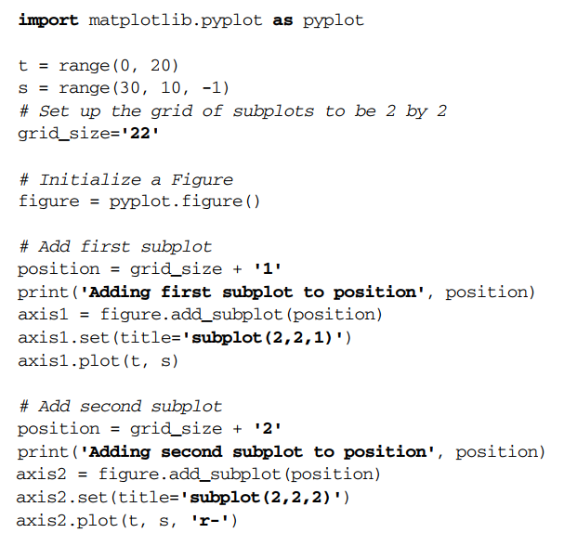
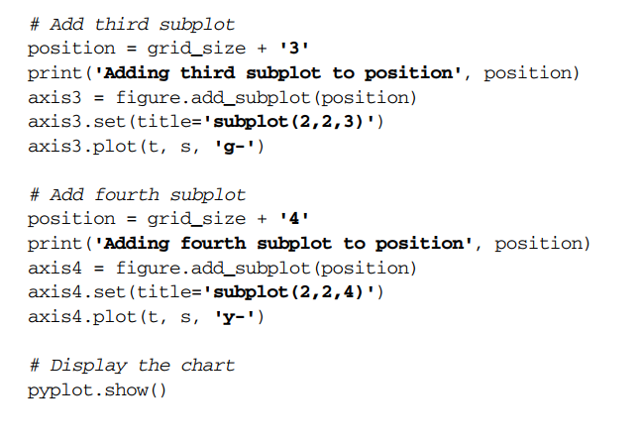
Figures and Subplots

Slide 17
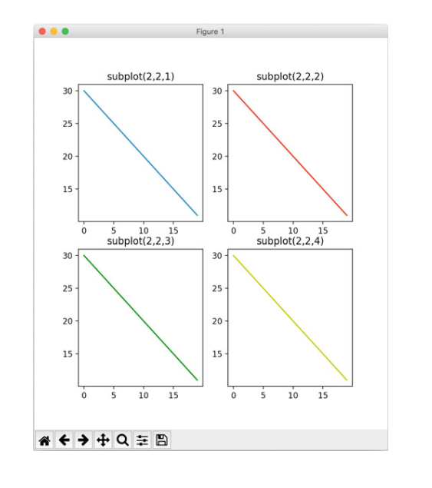

Slide 18
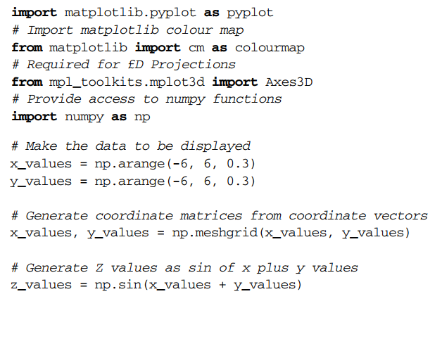
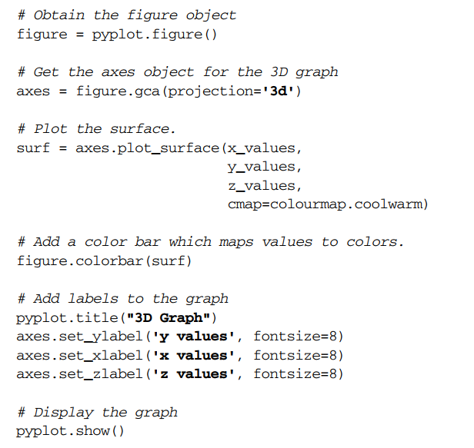
3D Plot

Slide 19
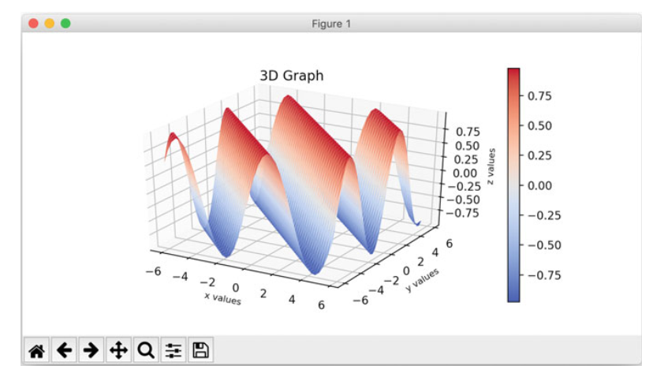

Slide 20
THANK YOU

