Slide 1
Basics of Web Technologies
Dr. Dhruba Jyoti Kalita

Slide 2
World Wide Web (WWW)
World Wide Web (WWW) is a an information system that enables content sharing over the Internet.
It allows documents and other web resources to be accessed over the Internet according to specific rules of the Hypertext Transfer Protocol (HTTP).

Slide 3
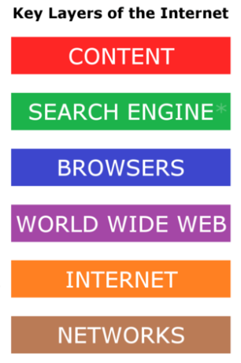
Key Components of Internet

Slide 4
World Wide Consortium:
The World Wide Web Consortium (W3C) is the main international standards organization for the World Wide Web.
W3C was created to ensure compatibility and agreement among industry members in the adoption of new standards.

Slide 5
Static Website:
A static website is one that has web pages stored on the server in the format that is sent to a client web browser.
This type of website usually displays the same information to all visitors.

Slide 6
Dynamic Website:
A dynamic website is one that changes or customizes itself frequently and automatically, based on certain criteria.
Application Server:

Slide 7
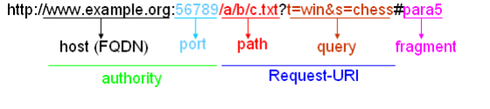
Uniform Resource Locator (URL)

Slide 8
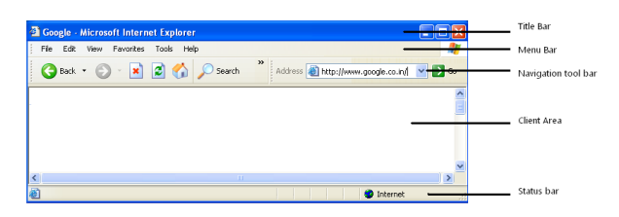
Web Browsers

Slide 9
Scripting
Server side Scripting
Client Side Scripting:

