Slide 1
Uninformed Search
Dhruba Jyoti Kalita

Slide 2
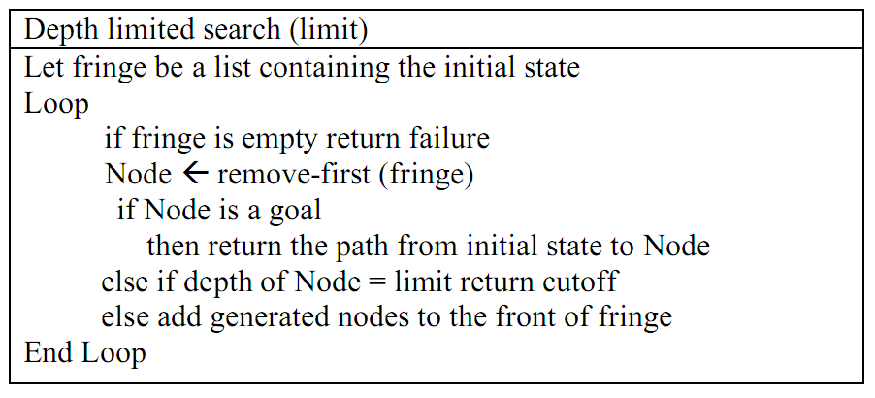
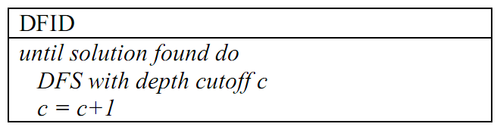
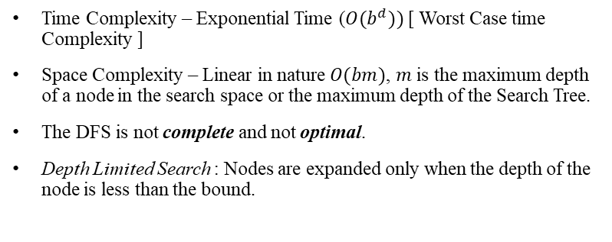
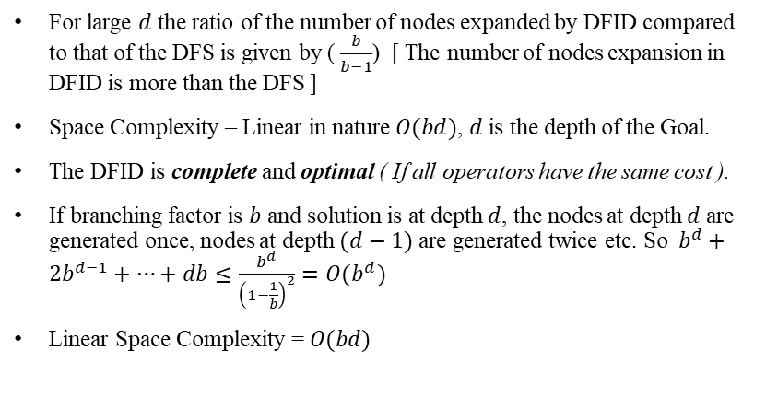
Depth First Search (Properties)
Time Complexity – Exponential Time ($O(b^{d}))$ [ Worst Case time Complexity ]
Space Complexity – Linear in nature $O(bm)$, $m$ is the maximum depth of a node in the search space or the maximum depth of the Search Tree.
The DFS is not complete and not optimal.
Depth Limited Search : Nodes are expanded only when the depth of the node is less than the bound.
Fig 1. Depth Limited Search
Depth-First Iterative Deepening Search
For large $d$ the ratio of the number of nodes expanded by DFID compared to that of the DFS is given by ( $\frac{b}{b−1}$) [ The number of nodes expansion in DFID is more than the DFS ]
Space Complexity – Linear in nature $O(bd)$, $d$ is the depth of the Goal.
The DFID is complete and optimal ( If all operators have the same cost ).
If branching factor is $b$ and solution is at depth $d$, the nodes at depth $d$ are generated once, nodes at depth $(d−1)$ are generated twice etc. So $b^{d}+2b^{d−1}+…+db≤\frac{b^{d}}{{\left(1−\frac{1}{b}\right)}^{2}}=O(b^{d})$
Linear Space Complexity = $O(bd)$

Slide 3
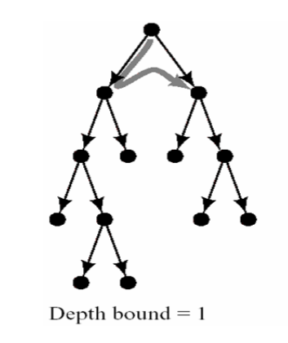
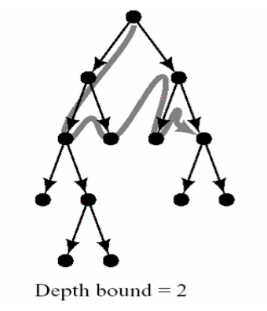
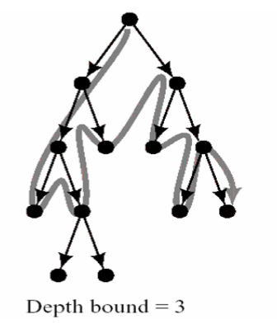
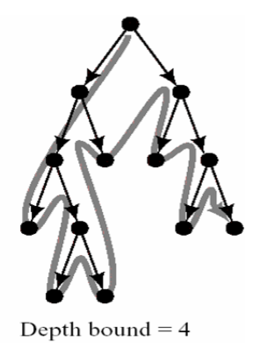
Depth-First Iterative Deepening (DFID)

Slide 4
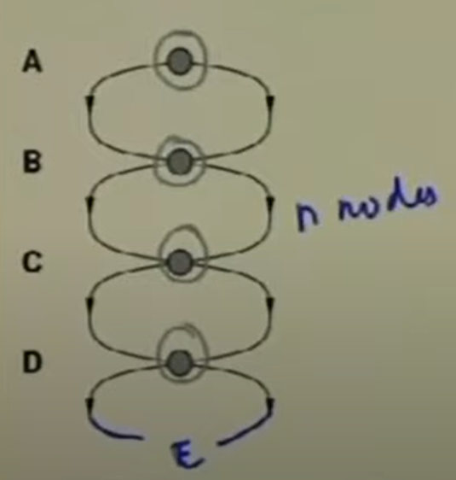
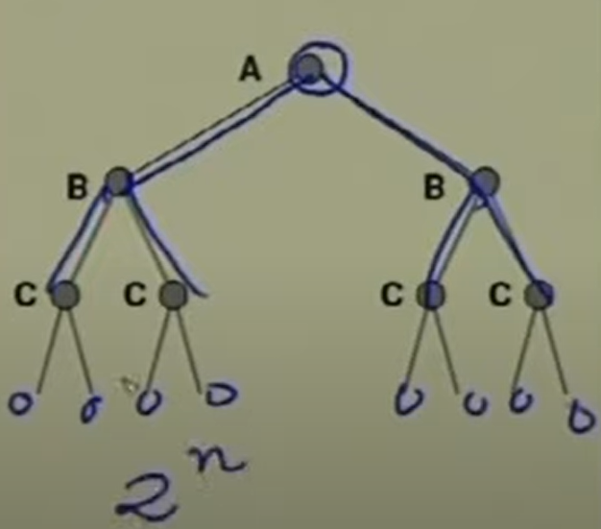
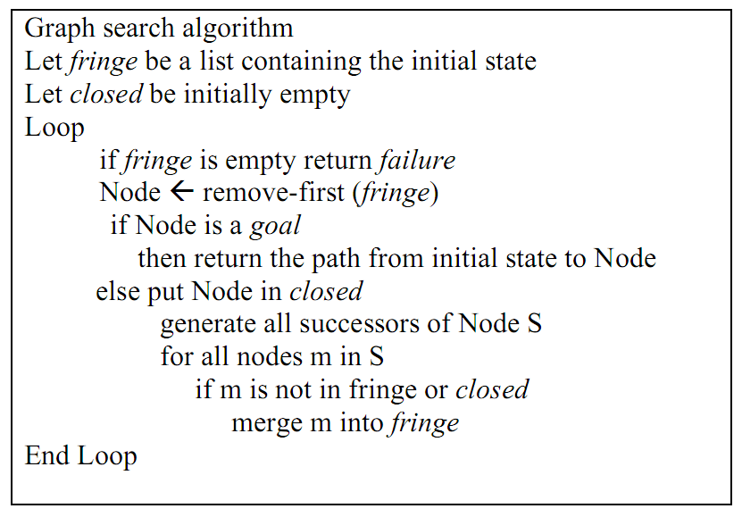
Graph Search
Fig: A state space that generates an exponentially growing Search Space
In graph, the search tree may contain different nodes corresponding to the same state.
To avoid the above-
- Not return to the state, the algorithm just came from.
- Check that you do not create paths with cycles in them.
- Do not generate any state that was ever created before.

Slide 5
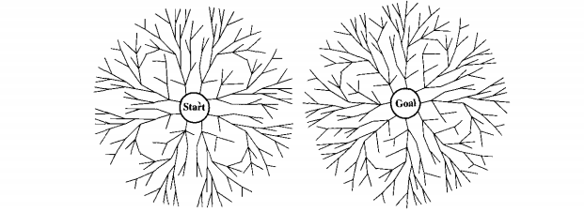
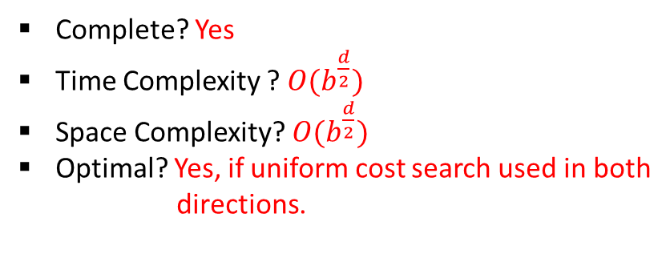
Bi-directional
Complete? Yes
Time Complexity ? $O(b^{\frac{d}{2}})$
Space Complexity? $O(b^{\frac{d}{2}})$
Optimal? Yes, if uniform cost search used in both
directions.
When to use Bi-Directional Search?
Generating predecessors is easy
Only 1 (or few) goal states.
Assumption:
One step expansion in forward direction.
One step expansion in backward direction.

Slide 6
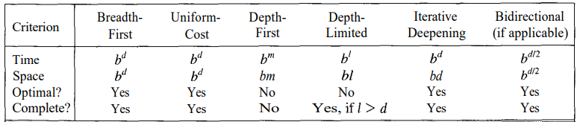
Comparing All Search Strategies

