Slide 1

Chapter 5
IPv4 Address

Slide 2
5.1 Introduction
Identifier of each device connected to the Internet : IP Address
IPv4 Address : 32 bits
  The address space of IPv4 is 2³² or 4,294,967,296
The IPv4 addresses are unique and universal
  Two devices on the Internet can never have the same address at same time
Number in base 2, 16, and 256
  Refer to Appendix B

Slide 3
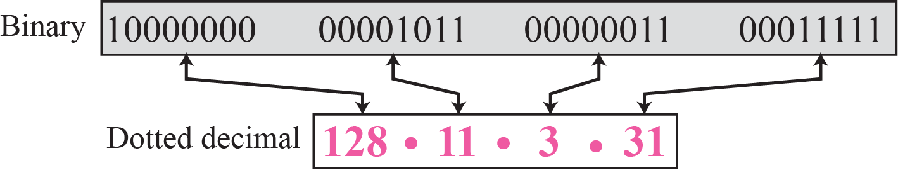
Binary Notation and Dotted-Decimal Notation
Binary notation
01110101 10010101 00011101 11101010
32 bit address, or a 4 octet address or a 4-byte address
Decimal point notation

Slide 4
Notation (cont’d)
Hexadecimal Notation
- 8 hexadecimal digits
- Used in network programming
0111 0101 1001 0101 0001 1101 1110 1010
75 95 1D EA
0x75951DEA

Slide 5
Example 5.1
Change the following IPv4 addresses from binary notation to dotted-decimal notation
a. 10000001 00001011 00001011 11101111
b. 11000001 10000011 00011011 11111111
c. 11100111 11011011 10001011 01101111
d. 11111001 10011011 11111011 00001111
Solution
  We replace each group of 8 bits with its equivalent decimal number (see Appendix B) and add dots for separation.
a. 129.11.11.239
b. 193.131.27.255
c. 231.219.139.111
d. 249.155.251.15

Slide 6
Example 5.4
Change the following IPv4 address in hexadecimal notation.
a. 10000001 00001011 00001011 11101111
b. 11000001 10000011 00011011 11111111
Solution
  We replace each group of 4 bits with its hexadecimal equivalent. Note that hexadecimal notation normally has no added spaces or dots; however, 0x is added at the beginning of the subscript 16 at the end
a. 0X810B0BEF or 810B0BEF16
b. 0XC1831BFF or C1831BFF16

Slide 7
Example 5.5
Find the number of addresses in a range if the first address is 146.102.29.0 and last address is 146.102.32.225.
Solution
  We can subtract the first address from the last address in base 256(see Appendix B). The result is 0.0.3.255 in this base. To find the number of addresses in the range, we convert this number to base 10 and add 1 to the result
Number of addresses = (0 x 256³ + 0 x 256² + 3 x 256¹ + 255 x 256⁰)+ 1 = 1024

Slide 8
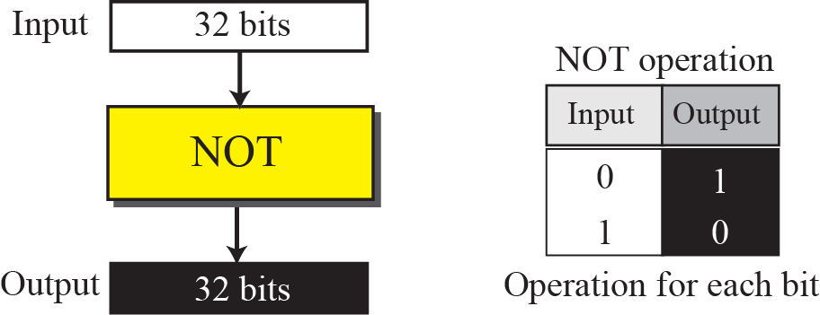
Operations
Need to apply some operations on 32-bit numbers in binary or dotted-decimal notation.
Bitwise NOT operation

Slide 9
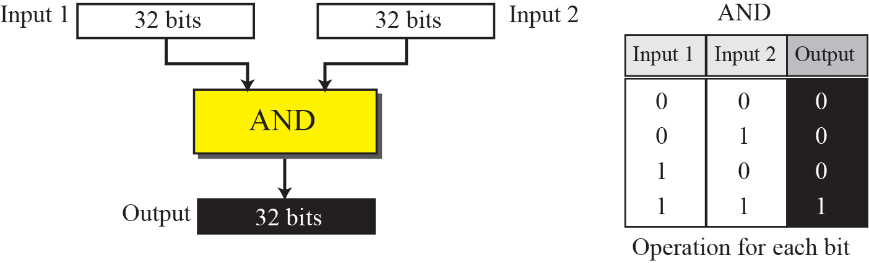
Operations(con’t)
Bitwise AND operation

Slide 10
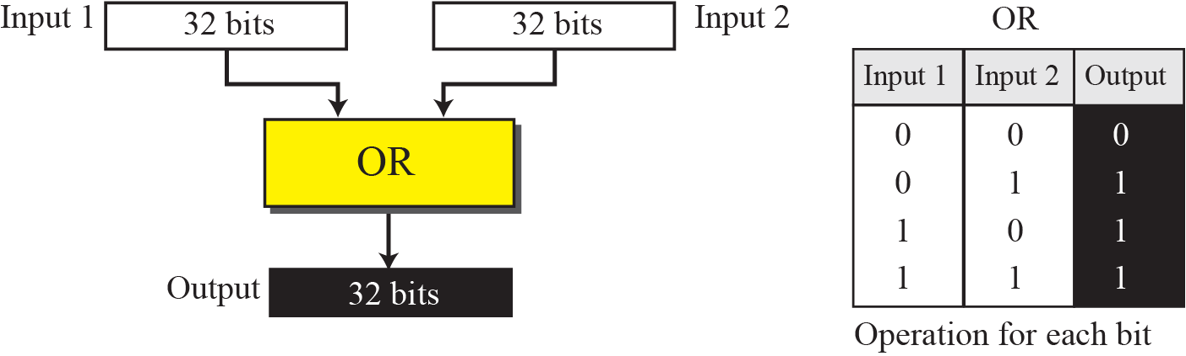
Operations(cont’d)
Bitwise OR operation

Slide 11
5.2 Classful Addressing
IP addresses, when started a few decades ago, used the concept of classes
In the mid-1990s, a new architecture, called classless addressing, was introduced
We will discuss classful addressing in this section, first. Classless addressing will be discussed in next section.

Slide 12
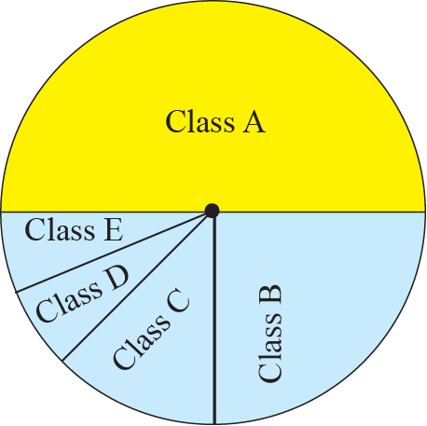
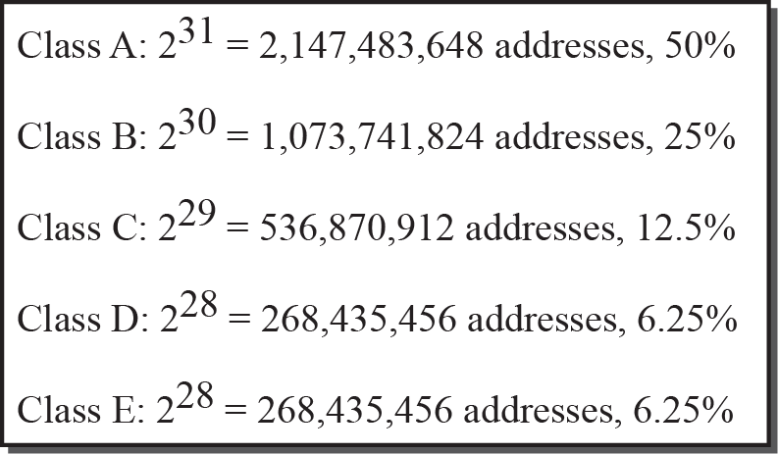
Occupation of the Address Space
Five classes

Slide 13
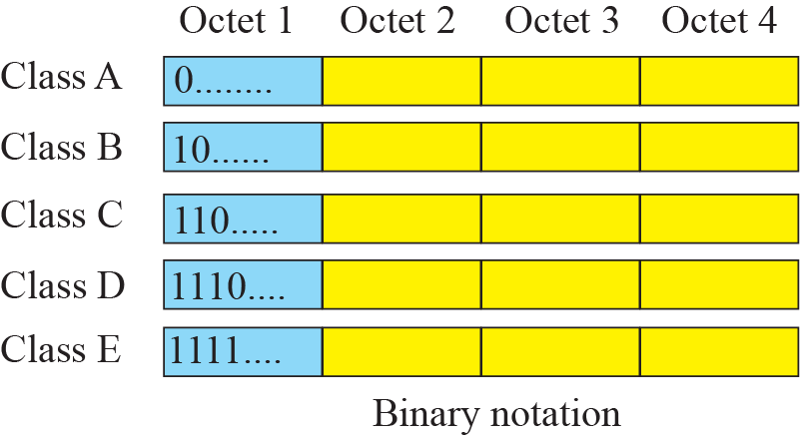
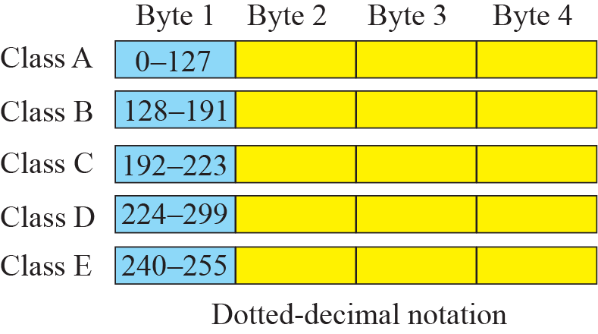
Finding the Class of an Address

Slide 14
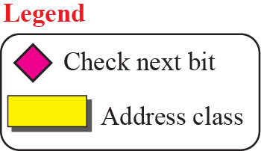
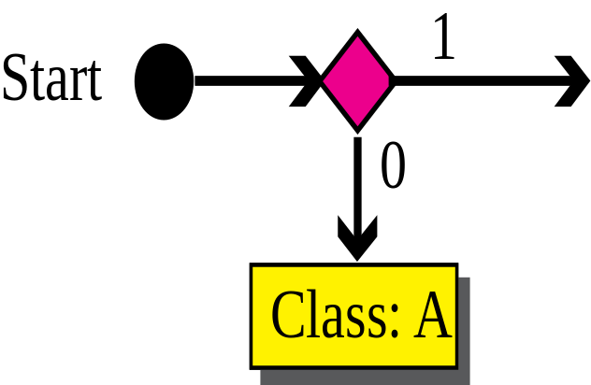
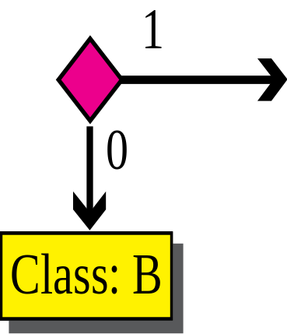
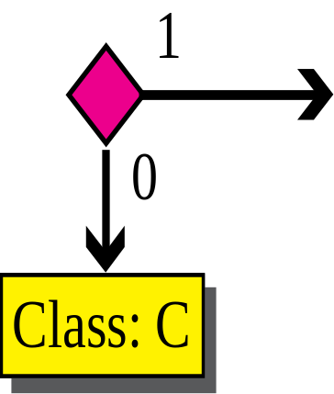
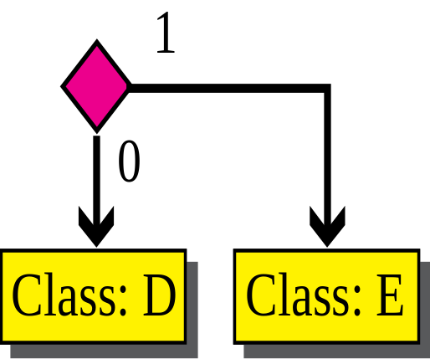
Finding the Addresses Class Using Continuous Checking

Slide 15
Example 5.10
Find the class of each address:
a. 00000001 00001011 00001011 11101111
b. 11000001 10000011 00011011 11111111
c. 10100111 11011011 10001011 01101111
d. 11110011 10011011 11111011 00001111
Solution
See the procedure in Figure 5.7
a. The first bit is 0. This is a class A address.
b. The first 2 bits are 1; the third bit is 0. This is a class C address.
c. The first bit is 1; the second bit is 0. This is a class B address.
d. The first 4 bits are 1s. This is a class E address.

Slide 16
Netid and hostid of A, B, and C Classes
netid and hostid are of varying lengths, depending on the class of the address

Slide 17
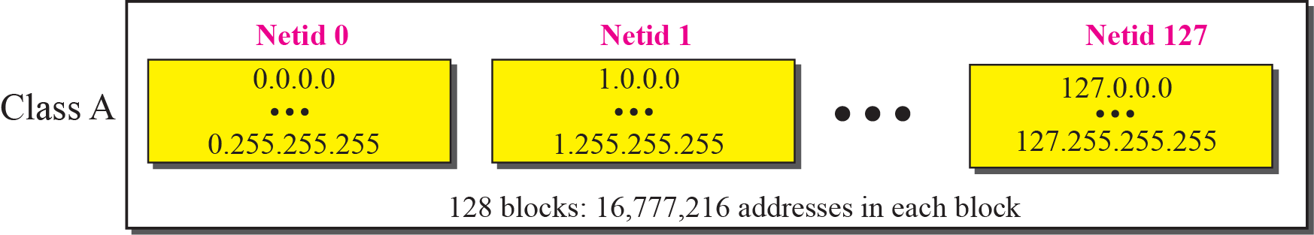
Blocks in Class A
Only 1 byte in class A defines the netid
The leftmost bit should be ‘0’
Class A is divided into 2⁷ = 128 blocks
Each block in class A contains 16,777,216 addresses

Slide 18
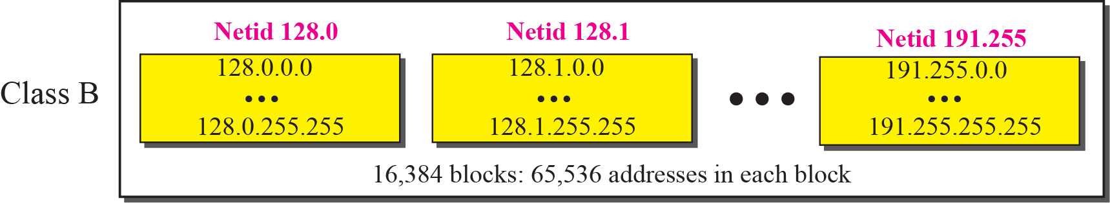
Blocks in Class B
2 bytes in class B define the class
The two leftmost bits should be ‘10’
Class B is divided into 2¹⁴ = 16,384 blocks
Each block in class B contains 65,536 addresses

Slide 19
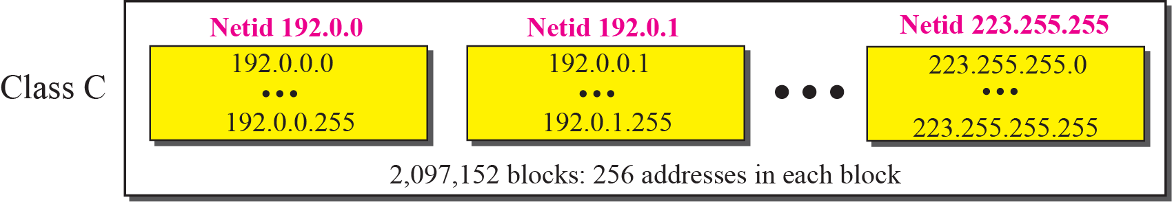
Blocks in Class C
3 bytes in class C define the class
The three leftmost bits should be ‘110’
Class C is divided into 2²¹ = 2,097,152 blocks
Each block in class C contains 256 addresses

Slide 20
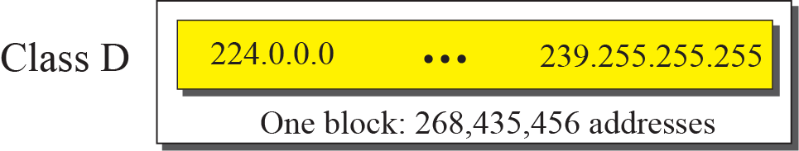
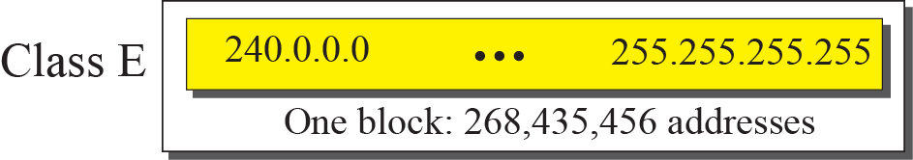
The Single Block in Class D and E
Class D
  Class D is designed for multicasting
  Used to define one group of hosts on the Internet
Class E
  Reserved for future purposes

Slide 21
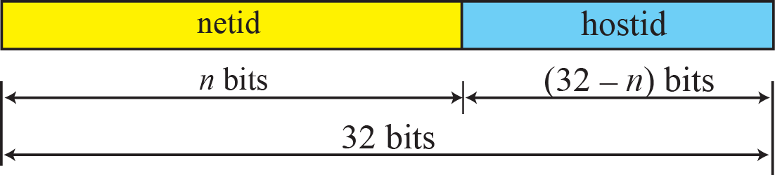
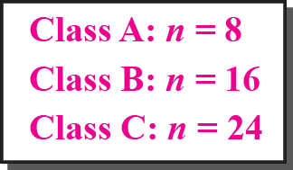
Two-Level Addressing

Slide 22
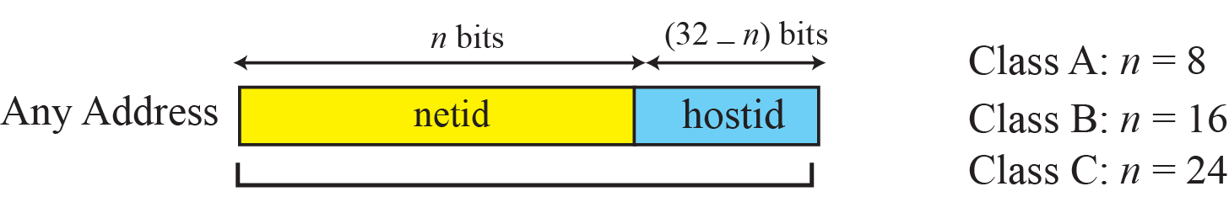
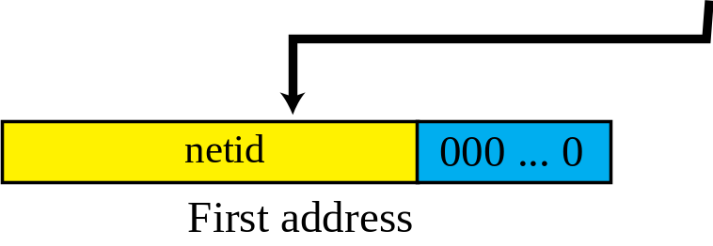
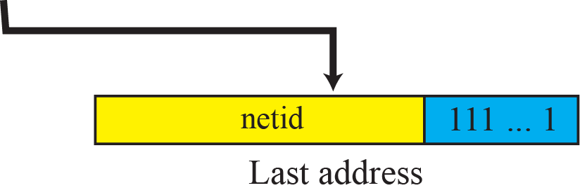
Information Extraction in Classful Addressing
The number of addresses
The first address
The last address

Slide 23
Example 5.13
An address in a block is given as 73.22.17.25. Find the number of addresses in the block, the first address, and the last address
Solution
The number of addresses in this block is
  N = 2^{32-n} = 2²⁴ = 16,777,216
To find the first address, we keep the left most 8 bits and set the rightmost 24 bits all to 0s. The first address is 73.0.0.0/8 in which 8 is the value of n.
To find the last address, we keep the leftmost 8 bits and set the rightmost 24 bits all to 1s. The last address is 73.255.255.255

Slide 24
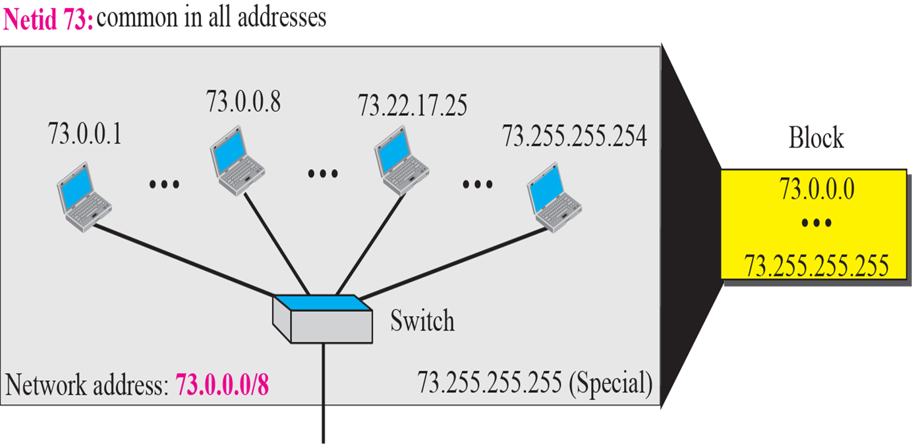
Solution of Example 5.13

Slide 25
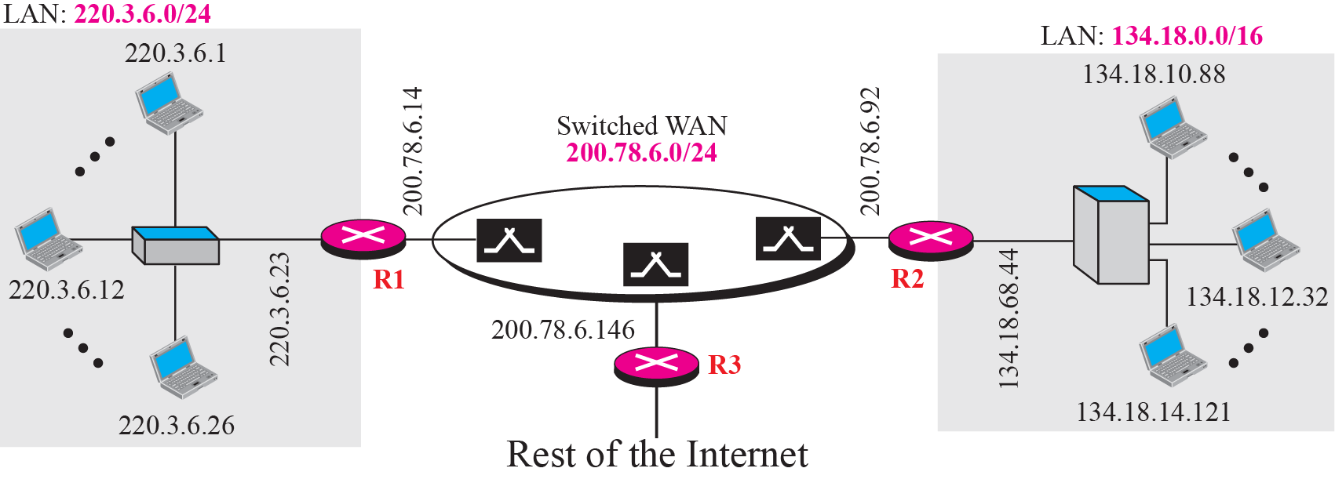
Sample Internet

Slide 26
Network Address
The first address of block is network address
Used in routing a packet to its destination network
The network address is the identifier of a network

Slide 27
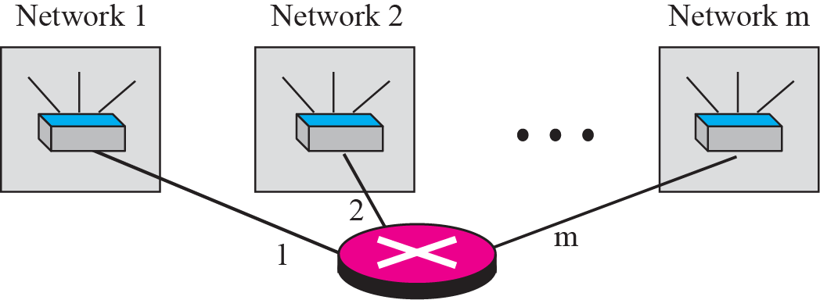
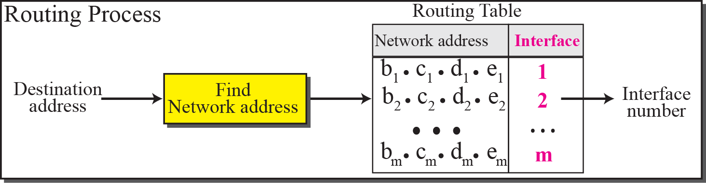
Network Address

Slide 28
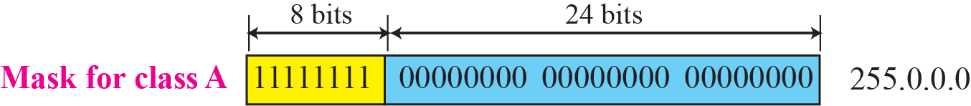
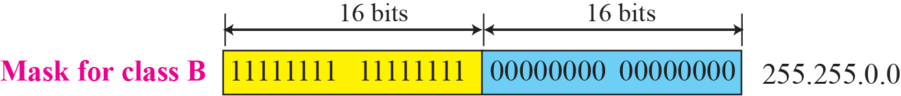
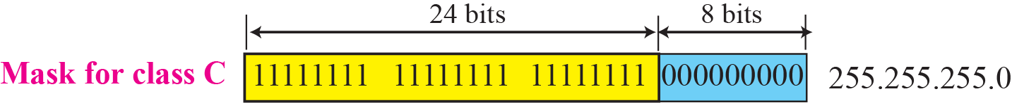
Network Mask
Used to extract the network address from the destination address of a packet
Called a default mask

Slide 29
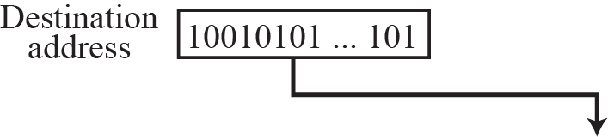
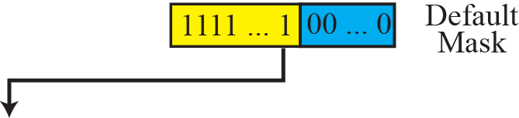
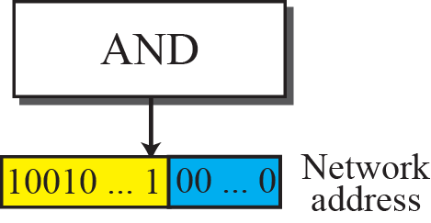
Finding a Network Address using the Default Mask

Slide 30
Example 5.16
A router receives a packet with the destination address 201.24.67.32. Show how the router finds the network address of the packet.
Solution
  Since the class of the address is B, we assume that the router applies the default mask for class B, 255.255.0.0 to find the network address.
Destination address -> | 201 | . | 24 | . | 67 | . | 32
Default mask -> | 255 | . | 255 | . | 0 | . | 0
Network address -> | 201 | . | 24 | . | 0 | . | 0

Slide 31
Three-Level Addressing : Subnetting
The organization that was granted a block in class A or B needed to divide its large network into several subnetworks for better security and management
In subnetting, a network is divided into several smaller subnetworks with each subnetwork having its own subnetwork address

Slide 32
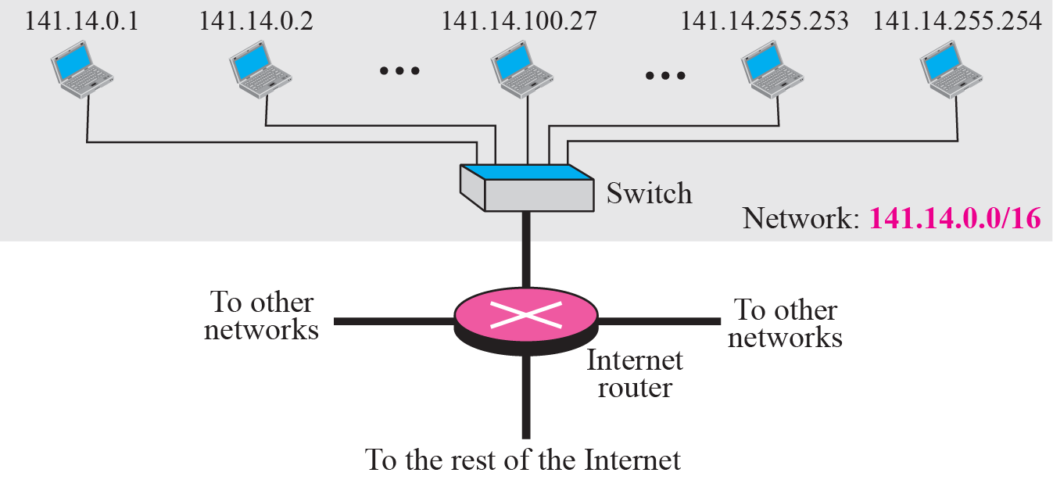
Example 5.18
The next figure shows a network using class B addresses before subnetting. We have just one network with almost 2¹⁶ hosts. The whole network is connected, through one single connection, to one of the routers in the Internet. Note that we have shown /16 to show the length of the netid (class B)

Slide 33
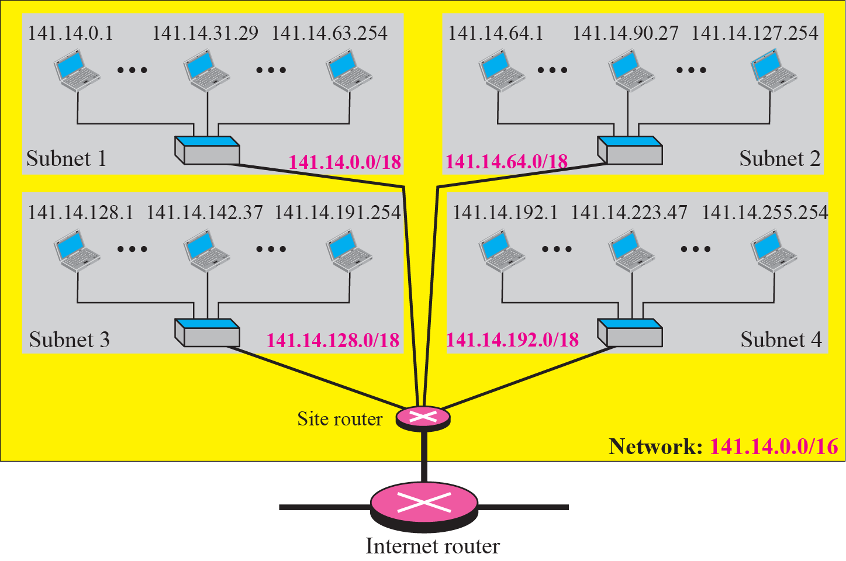
Example 5.19
The next figure shows same network in example 5.18 after subnetting.

Slide 34
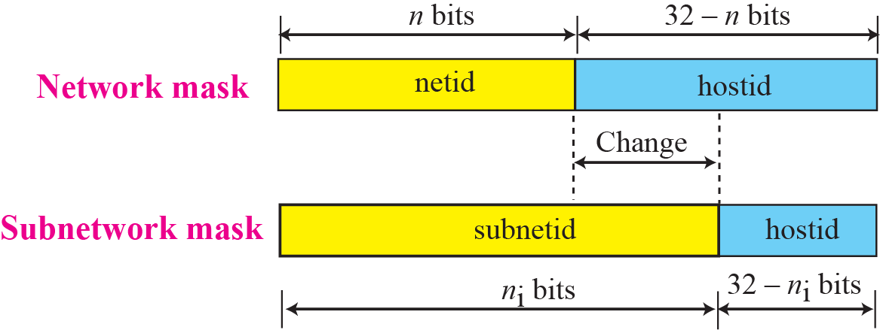
Network Mask and Subnet Mask

Slide 35
Supernetting
Combine several class C blocks to create a larger range of address
  An organization that needs 1000 addresses can be granted four class C blocks.
Supernet mask is the reverse of a subnet mask

Slide 36
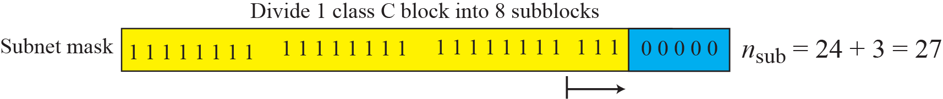
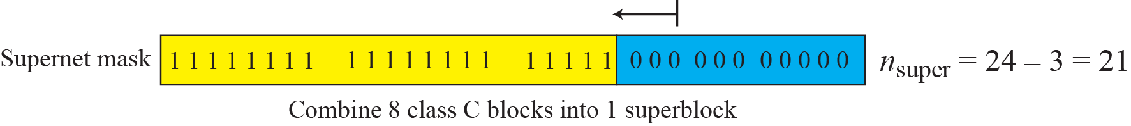
Comparison of Subnet, Default, and Supernet masks

Slide 37
5.3 Classless Addressing
Classful address did not solve the address depletion problem
  Distribution of addresses and the routing process more difficult
With the growth of the Internet, a larger address space was needed as a long-term solution
Although the long-range solution has already been devised and is called IPv6, a short-term solution was also devised to use the same address space but to change the distribution of addresses
  Classless addressing

Slide 38
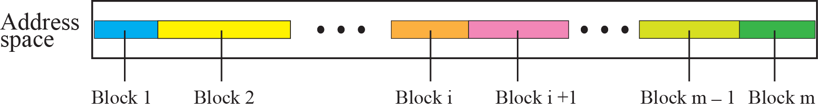
Variable-length blocks in Classless Addressing
In classless addressing, whole address space id divided into variable length blocks
  Theoretically, we can have a block of 2⁰, 2¹, 2², … 2³² addresses

Slide 39
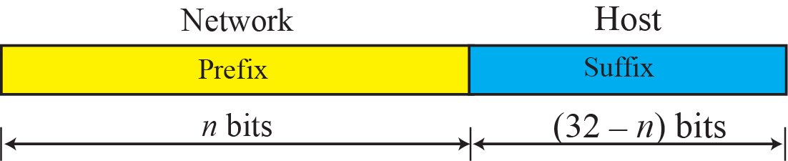
Prefix and Suffix
Prefix : play the same role as the netid
Suffix : play the same role as the hostid
The prefix length in classless addressing can be 1 to 32

Slide 40
Example 5.22
What is the prefix length and suffix length if the whole Internet is considered as one single block with 4,294,967,296 addresses?
Solution
In this case, the prefix length is 0 and suffix length is 32. All 32 bits vary to define 2³² = 4,294,967,296 hosts in this single block

Slide 41
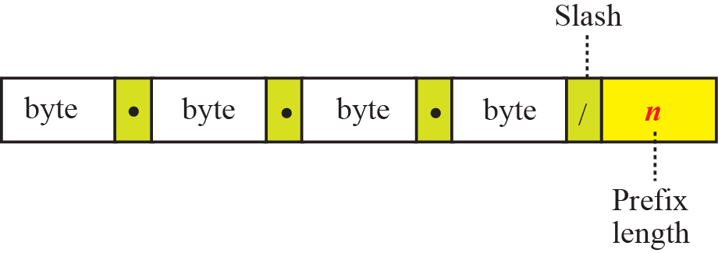
Slash Notation
Notation of address including length of prefix
In classless addressing, we need to know one of the addresses in the block and the prefix length to define the block

Slide 42
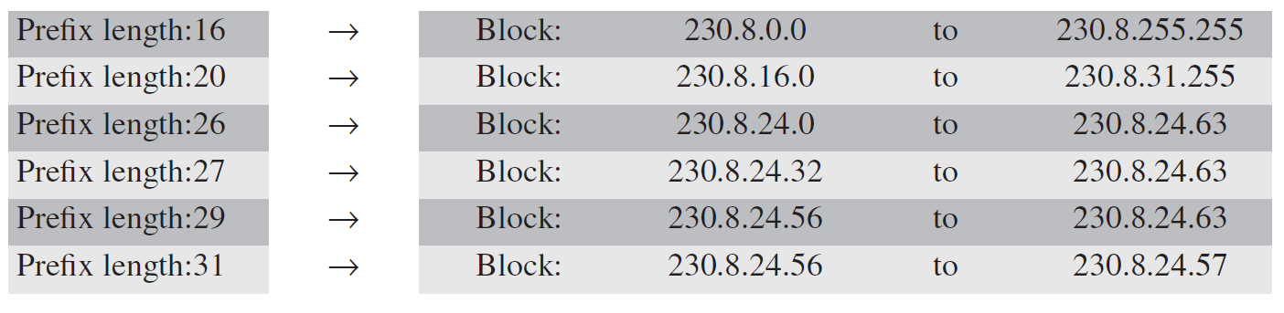
Example 5.25
In classless addressing, an address cannot per se define the block the address belongs to. For example, the address 230.8.24.56 can belong to many blocks some of them are shown below with the value of the prefix associated with that block :

Slide 43
Example 5.27
One of the address in a block is 167.199.170.82/27. To find the number of addresses in the network, the first address, and the last address.
Solution
The value of n is 27. The network mask has twenty-seven 1s and five 0s. It is 255.255.255.240.
The number of addresses in the network is 2^{32-n} = 2⁵ = 32
We use the AND operation to find the first address. The first address is 167.199.170.64/27
Address in Binary | 10100111 | 11000111 | 10101010 | 01010010
Network mask | 11111111 | 11111111 | 11111111 | 11100000.
First address | 10100111 | 11000111 | 10101010 | 01000000

Slide 44
Example 5.27(cont’d)
c. To find the last address, we first find the complement of the network mask and the OR it with the given address : the last address is 167.199.170.95/27
Address in Binary | 10100111 | 11000111 | 10101010 | 01010010
Network mask | 0000000 | 00000000 | 00000000 | 00011111
Last address | 10100111 | 11000111 | 10101010 | 01011111

Slide 45
Extracting Block Information
The number of addresses in the block can be found as
  N = 2^{32-n}
The first address in the block can be found by ANDing the address with the network mask
  First address = (any address) AND (network mask)
The last address in the block can be found by either adding the first address with the number of addresses or, directly, by ORing the address with complement (NOTing) of the network mask
  Last address = (any address) OR [NOT (network mask)]

Slide 46
Block Allocation
The ultimate responsibility of block allocation is given to a global authority called ICANN(Internet Corporation for Assigned Names and Address)
Assign a large block of addresses to an ISP (Internet Service Provider)
For the proper operation of the CIDR, there are three restrictions
  The number of requested addresses, N, needs to be power of 2.
  The value of prefix length can be found from the number of addresses in the block
  The requested block needs to be allocated where there are a contiguous number of unallocated addresses in the address space

Slide 47
Example 5.30
An ISP has requested a block of 1000 addresses. The following block is granted.
Since 1000 is not a power of 2, 1024 addresses are granted
The prefix length for the block is calculated as n = 32 – log₂1024 = 22
The beginning address is chosen as 18.14.12.0
The granted block is 18.14.12.0/22. The first address is 18.14.12.0/22 and the last address is 18.14.15.255/22

Slide 48
5.4 Special Addresses
In classful addressing some addresses were reserved for special purposes. The classless addressing scheme inherits some of these special addresses from classful addressing
Special block
  All-Zero Address
  All-One Address
  Loopback Address
  Private Address
  Multicast Address
Special address in each block
  Network Address
  Direct broadcast address

Slide 49
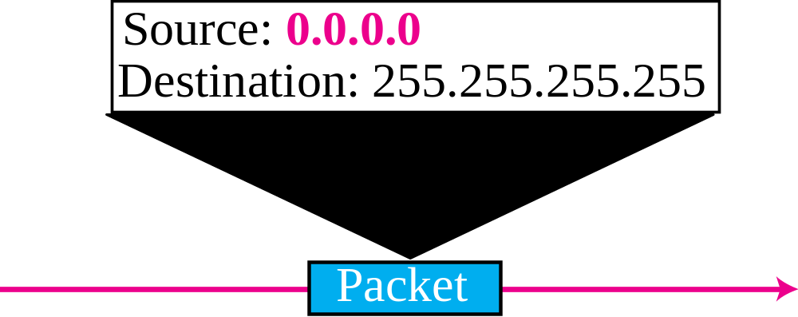
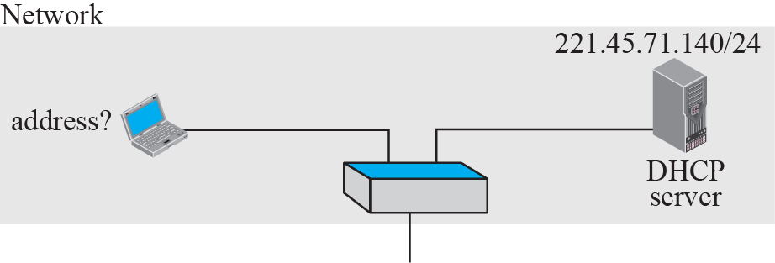
Example of using the all-zeros address
When a host needs to send an IPv4 packet but it does not know its own address

Slide 50
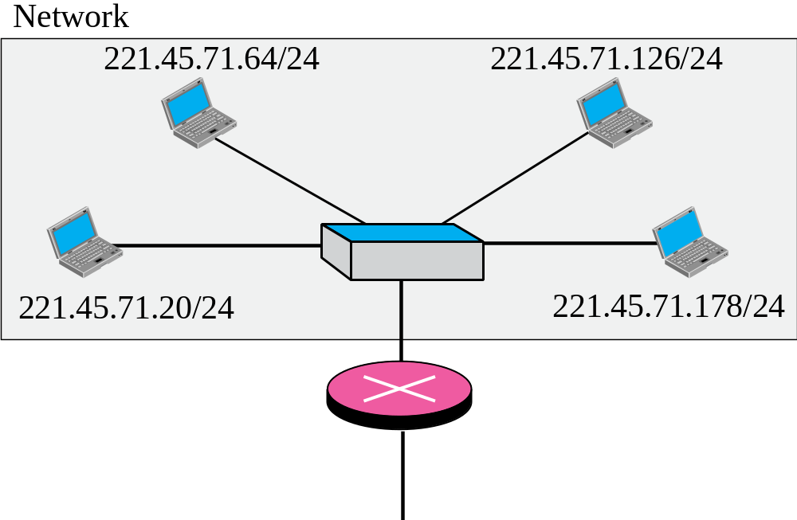
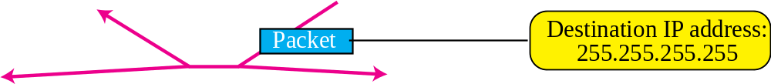
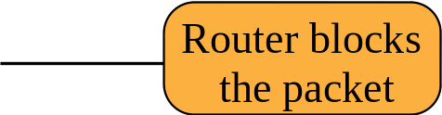
Example of Limited Broadcast Address
All-One Address
A host that wants to send a message to every other host can use

Slide 51
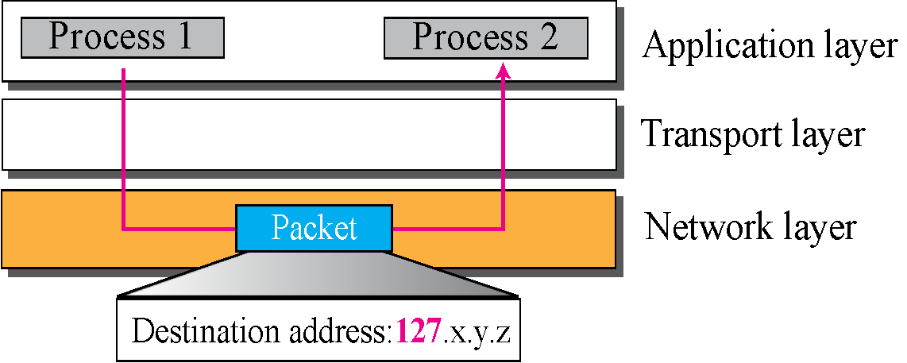
Example of Loopback Address
Used to test the software on a machine

Slide 52
Private address
Not recognize globally
Used either in isolation or in connection with network address translation technique
Block | Number of addresses | Block | Number of address
10.0.0.0/8 | 16,777,216 | 192.168.0.0/16 | 65,536
172.16.0.0/12 | 1,047,584 | 169.254.0.0/16 | 65,536

Slide 53
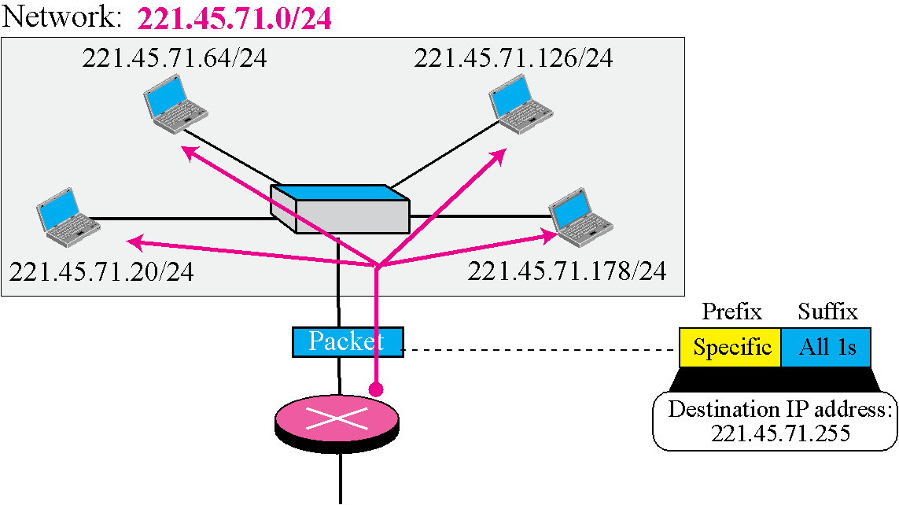
Example of Directed Broadcast Address

Slide 54
5.5 NAT
The distribution of addresses through ISPs has created a new problem
  ISP cannot rearrange the range of addresses
But in most situation, only a portion of computers in a small network need access to the Internet simultaneously
  The number of allocated addresses does not have to match the number of computers in the network
A technology that can provide the mapping between the private and universal addresses, and at the same time, support virtual private networks is NAT(Network Address Translation)

Slide 55
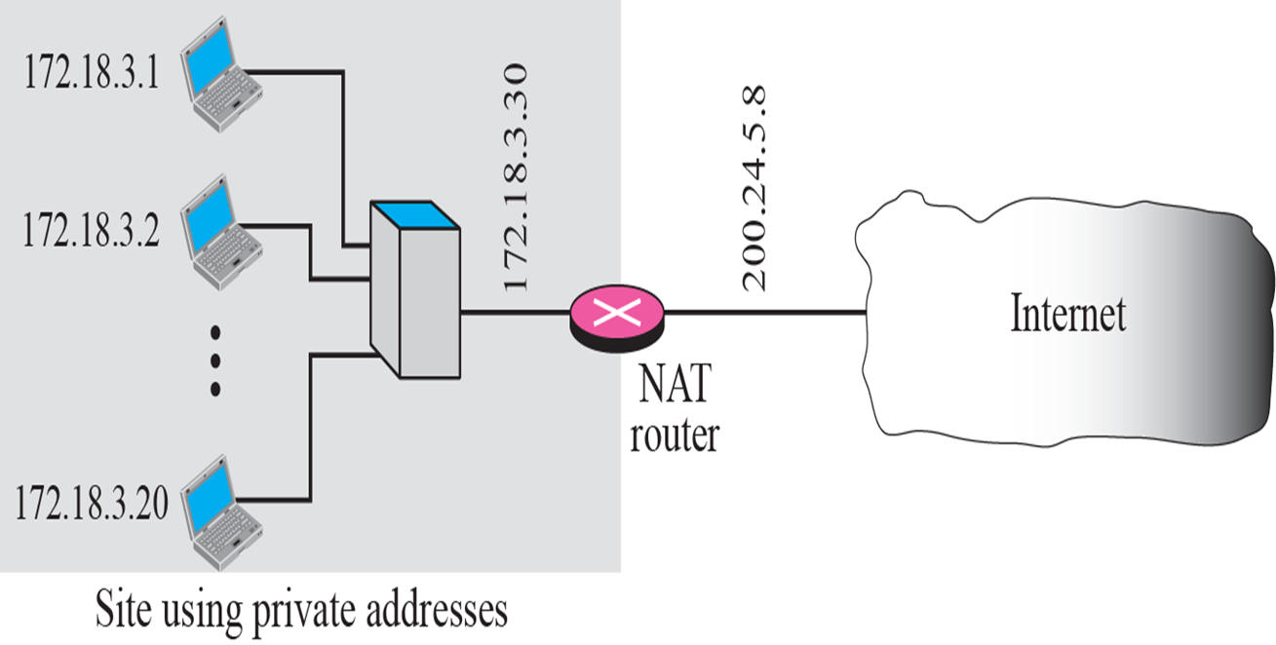

Example of NAT and Address Translation

Slide 56

Using One IP Address

Slide 57
Example of NAT
Using a pool of IP address
  Using one global address by the NAT router allows only one private-network host to access the same external host
    To remove this restriction, NAT router can use a pool of global addresses
Using both IP addresses and port addresses
  To allow a many-to-many relationship
Private Address | Private Port | External Address | External Port | Transport Protocol
172.18.3.1 | 1400 | 25.8.3.2 | 80 | TCP
172.18.3.2 | 1401 | 25.8.3.2 | 80 | TCP
… | … | … | … | ...

Slide 58
Summary (1)
The identifier used in the IP layer of the TCP/IP layer of the TCP/IP protocol suite is called the Internet address or IP address. An IPv4 address is 32 bits long. An address space is the total number of addresses used by the protocol. The address space of IPv4 is 2³² or 4,294,967,296.
In classful addressing, the IPv4 address space is divided into five classes: A, B, C, D, and E. An organization is granted a block in one of the three classes, A, B, or C. Classes D and E is reserved for special purpose. An IP address in classes A, B, and C is divided into netid and hostid.
In classful addressing, the first address in the block is called the network address. It defines the network to which an address belongs. The network address is used in routing a packet to its destination network.
A network mask or a default mask in classful addressing is a 32-bit number with n leftmost bits all set to 1s and (32 – n) rightmost bits all set to 0s. It is used by a router to find the network address from the destination address of a packet.
The idea of splitting a network into smaller subnetworks is called subnetting. A subnetwork mask, like a network mask, is used to find the subnetwork address when a destination IP address is given. In supernetting, an organization can combine several class C blocks to create a larger range of addresses.

Slide 59
Summary (2)
In 1996, the Internet authorities announced a new architecture called classless addressing, or CIDR (classless Inter-domain routing) that allows an organization to have a block addresses of any size as long as the size of the block is a power of two.
The address in classless addressing is also divided into two parts: the prefix and the suffix. The prefix plays the same role as the netid; the suffix plays the same role as the hostid. All addresses in the block have the same prefix; each address has a different suffix
Some of the blocks in IPv4 are reserved for special purpose. In addition, some addresses in a block are traditionally used for special addresses. These addresses are not assigned to any host.
To improve the distribution of addresses, NAT technology has been created to allow separation of private addresses in a network from the global addresses used in the Internet. A translation table can translate the private addresses, selected from the blocks allocated for this purpose, to global addresses. The translation table also translates the IP addresses as well as the port number for mapping from the private to global addresses and vice versa.

Slide 60

Q and A

