Slide 1
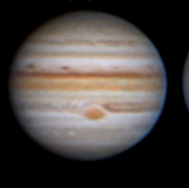
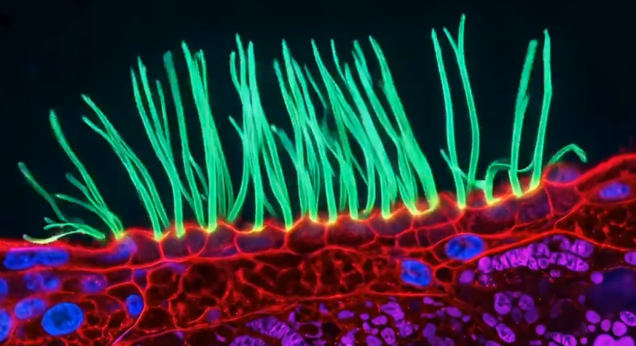

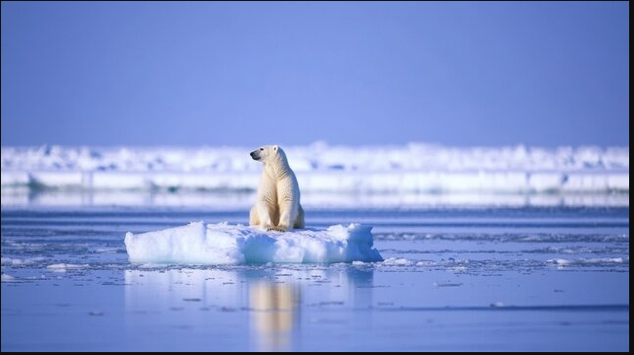
Soft-Matter @ NORDITA
Dhrubaditya (Dhruba) Mitra

Slide 2
us
friends
Anthony Bonfils
Ralf Eichorn
Dhrubaditya (dhruba) Mitra
Pijush Patra
John Wettlaufer
Mason Porter (NORDITA)
Supriya Krishnamurthy (SU)

Slide 3
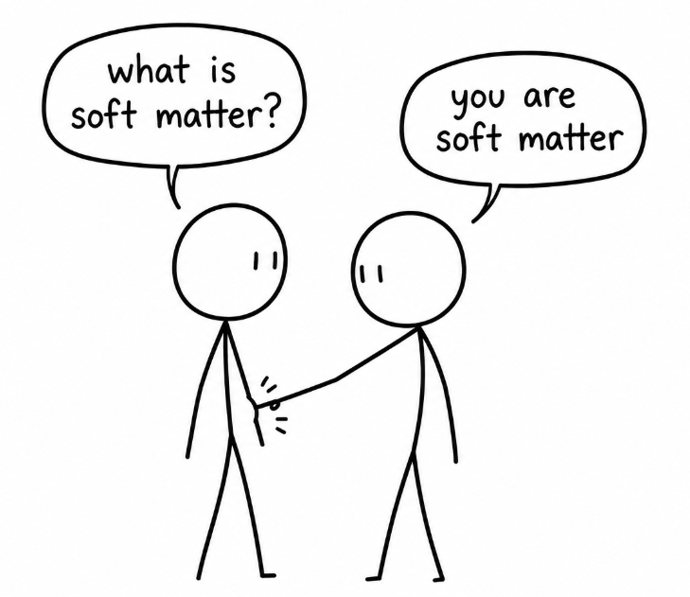

Slide 4
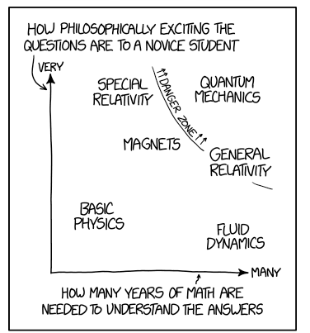
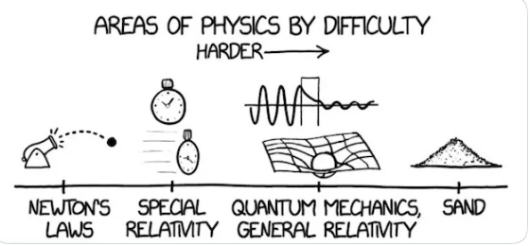

Slide 5
Abnormal beating of airway cillia (micro meter)
https://www.nikonsmallworld.com/galleries/2026-small-world-in-motion-competition/abnormal-beating-of-airway-cilia-from-a-child-with-primary-ciliary-dyskinesia-pcd

Slide 6
3D Medical Animations : John Leiber : Art of the Cell
Animation of subcellular processes

Slide 7
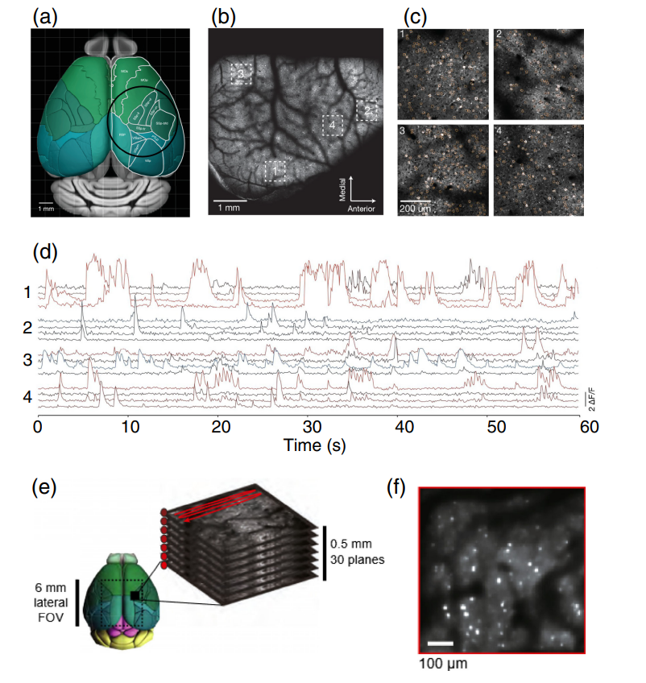
Imaging from individual cells with voltage sensitive dyes (scale mm )
Data from mouse cortex. Sampling rate is 9.6 Hz. Individual neurons can sometime be identified and If we know the underlying wiring diagram then the activity can be connected to that. In two dimensions we are reaching 1000 neurons, the recording can go on for days. There are challenges to make sure that the recordings are from the same cell.

Slide 8
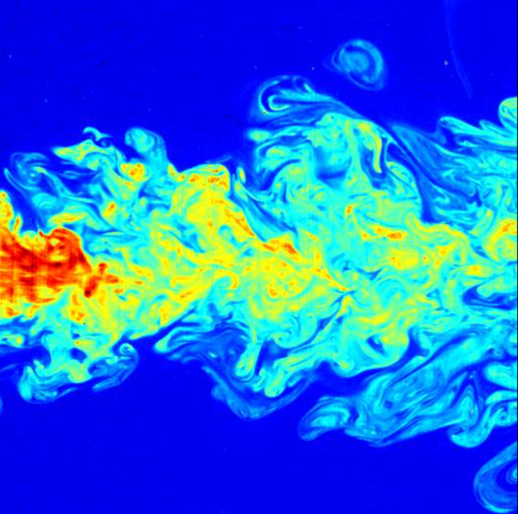
Engineering Turbulence (scale meters)

Slide 9
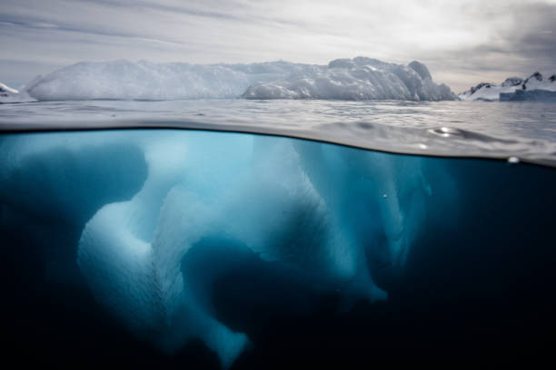
Ice floe (scale 10 meter)

Slide 10
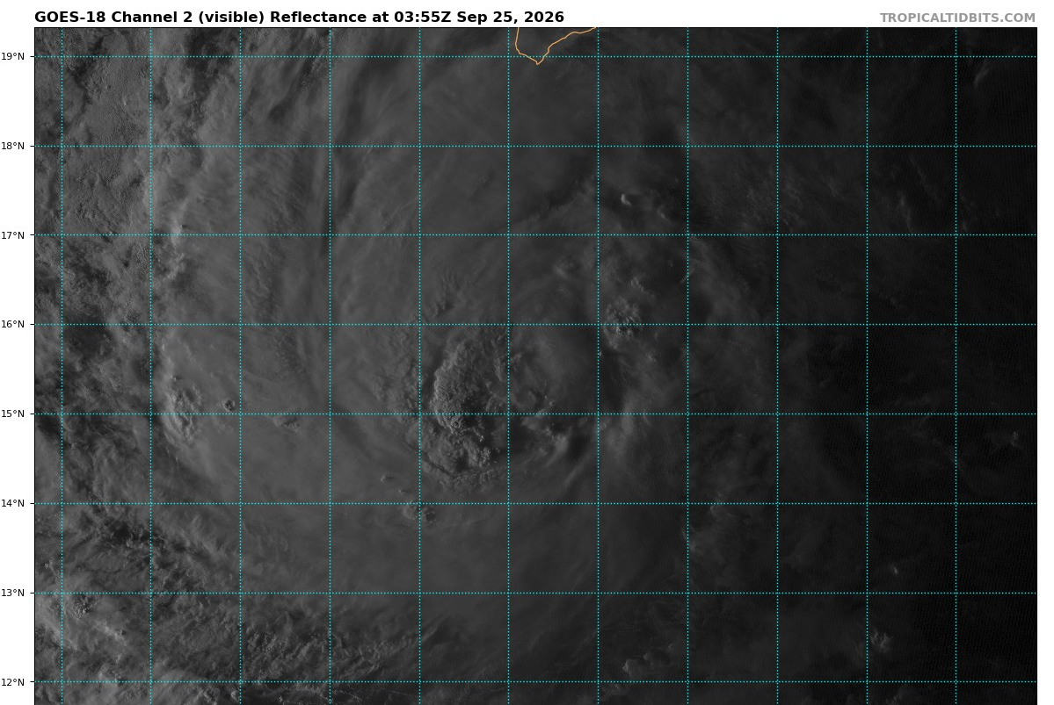
Tropical cyclone (scale kms)

Slide 11
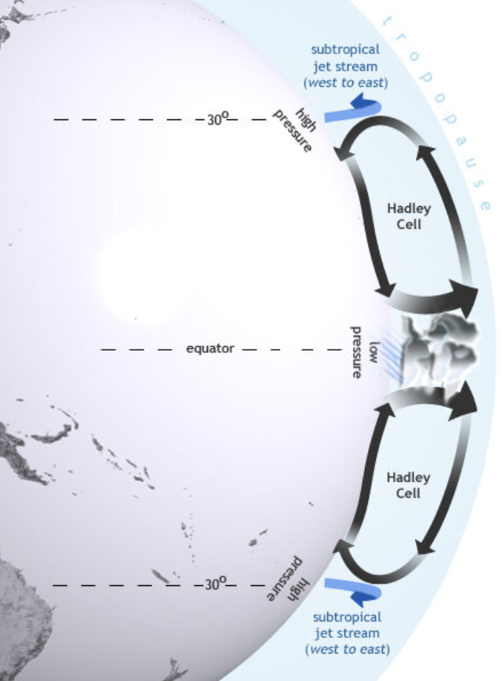
Hadley cells (scale 100 km)

Slide 12
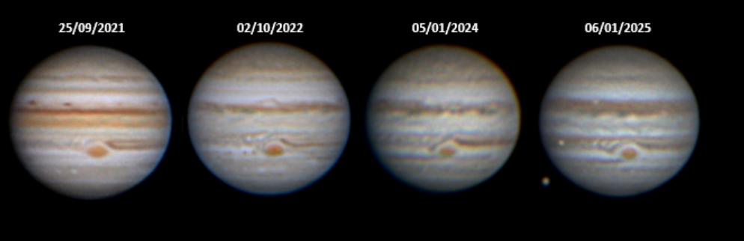
Great red spot of Jupiter (scale Mm)

Slide 13
What do we do ?
Statistical Mechanics ( Beyond second law, active matter ...)
Biophysics
Climate Science
Turbulence
Fluid Mechanics
Elasticity
Neuroscience
Astrophysics

Slide 14
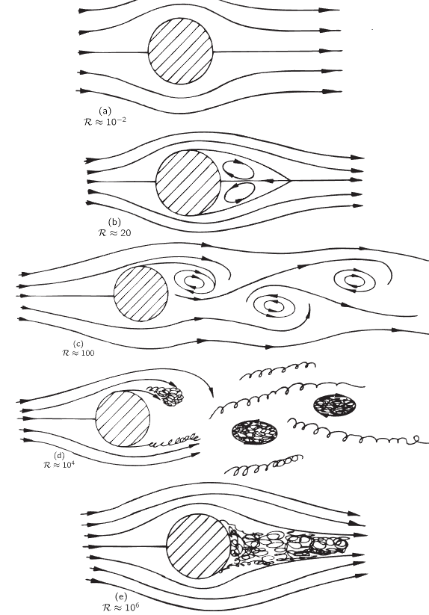
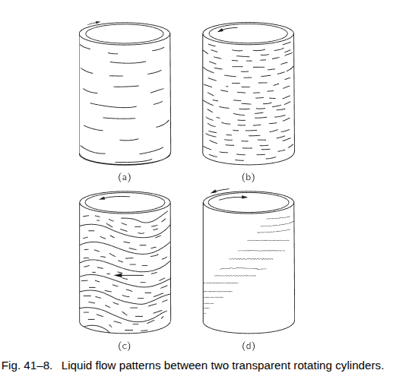
Why is it difficult ?
“ I was born late, all easy problems are solved, all beautiful women are married “ - Landau
NON-LINEAR

Slide 15
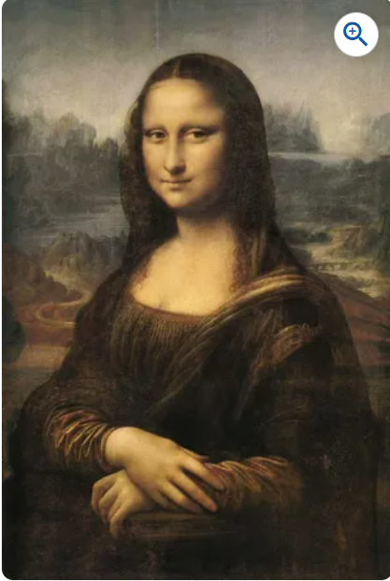

Intermediate asymptotics
There is a range of scales over which the theory is scale invarint

Slide 16
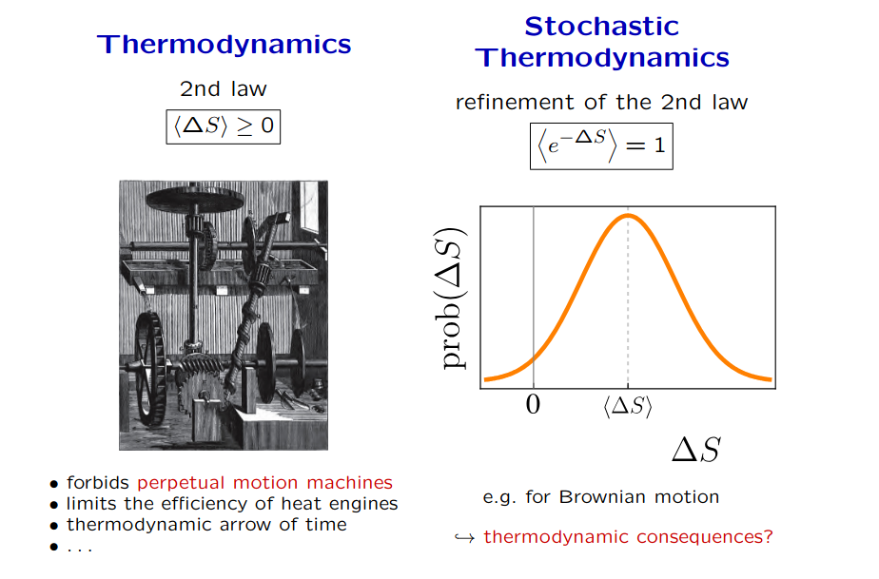
NON-EQUILIBRIUM

Slide 17
Techniques
Numerical Simulations (Monte-carlo, PDEs, ML/AI, GPU computing ...)
Probability Theory
PDEs
Asymptotic Methods ( matched expansions, boundary layer, renormalization group ...)
Stability theory

Slide 18

Chaos is brickyard
Q: How to make sense out of so much data ?
Counter Q : how is it done in other parts of physics ?

Slide 19
What do want from you
Unlimited curiosity
Excellent work ethics
Supriya’s course on stat mech. (SU students)
Stat. Mech., Fluids courses for KTH students
Computational Physics students welcome
Want to apply QFT/RG to soft matter problems ? Courses on path integrals and Feynman Diagrams either in QFT or Stat Mech

Slide 20
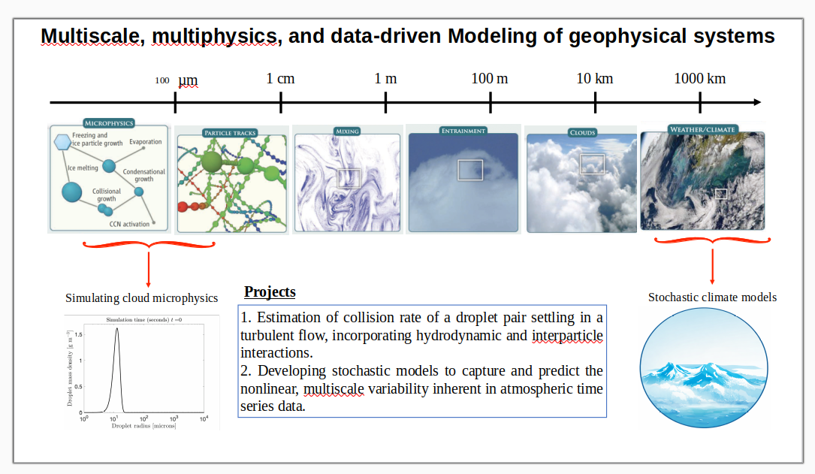
Pijush Patra

Slide 21
