Slide 1

Amortized Analysis
2022
B.Sc Sem IV

Slide 2
Presenter
Ritidip Sarkar
Dhruba saha
Saptak Roy Akash

Slide 3
Introduction
Ritidip Sarkar

Slide 4
Amortized Analysis
Not just consider one operation, but a sequence of operations on a given data structure.
Average cost over a sequence of operations.
Probabilistic analysis:
Average case running time: average over all possible inputs for one algorithm (operation).
If using probability, called expected running time.
Amortized analysis:
No involvement of probability
Average performance on a sequence of operations, even some operation is expensive.
Guarantee average performance of each operation among the sequence in worst case.

Slide 5
Three Methods of Amortized Analysis
Aggregate analysis:
Total cost of n operations/n,
Accounting method:
Assign each type of operation an (different) amortized cost
overcharge some operations,
store the overcharge as credit on specific objects,
then use the credit for compensation for some later operations.
Potential method:
Same as accounting method
But store the credit as “potential energy” and as a whole.

Slide 6
Aggregate Analysis
Ritidip Sarkar

Slide 7
Aggregate Analysis : Stack Operation
Stack operations:
PUSH(S,x), O(1)
POP(S), O(1)
MULTIPOP(S,k), min(s,k)
while not STACK-EMPTY(S) and k>0
do POP(S)
k=k-1
Let us consider a sequence of n PUSH, POP, MULTIPOP.
The worst case cost for MULTIPOP in the sequence is O(n), since the stack size is at most n.
thus the cost of the sequence is O(n²). Correct, but not tight.

Slide 8
Aggregate Analysis
In fact, a sequence of n operations on an initially empty stack cost at most O(n). Why?
Each object can be POP only once (including in MULTIPOP) for each time
it is PUSHed. #POPs is at most #PUSHs, which is at most n.
Thus the average cost of an operation is O(n)/n = O(1).
Amortized cost in aggregate analysis is defined to be average cost.

Slide 9
Another example: increasing a binary counter
Binary counter of length k, A[0..k-1] of bit array.
INCREMENT(A)
i←0
while i<k and A[i]=1
do A[i]←0 (flip, reset)
i←i+1
if i<k
then A[i]←1 (flip, set)

Slide 10
Analysis of INCREMENT(A)
Cursory analysis:
A single execution of INCREMENT takes O(k) in the worst case (when A contains all 1s)
So a sequence of n executions takes O(nk) in worst case (suppose initial counter is 0).
This bound is correct, but not tight.
The tight bound is O(n) for n executions.

Slide 11
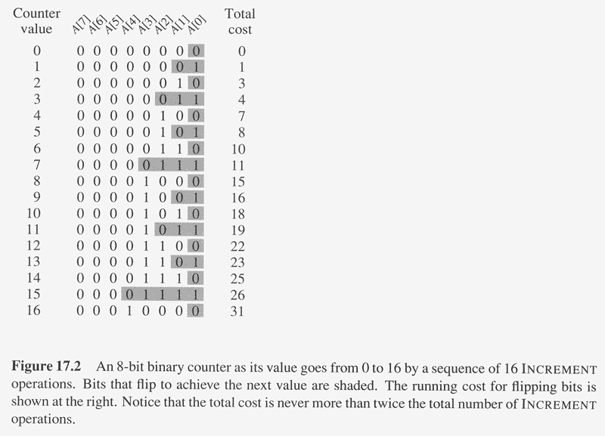
Amortized (Aggregate) Analysis of INCREMENT(A)
Observation: The running time determined by #flips
but not all bits flip each time INCREMENT is called.
A[0] flips every time, total n times.
A[1] flips every other time, ⎣n/2⎦ times.
A[2] flips every forth time, ⎣n/4⎦ times.
….
for i=0,1,…,k-1, A[i] flips ⎣n/2^{i}⎦ times.
Thus total #flips is ∑_{i=0}^{k-1} ⎣n/2^{i}⎦ < n∑_{i=0}∞ 1/2^{i}
=2n.

Slide 12
Amortized Analysis of INCREMENT(A)
Thus the worst case running time is O(n) for a sequence of n INCREMENTs.
So the amortized cost per operation is O(1).

Slide 13
Accounting Method

Slide 14
Amortized Analysis: Accounting Method
Idea
Assign differing charges to different operations.
The amount of the charge is called amortized cost.
amortized cost is more or less than actual cost.
When amortized cost > actual cost, the difference is saved in specific objects as credits.
The credits can be used by later operations whose amortized cost < actual cost.
As a comparison, in aggregate analysis, all operations have same amortized costs.

Slide 15
Accounting Method (cont.)
Conditions
suppose actual cost is c_{i} for the ‘i’ th operation in the sequence, and amortized cost is c_{i}’.
∑_{i=1}^{n} c_{i}' ≥∑_{i=1}^{n} c_{i} should hold.
since we want to show the average cost per operation is small using amortized cost, we need the total amortized cost is an upper bound of total actual cost.
holds for all sequences of operations.
∑_{i=1}^{n} c_{i}' - ∑_{i=1}^{n} c_{i} , which should be nonnegative

Slide 16
Accounting Method: Dynamic Tables
Charge i th operation a fictitious amortized cost c_{i}' , where $1 pays for 1 unit of work(i.e. time).
This fee is consumed to perform the operation.
Any amount not immediately consumed is stored in the bank for use by subsequent operations.
The bank balance must not go negative. We must ensure that
∑_{i=1}^{n} c_{i}' ≥∑_{i=1}^{n} c_{i} for all n.
Thus , the total amortized costs provide an upper bound on the total true cost.

Slide 17
Accounting Method: Dynamic Tables (cont.)
Charge an amortized cost of c_{i}’ =$3 for the i th insertion.
$1 pays for the immediate insertion.
$2 is stored for later for table doubling
When the table doubles, $1 pays to move a recent items, and 1$ pays to move and old item.
Example:
Overflow
$0 | $0 | $0 | $0 | $2 | $2 | $2 | $2

Slide 18
Accounting Method: Dynamic Tables (cont.)
Charge an amortized cost of c_{i}’ =$3 for the i th insertion.
$1 pays for the immediate insertion.
$2 is stored for later for table doubling
When the table doubles, $1 pays to move a recent items, and 1$ pays to move and old item.
Example:
$0 | $0 | $0 | $0 | $0 | $0 | $0 | $0 | $2 | $2 | $2 | $2 | $2 | $2 | $2 | $2

Slide 19
Accounting Method: Dynamic Tables (cont.)
i | 1 | 2 | 3 | 4 | 5 | 6 | 7 | 8 | 9 | 10
size _{i} | 1 | 2 | 4 | 4 | 8 | 8 | 8 | 8 | 16 | 16
c_{i} | 1 | 2 | 3 | 1 | 5 | 1 | 1 | 1 | 9 | 1
c_{i}' | 2* | 3 | 3 | 3 | 3 | 3 | 3 | 3 | 3 | 3
bank_{i} | 1 | 2 | 2 | 4 | 2 | 4 | 6 | 8 | 2 | 4
Bank balance never drops below 0. Thus sum of the amortized costs provide an upper bound on the sum of the true cost
* Initial value can be any as long as bank_{i} ≥ 0

Slide 20
Accounting Method: Stack Operations
Actual costs
PUSH :1, POP :1, MULTIPOP: min(s,k).
Let assign the following amortized costs:
PUSH:2, POP: 0, MULTIPOP: 0.
Similar to a stack of plates in a cafeteria.
Suppose $1 represents a unit cost.
When pushing a plate, use one dollar to pay the actual cost of the push and leave one dollar on the plate as credit.
Whenever POPing a plate, the one dollar on the plate is used to pay the actual cost of the POP. (same for MULTIPOP).
By charging PUSH a little more, do not charge POP or MULTIPOP.

Slide 21
Accounting Method: Stack Operations(cont.)
The total amortized cost for n PUSH, POP, MULTIPOP is O(n), thus O(1) for average amortized cost for each operation.
Conditions hold: total amortized cost ≥total actual cost, and amount of credits never becomes negative.

Slide 22
Potential Method

Slide 23
The Potential Method
Same as accounting method: something prepaid is used later.
Different from accounting method
The prepaid work not as credit, but as “potential energy”, or “potential”.
The potential is associated with the data structure as a whole rather than with specific objects within the data structure.

Slide 24
The Potential Method (cont.)
Initial data structure D₀,
n operations, resulting in D₀, D₁,…, D_{n} with costs c₁, c₂,…, c_{n}.
A potential function Φ: {D_{i}} → R (real numbers)
Φ(D_{i}) is called the potential of D_{i}.
Amortized cost c_{i}' of the ith operation is:
c_{i}' = c_{i} + Φ(D_{i}) - Φ(D_{i-1}). (actual cost + potential change)
∑_{i=1}^{n} c_{i}' = ∑_{i=1}^{n} (c_{i} + Φ(D_{i}) - Φ(D_{i-1}))
= ∑_{i=1}^{n}c_{i} + Φ(D_{n}) - Φ(D₀)

Slide 25
Potential method: stack operation
Potential for a stack is the number of objects in the stack.
So Φ(D₀)=0, and Φ(D_{i}) ≥0
Amortized cost of stack operations:
PUSH:
Potential change: Φ(D_{i})- Φ(D_{i-1}) =(s+1)-s =1.
Amortized cost: c_{i}' = c_{i} + Φ(D_{i}) - Φ(D_{i-1})=1+1=2.
POP:
Potential change: Φ(D_{i})- Φ(D_{i-1}) =(s-1) –s= -1.
Amortized cost: c_{i}' = c_{i} + Φ(D_{i}) - Φ(D_{i-1})=1+(-1)=0.
MULTIPOP(S,k): k'=min(s,k)
Potential change: Φ(D_{i})- Φ(D_{i-1}) = –k'.
Amortized cost: c_{i}' = c_{i} + Φ(D_{i}) - Φ(D_{i-1})=k'+(-k')=0.
So amortized cost of each operation is O(1), and total amortized cost of n operations is O(n).
Since total amortized cost is an upper bound of actual cost, the worse case cost of n operations is O(n).

Slide 26
Potential method: binary counter
Define the potential of the counter after the ith INCREMENT is Φ(D_{i}) =b_{i}, the number of 1’s. clearly, Φ(D_{i})≥0.
Let us compute amortized cost of an operation
Suppose the ith operation resets t_{i} bits.
Actual cost c_{i} of the operation is at most t_{i} +1.
If b_{i}=0, then the ith operation resets all k bits, so b_{i-1}=t_{i}=k.
If b_{i}>0, then b_{i}=b_{i-1}-t_{i}+1
In either case, b_{i}≤b_{i-1}-t_{i}+1.
So potential change is Φ(D_{i}) - Φ(D_{i-1}) ≤b_{i-1}-t_{i}+1-b_{i-1}=1-t_{i.}
So amortized cost is: c_{i}' = c_{i} + Φ(D_{i}) - Φ(D_{i-1}) ≤ t_{i} +1+1-t_{i}=2.
The total amortized cost of n operations is O(n).
Thus worst case cost is O(n).

Slide 27
Thank You…

