Slide 1
Assessing Operations and Services of New Schools: Shishu Niketan
BRAC Monitoring Department

Slide 2
Objectives
To assess
operation of Shishu Niketan schools opened in 2018
satisfaction of the parents regarding school operation

Slide 3
Methodology

Slide 4
Methodology
Quantitative
Quantitative method explored operational issues based on given guidelines by the programme
Qualitative
Qualitative method explored satisfaction of parents on school operation, teaching, and other facilities
Data were collected through interview (teacher/PO), document review, and observation
Samples: 91 schools
Samples: 2 FGDs and 4 IDIs

Slide 5
Methodology: Sample Selection Procedure
Number of Shishu Niketan schools was small in the population
Hence, the study covered only those braches where 3 or more Shishu Niketon schools were opened
Following this, study covered 25 branches under 6 regions (except Chattogram)
The study collected information from 91 Shishu Niketan schools
Dhaka | Khulna | Mymensingh | Rajshahi | Rangpur | Sylhet | Total
13% | 9% | 27% | 22% | 18% | 11% | 91

Slide 6
Findings

Slide 7
Students’ Information
Opening month
84 schools opened during the month of January
7 schools opened in February
92%
Schools opened in January
8%
Schools opened in February

Slide 8
Students’ Information
Number of students (average) in Shishu Niketon schools
Number of admitted students 31 (average)
Average number of drop out students is 2
Girls admission was 45%
No PWD students in 28% schools
Number of students (avg.) | Boys | Girls | Total
School opening report | 17 | 14 | 31
Attendant register book | 15 | 14 | 29
Present during observed day | 15 | 12 | 27 (93%)

Slide 9
Students’ Information
Waived students
40% schools were found with waived students and 7% with full waived
Permission letters found only in 75% and 67% cases
In 83% cases, permissions were yet to receive
Waived students | Numbers/ percentage | Full waived students | Numbers/ percentage
Schools with waived students | 40% (36) | Schools with free students | 7% (6)
Number of students | 148 | Number of students | 7
With permission | 75% | With permission | 67%

Slide 10
Teachers’ Information
34 years
Average age of all teachers
12%
Share of newly recruited teachers
25 years
Average age of new teachers
45%
New teachers were then studying
27%
New teachers were then unmarried
100%
Teachers had sat for and passed recruitment test

Slide 11
Teachers’ Information
Education attainment of all teachers
1% and 49% of all teachers were found with highest education of Class 10 and SSC passed respectively
Among the new teachers, 9% teachers were found with SSC as highest educational attainment
There was no new teachers below SSC level

Slide 12
Teachers’ Information
82%
Teachers did not receive basic training
9%
Did not receive orientation
Reasons for not receiving basic training
Yet to get a schedule
Reasons for not having an orientation
Teacher is very much new, yet to get a schedule

Slide 13
Teachers’ Perception
Issues/activities suggested to be added to basic training
More rhymes
Hand writing practice
More drawing practice
English pronunciation
More time for Deep-shikha

Slide 14
School building: Physical Properties
New school 16%
Area <318 ft² 2%
Windows # <5 16%
Low light 7%
Insufficient light 7%
Ceiling 89%
Partial ceiling 16%
Veranda 7%
Playing field 37%
Cement floor 87%
Reasons behind insufficient lights
Trees around the school room
Small windows

Slide 15
School building: Physical Properties
No drinking water 4%
No latrine 2%
Not usable 6%
Defective blackboards 9%
No glass/jug 20%
No sign board 5%
Ceiling fan 91%
Windows opens inside 68%
Latrines not usable due to
Broken pan
Broken ring
Dirty floor
Status of blackboards-
Broken – 26%
Uneven – 53%
Colour faded -21%

Slide 16
Classroom Observation
Classroom teaching was observed for 90 schools
In 95% classes, teachers made the students to study/work in small or big groups
In 82% classes, where necessary, teachers called students to write on board
In 2% teachers stood in one place while teaching the class
95%
82%
2%
Group works (small/big)
Calling students to write on board
Teachers stood in one place

Slide 17
Qualitative Findings

Slide 18
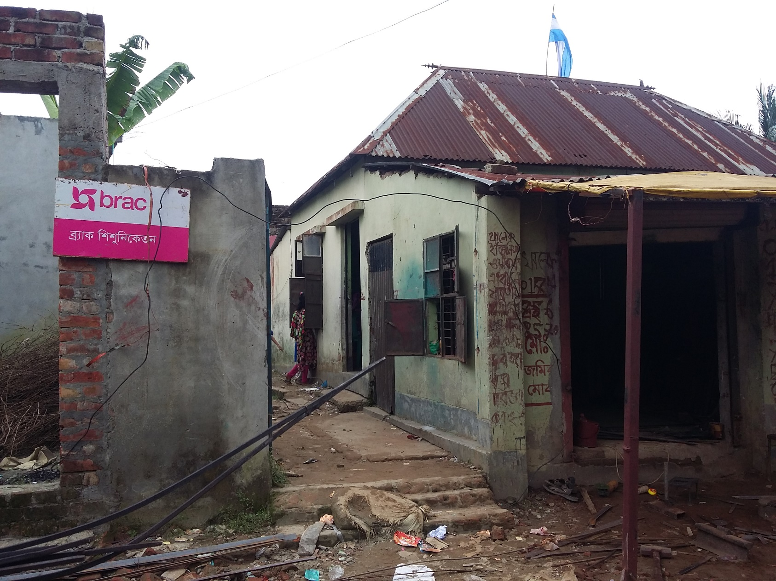

Slide 19
Parents’ Feedback
School operation
Teacher maintains class time
If any student get sick in school then the teacher takes care of the student
School management
PO checks the student’s progress regularly
Parents’ meetings are ensured every month
School fees are high
Monthly parents’ meeting is a specialty of BRAC schools

Slide 20
Parents’ Feedback
Teaching quality
Education activities are sufficient
School facility
Ceiling fan is not working in schools
Latrines get dirty
Parents are happy with the teacher
Students come to school for dancing, singing and rhymes
Lack of play ground

Slide 21
Major Findings

Slide 22
Major Findings
Students’ information
All schools were opened in January (92%) and February (8%)
Average number of students were 31
45% students were girls
Average number of students attendance is 27
87% students were present in the schools
Number of waived students is 154, permission letters were not found for 29% cases
In 83% cases, permissions are yet to receive

Slide 23
Major Findings
Teachers’ Information
45% of new teachers were then students (studying)
27% of new teachers were then unmarried
9% teachers were found with highest education of SSC
82% new teachers did not receive basic training
9% new teachers did not receive orientation

Slide 24
Major Findings
School building
2% of new schools had room space less than recommended size
7% schools lacked sufficient day light
There were no open space/play ground in 63% schools
There was no drinking water facility in 4% schools and no latrine in 2% schools
94% latrines were usable
9% blackboards were defective
Windows open to inside in 68% schools

Slide 25
Recommendations

Slide 26
Recommendations
New teachers need to have basic training before they start teaching.
Also new teachers should have an orientation before starting teaching in schools.
Programme should ensure enough natural light in the classroom.
Programme should ensure that windows can be from outside.
Girls admission (45%) is lower than expected. Efforts should be given for equal gender participation.

Slide 27
Recommendations
Every school must have the facility of drinking water and usable latrine.
It is essential that there should be a jug and a glass for drinking water.
Programme should ensure that every blackboard is usable and the texts written on the board are readable.
Programme may change/fix the electric fans where necessary.

Slide 28
Thanks

