Slide 1
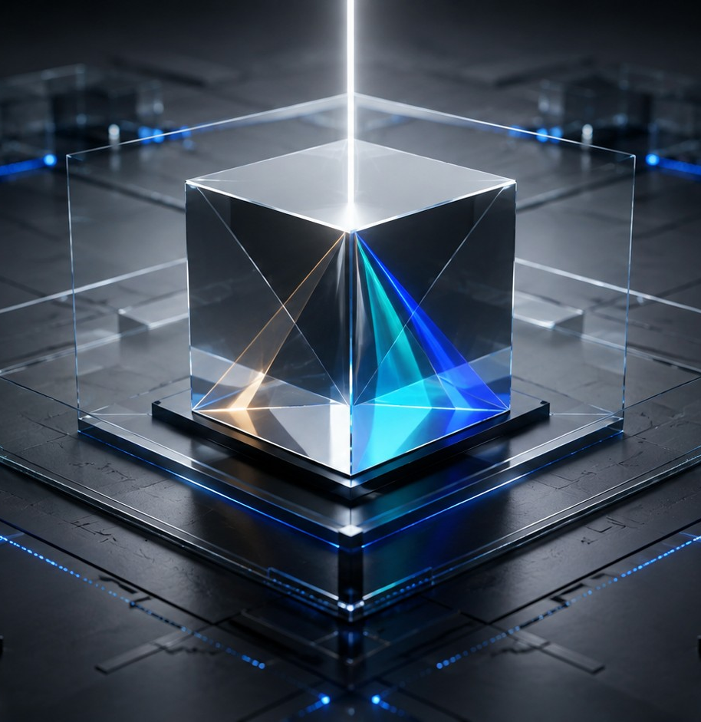
AI COURSES
Generative AI
What it actually makes, why every answer is different, and where it beats a search box.
AI-02
18 MINUTES
NEW JOINERS + STAFF
Start here → the next slide shows what this saves you.
AI-02 · Generative AI
Inducto Learning Library

Slide 2
WHY THIS MATTERS TO YOU
Menu
Shalini sends a line she never wrote
AFTER THIS MODULE
You will know why it does that, and how to catch it in four seconds.
Shalini runs marketing for a Pune plant. She asks an AI tool for a team note about a moved meeting. The note is excellent. It also mentions a quarterly bonus review that nobody has scheduled. Two people email HR about it.
An afternoon spent explaining a sentence she did not write.
AI-02 · Generative AI
Inducto Learning Library

Slide 3
WHAT YOU'LL BE ABLE TO DO
Menu
By the end, you can do these
Explain what "generative" means without using the word
Say why the same question gives two colleagues two answers
Choose between a search box and a generator, first time
Get three usable versions of a message from one set of facts
Spot an invented line in a draft before you send it
AI-02 · Generative AI
Inducto Learning Library

Slide 4
INTERACTIVE MENU
Tap any line to jump straight there
Every slide has a Menu button in the top-right corner to bring you back here.
01
What generative means
It builds — even when it looked something up first
02
What it can make
Text, structure, shorter versions, options
03
Why answers change
The same question, two answers
04
Search box or generator?
Pick the right one first time
05
Do this now
Make something in two minutes
06
Choose what you'd do
A Wednesday morning decision
07
Watch this
An 8-minute outside explainer
08
Quiz
5 questions, instant feedback
09
Recap card
The whole topic on one screen
10
Your toolkit
Templates, links, what to do next
AI-02 · Generative AI
Inducto Learning Library

Slide 5
WHAT GENERATIVE MEANS
Menu
It builds — even when a tool looked something up first
By default there is no file it is copying from — the wording is assembled the moment you ask for it. Some tools can search or read a document first and then build the answer from that; assume nothing was looked up unless the tool shows you it was.
1
2
3
4
You describe it
It builds
Nothing is copied
You get something new
In plain sentences, with your own facts in them.
Each word chosen to fit the words before it.
There is no stored answer being handed back to you.
Text that did not exist a second earlier.
AI-02 · Generative AI
Inducto Learning Library

Slide 6
WHAT GENERATIVE MEANS
Menu
A generator is not a database
A search index
This is why two colleagues asking the same question often get different wording: the wording itself is always built fresh, even on the occasions when a tool looked something up first.
Stores pages. Returns the ones that match.
A generative model
Stores patterns. Builds a fresh answer every time.
What that means for you
Never quote it. Always read it.
What does this mean?
GENERATIVE AI ?
AI-02 · Generative AI
Inducto Learning Library

Slide 7
WHAT IT CAN MAKE
Menu
Four things it makes well
Text — emails, SOP drafts, replies to a complaint
Structure — a messy list turned into a clean table
Shorter versions — twelve pages into six bullets
Options — ten subject lines, five ways to say no
AI-02 · Generative AI
Inducto Learning Library

Slide 8
WHAT IT CAN MAKE
Menu
It makes more than text
Images and slides
Formulas and code
Translation
Fine for a rough internal draft. Risky for anything a customer will actually see.
Excel formulas, small scripts. Always test one row before you trust the column.
Hindi to English, English to Arabic. Good for the gist, never for a contract.
AI-02 · Generative AI
Inducto Learning Library

Slide 9
WHY ANSWERS CHANGE
Menu
Same words, different answer
A SEARCH BOX
A GENERATOR
Same words, same result
Same words, new answer
Everyone gets the same ten links
The wording differs every single time
Run it tomorrow and get the same list
Two colleagues get two versions
You can cite the page you found
There is no page you could cite
The result is a place, not a sentence
The result is text, made only for you
AI-02 · Generative AI
Inducto Learning Library

Slide 10
WHY ANSWERS CHANGE
Menu
Turn that into an advantage
Variation is a problem when you did not ask for it, and a gift when you did.
Copy this prompt
Select + copy
WHY THIS WORKS
Give me three versions of this message: one formal, one friendly, one very short. Message: our delivery to the Sharjah site will now arrive on Thursday instead of Tuesday, because of a customs hold.
You pick a tone instead of arguing with the tool.
Seeing three side by side makes the choice obvious.
Three versions cost you the same as one.
The facts stay identical across all three.
AI-02 · Generative AI
Inducto Learning Library

Slide 11
SEARCH BOX OR GENERATOR?
Menu
Which one do I need?
Will anyone ask me where this came from?
NO
YES
Use the generator
Use search
A reply, a summary, a first draft, a set of options. You already hold the facts and you need them turned into sentences.
A duty rate, a rule, a specification, a news report. If you will have to show the source, you need the actual page.
AI-02 · Generative AI
Inducto Learning Library

Slide 12
SEARCH BOX OR GENERATOR?
Menu
Gaps get filled, never flagged
A missing detail does not produce a blank. It produces something plausible.
The tool has no way to leave a hole in a sentence, so it closes it.
Names of people, products and places you never supplied
Figures and dates that look exactly right
Quotes and references that exist nowhere
Policies it assumes a company like ours must have
What does this mean?
HALLUCINATION ?
AI-02 · Generative AI
Inducto Learning Library

Slide 13
DO THIS NOW
Menu
Do this now: make something
Open your approved assistant.
Copy this prompt
Select + copy
1
Write a short internal note telling the team that the Friday review has moved from 11 am to 3 pm, and that the monthly numbers are still due on Thursday evening. Under 70 words. Friendly but clear.
Think of one message you owe somebody today.
2
Works as written. Swap in your own meeting afterwards.
Paste the prompt on the right and press Enter.
3
Read it once, change one detail, and send it.
4
AI-02 · Generative AI
Inducto Learning Library

Slide 14
DO THIS NOW
Menu
The four seconds that matter
SENT UNREAD
READ ONCE, THEN SENT
The note reads beautifully and mentions a "quarterly bonus review" nobody has scheduled.
Two people email HR about the bonus that afternoon.
You spend an hour explaining a sentence you did not write.
The same note, read through once before sending.
You spot the invented line and delete it in four seconds.
Nobody ever knows it was there.
Generated text is a first draft with your name at the bottom. Reading it once is the whole job.
AI-02 · Generative AI
Inducto Learning Library

Slide 15
DO THIS NOW
Menu
Four habits with generated text
Read every line before it leaves you. Every line.
Delete anything you did not supply and cannot check.
Never present it as a quote, a source or a policy.
Save the prompt that produced a genuinely good result.
AI-02 · Generative AI
Inducto Learning Library

Slide 16
DO THIS NOW
Menu
Five mistakes people really make
Sending the first version unread
Invented meetings, bonuses and policies reach the team with your name on them.
1
Asking it to "find" something
Unless the tool clearly shows it searched, assume it built a plausible-looking answer instead of finding a real one.
2
Trusting a precise-looking number
A figure quoted to one decimal place is the most convincing kind of invention.
3
Putting generated images in front of customers
Almost-words and wrong details are obvious, and they read as carelessness.
4
Asking again to check the first answer
You get a second generated answer, not a check on the first one.
5
AI-02 · Generative AI
Inducto Learning Library

Slide 17
DO THIS NOW
Menu
Where it genuinely earns its keep
First drafts
Changing shape
Options on demand
A blank page becomes 200 words you can edit. This alone saves hours in a week.
Long into short. A list into a table. Formal into plain. Hindi into English.
Ten ideas in twenty seconds. You are choosing rather than inventing.
AI-02 · Generative AI
Inducto Learning Library

Slide 18
DO THIS NOW
Menu
The one habit that matters
If you did not supply it and cannot check it, take it out.
That one rule removes almost every problem generated text can cause you.
Names you never typed
Numbers you cannot trace
Rules nobody has confirmed
AI-02 · Generative AI
Inducto Learning Library

Slide 19
CHOOSE WHAT YOU'D DO
Menu
Wednesday, 11:05 am
A customer in Abu Dhabi asks in writing what your standard warranty period is. You are fairly sure it is 12 months, but you have not actually checked.
OPTION A
OPTION B
OPTION C
Ask the assistant what a standard warranty period usually is, and quote that.
Open the contract, confirm the period, then ask the tool to word the reply.
Reply that you will confirm and come back tomorrow.
See what happens
See what happens
See what happens
AI-02 · Generative AI
Inducto Learning Library

Slide 20
You just invented company policy
Menu
It answers "12 months", because that is the common pattern. Three months later a claim arrives quoting your email. The contract says six months for that product line, and the customer has your written confirmation.
THE RULE
Never let a generated pattern stand in for a policy nobody has checked.
Back to the situation →
AI-02 · Generative AI
Inducto Learning Library

Slide 21
Thirty seconds checking, twenty seconds writing
Menu
The contract says six months for that line. You hand the tool the number and the tone, and it writes a clear two-line reply. The fact came from the contract. The sentences came from the tool. Nothing was guessed.
THE RULE
Facts from the file. Wording from the tool.
Back to the situation →
AI-02 · Generative AI
Inducto Learning Library

Slide 22
Safe, but slower than it needed to be
Menu
Nothing goes wrong. The customer waits a day for a number that was two clicks away in the contract, and sends a chaser in the morning. Being careful and being slow are not the same thing.
THE RULE
Check the fact now. It is usually faster than promising to check it later.
Back to the situation →
AI-02 · Generative AI
Inducto Learning Library

Slide 23
WATCH THIS
Menu
Nine minutes on how it builds
HOW TO USE IT
What are Generative AI models?
Optional. Everything you need is already in this deck.
Watch it if you want the mechanism, not just the rule.
IBM TECHNOLOGY
8:47 MIN
An outside video, not company material. Where it differs from this module, follow this module.
It opens in your browser. Turn the sound on.
Click to open on YouTube
AI-02 · Generative AI
Inducto Learning Library

Slide 24
QUIZ · QUESTION 1 OF 5
Menu
Why are the answers different?
You and a colleague type the same question into the same tool a minute apart, and get different wording back.
One of you made a typing mistake
It builds a new answer every time
A
B
The tool learned something in that minute
One of you is on a paid account
C
D
AI-02 · Generative AI
Inducto Learning Library

Slide 25
Not quite — here's what actually happens
Menu
YOU CHOSE A. One of you made a typing mistake
Not needed. Even a character-perfect repeat gives different wording, because the answer is built fresh rather than looked up. Identical input does not mean identical output here.
REMEMBER
The wording is built fresh every time, even when a tool has looked something up first.
Try this question again →
AI-02 · Generative AI
Inducto Learning Library

Slide 26
Correct — here's why
Menu
YOU CHOSE B. It builds a new answer every time
Exactly. There is no stored answer to hand back. It constructs text word by word, and tiny differences compound. This is why you can never cite it and never assume a colleague saw what you saw.
REMEMBER
The wording is built fresh every time, even when a tool has looked something up first.
Next question →
AI-02 · Generative AI
Inducto Learning Library

Slide 27
Not quite — here's what actually happens
Menu
YOU CHOSE C. The tool learned something in that minute
It did not. The model does not update between your question and your colleague's. What changed is the generation, not the model's knowledge.
REMEMBER
The wording is built fresh every time, even when a tool has looked something up first.
Try this question again →
AI-02 · Generative AI
Inducto Learning Library

Slide 28
Not quite — here's what actually happens
Menu
YOU CHOSE D. One of you is on a paid account
Account tier changes speed and limits, not this. Two people on identical paid accounts still get different wording a minute apart.
REMEMBER
The wording is built fresh every time, even when a tool has looked something up first.
Try this question again →
AI-02 · Generative AI
Inducto Learning Library

Slide 29
QUIZ · QUESTION 2 OF 5
Menu
Which job suits a generator best?
"Find the current customs duty on this part"
"Turn these five bullets into a 150-word note"
A
B
"Tell me what our refund policy says"
"Confirm whether this invoice was paid"
C
D
AI-02 · Generative AI
Inducto Learning Library

Slide 30
Not quite — here's what actually happens
Menu
YOU CHOSE A. "Find the current customs duty on this part"
It cannot look anything up. It will produce a duty figure shaped exactly like a real one, and you will have no way to tell. Use the official schedule.
REMEMBER
You bring the facts. It brings the sentences.
Try this question again →
AI-02 · Generative AI
Inducto Learning Library

Slide 31
Correct — here's why
Menu
YOU CHOSE B. "Turn these five bullets into a 150-word note"
The facts are already yours. The tool only supplies sentences, and you can check every line against your own bullets in well under a minute.
REMEMBER
You bring the facts. It brings the sentences.
Next question →
AI-02 · Generative AI
Inducto Learning Library

Slide 32
Not quite — here's what actually happens
Menu
YOU CHOSE C. "Tell me what our refund policy says"
It has never seen your policy. Rather than say so, it will describe a refund policy that sounds entirely reasonable and is not yours.
REMEMBER
You bring the facts. It brings the sentences.
Try this question again →
AI-02 · Generative AI
Inducto Learning Library

Slide 33
Not quite — here's what actually happens
Menu
YOU CHOSE D. "Confirm whether this invoice was paid"
It has no connection to your accounts system. This is a question for the ledger, and no amount of good prompting changes that.
REMEMBER
You bring the facts. It brings the sentences.
Try this question again →
AI-02 · Generative AI
Inducto Learning Library

Slide 34
QUIZ · QUESTION 3 OF 5
Menu
There is a line you did not write.
Your generated note refers to a "quarterly bonus review". Nobody has scheduled one.
Leave it — it might be planned
Delete it before sending
A
B
Ask the tool whether it is true
Send it and correct it later
C
D
AI-02 · Generative AI
Inducto Learning Library

Slide 35
Not quite — here's what actually happens
Menu
YOU CHOSE A. Leave it — it might be planned
It is not planned; it was invented to close a gap in a sentence. Leaving it in means your team hears about a bonus review from you. That is a very hard sentence to walk back.
REMEMBER
If you did not supply it, take it out.
Try this question again →
AI-02 · Generative AI
Inducto Learning Library

Slide 36
Correct — here's why
Menu
YOU CHOSE B. Delete it before sending
Right, and it takes four seconds. Anything in a draft that you did not supply and cannot confirm comes out before the message leaves you.
REMEMBER
If you did not supply it, take it out.
Next question →
AI-02 · Generative AI
Inducto Learning Library

Slide 37
Not quite — here's what actually happens
Menu
YOU CHOSE C. Ask the tool whether it is true
It will generate an answer about its own answer, with the same confidence and no more evidence. A second generation is not a check on the first.
REMEMBER
If you did not supply it, take it out.
Try this question again →
AI-02 · Generative AI
Inducto Learning Library

Slide 38
Not quite — here's what actually happens
Menu
YOU CHOSE D. Send it and correct it later
By then it has been read, forwarded and believed. Corrections travel far less widely than the original, and the original had your name on it.
REMEMBER
If you did not supply it, take it out.
Try this question again →
AI-02 · Generative AI
Inducto Learning Library

Slide 39
QUIZ · QUESTION 4 OF 5
Menu
Where should generated images not go?
An internal brainstorming deck
A proposal a customer will read
A
B
A personal note to yourself
An early draft for your manager
C
D
AI-02 · Generative AI
Inducto Learning Library

Slide 40
Not quite — here's what actually happens
Menu
YOU CHOSE A. An internal brainstorming deck
That is a reasonable place for them. Rough visuals help people react to an idea, and everyone in the room knows they are drafts.
REMEMBER
Drafts internally. Never in front of a customer.
Try this question again →
AI-02 · Generative AI
Inducto Learning Library

Slide 41
Correct — here's why
Menu
YOU CHOSE B. A proposal a customer will read
Generated images carry small errors — text that is almost words, details that are nearly right. In a customer document they read as carelessness about everything else too.
REMEMBER
Drafts internally. Never in front of a customer.
Next question →
AI-02 · Generative AI
Inducto Learning Library

Slide 42
Not quite — here's what actually happens
Menu
YOU CHOSE C. A personal note to yourself
Harmless. Nobody else sees it and nothing depends on it being accurate.
REMEMBER
Drafts internally. Never in front of a customer.
Try this question again →
AI-02 · Generative AI
Inducto Learning Library

Slide 43
Not quite — here's what actually happens
Menu
YOU CHOSE D. An early draft for your manager
Fine, as long as you say what it is. A manager reviewing a draft expects rough visuals in it.
REMEMBER
Drafts internally. Never in front of a customer.
Try this question again →
AI-02 · Generative AI
Inducto Learning Library

Slide 44
QUIZ · QUESTION 5 OF 5
Menu
What can you honestly call it?
A source, as long as you name the tool
Your draft, which you checked
A
B
A summary of general industry opinion
A starting point you can cite internally
C
D
AI-02 · Generative AI
Inducto Learning Library

Slide 45
Not quite — here's what actually happens
Menu
YOU CHOSE A. A source, as long as you name the tool
Naming the tool does not make it a source. There is no page, no author and no date behind the sentence — it was built for you and for nobody else.
REMEMBER
It is your draft. Never a source.
Try this question again →
AI-02 · Generative AI
Inducto Learning Library

Slide 46
Correct — here's why
Menu
YOU CHOSE B. Your draft, which you checked
That is the honest description and the safe one. You wrote the message using a tool, and you stand behind every line because you read every line.
REMEMBER
It is your draft. Never a source.
See the recap →
AI-02 · Generative AI
Inducto Learning Library

Slide 47
Not quite — here's what actually happens
Menu
YOU CHOSE C. A summary of general industry opinion
It is not a survey of anything. Calling it industry opinion invents a second layer of authority on top of an answer that already had none.
REMEMBER
It is your draft. Never a source.
Try this question again →
AI-02 · Generative AI
Inducto Learning Library

Slide 48
Not quite — here's what actually happens
Menu
YOU CHOSE D. A starting point you can cite internally
Even internally, "the AI said" is not something a colleague can act on or defend. Find the real source, or present the point as your own judgement.
REMEMBER
It is your draft. Never a source.
Try this question again →
AI-02 · Generative AI
Inducto Learning Library

Slide 49
RECAP CARD
Menu
Generative AI on one screen
Screenshot this slide. It is the whole module in one screen.
It builds, even when it also looked something up
Different every time
The wording is always constructed fresh — assume nothing was looked up unless the tool shows you it was.
Two colleagues asking the same thing get two answers. Neither is the record.
Gaps get filled, not flagged
Strong on shape, weak on truth
A missing fact produces a plausible invention, never a blank space.
Drafting, shortening, restructuring, options. Not lookups, not policy, not figures.
Read every line
Never a source
Anything you did not supply and cannot verify comes out before you send.
It is your draft, that you checked. That is the only honest description of it.
Generative means it makes something new every time. That is the power and the whole risk, in one sentence.
AI-02 · Generative AI
Inducto Learning Library

Slide 50
YOUR TOOLKIT
Menu
Take these three things with you
TEMPLATES YOU CAN REUSE TODAY
LINKS THAT WORK
The three-versions prompt
ChatGPT
Formal, friendly and very short, from one set of facts.
chatgpt.com
Microsoft Copilot
The internal-note prompt
copilot.microsoft.com
Two changes, seventy words, friendly but clear.
Google Gemini
gemini.google.com
The read-before-send check
Delete anything you did not supply and cannot verify.
DO THIS NEXT
Next module: AI-03, AI Capabilities. It maps the tasks where these tools genuinely save you an hour, and the ones where they quietly cost you one.
AI-02 · Generative AI
Inducto Learning Library

Slide 51
GLOSSARY
Menu
Words people use around AI
Generative AI
Model
A system that builds new text, images or code rather than retrieving something that already exists.
The trained system behind the app. ChatGPT, Copilot and Gemini are apps built around models.
Prompt
Hallucination
Everything you type in: the request plus the facts you choose to supply.
A confident, invented answer. Usually a name, a number, a date or a policy.
Training data
Output
The public text a model learned from, up to a fixed cut-off date.
What comes back. Your draft, which you are responsible for checking.
Back to the menu →
AI-02 · Generative AI
Inducto Learning Library

