Slide 1
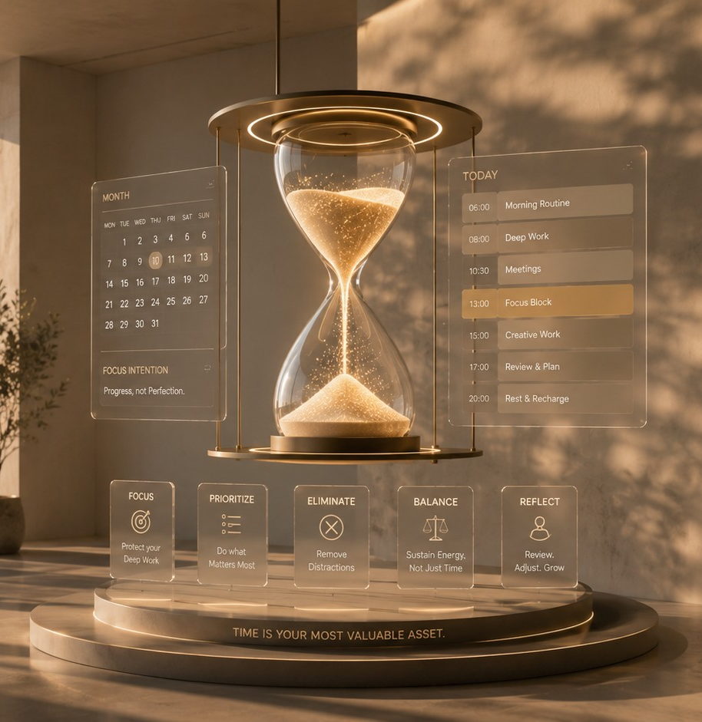
PROFESSIONAL SKILLS
Time Management
Protecting the two hours a day where your real work actually gets done.
PS-04
16 MINUTES
NEW JOINERS + STAFF
Start here → the next slide shows what this saves you.
PS-04 · Time Management
Inducto Learning Library

Slide 2
WHY THIS MATTERS TO YOU
Menu
Arjun is busy from nine to seven
AFTER THIS MODULE
Two protected hours, and a rule for everything that interrupts.
Arjun coordinates dispatch in Surat. He arrives at nine and leaves at seven. He is genuinely busy the whole time. The two things his manager actually asked for have not moved in a fortnight.
Ten hours a day, and the important work untouched.
PS-04 · Time Management
Inducto Learning Library

Slide 3
WHAT YOU'LL BE ABLE TO DO
Menu
By the end, you can do these
Protect two hours a day for work that needs concentration
Say no to a request without damaging the relationship
Handle an interruption in under thirty seconds
Tell the difference between busy and productive, honestly
Finish the day knowing what actually moved
PS-04 · Time Management
Inducto Learning Library

Slide 4
INTERACTIVE MENU
Tap any line to jump straight there
Every slide has a Menu button in the top-right corner to bring you back here.
01
Busy is not productive
Ten hours, nothing moved
02
The protected block
Two hours, defended
03
Handling interruptions
Thirty seconds each
04
Saying no
Without damaging anything
05
Do this now
Book tomorrow's block
06
Choose what you'd do
A Tuesday morning decision
07
Watch this
A 3-minute outside summary
08
Quiz
5 questions, instant feedback
09
Recap card
The whole topic on one screen
10
Your toolkit
Templates, links, what to do next
PS-04 · Time Management
Inducto Learning Library

Slide 5
BUSY IS NOT PRODUCTIVE
Menu
Ten hours, nothing moved
Reactive work fills any space you give it. It also feels productive, which is why it wins.
REACTIVE WORK
DELIBERATE WORK
Fills the day
Has to be defended
Answering as messages arrive
The analysis your manager asked for
Attending anything you were invited to
The process that keeps breaking
Solving problems people bring to your desk
The proposal that would win the account
Feels productive, and leaves no trace
Never urgent, and the only thing remembered
PS-04 · Time Management
Inducto Learning Library

Slide 6
BUSY IS NOT PRODUCTIVE
Menu
The honest end-of-day test
1
2
3
4
What did I finish?
Was it on my list this morning?
Would my manager count it?
If none — that was a reactive day
Not touched, not progressed. Finished.
Or did it arrive and take over?
Against what they actually asked for.
Two of those a week is normal. Five is a problem.
PS-04 · Time Management
Inducto Learning Library

Slide 7
THE PROTECTED BLOCK
Menu
Two hours, defended
SAME TIME DAILY — habit beats willpower, every time
IN THE CALENDAR — as a real booking, not an intention
NOTIFICATIONS OFF — email, chat and phone, all of them
ONE TASK ONLY — decided the evening before, not at the start
PS-04 · Time Management
Inducto Learning Library

Slide 8
THE PROTECTED BLOCK
Menu
Two hours is enough
Not the whole day
Tell people once
Decide the night before
Nobody in an operational job protects six hours. Two is achievable and it changes the week.
"I am heads-down until eleven, catch me after." Most people simply adjust.
Choosing what to work on inside the block eats into the freshest, most protected part of it.
PS-04 · Time Management
Inducto Learning Library

Slide 9
HANDLING INTERRUPTIONS
Menu
Thirty seconds each
The cost of an interruption is not the couple of minutes it takes to answer. It is the time it takes afterwards to get back to where you were.
Copy this wording
Select + copy
WHY THIS WORKS
"I am in the middle of something until eleven — is it a two-minute thing or a twenty-minute thing?" If two minutes: deal with it now. If twenty: "Let us do it at eleven, I will come to you."
It does not refuse, so nobody feels turned away.
It makes them size the request, which they rarely have.
Works in person, on chat, and on the phone.
You commit to a time, so it does not become a brush-off.
PS-04 · Time Management
Inducto Learning Library

Slide 10
HANDLING INTERRUPTIONS
Menu
The interruption ledger
EVERY INTERRUPTION TAKEN
BATCHED TO ELEVEN
Eleven interruptions between nine and one.
Each one costs a couple of minutes to answer, plus real time afterwards to refocus.
It adds up to far more of the morning than it feels like at the time.
Two dealt with instantly, nine held to eleven o'clock.
Those nine become one short run of conversations, handled together, once.
The morning block survives, and nobody waited long.
Batching is not avoiding people. It is answering nine of them properly instead of eleven of them badly.
PS-04 · Time Management
Inducto Learning Library

Slide 11
SAYING NO
Menu
Saying no without damage
Copy these three
Select + copy
WHY THIS WORKS
"I can do that, but it would push the dispatch report to Thursday — is that the right trade?" / "Not this week. I could pick it up Monday if that works." / "That one sits with Ops — worth asking them, they will do it faster than me."
The trade version makes the cost visible to them.
The defer version says yes, just later.
Trade, defer, redirect. Almost nothing needs a flat no.
The redirect version helps them and costs you nothing.
PS-04 · Time Management
Inducto Learning Library

Slide 12
SAYING NO
Menu
Make the trade visible
Is this coming from my manager?
NO
YES
Defer or redirect
Offer the trade
A colleague's request rarely needs your immediate week. "Monday" or "Ops will be faster" resolves most of them without any friction.
"Happy to — which of these two should slip?" Managers usually do not know what is on your plate, and almost always pick one when asked.
PS-04 · Time Management
Inducto Learning Library

Slide 13
DO THIS NOW
Menu
Do this now: book tomorrow
Open your calendar and find two hours tomorrow morning.
Copy this prompt
Select + copy
1
I have these tasks and about six working hours tomorrow after meetings. Tell me the single task worth protecting two hours for, and which of the rest can be batched into one afternoon block. Assume my estimates are 50 per cent optimistic.
Book them as a real appointment with a name on it.
2
Write down now which single task you will do in them.
Deciding tonight is what makes the block work.
3
Turn notifications off before you start, not after.
4
PS-04 · Time Management
Inducto Learning Library

Slide 14
DO THIS NOW
Menu
Four habits worth having
Same two hours every day, booked in the calendar.
Decide the task the evening before, never at the start.
Batch interruptions to one point in the day.
End the day by naming one thing you actually finished.
PS-04 · Time Management
Inducto Learning Library

Slide 15
DO THIS NOW
Menu
Five mistakes people really make
Leaving the important work until you feel free
You never feel free. Reactive work expands to fill whatever you leave open.
1
Protecting time but not notifications
One chat notification breaks the block just as effectively as an open door, whatever your calendar says.
2
Choosing the task at the start of the block
A meaningful part of the two hours gone before anything moves.
3
Saying yes to everything to be helpful
You become reliable for small things and unreliable for large ones.
4
Judging the day by how tired you are
Tiredness measures interruption, not progress. Ask what finished instead.
5
PS-04 · Time Management
Inducto Learning Library

Slide 16
DO THIS NOW
Menu
The meeting you did not need
An hour-long meeting with six people costs six hours. Almost nobody prices it that way.
Declining politely, with a reason and an offer, is normal professional behaviour.
No agenda — ask for one first.
No decision — ask if notes would do.
Not your decision — send someone or read the notes.
PS-04 · Time Management
Inducto Learning Library

Slide 17
DO THIS NOW
Menu
The time management rule
Two protected hours a day beats ten reactive ones, every week.
The work people remember is almost never the work that was urgent.
Two hours, same time, defended.
Interruptions batched, not refused.
Trade offered, not a flat no.
PS-04 · Time Management
Inducto Learning Library

Slide 18
CHOOSE WHAT YOU'D DO
Menu
Tuesday, 9:40 am
You are twenty minutes into your protected block on the analysis your manager asked for. A colleague appears at your desk with a question about a delivery.
OPTION A
OPTION B
OPTION C
Deal with it now — it is only a couple of minutes.
Ask whether it is a two-minute or twenty-minute thing.
Say you are busy and cannot help right now.
See what happens
See what happens
See what happens
PS-04 · Time Management
Inducto Learning Library

Slide 19
Two minutes, plus real time to get back
Menu
The question genuinely takes two minutes. Returning to where you were in the analysis takes real time on top of that. Four more colleagues arrive before eleven, and the block produces nothing.
THE RULE
The cost of an interruption is the refocusing, not the answer.
Back to the situation →
PS-04 · Time Management
Inducto Learning Library

Slide 20
Thirty seconds, and the block survives
Menu
They think about it and say twenty. You agree eleven o'clock and go to them then. Two others get the same answer, and all three get a better conversation than an interrupted one would have been.
THE RULE
Make them size it. Most people have never been asked.
Back to the situation →
PS-04 · Time Management
Inducto Learning Library

Slide 21
Protects the block, damages the relationship
Menu
The block survives and the colleague leaves with nothing. If it genuinely was two minutes, you have made an enemy over 120 seconds. They will remember it next time you need something.
THE RULE
Never refuse without offering a time. The offer is the whole difference.
Back to the situation →
PS-04 · Time Management
Inducto Learning Library

Slide 22
WATCH THIS
Menu
Three minutes, quick summary
HOW TO USE IT
Master Your Minutes - Time Management Hacks (3 Minutes)
Optional. Three minutes, so it costs almost nothing.
Useful as a reminder rather than an introduction.
BIOTECH WHISPERER
3:00 MIN
An outside video, not company material. Where it differs from this module, follow this module.
It opens in your browser. Turn the sound on.
Click to open on YouTube
PS-04 · Time Management
Inducto Learning Library

Slide 23
QUIZ · QUESTION 1 OF 5
Menu
What does an interruption actually cost?
The two minutes it takes to answer
The time to answer, plus the time it takes to get back to where you were
A
B
Nothing, if you were not concentrating
It depends on who is interrupting
C
D
PS-04 · Time Management
Inducto Learning Library

Slide 24
Not quite — here's what actually happens
Menu
YOU CHOSE A. The two minutes it takes to answer
That is the visible part and much the smaller one. The expensive part is getting back to where you were in the work.
REMEMBER
The refocusing, not the answer.
Try this question again →
PS-04 · Time Management
Inducto Learning Library

Slide 25
Correct — here's why
Menu
YOU CHOSE B. The time to answer, plus the time it takes to get back to where you we
Getting back to where you were is real work, even though it is hard to put an exact number on. That is why a handful of small interruptions can consume a morning without anyone noticing where it went.
REMEMBER
The refocusing, not the answer.
Next question →
PS-04 · Time Management
Inducto Learning Library

Slide 26
Not quite — here's what actually happens
Menu
YOU CHOSE C. Nothing, if you were not concentrating
If you were not concentrating, the block was already lost. The cost applies precisely when the work mattered.
REMEMBER
The refocusing, not the answer.
Try this question again →
PS-04 · Time Management
Inducto Learning Library

Slide 27
Not quite — here's what actually happens
Menu
YOU CHOSE D. It depends on who is interrupting
Seniority changes how you respond, not what it costs your attention. A director's question breaks focus the same way.
REMEMBER
The refocusing, not the answer.
Try this question again →
PS-04 · Time Management
Inducto Learning Library

Slide 28
QUIZ · QUESTION 2 OF 5
Menu
Why decide the task the night before?
It helps you sleep better
Choosing at the start spends your freshest protected time on the decision, not the work
A
B
Your manager may change priorities overnight
It makes the block feel longer
C
D
PS-04 · Time Management
Inducto Learning Library

Slide 29
Not quite — here's what actually happens
Menu
YOU CHOSE A. It helps you sleep better
It might, and that is not the operational reason. The reason is what happens at nine the next morning.
REMEMBER
Choosing inside the block eats the block.
Try this question again →
PS-04 · Time Management
Inducto Learning Library

Slide 30
Correct — here's why
Menu
YOU CHOSE B. Choosing at the start spends your freshest protected time on the decis
Deciding is real work, and doing it inside your two protected hours spends the freshest part of them on something you could have settled the evening before, in far less time.
REMEMBER
Choosing inside the block eats the block.
Next question →
PS-04 · Time Management
Inducto Learning Library

Slide 31
Not quite — here's what actually happens
Menu
YOU CHOSE C. Your manager may change priorities overnight
Occasionally, and that is an argument for a quick check rather than for not deciding. Most mornings nothing has changed.
REMEMBER
Choosing inside the block eats the block.
Try this question again →
PS-04 · Time Management
Inducto Learning Library

Slide 32
Not quite — here's what actually happens
Menu
YOU CHOSE D. It makes the block feel longer
It makes it genuinely longer, in usable minutes. Feeling is not the point.
REMEMBER
Choosing inside the block eats the block.
Try this question again →
PS-04 · Time Management
Inducto Learning Library

Slide 33
QUIZ · QUESTION 3 OF 5
Menu
Your manager adds a task. Best reply?
"Yes, no problem" and work later
"Happy to — which of these two should slip?"
A
B
"I am completely full this week"
Take it and drop something without saying
C
D
PS-04 · Time Management
Inducto Learning Library

Slide 34
Not quite — here's what actually happens
Menu
YOU CHOSE A. "Yes, no problem" and work later
They do not learn what is on your plate, and something else slips silently. Working later is not a plan, it is a way of hiding the problem.
REMEMBER
Offer the trade.
Try this question again →
PS-04 · Time Management
Inducto Learning Library

Slide 35
Correct — here's why
Menu
YOU CHOSE B. "Happy to — which of these two should slip?"
Managers usually have no visibility of your full load, and almost always choose when asked. It also makes you look organised rather than obstructive.
REMEMBER
Offer the trade.
Next question →
PS-04 · Time Management
Inducto Learning Library

Slide 36
Not quite — here's what actually happens
Menu
YOU CHOSE C. "I am completely full this week"
It is a refusal without information. They cannot help you prioritise, and it reads as unwillingness rather than capacity.
REMEMBER
Offer the trade.
Try this question again →
PS-04 · Time Management
Inducto Learning Library

Slide 37
Not quite — here's what actually happens
Menu
YOU CHOSE D. Take it and drop something without saying
The worst outcome. Something important stops moving and nobody knows, until it is noticed at the worst possible moment.
REMEMBER
Offer the trade.
Try this question again →
PS-04 · Time Management
Inducto Learning Library

Slide 38
QUIZ · QUESTION 4 OF 5
Menu
How do you judge whether a day worked?
By how many hours you worked
By naming one thing you actually finished
A
B
By how tired you feel
By how many emails you cleared
C
D
PS-04 · Time Management
Inducto Learning Library

Slide 39
Not quite — here's what actually happens
Menu
YOU CHOSE A. By how many hours you worked
Ten busy hours with nothing finished is a bad day that feels like a good one. Hours measure effort, not output.
REMEMBER
Ask what finished, not how tired you are.
Try this question again →
PS-04 · Time Management
Inducto Learning Library

Slide 40
Correct — here's why
Menu
YOU CHOSE B. By naming one thing you actually finished
Finished, not touched. If you cannot name one on most days, the reactive work is winning and the block is not being defended.
REMEMBER
Ask what finished, not how tired you are.
Next question →
PS-04 · Time Management
Inducto Learning Library

Slide 41
Not quite — here's what actually happens
Menu
YOU CHOSE C. By how tired you feel
Tiredness measures interruption and context switching, which are exactly the things that produce nothing.
REMEMBER
Ask what finished, not how tired you are.
Try this question again →
PS-04 · Time Management
Inducto Learning Library

Slide 42
Not quite — here's what actually happens
Menu
YOU CHOSE D. By how many emails you cleared
A cleared inbox is a good feeling and rarely the work you were hired for. It is the most seductive form of reactive work there is.
REMEMBER
Ask what finished, not how tired you are.
Try this question again →
PS-04 · Time Management
Inducto Learning Library

Slide 43
QUIZ · QUESTION 5 OF 5
Menu
When should you decline a meeting?
Whenever you are busy
When there is no agenda or your input is not needed
A
B
Never — declining looks uncommitted
When your manager is not attending
C
D
PS-04 · Time Management
Inducto Learning Library

Slide 44
Not quite — here's what actually happens
Menu
YOU CHOSE A. Whenever you are busy
Everyone is busy, so it is not a criterion. The question is whether your presence changes what the meeting produces.
REMEMBER
No agenda, or no decision that needs you.
Try this question again →
PS-04 · Time Management
Inducto Learning Library

Slide 45
Correct — here's why
Menu
YOU CHOSE B. When there is no agenda or your input is not needed
Ask for an agenda first — often that alone improves the meeting. If you are not part of the decision, notes will do, and an hour with six people costs six hours.
REMEMBER
No agenda, or no decision that needs you.
See the recap →
PS-04 · Time Management
Inducto Learning Library

Slide 46
Not quite — here's what actually happens
Menu
YOU CHOSE C. Never — declining looks uncommitted
Attending everything is not commitment, it is an absence of prioritisation. Declining politely with a reason and an offer is normal.
REMEMBER
No agenda, or no decision that needs you.
Try this question again →
PS-04 · Time Management
Inducto Learning Library

Slide 47
Not quite — here's what actually happens
Menu
YOU CHOSE D. When your manager is not attending
Their attendance is not the test. Plenty of important meetings do not involve them, and plenty of unnecessary ones do.
REMEMBER
No agenda, or no decision that needs you.
Try this question again →
PS-04 · Time Management
Inducto Learning Library

Slide 48
RECAP CARD
Menu
Time management on one screen
Screenshot this slide. It is the whole module in one screen.
Busy is not productive
Two hours, defended
Reactive work fills any space you leave and leaves no trace.
Same time daily, in the calendar, notifications off, one task.
Decide the night before
Size the interruption
Choosing inside the block spends its freshest, most protected time on the decision instead of the work.
"Two minutes or twenty?" Batch the twenties to one point.
Trade, defer, redirect
Judge by what finished
Almost nothing needs a flat no, and a flat no costs the most.
Not by hours worked, emails cleared, or how tired you feel.
Two protected hours a day beats ten reactive ones, every single week.
PS-04 · Time Management
Inducto Learning Library

Slide 49
YOUR TOOLKIT
Menu
Take these three things with you
TEMPLATES YOU CAN REUSE TODAY
LINKS THAT WORK
The interruption question
Microsoft Copilot
"Two-minute thing or twenty-minute thing?"
copilot.microsoft.com
ChatGPT
Three ways to say no
chatgpt.com
Offer the trade, defer to Monday, redirect to the right team.
Google Gemini
gemini.google.com
The end-of-day test
Name one thing that actually finished.
DO THIS NEXT
Next module: PS-05, Personal Productivity Systems. A system simple enough that you will still be using it in March.
PS-04 · Time Management
Inducto Learning Library

Slide 50
GLOSSARY
Menu
Words people use around AI
Reactive work
Protected block
Work that arrives and demands a response. It fills any space you leave open.
Two hours booked in the calendar, with notifications off and one task decided.
Context switching
Batching
Moving between tasks. Costs real, hard-to-measure time refocusing each time, even when the interruption itself was brief.
Holding several small requests and handling them together at one point in the day.
The trade
Deep work
Offering a choice about what slips, rather than accepting silently or refusing.
Work needing sustained concentration. It never feels urgent, and it is what gets remembered.
Back to the menu →
PS-04 · Time Management
Inducto Learning Library

