Slide 1
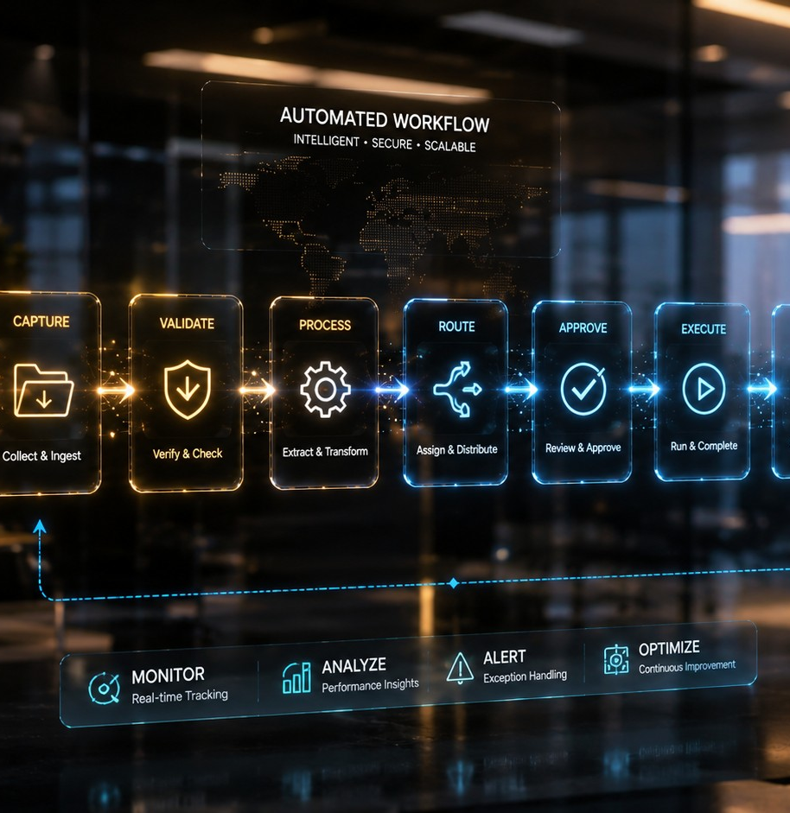
AI FOR DAY-TO-DAY WORK
Automation Basics
Spotting the jobs worth automating, and describing one clearly enough that somebody can actually build it.
DW-11
18 MINUTES
NEW JOINERS + STAFF
Start here → the next slide shows what this saves you.
DW-11 · Automation Basics
Inducto Learning Library

Slide 2
WHY THIS MATTERS TO YOU
Menu
The same report, 240 times a year
AFTER THIS MODULE
You do not need to build it. You need to describe it well enough.
Every weekday, someone in a Chennai office downloads two files, pastes them into a third, deletes four columns, and emails the result to six people. It takes 25 minutes. It has been done this way for three years.
About 100 hours a year, on copying and deleting.
DW-11 · Automation Basics
Inducto Learning Library

Slide 3
WHAT YOU'LL BE ABLE TO DO
Menu
By the end, you can do these
Spot which of your regular jobs is worth automating
Recognise the ones that should never be automated
Write a request clear enough for somebody to build from
Describe a process as triggers, steps and exceptions
Know what a running automation must never be allowed to do
DW-11 · Automation Basics
Inducto Learning Library

Slide 4
INTERACTIVE MENU
Tap any line to jump straight there
Every slide has a Menu button in the top-right corner to bring you back here.
01
What can be automated
Rules, not judgement
02
Spotting a candidate
Four questions
03
Describing it properly
Trigger, steps, exceptions
04
What must stay manual
Where automation hurts
05
Do this now
Describe one real job
06
Choose what you'd do
A process-review decision
07
Watch this
A 7-minute outside overview
08
Quiz
5 questions, instant feedback
09
Recap card
The whole topic on one screen
10
Your toolkit
Templates, links, what to do next
DW-11 · Automation Basics
Inducto Learning Library

Slide 5
WHAT CAN BE AUTOMATED
Menu
Rules can be automated
If you can write the job as "when this happens, do exactly that", it can be automated. If you cannot, it cannot.
AUTOMATABLE
NOT AUTOMATABLE
Same input, same action
Requires a judgement
Move files that arrive into a dated folder
Decide whether a complaint deserves a credit
Email a report every Monday at eight
Choose which supplier to trust this quarter
Flag any invoice over a set value
Word a difficult message to a client
Copy fields from a form into a sheet
Decide when a rule should be broken
DW-11 · Automation Basics
Inducto Learning Library

Slide 6
WHAT CAN BE AUTOMATED
Menu
The three parts of any automation
1
2
3
4
A trigger
Steps
Exceptions
A human
What starts it. A time, a file, an email, a form.
Exactly what happens, in order, with no choices.
What to do when reality does not match the rule.
Who gets told when an exception happens.
What does this mean?
TRIGGER ?
DW-11 · Automation Basics
Inducto Learning Library

Slide 7
SPOTTING A CANDIDATE
Menu
Four questions that find one
Do I do this more than twice a week?
Do I do it exactly the same way every time?
Would a colleague do it identically from my instructions?
Does it move or reshape data rather than judge it?
DW-11 · Automation Basics
Inducto Learning Library

Slide 8
SPOTTING A CANDIDATE
Menu
Four yeses is a candidate
Frequent
Identical
Mechanical
Twice a week is 100 times a year. Twenty-five minutes each is a working fortnight.
If it varies, write down what varies. That is usually the exception list.
Copying, moving, renaming, filtering, sending. No decisions in the middle.
DW-11 · Automation Basics
Inducto Learning Library

Slide 9
DESCRIBING IT PROPERLY
Menu
Describe it, do not build it
Most automation requests fail because the description is vague, not because the tool was wrong.
Copy this description prompt
Select + copy
WHY THIS WORKS
Help me describe a manual process so somebody could automate it. Ask me one question at a time until you have: the trigger, every step in order, every exception, and who should be told when an exception happens. Do not suggest tools yet. Start with your first question.
Interviewing you finds steps you would not have written down.
"No tools yet" keeps the focus on the process.
One question at a time is what makes this work.
You end up with a specification, not a wish.
DW-11 · Automation Basics
Inducto Learning Library

Slide 10
DESCRIBING IT PROPERLY
Menu
Vague request, clear request
WHAT USUALLY GETS ASKED
WHAT GETS BUILT
"Can we automate the daily report?"
Nobody knows which files, which columns, or who receives it.
Three meetings later it is still being discussed.
"Every weekday at 07:00, take the two files from this folder..."
"...remove columns D, F, H and K, merge on order number, email to this group."
"If either file is missing at 07:15, email me and stop."
The second one can be built by somebody who has never seen your job. That is the whole test.
DW-11 · Automation Basics
Inducto Learning Library

Slide 11
WHAT MUST STAY MANUAL
Menu
Where automation hurts
Automating an approval
The approval was the control. Automating it removes the only place a human looked.
1
Auto-sending to customers
One bad input becomes 400 wrong emails before anybody notices.
2
Automating a broken process
You now do the wrong thing reliably, at speed, without anyone watching.
3
Hiding the exceptions
If nobody is told when it fails, it fails silently for months.
4
Automating something one person understands
When they leave, nobody knows what it does or how to stop it.
5
DW-11 · Automation Basics
Inducto Learning Library

Slide 12
WHAT MUST STAY MANUAL
Menu
The rule about approvals
Automate the work. Never automate the check on the work.
If a step exists so that a human looks at something, that step is the point.
Payments — a person approves.
Customer messages — a person sends.
Anything irreversible — a person decides.
DW-11 · Automation Basics
Inducto Learning Library

Slide 13
DO THIS NOW
Menu
Do this now: describe one job
Pick the job you do most often that has no thinking in it.
Copy this prompt
Select + copy
1
Interview me one question at a time to document a manual process for automation. I need: the trigger, the steps in order, every exception, and who is told when an exception happens. Do not suggest tools. Do not ask for real data. Begin.
Run the interview prompt and answer its questions honestly.
2
Add every exception you can remember from the last year.
Twenty minutes of questions produces something buildable.
3
Send the result to [COMPANY INPUT NEEDED: who handles automation requests].
4
DW-11 · Automation Basics
Inducto Learning Library

Slide 14
DO THIS NOW
Menu
Exceptions are the hard part
Copy this prompt
Select + copy
WHAT COMES BACK
Here is a process description. List every way this could go wrong in practice: missing input, wrong format, duplicate, late arrival, partial data, and anything else. For each, suggest what the automation should do instead of guessing. One line each.
Ten to fifteen failure cases, several you had not considered.
A suggested safe behaviour for each, usually "stop and tell a human".
The list that turns a fragile script into a reliable one.
Most automations fail on the cases nobody listed.
DW-11 · Automation Basics
Inducto Learning Library

Slide 15
DO THIS NOW
Menu
Three rules for anything running
It must stop and tell someone when reality does not match.
A named person owns it, and anyone can switch it off.
It never sends externally without a human pressing send.
DW-11 · Automation Basics
Inducto Learning Library

Slide 16
DO THIS NOW
Menu
What must never be in the description
Describing a process needs the shape of the data, never the data itself.
Column names and formats are enough for anyone to build from.
Real customer records used as the example
Passwords, API keys or shared login details
Internal system addresses posted outside the company
Live financial figures used to illustrate a step
DW-11 · Automation Basics
Inducto Learning Library

Slide 17
DO THIS NOW
Menu
Is it worth automating?
Does this cost more than a day a year?
NO
YES
Leave it alone
Write it up
A monthly ten-minute job costs two hours a year. Automating it costs more than that to build, document and maintain.
Twenty-five minutes a day is a hundred hours a year. Even a rough automation that handles the normal case pays for itself in weeks.
DW-11 · Automation Basics
Inducto Learning Library

Slide 18
DO THIS NOW
Menu
The automation rule
If you cannot write it as rules with no choices in the middle, it is not ready to automate.
The writing is the work. Building is usually the easy part afterwards.
Rules — automate.
Judgement — keep.
Exceptions — always to a human.
DW-11 · Automation Basics
Inducto Learning Library

Slide 19
CHOOSE WHAT YOU'D DO
Menu
Process review, Wednesday
Your manager asks which of your jobs could be automated. You have the daily report, the monthly reconciliation and the credit note approvals.
OPTION A
OPTION B
OPTION C
Propose automating the credit note approvals — they take longest.
Propose the daily report, described as trigger, steps and exceptions.
Say nothing is automatable — every job needs judgement.
See what happens
See what happens
See what happens
DW-11 · Automation Basics
Inducto Learning Library

Slide 20
You would be removing the control, not the work
Menu
Approvals take time because somebody is looking. Automate that and credit notes issue themselves against rules that cannot see context. The first disputed one has no human decision behind it at all.
THE RULE
If a step exists so a person looks, that step is the point.
Back to the situation →
DW-11 · Automation Basics
Inducto Learning Library

Slide 21
Twenty-five minutes a day, and no judgement in it
Menu
You write it up properly: 07:00 trigger, named folders, exact columns, the recipient group, and "if a file is missing by 07:15, email me and stop". It is built in two days and saves a hundred hours a year.
THE RULE
Frequent, identical, mechanical. Four yeses is a candidate.
Back to the situation →
DW-11 · Automation Basics
Inducto Learning Library

Slide 22
True of parts, and not of the copying
Menu
Real judgement lives in the approvals and the exceptions. But deleting four columns and merging two files involves no judgement whatsoever, and it is a fortnight of your year.
THE RULE
Separate the judgement from the copying. Automate only the second.
Back to the situation →
DW-11 · Automation Basics
Inducto Learning Library

Slide 23
WATCH THIS
Menu
Seven minutes on how it fits together
HOW TO USE IT
From Idea to AI: Building Applications with Generative AI
Optional. You do not need to build anything yourself.
Useful for understanding what you are asking for.
IBM TECHNOLOGY
7:12 MIN
Aimed at people building systems. Watch for the overview, not for the rules — those are in this module.
It opens in your browser. Turn the sound on.
Click to open on YouTube
DW-11 · Automation Basics
Inducto Learning Library

Slide 24
QUIZ · QUESTION 1 OF 5
Menu
Which job can be automated?
Deciding whether a complaint deserves a credit
Merging two files and emailing the result each morning
A
B
Choosing which supplier to use this quarter
Wording a reply to an unhappy customer
C
D
DW-11 · Automation Basics
Inducto Learning Library

Slide 25
Not quite — here's what actually happens
Menu
YOU CHOSE A. Deciding whether a complaint deserves a credit
That is a judgement weighing history, relationship and context. A rule can flag candidates for a person to look at, but it cannot make the call.
REMEMBER
Rules yes, judgement no.
Try this question again →
DW-11 · Automation Basics
Inducto Learning Library

Slide 26
Correct — here's why
Menu
YOU CHOSE B. Merging two files and emailing the result each morning
Same trigger, same steps, same output, no decisions in the middle. Twenty-five minutes a day is a hundred hours a year for a process with no thinking in it.
REMEMBER
Rules yes, judgement no.
Next question →
DW-11 · Automation Basics
Inducto Learning Library

Slide 27
Not quite — here's what actually happens
Menu
YOU CHOSE C. Choosing which supplier to use this quarter
A commercial judgement with money and relationships attached. Automation could assemble the comparison, but the choice stays with a person.
REMEMBER
Rules yes, judgement no.
Try this question again →
DW-11 · Automation Basics
Inducto Learning Library

Slide 28
Not quite — here's what actually happens
Menu
YOU CHOSE D. Wording a reply to an unhappy customer
Every one is different and the tone depends on context a rule cannot see. Draft it with AI by all means, but a person sends it.
REMEMBER
Rules yes, judgement no.
Try this question again →
DW-11 · Automation Basics
Inducto Learning Library

Slide 29
QUIZ · QUESTION 2 OF 5
Menu
What is the hard part of a spec?
Choosing the right tool
Listing what happens when reality does not match
A
B
Writing the steps in order
Estimating the time saved
C
D
DW-11 · Automation Basics
Inducto Learning Library

Slide 30
Not quite — here's what actually happens
Menu
YOU CHOSE A. Choosing the right tool
Tool choice is usually the easiest decision and belongs to whoever builds it. A clear description makes the tool almost obvious.
REMEMBER
The exceptions, not the steps.
Try this question again →
DW-11 · Automation Basics
Inducto Learning Library

Slide 31
Correct — here's why
Menu
YOU CHOSE B. Listing what happens when reality does not match
Normal-case steps take ten minutes to write. Missing files, duplicates, wrong formats and late arrivals are where automations actually fail, usually silently.
REMEMBER
The exceptions, not the steps.
Next question →
DW-11 · Automation Basics
Inducto Learning Library

Slide 32
Not quite — here's what actually happens
Menu
YOU CHOSE C. Writing the steps in order
You already know the order, because you do it every day. Getting it out of your head is quick with a good interview prompt.
REMEMBER
The exceptions, not the steps.
Try this question again →
DW-11 · Automation Basics
Inducto Learning Library

Slide 33
Not quite — here's what actually happens
Menu
YOU CHOSE D. Estimating the time saved
Straightforward arithmetic: minutes times frequency. Useful for making the case, and not the hard part of the specification.
REMEMBER
The exceptions, not the steps.
Try this question again →
DW-11 · Automation Basics
Inducto Learning Library

Slide 34
QUIZ · QUESTION 3 OF 5
Menu
What must an automation always do?
Run without any human involvement
Stop and notify a person when something is wrong
A
B
Log everything it does
Be built by the IT team
C
D
DW-11 · Automation Basics
Inducto Learning Library

Slide 35
Not quite — here's what actually happens
Menu
YOU CHOSE A. Run without any human involvement
That is the goal for the normal case and a serious risk for the abnormal one. Something running unattended with no failure route fails silently for months.
REMEMBER
Stop and tell someone.
Try this question again →
DW-11 · Automation Basics
Inducto Learning Library

Slide 36
Correct — here's why
Menu
YOU CHOSE B. Stop and notify a person when something is wrong
Every automation meets a case nobody predicted. Stopping and telling a named person turns a silent failure into a five-minute fix.
REMEMBER
Stop and tell someone.
Next question →
DW-11 · Automation Basics
Inducto Learning Library

Slide 37
Not quite — here's what actually happens
Menu
YOU CHOSE C. Log everything it does
Good practice and not sufficient. A log nobody reads does not help when the report has been wrong for three weeks.
REMEMBER
Stop and tell someone.
Try this question again →
DW-11 · Automation Basics
Inducto Learning Library

Slide 38
Not quite — here's what actually happens
Menu
YOU CHOSE D. Be built by the IT team
Who builds it matters far less than whether the exceptions were described and somebody is named as its owner.
REMEMBER
Stop and tell someone.
Try this question again →
DW-11 · Automation Basics
Inducto Learning Library

Slide 39
QUIZ · QUESTION 4 OF 5
Menu
Which should stay manual?
Moving arriving files into dated folders
Approving a payment
A
B
Emailing a fixed report to a fixed group
Flagging invoices over a threshold
C
D
DW-11 · Automation Basics
Inducto Learning Library

Slide 40
Not quite — here's what actually happens
Menu
YOU CHOSE A. Moving arriving files into dated folders
Purely mechanical, high frequency, no judgement. One of the easiest and safest things to automate.
REMEMBER
Anything that exists so a human looks.
Try this question again →
DW-11 · Automation Basics
Inducto Learning Library

Slide 41
Correct — here's why
Menu
YOU CHOSE B. Approving a payment
The approval is a control, not a task. Its whole purpose is that a person looked before money moved, and automating it removes the only check in the chain.
REMEMBER
Anything that exists so a human looks.
Next question →
DW-11 · Automation Basics
Inducto Learning Library

Slide 42
Not quite — here's what actually happens
Menu
YOU CHOSE C. Emailing a fixed report to a fixed group
Fine to automate internally, as long as it stops and tells somebody when an input is missing rather than sending an empty report.
REMEMBER
Anything that exists so a human looks.
Try this question again →
DW-11 · Automation Basics
Inducto Learning Library

Slide 43
Not quite — here's what actually happens
Menu
YOU CHOSE D. Flagging invoices over a threshold
Flagging is ideal automation — a rule with no judgement. What happens after the flag is where the person comes in.
REMEMBER
Anything that exists so a human looks.
Try this question again →
DW-11 · Automation Basics
Inducto Learning Library

Slide 44
QUIZ · QUESTION 5 OF 5
Menu
Is a monthly ten-minute job worth it?
Yes — all repetition should be automated
No — it costs more to build and maintain than it saves
A
B
Yes, if it is easy to build
Only if a customer sees the output
C
D
DW-11 · Automation Basics
Inducto Learning Library

Slide 45
Not quite — here's what actually happens
Menu
YOU CHOSE A. Yes — all repetition should be automated
Two hours a year does not repay the time to specify, build, document and maintain it. Automations also need looking after, and rare ones get forgotten.
REMEMBER
Two hours a year rarely pays for the build.
Try this question again →
DW-11 · Automation Basics
Inducto Learning Library

Slide 46
Correct — here's why
Menu
YOU CHOSE B. No — it costs more to build and maintain than it saves
Ten minutes monthly is two hours a year. Specifying and building it costs more than that, and then somebody has to remember what it does when it breaks next year.
REMEMBER
Two hours a year rarely pays for the build.
See the recap →
DW-11 · Automation Basics
Inducto Learning Library

Slide 47
Not quite — here's what actually happens
Menu
YOU CHOSE C. Yes, if it is easy to build
Ease of building is only part of the cost. Every running automation carries ongoing maintenance and the risk of failing quietly.
REMEMBER
Two hours a year rarely pays for the build.
Try this question again →
DW-11 · Automation Basics
Inducto Learning Library

Slide 48
Not quite — here's what actually happens
Menu
YOU CHOSE D. Only if a customer sees the output
Customer-facing output is a reason for more caution, not less. It is also a reason to keep a human pressing send.
REMEMBER
Two hours a year rarely pays for the build.
Try this question again →
DW-11 · Automation Basics
Inducto Learning Library

Slide 49
RECAP CARD
Menu
Automation on one screen
Screenshot this slide. It is the whole module in one screen.
Rules can be automated
Four questions find a candidate
"When this happens, do exactly that." If you cannot write it that way, it is not ready.
Frequent, identical, transferable, mechanical. Four yeses and it is worth writing up.
Describe, do not build
Exceptions are the real work
Trigger, steps in order, exceptions, and who gets told.
Missing files, duplicates and wrong formats are where things fail silently.
Never automate the check
Someone owns it, someone can stop it
If a step exists so a person looks, that step is the whole point.
Named owner, documented purpose, and an off switch anyone can use.
Automate the copying. Keep the judgement. Send every exception to a human.
DW-11 · Automation Basics
Inducto Learning Library

Slide 50
YOUR TOOLKIT
Menu
Take these three things with you
TEMPLATES YOU CAN REUSE TODAY
LINKS THAT WORK
The interview prompt
Microsoft Copilot
One question at a time until the process is documented.
copilot.microsoft.com
ChatGPT
The exception prompt
chatgpt.com
Every way it could go wrong, and what to do instead.
Google Gemini
gemini.google.com
The four-question test
Frequent, identical, transferable, mechanical.
DO THIS NEXT
Next track: PS-01, Business Communication. The skills that decide whether any of this writing actually lands.
DW-11 · Automation Basics
Inducto Learning Library

Slide 51
GLOSSARY
Menu
Words people use around AI
Trigger
Exception
What starts an automation: a time, a file arriving, an email, a form submission.
A case where reality does not match the rule. The automation should stop and tell someone.
Specification
Owner
A description clear enough that somebody who has never seen your job could build it.
The named person responsible for an automation and for switching it off.
Judgement
Prompt
A decision needing context a rule cannot see. Never automated.
Everything you type in: your process description and the constraints.
Back to the menu →
DW-11 · Automation Basics
Inducto Learning Library

