Slide 1
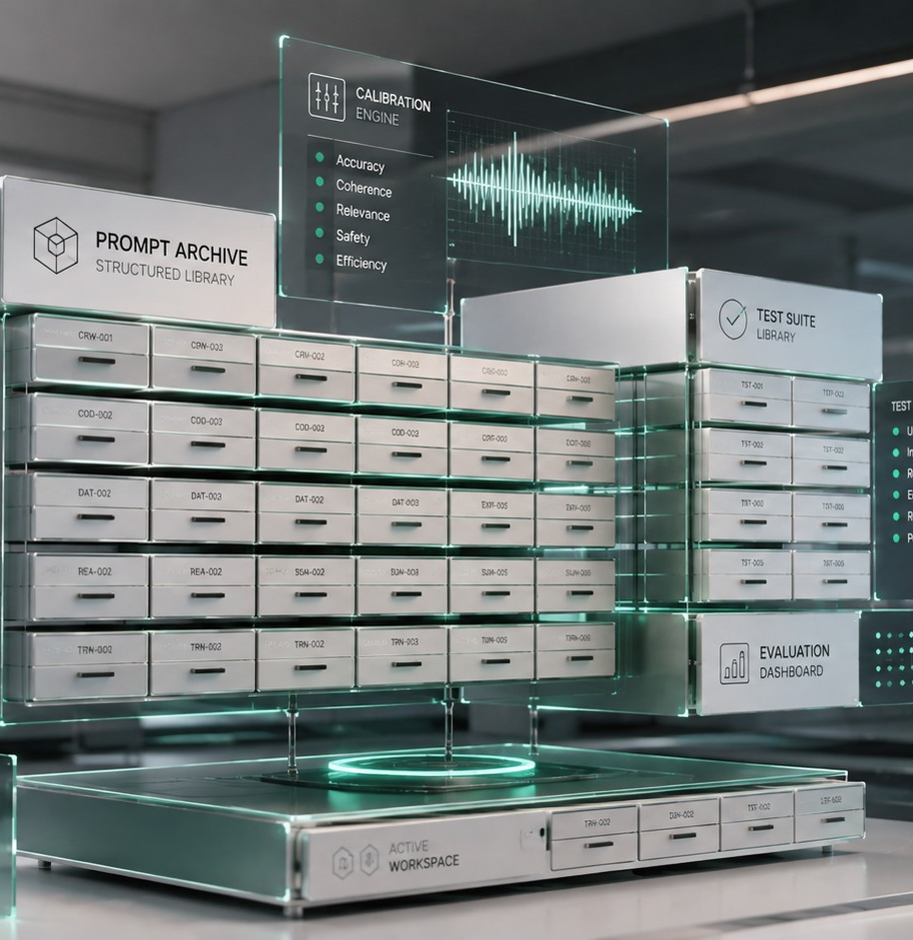
PROMPT ENGINEERING
Reusable Prompts
Turning the prompts that worked into a library you and your team stop rewriting every week.
PE-06
17 MINUTES
NEW JOINERS + STAFF
Start here → the next slide shows what this saves you.
PE-06 · Reusable Prompts
Inducto Learning Library

Slide 2
WHY THIS MATTERS TO YOU
Menu
Karthik rewrites the same prompt weekly
AFTER THIS MODULE
Saved once, with brackets. Ten seconds a week from then on.
Karthik runs IT support for a Chennai office. Every Monday he writes a prompt to turn the week's ticket log into a summary. Every Monday it takes four attempts, because he cannot remember what worked last week.
Fifteen minutes a week rediscovering something he already knew.
PE-06 · Reusable Prompts
Inducto Learning Library

Slide 3
WHAT YOU'LL BE ABLE TO DO
Menu
By the end, you can do these
Turn a prompt that worked into a reusable template today
Name and store prompts so you can actually find them again
Strip a prompt of anything that must not be stored
Share a prompt so a colleague can use it without you
Improve a stored prompt instead of starting over
PE-06 · Reusable Prompts
Inducto Learning Library

Slide 4
INTERACTIVE MENU
Tap any line to jump straight there
Every slide has a Menu button in the top-right corner to bring you back here.
01
Why prompts get lost
The Monday morning tax
02
Turning one into a template
Brackets and a name
03
Naming and storing
So you find it in ten seconds
04
Sharing safely
What must never be saved
05
Do this now
Build your first three
06
Choose what you'd do
A Monday morning decision
07
Watch this
An 8-minute outside walkthrough
08
Quiz
5 questions, instant feedback
09
Recap card
The whole topic on one screen
10
Your toolkit
Templates, links, what to do next
PE-06 · Reusable Prompts
Inducto Learning Library

Slide 5
WHY PROMPTS GET LOST
Menu
The Monday morning tax
The prompt that worked is thinking you already did. Almost nobody keeps it.
1
2
3
4
You get it right
You use the answer
The prompt disappears
Next week, from scratch
After three or four attempts, the answer is exactly right.
The job is done, so you close the tab.
It was in a chat you will never scroll back to.
Four attempts again, for the same job.
PE-06 · Reusable Prompts
Inducto Learning Library

Slide 6
WHY PROMPTS GET LOST
Menu
Which prompts are worth keeping
KEEP IT
LET IT GO
Worth ten seconds to save
Not worth the filing
You will do this job again this month
A one-off question you will never repeat
It took more than two attempts to get right
It worked on the first attempt anyway
A colleague does the same job
It only makes sense for today's document
The format matters and drifts easily
You would rewrite it faster than find it
PE-06 · Reusable Prompts
Inducto Learning Library

Slide 7
TURNING ONE INTO A TEMPLATE
Menu
Brackets do the work
The template pattern
Select + copy
WHY THIS WORKS
Turn the [WHAT: ticket log / delay list / site notes] below into a [FORMAT: 200-word summary / table / five bullets] for [READER: my manager / the client / the team]. Use only what I have pasted. Do not add anything I have not given you. [TONE: brief and factual].
Brackets say what belongs there, not just that something does.
The unchanging half is the half you kept getting wrong.
Four brackets. Ten seconds to fill, every time.
Anyone can use it without asking you what you meant.
PE-06 · Reusable Prompts
Inducto Learning Library

Slide 8
TURNING ONE INTO A TEMPLATE
Menu
Make the template for me
Copy this prompt
Select + copy
WHAT COMES BACK
Below is a prompt that worked well for me. Turn it into a reusable template. Keep every instruction exactly as it is, and replace only the specific facts with clearly labelled brackets saying what belongs there. Do not improve the wording.
The same prompt with your one-off details swapped for labelled brackets.
Instructions untouched, because you told it not to touch them.
A template you can paste next week without thinking about it.
"Do not improve the wording" protects what already worked.
PE-06 · Reusable Prompts
Inducto Learning Library

Slide 9
NAMING AND STORING
Menu
Name it the way you search
A prompt you cannot find in ten seconds is a prompt you will rewrite.
Name it after the job, not the technique: "weekly ticket summary"
Put the reader in the name if there are two versions
Keep them all in one file, not scattered across chats
Add one line saying what good output looked like
PE-06 · Reusable Prompts
Inducto Learning Library

Slide 10
NAMING AND STORING
Menu
Where a library actually lives
One shared file
One line per prompt
One owner
A single document everyone can open beats a clever system nobody updates.
Name, what it is for, the prompt itself. Nothing else needed to start.
Somebody who tidies it monthly. Otherwise it becomes a graveyard within a quarter.
PE-06 · Reusable Prompts
Inducto Learning Library

Slide 11
SHARING SAFELY
Menu
What must never be saved
A stored prompt gets copied, shared and pasted for years. Everything in it travels too.
The parts that change are exactly the parts that must not be stored.
Customer names, sites, contacts or order numbers
Prices, margins or wording taken from a contract
Colleague names beside performance or pay
Anything marked internal, confidential or restricted
PE-06 · Reusable Prompts
Inducto Learning Library

Slide 12
SHARING SAFELY
Menu
Strip it before you save it
SAVED AS USED
SAVED AS TEMPLATE
"Summarise the ticket log for Ashirwad Traders, account 4471, contact Ramesh Nair..."
The template now carries a real customer, a real account and a real name.
It gets shared with four colleagues and pasted for two years.
"Summarise the ticket log for [CLIENT], account [NUMBER], contact [NAME]..."
Identical usefulness, and nothing identifying is stored anywhere.
Safe to share with anyone, including a new joiner on day one.
The brackets are not only convenience. They are what makes a prompt safe to keep.
PE-06 · Reusable Prompts
Inducto Learning Library

Slide 13
DO THIS NOW
Menu
Do this now: build three
Open a blank document and call it "My prompts".
Copy this prompt
Select + copy
1
Turn the [WHAT] below into a [FORMAT] for [READER]. Use only what I have pasted and do not add anything I have not given you. Keep it under [NUMBER] words. [TONE]. No introduction and no closing summary.
Write down the three jobs you do most often in writing.
2
Start with this one. It covers most writing jobs as it stands.
For each, paste the prompt you last used and add brackets.
3
Put it where your team can reach it: [COMPANY INPUT NEEDED: shared location].
4
PE-06 · Reusable Prompts
Inducto Learning Library

Slide 14
DO THIS NOW
Menu
Improving a stored prompt
Did the stored prompt give a weak answer today?
NO
YES
Leave it alone
Fix the template
A template that works does not need polishing. Tinkering with a good prompt is how teams end up with six versions of one thing.
Add the missing line to the stored version straight away, not just to today's chat. Otherwise you meet the same gap next month.
PE-06 · Reusable Prompts
Inducto Learning Library

Slide 15
DO THIS NOW
Menu
Four habits that keep it alive
Save it the day it works, not the day you have time.
Fix the stored version, never just today's copy.
Delete anything nobody has used in six months.
Show a new joiner the file in their first week.
PE-06 · Reusable Prompts
Inducto Learning Library

Slide 16
DO THIS NOW
Menu
Five mistakes people really make
Meaning to save it later
The tab closes, the week moves on, and Monday costs you fifteen minutes again.
1
Saving the version with real data in it
One customer's details get copied into a file four people share for two years.
2
Naming it after the technique
"Few-shot summary v2" is unfindable. "Weekly ticket summary" is not.
3
Keeping six near-identical versions
Nobody knows which one is current, so everyone writes a seventh.
4
Fixing today's copy and not the template
You solve the same gap every month and never notice you are doing it.
5
PE-06 · Reusable Prompts
Inducto Learning Library

Slide 17
DO THIS NOW
Menu
What a good library looks like
One file everyone can open
Twenty good prompts covers most of what an office writes in a week. Beyond that, teams stop reading the list and start rewriting again.
Not a folder, not an app nobody logs into.
Ten to twenty prompts
Named after jobs people actually do.
Every one with brackets
No customer, no colleague, no contract in any of them.
PE-06 · Reusable Prompts
Inducto Learning Library

Slide 18
DO THIS NOW
Menu
The reusable prompt rule
Save the shape the day it works. Never save the details.
The shape is what you keep rediscovering. The details are what you must not store.
Worked today — save it today.
Real names in it — bracket them out.
Nobody uses it — delete it.
PE-06 · Reusable Prompts
Inducto Learning Library

Slide 19
CHOOSE WHAT YOU'D DO
Menu
Monday, 9:00 am
The weekly ticket summary is due at 10. You wrote a prompt for this three weeks ago that worked beautifully, and you cannot find it.
OPTION A
OPTION B
OPTION C
Scroll back through your chat history to find it.
Write it fresh, then save it with brackets straight away.
Copy the prompt from last week's chat, real names and all, into a shared file.
See what happens
See what happens
See what happens
PE-06 · Reusable Prompts
Inducto Learning Library

Slide 20
Sometimes works, never reliably
Menu
Twelve minutes of scrolling. You find something close, but you are not sure whether it is the version that worked or the one before it. You use it anyway and spend another five minutes fixing the output.
THE RULE
Chat history is not storage. It is a place things go to be lost.
Back to the situation →
PE-06 · Reusable Prompts
Inducto Learning Library

Slide 21
Costs today. Free every week after.
Menu
Four attempts, as usual, and eight minutes. Then thirty seconds pasting it into a shared file with [CLIENT] and [WEEK] in place of the specifics. Next Monday the same job takes under a minute, and so does the Monday after.
THE RULE
The saving is the cheap part. Doing it the same day is what makes it happen.
Back to the situation →
PE-06 · Reusable Prompts
Inducto Learning Library

Slide 22
You just filed a customer record
Menu
The prompt works, and the file now contains a real client name, an account number and a named contact. Four colleagues have access to it, and it will still be there in two years, long after that account has closed.
THE RULE
Bracket the details before anything is stored or shared.
Back to the situation →
PE-06 · Reusable Prompts
Inducto Learning Library

Slide 23
WATCH THIS
Menu
Eight minutes on building one
HOW TO USE IT
Why You Need an AI Prompt Library Now & How to Build One
Optional. A single shared file is enough to start.
Useful if your team wants something more organised.
MARKETING EXPLAINED
8:17 MIN
An outside video, not company material. A single shared file is still enough to start.
It opens in your browser. Turn the sound on.
Click to open on YouTube
PE-06 · Reusable Prompts
Inducto Learning Library

Slide 24
QUIZ · QUESTION 1 OF 5
Menu
Which prompt is worth saving?
One that worked on the first attempt
One that took four attempts and you will need again
A
B
A one-off question about today's document
Any prompt at all — save everything
C
D
PE-06 · Reusable Prompts
Inducto Learning Library

Slide 25
Not quite — here's what actually happens
Menu
YOU CHOSE A. One that worked on the first attempt
If it worked immediately, you will get it right immediately next time too. The filing costs more than the rewriting would.
REMEMBER
Repeated, and hard to get right first time.
Try this question again →
PE-06 · Reusable Prompts
Inducto Learning Library

Slide 26
Correct — here's why
Menu
YOU CHOSE B. One that took four attempts and you will need again
Those four attempts were real thinking. Saving it means you never repeat that work, and a colleague gets it without doing it at all.
REMEMBER
Repeated, and hard to get right first time.
Next question →
PE-06 · Reusable Prompts
Inducto Learning Library

Slide 27
Not quite — here's what actually happens
Menu
YOU CHOSE C. A one-off question about today's document
It only makes sense alongside a document you will never open again. Storing it clutters the file without helping anyone.
REMEMBER
Repeated, and hard to get right first time.
Try this question again →
PE-06 · Reusable Prompts
Inducto Learning Library

Slide 28
Not quite — here's what actually happens
Menu
YOU CHOSE D. Any prompt at all — save everything
A library of two hundred prompts is one nobody reads. Ten to twenty good ones is the range where people actually look before writing.
REMEMBER
Repeated, and hard to get right first time.
Try this question again →
PE-06 · Reusable Prompts
Inducto Learning Library

Slide 29
QUIZ · QUESTION 2 OF 5
Menu
What do brackets actually do?
They tell the tool to search for the value
They mark what changes, and keep real data out
A
B
They make the prompt shorter
They stop the tool inventing facts
C
D
PE-06 · Reusable Prompts
Inducto Learning Library

Slide 30
Not quite — here's what actually happens
Menu
YOU CHOSE A. They tell the tool to search for the value
It cannot search. If you leave a bracket unfilled it will either ask you or invent something plausible to put there.
REMEMBER
They make it reusable and safe to store.
Try this question again →
PE-06 · Reusable Prompts
Inducto Learning Library

Slide 31
Correct — here's why
Menu
YOU CHOSE B. They mark what changes, and keep real data out
Both at once. [CLIENT] tells the next person what belongs there, and it means no real client name is sitting in a file four people can open.
REMEMBER
They make it reusable and safe to store.
Next question →
PE-06 · Reusable Prompts
Inducto Learning Library

Slide 32
Not quite — here's what actually happens
Menu
YOU CHOSE C. They make the prompt shorter
Length is roughly unchanged. The gain is that the unchanging part — the part you kept getting wrong — is now settled permanently.
REMEMBER
They make it reusable and safe to store.
Try this question again →
PE-06 · Reusable Prompts
Inducto Learning Library

Slide 33
Not quite — here's what actually happens
Menu
YOU CHOSE D. They stop the tool inventing facts
That is what "do not add anything I have not given you" does. Brackets are about reuse and safety, not invention.
REMEMBER
They make it reusable and safe to store.
Try this question again →
PE-06 · Reusable Prompts
Inducto Learning Library

Slide 34
QUIZ · QUESTION 3 OF 5
Menu
How should you name a prompt?
"Few-shot structured summary v3"
"Weekly ticket summary for my manager"
A
B
"Prompt 7"
The first line of the prompt itself
C
D
PE-06 · Reusable Prompts
Inducto Learning Library

Slide 35
Not quite — here's what actually happens
Menu
YOU CHOSE A. "Few-shot structured summary v3"
Nobody searches for that, including you in six weeks. The name describes how it works rather than what it is for.
REMEMBER
After the job, not the technique.
Try this question again →
PE-06 · Reusable Prompts
Inducto Learning Library

Slide 36
Correct — here's why
Menu
YOU CHOSE B. "Weekly ticket summary for my manager"
It names the job and the reader, which is exactly what someone types when they go looking. A colleague who has never met you can find it.
REMEMBER
After the job, not the technique.
Next question →
PE-06 · Reusable Prompts
Inducto Learning Library

Slide 37
Not quite — here's what actually happens
Menu
YOU CHOSE C. "Prompt 7"
Findable only by opening every prompt in turn. Within a month the file is unusable and people start rewriting from scratch.
REMEMBER
After the job, not the technique.
Try this question again →
PE-06 · Reusable Prompts
Inducto Learning Library

Slide 38
Not quite — here's what actually happens
Menu
YOU CHOSE D. The first line of the prompt itself
Usually too long and too similar to its neighbours. Three prompts starting "Turn the following into..." are indistinguishable in a list.
REMEMBER
After the job, not the technique.
Try this question again →
PE-06 · Reusable Prompts
Inducto Learning Library

Slide 39
QUIZ · QUESTION 4 OF 5
Menu
The stored prompt gave a weak answer.
Fix it in today's chat and move on
Add the missing line to the stored version
A
B
Write a new prompt and save that too
Delete the template — it clearly does not work
C
D
PE-06 · Reusable Prompts
Inducto Learning Library

Slide 40
Not quite — here's what actually happens
Menu
YOU CHOSE A. Fix it in today's chat and move on
You have solved it for an hour. Next month the stored version has the same gap and somebody solves it again, probably differently.
REMEMBER
Fix the template, not just today's copy.
Try this question again →
PE-06 · Reusable Prompts
Inducto Learning Library

Slide 41
Correct — here's why
Menu
YOU CHOSE B. Add the missing line to the stored version
Thirty seconds, and the fix belongs to everyone from now on. This is the single habit that separates a living library from a graveyard.
REMEMBER
Fix the template, not just today's copy.
Next question →
PE-06 · Reusable Prompts
Inducto Learning Library

Slide 42
Not quite — here's what actually happens
Menu
YOU CHOSE C. Write a new prompt and save that too
Now there are two versions and nobody knows which is current. Six months later there are five, and people write a sixth rather than choose.
REMEMBER
Fix the template, not just today's copy.
Try this question again →
PE-06 · Reusable Prompts
Inducto Learning Library

Slide 43
Not quite — here's what actually happens
Menu
YOU CHOSE D. Delete the template — it clearly does not work
One weak answer is not a broken template. It usually means one missing constraint, which is a one-line repair, not a reason to throw away the work.
REMEMBER
Fix the template, not just today's copy.
Try this question again →
PE-06 · Reusable Prompts
Inducto Learning Library

Slide 44
QUIZ · QUESTION 5 OF 5
Menu
What must never go in a saved prompt?
The word count
A real client name and account number
A
B
The tone instruction
The reader description
C
D
PE-06 · Reusable Prompts
Inducto Learning Library

Slide 45
Not quite — here's what actually happens
Menu
YOU CHOSE A. The word count
Word counts belong in the stored version. They are part of the shape you are trying to keep, and they identify nobody.
REMEMBER
Anything that identifies a person or a deal.
Try this question again →
PE-06 · Reusable Prompts
Inducto Learning Library

Slide 46
Correct — here's why
Menu
YOU CHOSE B. A real client name and account number
A stored prompt is copied, shared and pasted for years. Anything identifying inside it travels to everyone who ever opens the file, long after the account has closed.
REMEMBER
Anything that identifies a person or a deal.
See the recap →
PE-06 · Reusable Prompts
Inducto Learning Library

Slide 47
Not quite — here's what actually happens
Menu
YOU CHOSE C. The tone instruction
Tone is exactly what you want to preserve. "Brief and factual" took you three attempts to settle on the first time.
REMEMBER
Anything that identifies a person or a deal.
Try this question again →
PE-06 · Reusable Prompts
Inducto Learning Library

Slide 48
Not quite — here's what actually happens
Menu
YOU CHOSE D. The reader description
"For my manager" or "for a client who is already annoyed" is a role, not an identity. It names nobody and improves every answer.
REMEMBER
Anything that identifies a person or a deal.
Try this question again →
PE-06 · Reusable Prompts
Inducto Learning Library

Slide 49
RECAP CARD
Menu
Reusable prompts on one screen
Screenshot this slide. It is the whole module in one screen.
Save it the day it works
Brackets mark what changes
The tab closes and the thinking goes with it. Later never arrives.
[CLIENT], [WEEK], [NUMBER]. Ten seconds to fill, every time.
Brackets also keep it safe
Name it after the job
No real name, account or price is ever stored in the file.
"Weekly ticket summary", never "structured prompt v3".
Fix the template, not the copy
Twenty is plenty
One line added to the stored version fixes it for everybody.
A library nobody reads is a library that gets rewritten from scratch.
Save the shape the day it works. Never save the details.
PE-06 · Reusable Prompts
Inducto Learning Library

Slide 50
YOUR TOOLKIT
Menu
Take these three things with you
TEMPLATES YOU CAN REUSE TODAY
LINKS THAT WORK
The four-bracket template
ChatGPT
What, format, reader, tone. Covers most writing jobs.
chatgpt.com
Microsoft Copilot
The template-builder prompt
copilot.microsoft.com
Turns a prompt that worked into a reusable one.
Google Gemini
gemini.google.com
The strip-before-saving check
Bracket every name, number and price first.
DO THIS NEXT
Next module: PE-07, Evaluating AI Responses. A short way to score an answer so you know whether to send it, fix it or throw it away.
PE-06 · Reusable Prompts
Inducto Learning Library

Slide 51
GLOSSARY
Menu
Words people use around AI
Template
Prompt library
A prompt with brackets where the specifics go, so it can be reused without rewriting.
A shared file of named prompts your team reuses instead of writing from scratch.
Bracket
Prompt
A labelled gap like [CLIENT] that says what belongs there, and keeps real data out.
Everything you type in: context plus instructions plus your facts.
Context
Output
The background you give so the tool knows the situation it is writing about.
What comes back. Your draft, which you are responsible for checking.
Back to the menu →
PE-06 · Reusable Prompts
Inducto Learning Library

