Slide 1






Brainware University
Dept. of CSE (CS & DS) | Oct 2026
Capstone Engineering Project
NOETRIX
PITCH DECK
Explainable resume screening and tailoring with guardrailed generative AI
NAME OF PROJECT:
PRESENTED BY:
PRESENTED TO:
Noetrix
Dhrubojyoti Hazra
Isheeka Mukhopadhyay
Samprikta De
Adhiraj Das
Tiyasha Baidya
Mr. Mahendra Dutta, Industry Mentor, Ardent Computech Pvt. Ltd.

Slide 2


03 | Overview & Problem Statement
04 | Objectives & Core Pillars
05 | Candidate & Recruiter Doors
06-07 | Scoring Engine & Pipeline
08-09 | Guardrailed GenAI & Tech Stack
10-11 | Benchmarks & Empirical Results
12 | Engineering Team
13 | Live Demo & Project Links
Agenda

Slide 3
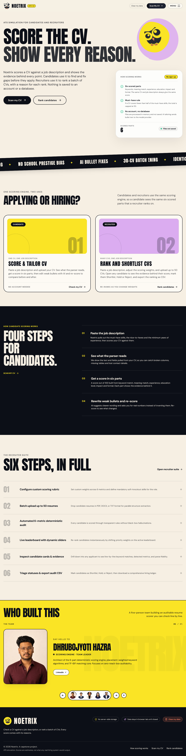
01
The problem. Commercial ATS tools are black boxes that keyword stuffing, prestige bias and AI hallucination can fool.
03/13
02
The solution. Noetrix: one system with deterministic six-metric scoring and guardrailed generative AI.
Overview
Noetrix shows candidates what the ATS sees and gives recruiters auditable, merit-based rankings.
03
The outcome. Reproducible scores, 42.4 ms per resume, no invented metrics, and zero server-side storage.
noetrix-virid.vercel.app

Slide 4


04/13
Objectives and Goals
Five engineering objectives, delivered as three pillars.
Auditable Scores
Zero Fabrication
Privacy by Design
Six weighted metrics with discounted skills-list credit stop keyword stuffing; 50-point cap flags missing must-haves.
Bullets become Google XYZ statements; a validator blocks invented numbers or skills.
Stateless in-memory sessions with PII redaction, delivered through two portals.

Slide 5
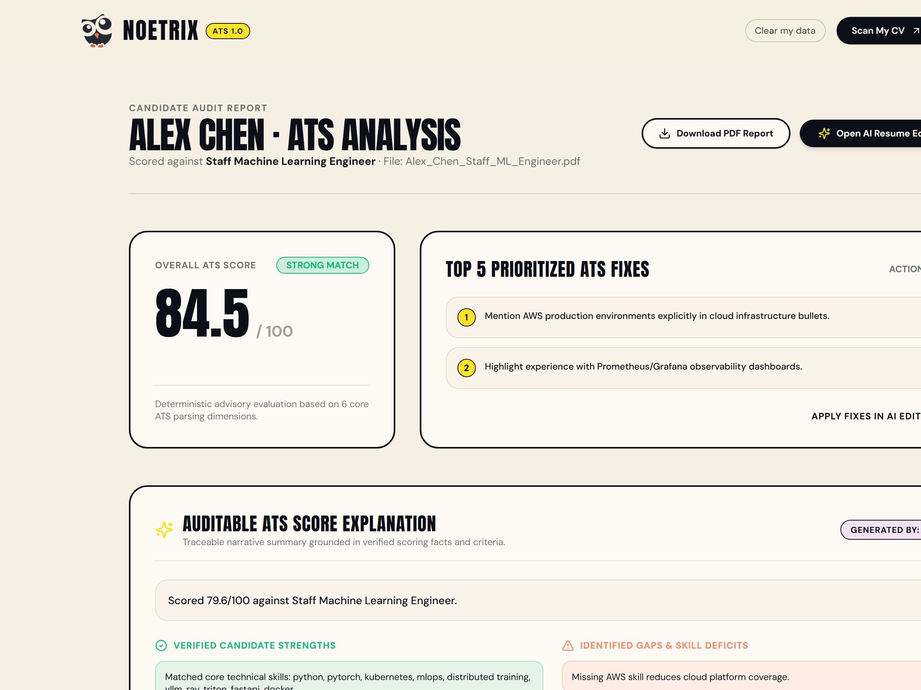

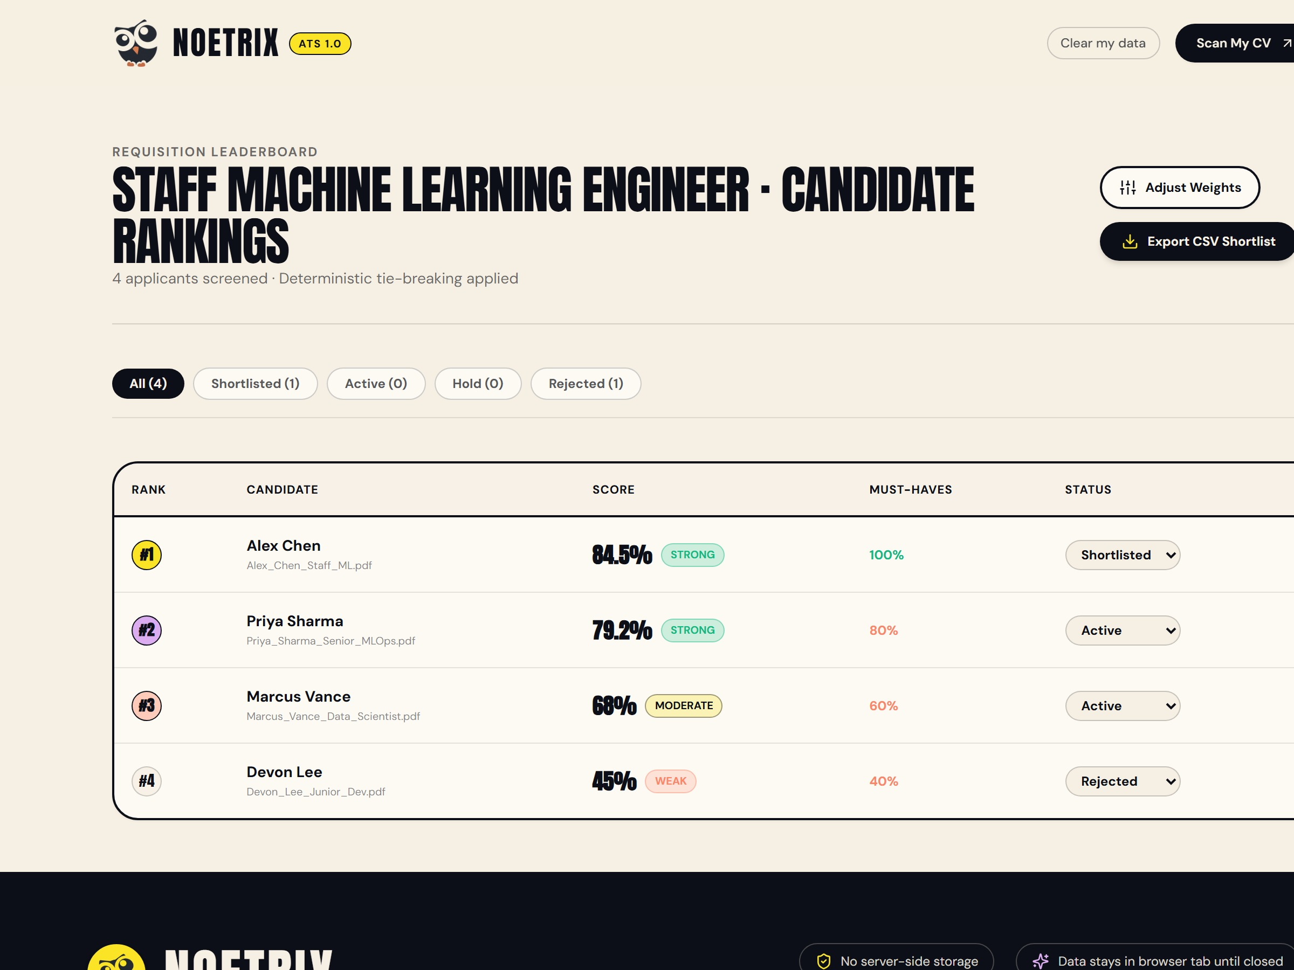
05/13
Dual Portal
Candidate Door: upload a CV, see what the ATS sees, read the score breakdown and tailor weak bullets.
Recruiter Door: batch-upload resumes, set weights, rank with tie-break telemetry and open candidate dossiers.

Slide 6
30% | Keyword match & taxonomy
20% | Semantic fit (all-MiniLM-L6-v2)
20% | Experience & seniority
10% | Education, prestige-free
10% | Quantified impact metrics
10% | ATS format hygiene
CAP | Must-have soft knockout (<50%)
TIE | Six-tier deterministic tie-break
Scoring Engine

Slide 7
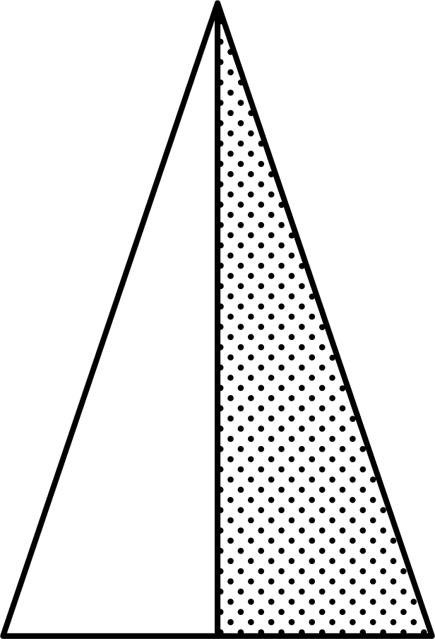
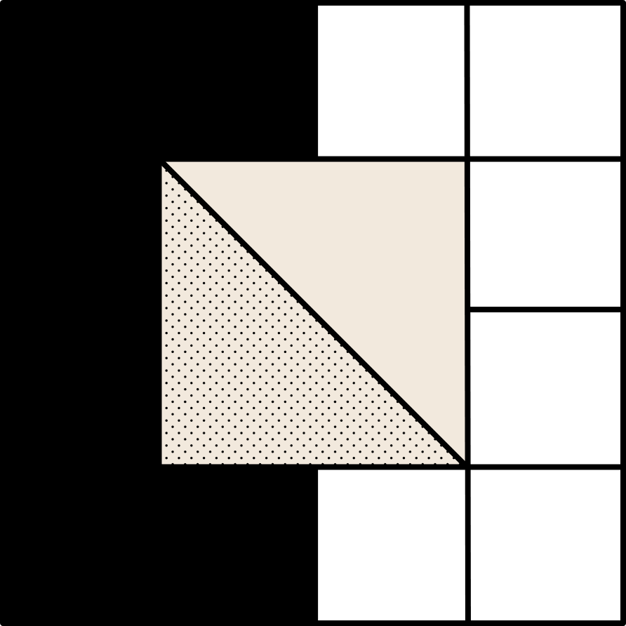
How It Works
07/13
From raw resume to auditable ranking in four stages.
1. Ingest
2. Score
3. Guard
4. Rank
Parse PDF, DOCX or TXT into sections, contacts and skills.
Six metrics with local MiniLM embeddings and a 50-point knockout cap.
PII redacted, LLM rewrites checked by the Zero-Fabrication Validator.
Six-tier tie-break leaderboard, dossier drawer, PDF and CSV export.

Slide 8
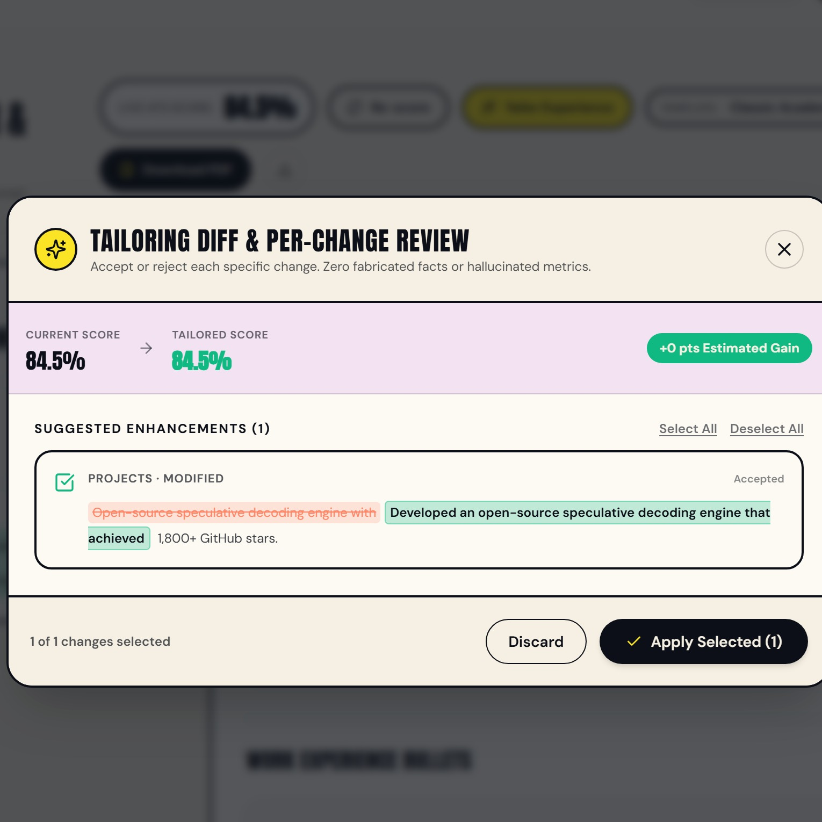
08/13
Guardrailed
Tailoring
An LLM rewrites weak bullets into Google XYZ statements. A deterministic validator then checks every rewrite for new numbers, new skills, edited titles or reversed meaning. Any failure falls back to rule-based edits, and the candidate accepts or rejects each change.

Slide 9
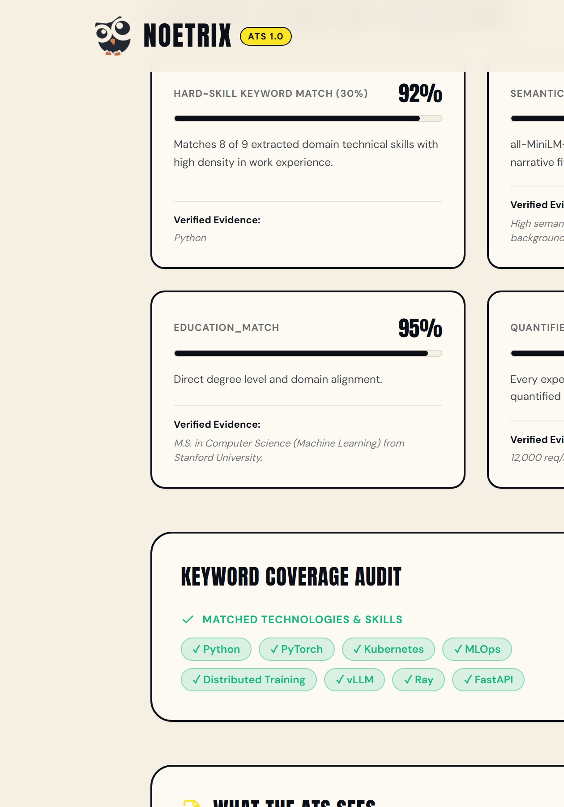
01
Frontend. Next.js 15, React 19, TypeScript and Tailwind CSS, hosted on Vercel.
09/13
02
Backend and NLP. FastAPI on Render, pdfplumber, Sentence-Transformers, scikit-learn.
Tech Stack
A decoupled three-tier design: presentation, API services, and a stateless analytics and GenAI layer.
03
Generative AI. Groq LLaMA 3.3 70B / 8B (temp 0), SHA-256 cache, Pydantic schemas, offline rules fallback.
noetrix-api.onrender.com/docs

Slide 10
Benchmarks
10/13
Noetrix against legacy keyword ATS and zero-shot LLM screening.
Legacy ATS
Gave 94.2% to a keyword-stuffed resume.
Pure LLM screening
Non-deterministic (+/-8.4 points), hallucination risk.
Noetrix hybrid
Capped stuffed resumes at 50; identical scores every run.

Slide 11
11/13
Results
Verified in the report's empirical evaluation.
100%
42.4 ms
71/71
Reproducible
Per resume
Tests passed
Zero variance across repeated runs; no score jitter.
Per resume on CPU only; 20 resumes ranked in 0.892 s.
Unit, integration and guardrail tests all pass.

Slide 12

Our team
12/13
DH
IM
SD
AD
TB
Dhrubojyoti Hazra
Isheeka Mukhopadhyay
Samprikta De
Adhiraj Das
Tiyasha Baidya
Architecture and Deployment
BWU/BTD/23/015
Document Parsing
BWU/BTD/23/042
Scoring and Ranking
BWU/BTD/23/056
Tailoring and Export
BWU/BTD/23/009
GenAI, Privacy and Fairness
BWU/BTD/23/025
Under the guidance of Mr. Mahendra Dutta, Project Engineer & Industry Mentor, Ardent Computech Pvt. Ltd.

Slide 13
13/13
Thank you
PROJECT LINKS
GitHub
github.com/dhrubojyotihazra/Noetrix
Live demo
noetrix-virid.vercel.app
API docs
noetrix-api.onrender.com/docs
Mentor org
Ardent Computech Pvt. Ltd., 398 Ramkrishnapur Road, Barasat, North 24 Parganas, Kolkata, West Bengal - 700 125
Brainware University, Kolkata

