Slide 1



LAYOUT AND COMPOSITION
DESIGN PRINCIPLE #1
This is part 1 (out of 2) of the Layout and Composition principle of web design. It deals with grid theory and, quite simply, the following building blocks (aka anatomy) of a typical web page…
--
Containing block
--
Logo
--
Navigation
--
Content
--
Footer
--
Whitespace
WEBD 4400

Slide 2

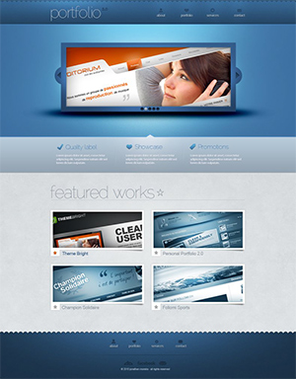
Website Anatomy
As mentioned above, in this section we’ll look at the website logo, navigation, content, footer, container and whitespace.

Slide 3

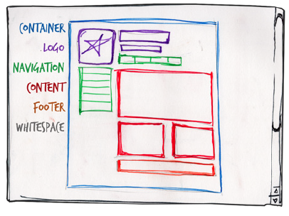

OVERVIEW
ANATOMY OF A WEBSITE
Although the number of these necessary blocks depends on the size and subject of the site, most websites have the components seen in below:
07

Slide 4
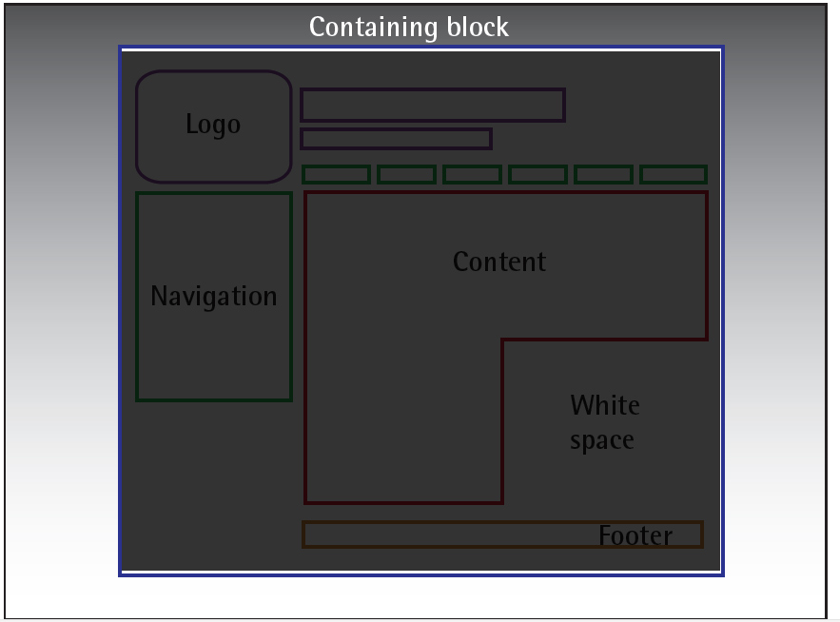
ANATOMY OF A WEBSITE
CONTAINER
Every web page has a container. This could be in the form of the page’s HTML body tag, an all-containing div tag.
Without some sort of container, we’d have no place to put the contents of our page. The elements would drift beyond the bounds of our browser window and off into empty space.
The width of this container can be fluid, meaning that it expands to fill the width of browser window; or fixed, so that the content is the same width no matter what size the window is.
07

Slide 5
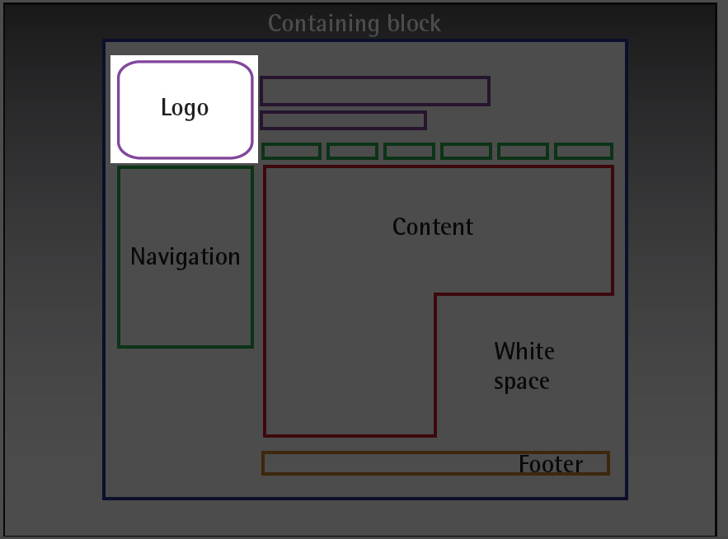
ANATOMY OF A WEBSITE
LOGO
When designers refer to an identity, they’re referring to the logo and colors that exist across a company’ s various forms of marketing, such as business cards, letterhead, brochures, and so on.
The identity block that appears on the website should contain the company’s logo or name, and sit at the top of each page of the website.
The identity block increases brand recognition while informing users that the pages they’ re viewing are part of a single site.
07

Slide 6
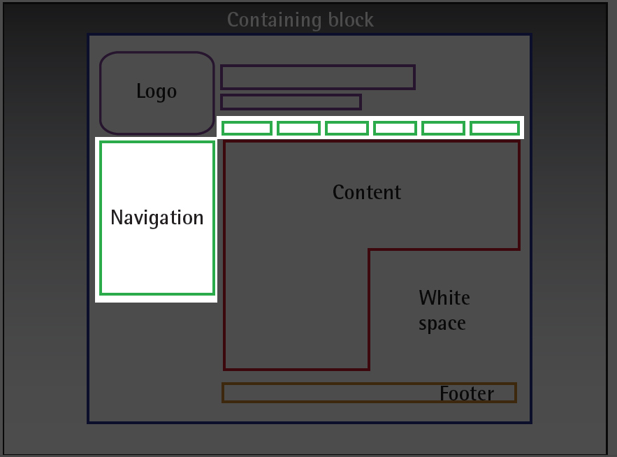
ANATOMY OF A WEBSITE
Navigation
It’s essential that the site’s navigation system is easy to find and use.
Users expect to see navigation right at the top of the page.
Whether you plan to use vertical menus down the side of the page, or a horizontal menu across the page, the navigation should be as close to the top of the layout as possible.
At the very least, all main navigation items should appear “ above the fold.”
07

Slide 7
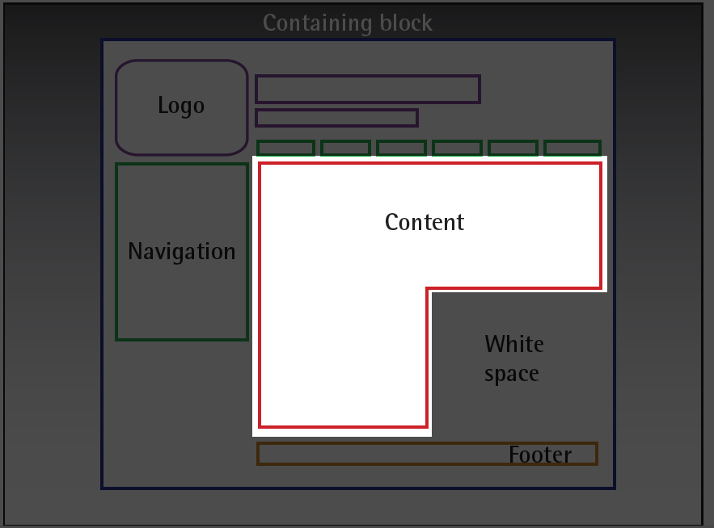
ANATOMY OF A WEBSITE
CONTENT
Content is king.
Content consists of any text, images, or videos found on a website.
A typical website visitor will enter and leave a website in a matter of seconds. If visitors are unable to find what they’ re looking for, they’ll undoubtedly close the browser or move on to another site.
It’s important to keep the main content block as the focal point of a design, so that visitors can scan the page for the information they need.
07

Slide 8
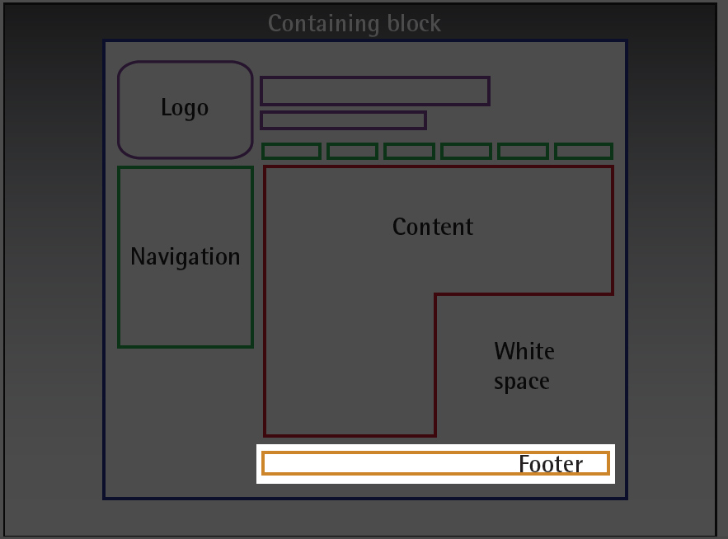
ANATOMY OF A WEBSITE
FOOTER
Located at the bottom of the page, the footer usually contains copyright, contact, and legal information, as well as a few links to the main sections of the site.
By separating the end content from the bottom of the browser window, the footer should indicate to users that they’re at the bottom of the page.
07

Slide 9
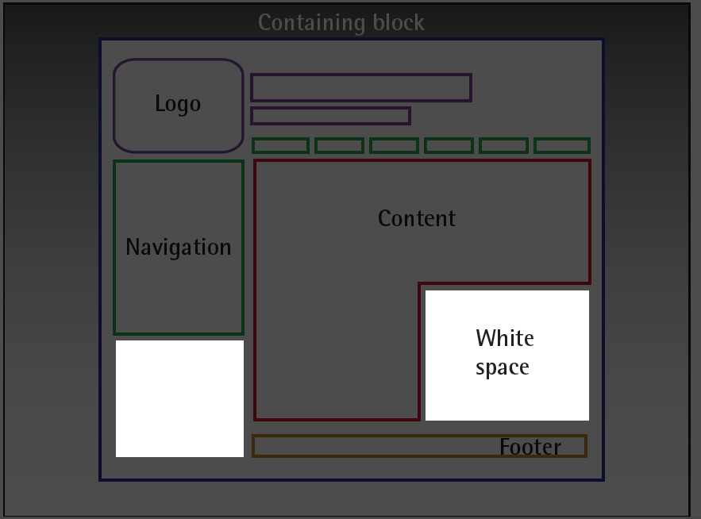
ANATOMY OF A WEBSITE
WHITEspace
The graphic design term whitespace (or negative space) literally refers to any area of a page without type or illustrations.
While many novice web designers (and most clients) feel a need to fill every inch of a web page with photos, text, tables, and data, empty space on a page is every bit as important as having content.
Whitespace helps a design to breathe by guiding the user’s eye around a page, but also helps to create balance and unity— two important concepts that we’ll discuss in more detail later in the semester.
07

Slide 10
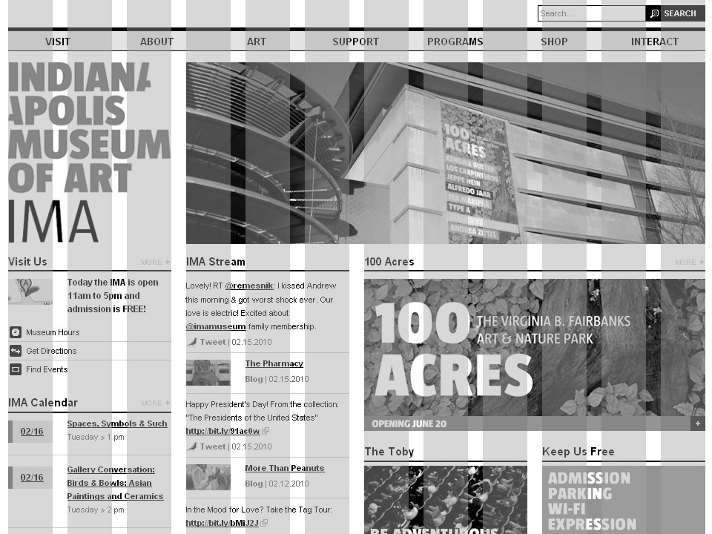
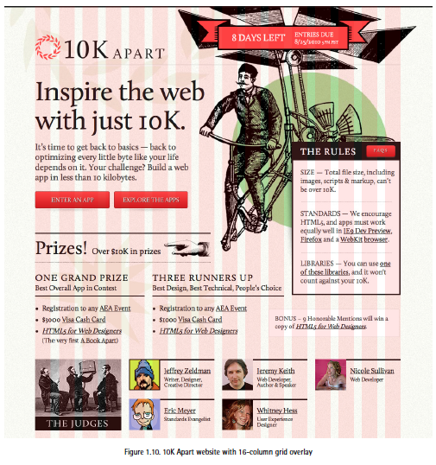
GRID THEORY
The grid is an essential tool for graphic design as well, and the use of grids in website design have exploded in popularity in the last few years. Lets look at the golden ratio, rule of thirds and grids.

Slide 11
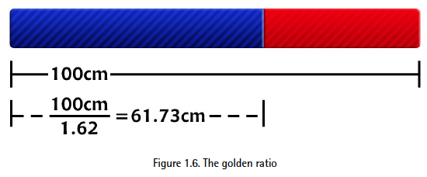
Pythagoras
THE GOLD RATIO
The concept of dividing the elements of a composition extends back to the mathematical ideas established by Pythagoras and his followers, who defined numbers as ratios rather than single units.
The Pythagoreans observed a mathematical pattern that occurred so often in nature that they believed it to be divinely inspired. They referred to this pattern as the golden ratio or divine proportion. The basic idea is illustrated below:
07

Slide 12
Pythagoras
THE GOLD RATIO - CONT’D
A line can be bisected using the golden ratio by dividing its length by 1.62.
So just what does this ratio have to do with graphic design? In general, compositions divided by lines that are proportionate to the golden ratio are considered to be aesthetically pleasing.
The artists of the Renaissance used divine proportion to design their paintings, sculpture, and architecture, just as designers today often employ this ratio when creating page layouts, posters, and brochures.
07

Slide 13
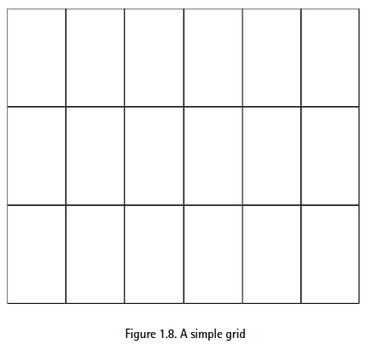
golden ratio &
The RULE OF THIRDS
Dividing a composition into thirds is an easy way to apply divine proportion without your calculator.
For quick layout experimentation, it’s common to divide a piece of paper into thirds horizontally and vertically, then draw a line between each vertical line to create six columns to work within, as shown below to the right.
07

Slide 14
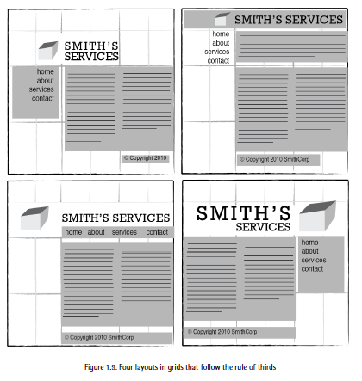
RULe of thirds &
Wireframes
With this simple ‘rule of thirds’ grid work in place, we can begin to lay out our elements. This is often referred to
as a wireframe.
Wireframes are simple sketches or layouts where you design blocks of content and
their positioning on the page.
Wireframes are extremely useful, because you can quickly and easily
move elements around.
07

Slide 15
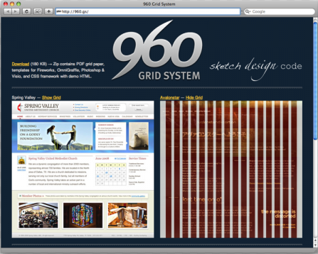
WIREFRAMES &
THe 960 Grid system
One of the most popular online tools for laying out website components is the set of templates and sketch sheets
from Nathan Smith’ s 960 Grid System.
As you experiment with different arrangements for your own layouts, use the columns of whatever
grid you’ ve chosen as alignment guides for the identity, navigation, content, and footer blocks.
Link: http://960.gs/
07

Slide 16
REVIEW OF TERMS
Below you will find a simple review of the terms that you should be familiar with after going through this document.
WEBSITE ANATOMY
Logo, Navigation,
Content, Footer
Container
Whitespace
GRID THEORY
The Golden Ratio
The Rule of Thirds
Wireframes
Grid Systems
Resources: Principles of Beautiful Web Design by Jason Beaird and James George. SitePoint Pty. Ltd.
03

