Slide 1
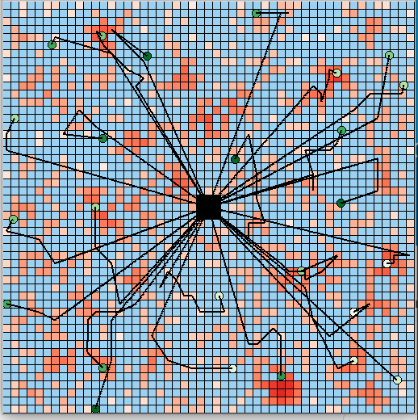
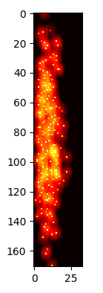
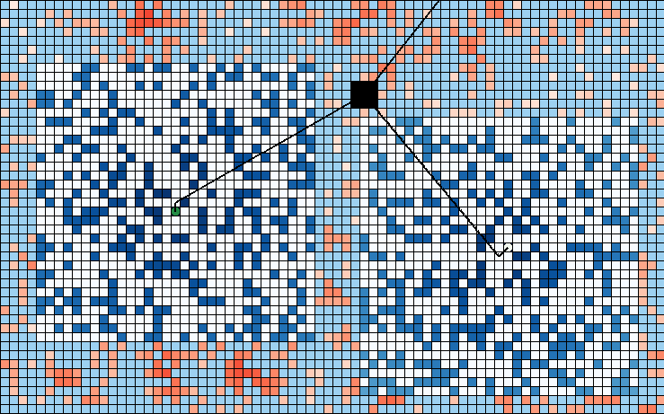
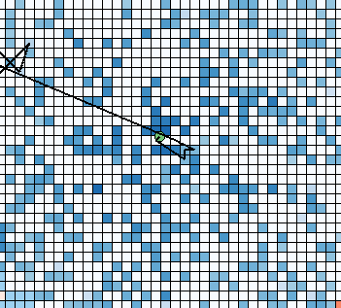
Lab
Logo
Title
Dhruva Arun | Loy McGuire
Simulation and Threshold
Project Objective and Intern Contribution:
Problem: Wildfires are fast, destructive, and erratic, rendering them a threat to both civilians and infrastructure. The trajectory of a wildfire depends on several factors, including tree species, tree heights, and tree trunk diameters. Accurately predicting wildfires requires a database of all of these tree attributes for forests across the globe. Many organizations are working towards developing such an inventory with various strategies and resources.
After interviewing several experts in the field, I learned that the hardest tree information to gather is tree diameter values. However, collecting tree diameter values of a a number of trees across the varying tree heights and densities allows for the rest of the tree diameter values to be predicted due to a linear relation between tree height and diameter.
Goal: Develop a distributed UAV swarming algorithm to collect a number of diameter values of trees with various densities and heights.
Solution: The information value of a given tree is evaluated based on the density and heights of trees that have already been collected using a 2D array threshold data structure. Each UAV will make decisions by overlaying a proximity and information value potential field as well as local communication between UAVS.
My Role: Researching of wildfire applications and swarming algorithm and simulation development.
Results / Accomplishments / Next Steps:
We demonstrated that UAV swarms can be applied to forest inventorying to significantly increase performance. We also demonstrated the effectiveness of potential field based information foraging.
The Navy can use this software for any type of goal-based information foraging.
In the future this work will develop into a real-world project and the deployment of UAVs throughout forests across the globe.
In the future, we will develop a complete inventory of all forests in the world and be able to predict and mitigate wildfires to save lives.
Image Area
Overlaid Potential Fields
1. I was most proud of being able to make meaningful contributions to a real-world problem. In the past, I often struggled with finding ways to help the research community that have not already been thoroughly reviewed.
2. I developed valuable research skills throughout this internship that will help me throughout my career. I learned how, starting from scratch, to identify a problem and build an effective solution.
3. Advice for future cohorts: Never give up on your research. There will be numerous roadblocks and seemingly unsolvable problems, so just move on and iterate to a better solution, even if it requires redoing a lot of work.

