Slide 1





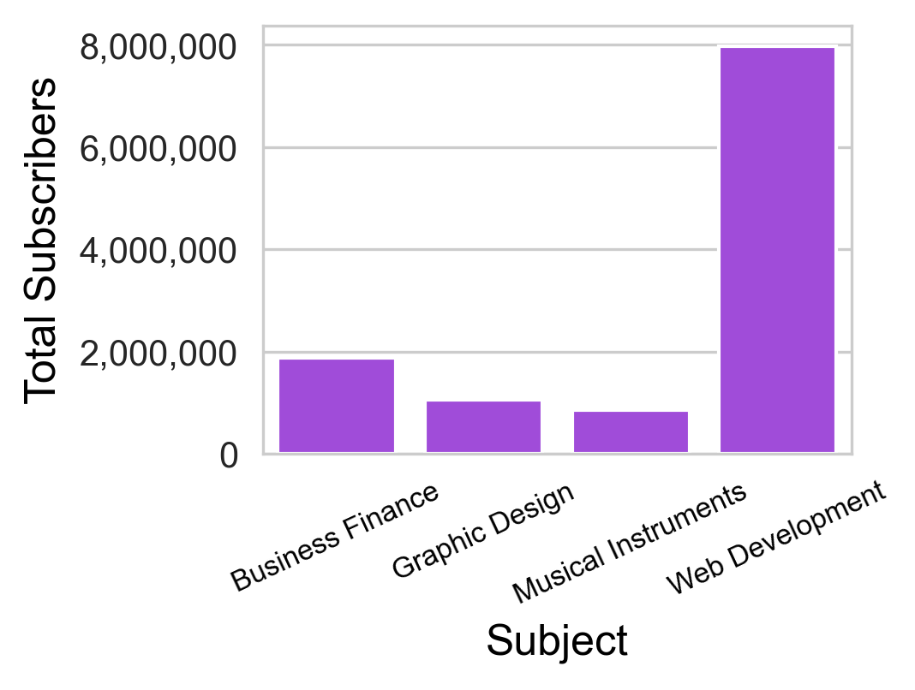
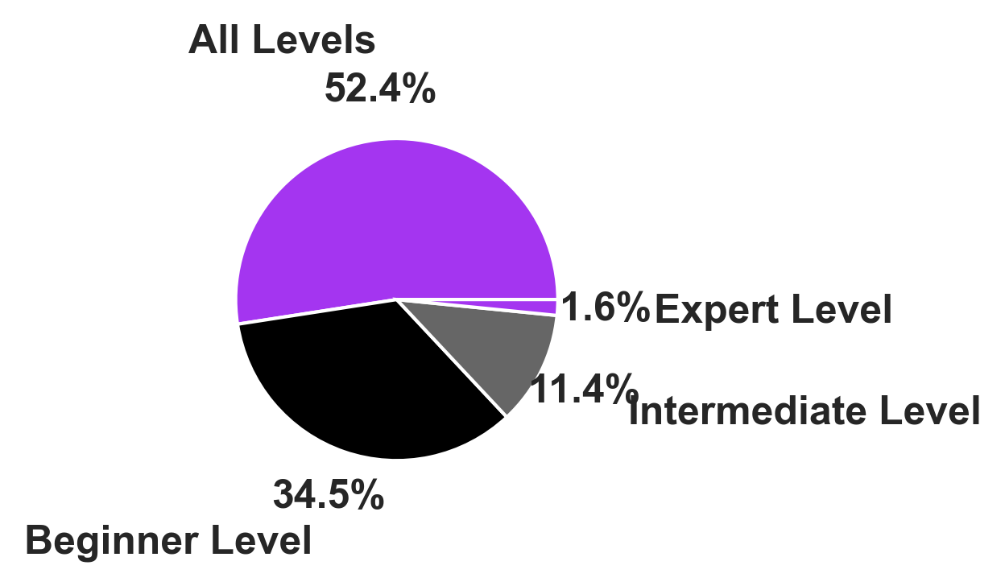
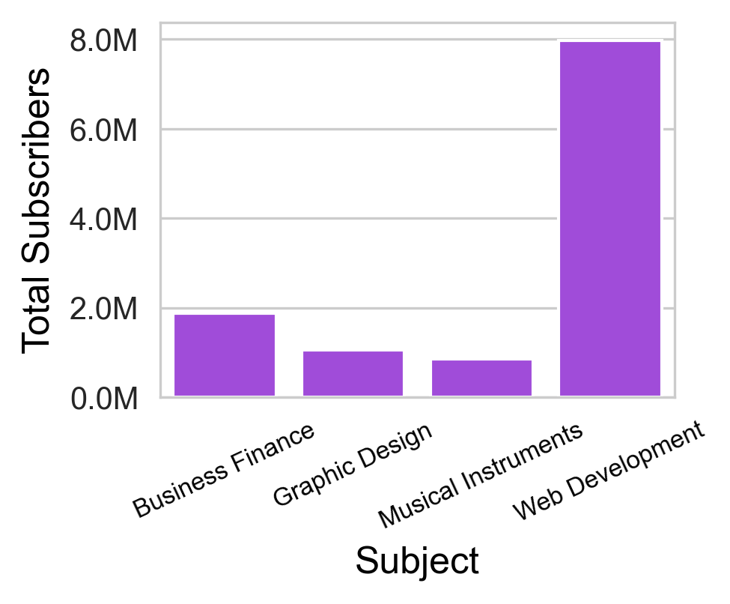
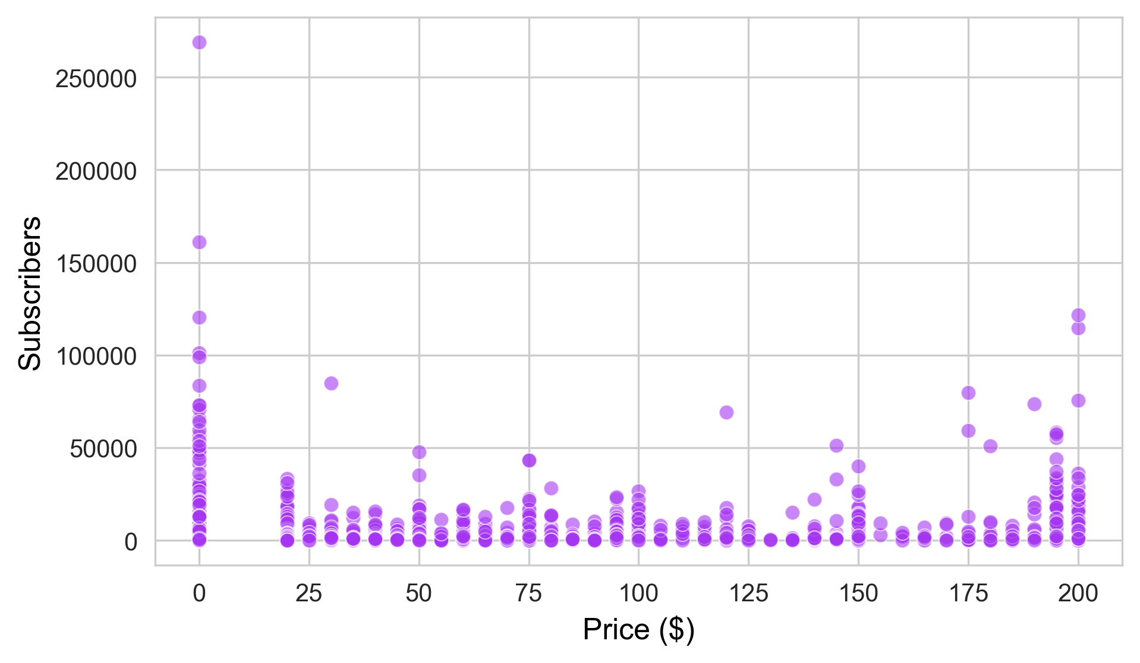
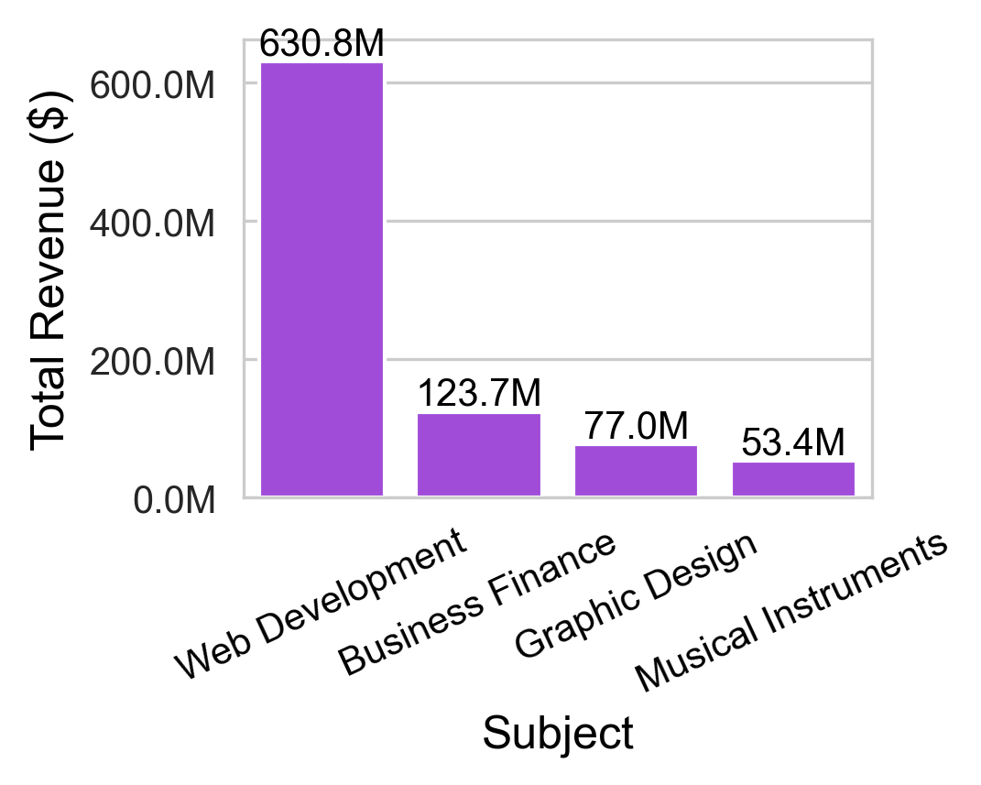
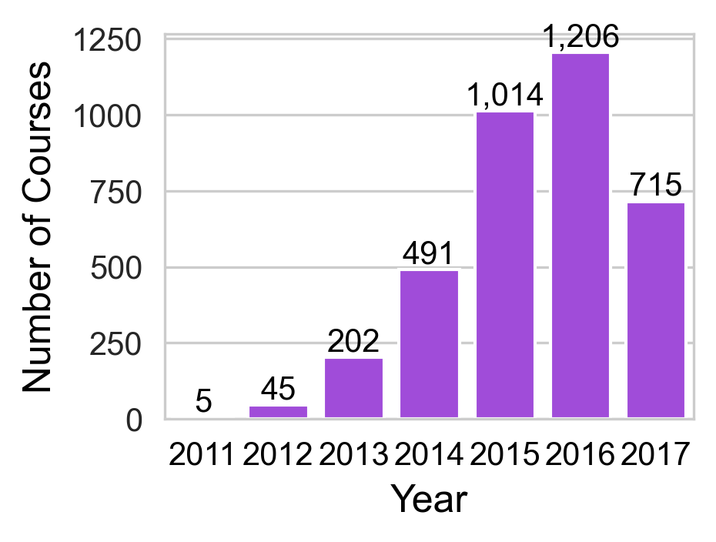
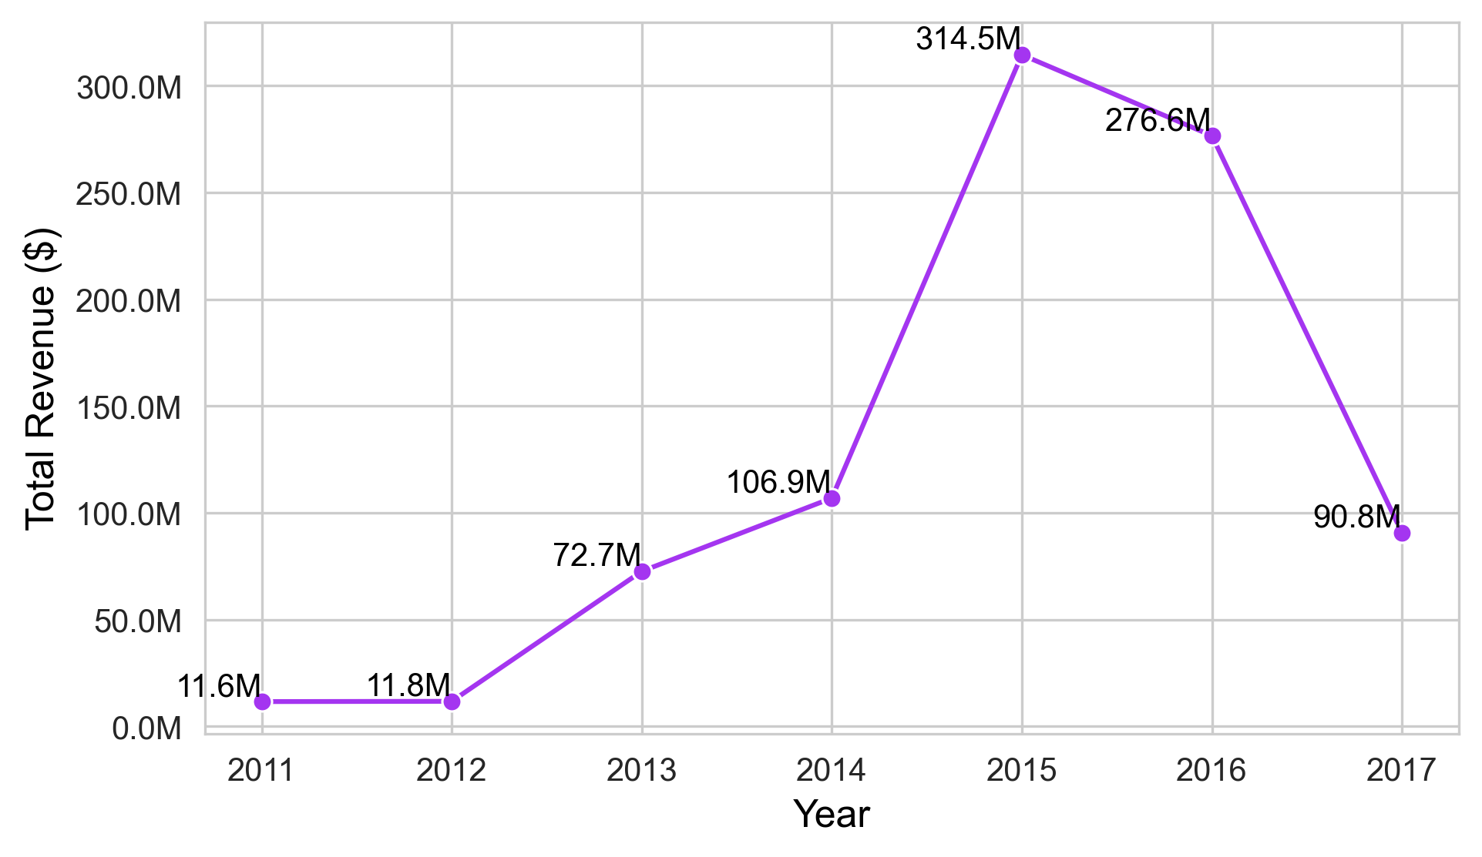
Revenues
Enrolments
Courses
Udemy Sales & Course Performance Analysis
884,921,315.
884,921,315
11,759,120
3,672
1. Performance Evaluation
Top Performing Categories
2. Customer Insights Course Level Distribution
3. Pricing & Profitability
Price vs Enrolment
4. Market Positioning
Subject-wise Revenue
Business Fin. & Web dev. In High Demand.
Expand Adv. Level Courses
Add more Intermediate & Expert courses.
Group courses to help learners level up.
Low-price = More students
Offer tiered pricing
Optimize discounts for max revenue
High Revenue: Web Dev, Business.
Boost marketing, improve the quality of courses content.
5. Identifying Bottlenecks Drop in Course Creation
6. Forecasting
Growth in Revenue
7. Reasoning of
Revenue Growth & Decline
8. Decision Making
Key Insights Summary
Funding boost – Norwest Venture Partners
More course launches
India and Germany expansion
Corporate training push
2016 pricing change policy
Course creator dissatisfatied
Drop in course creation
Revenue decline
Focus on high-demand areas
Add advanced-level content
Create fair policies that benefit both learners and instructors
2011–2014: Gradual growth
2014–2016: Sharp increase
2016–2017: Uploads dropped
2011–2014: Steady growth
2014–2016: Sharp peak
2016–2017: Major drop

