Slide 1


Summer Internship Presentation (3170001)

Slide 2
Noticehub using Django framework
Submitted By:- Guided By :-
Dhrumil patel pareshbhai Prof.Dhruval Kachhiya
201180107004

Slide 3
Company Details
CreArt Solutions is a privately owned venture of IT Solutions and IT Consultants formed in 2013. We always aspire to create a resistant future. We believe in bringing Business, People and Technology together in the way forward. CreArt is focused on rigorous development and comprehensive quality. CreArt is dedicated towards perfection in every aspect. Professionalism is the main ingredient of CreArt. We strongly believe in delivering the best services to the clients till their satisfaction. Main objective of CreArt is to provide professional , qualitative , innovative and accessible services in every possible form. Our objective is the strong collaboration between design, development, and delivering services on time, which benefits not only clients but also the communities in which the projects are implemented. More to help businesses succeed worldwide, we offer end-toend development of web and mobile apps that integrate dynamic modern technologies like AR/VR Development, AI, Machine Learning and many more.

Slide 4
Content
Introduction of Python
Introduction to Django
Why Python ?
Installation of SublimeText Editor
Web Development using Python (Mini project)
Skill Learned
Overall Experience

Slide 5
Introduction to Python
Python is an interpreted, object-oriented, high-level programming language. Its high-level built in data structures, combined with dynamic typing and dynamic binding, make it very attractive for Rapid Application Development. Python's simple, easy to understand. Python supports modules and packages, which encourages program modularity and code reuse. The Python interpreter and the extensive standard library are available in source or binary form without charge for all major platforms, and can be freely distributed.

Slide 6
Introduction to Django
“The framework for perfectionists with deadlines”
MVT (Model – View – Template ) controllers.
Flexible template language that can be HTML, CSS.
Includes ORM that supports many databases – MySQL, Oracle, SQLite
Lots of extras included – sessions, caching, authentication

Slide 7
Why Python ?
High performance, ability to link to C libraries for extensions
Interpreted script language
Easier to read coding standards – whitespace sensitive
Object Oriented

Slide 8
Introduction and Installation of SublimeText editor
There is recommended system requirement for python and so many IDEs are available for python. They also told us the pros and cons of different IDEs.
There are many software available for programming in Python like.. PyCharm, Notepad++, VScode, Sublime text 3, atom and NetBeans etc. I have installed PyCharm, VScode and Sublime text. mostly I am work on Sublime Text3.
We can directy Download Sublime Text 3 from https://www.sublimetext.com/3. And then directly Install it. After Installation Open Folder as shown below

Slide 9
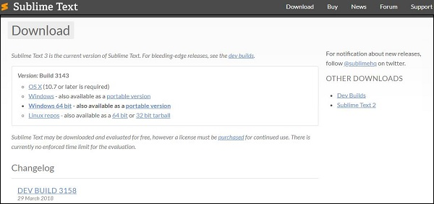
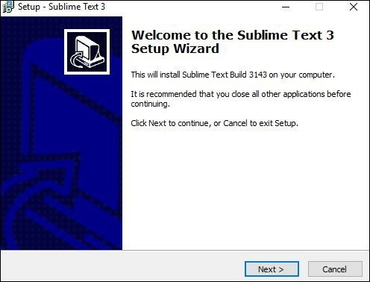
Introduction and Installation of SublimeText editor
In Sublime, We can create a Folder and then create a python file with .py extension. Here we see the folder named Project and inside this folder I created another folder name noticehub and inside this I created many other folders and many other python files
Step:- 1
Step:- 2

Slide 10
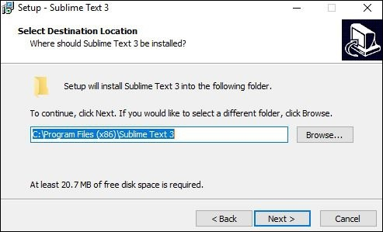
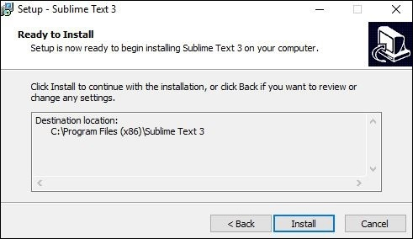
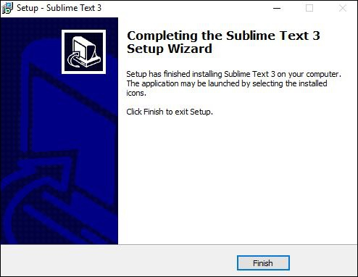
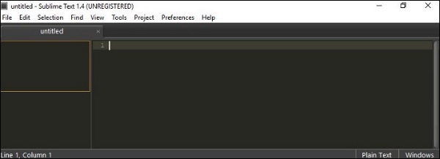
Screenshots
Step:- 3
Step:- 4
Step:- 5
Step:- 6

Slide 11
Configuration Command
1)First create & Activate Virtual Environment using Python by following command
Python–m venv VE & VE>Scripts>activate
2) Install Django using following command: pip install Django
3)Create project. Project>Django-admin startproject NoticeHub
4)Run on Server. Project>python manage.py runserver
5) Install MySQL client library: pip install mysqlclient
6) Change in Setting.py file : SQLite to SQL database Then migrate the database using:
python mange.py migrate
7)Create superuser (Admin) using: python manage.py createsuperuser

Slide 12
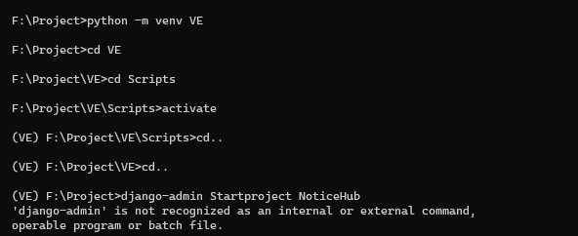
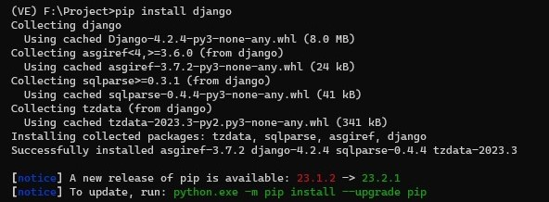
Screenshots

Slide 13
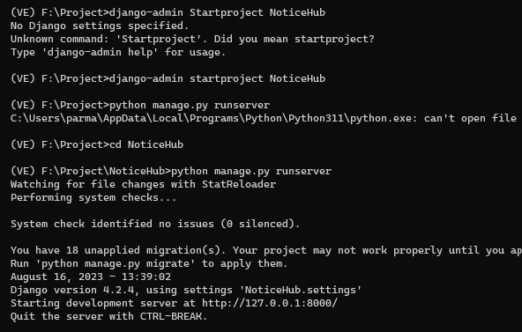
Screenshots

Slide 14
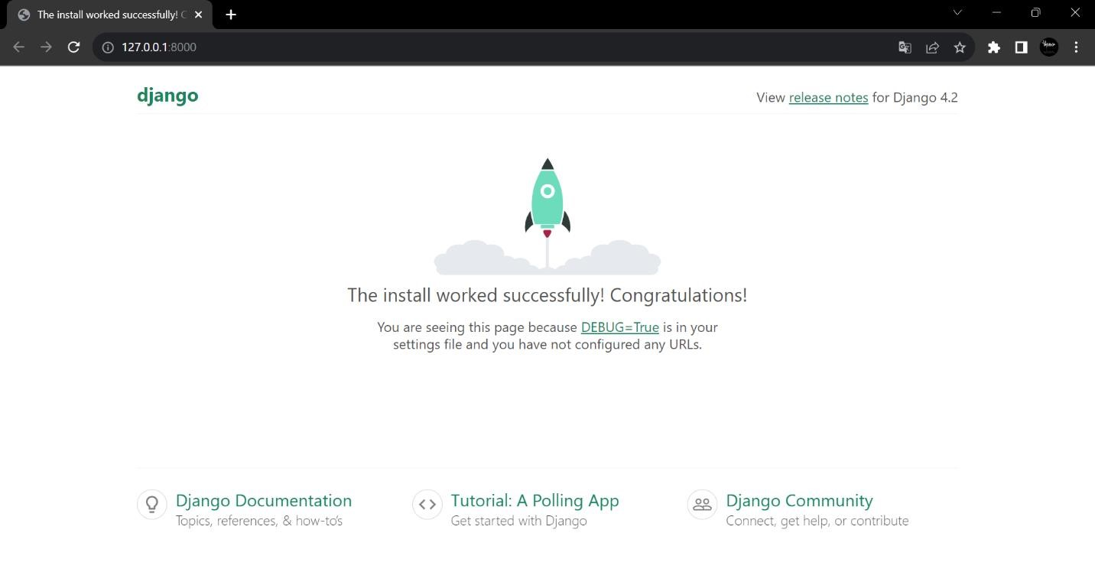
Output

Slide 15
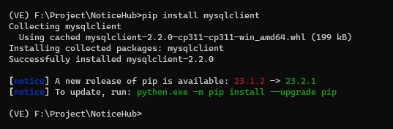
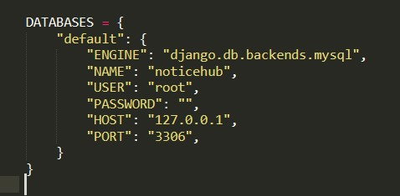
Configuration Command
8) Now run server using python manage.py runserver command here one local host address was displayed: - http:// 127.0.0.1.8000.
Once, the Changes are done in Setting.py (SQLite to SQL Database), Now we have to Create 10 tables by default with the help of Migrate command as shown in step number 6.

Slide 16
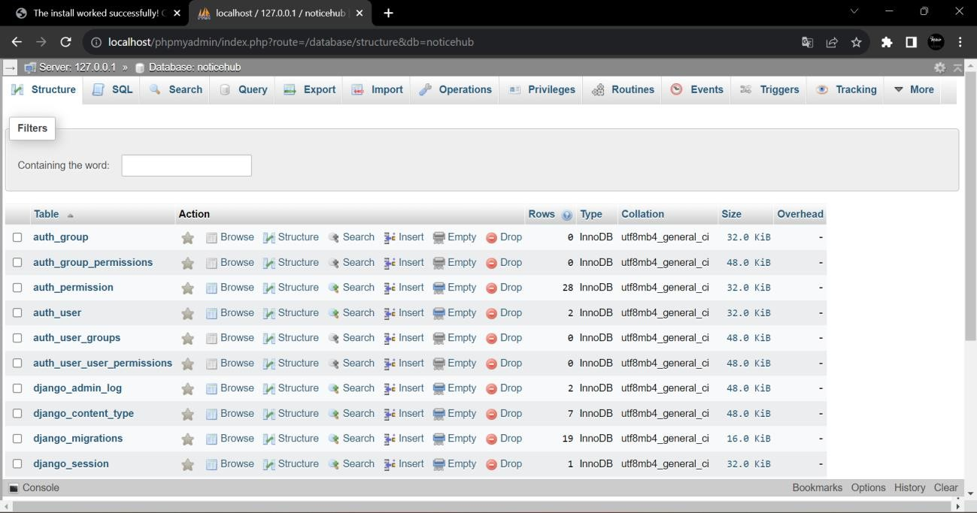
Configuration command

Slide 17
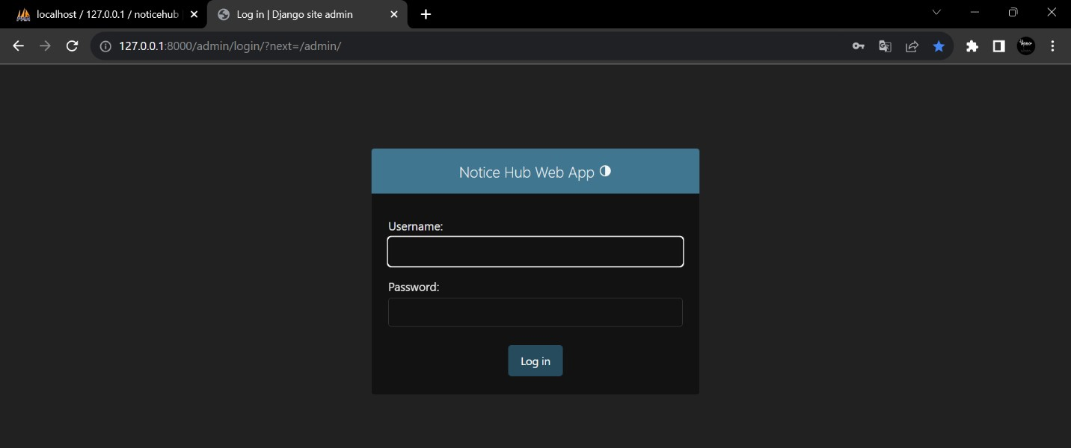
Configuration command
Now, we have to create Two superuser named Admin and User. once, the superusers are created in Noticehub, we have to check it can be run on server or not.
Admin pannel

Slide 18
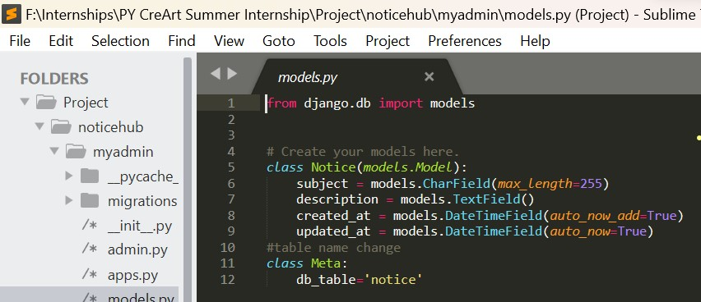
Frontend using D’jango Framework (using HTML) :
Our Project Setup is done. So now we go to Sublime Text 3 and make HTML file in User side folder. So that we can print notices on the web browser from our Project NoticeHub. For that we have to make notice.html file in template folder

Slide 19
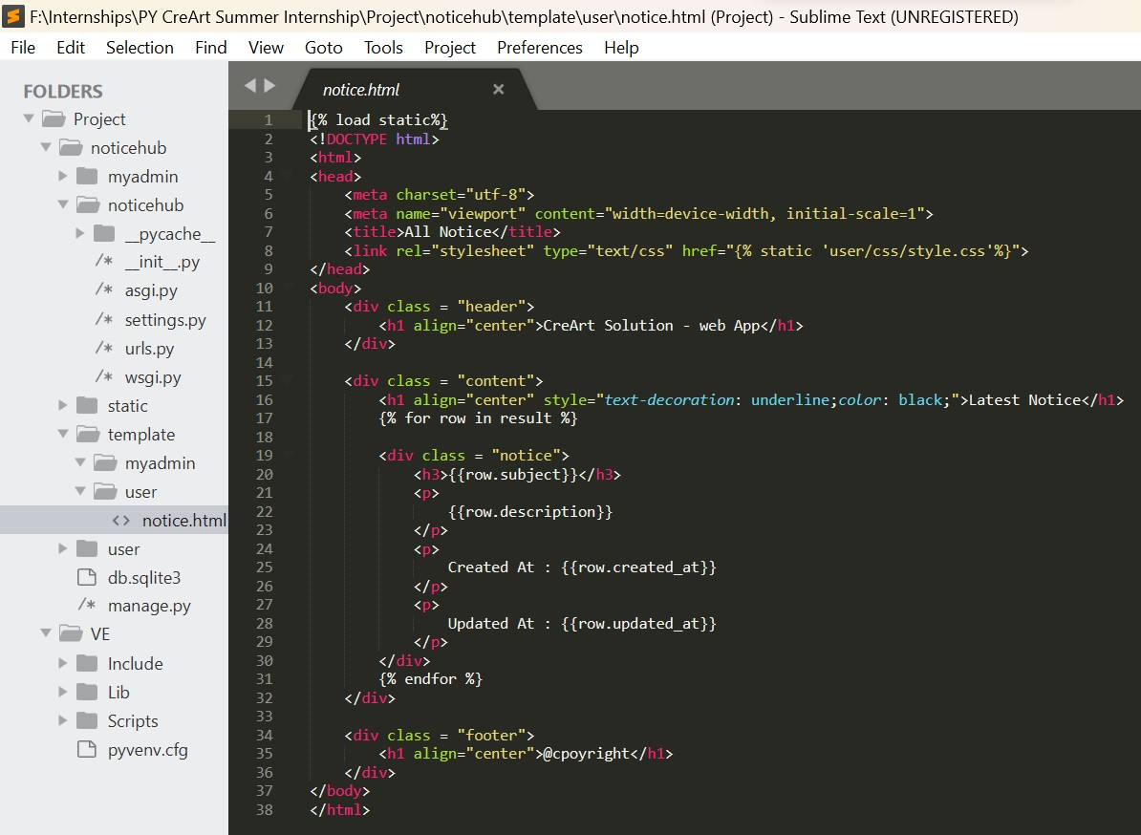
Frontend using D’jango Framework (using HTML) :

Slide 20
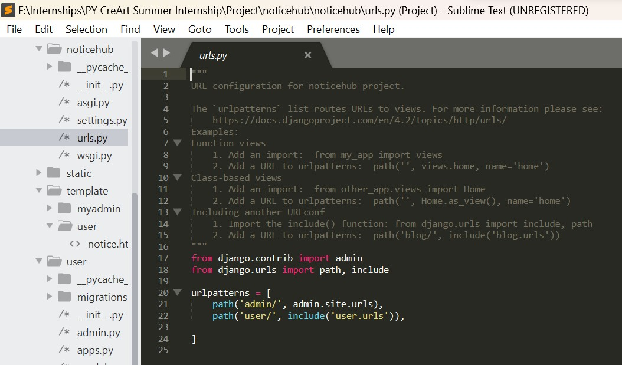
Frontend using D’jango Framework (using HTML) :

Slide 21
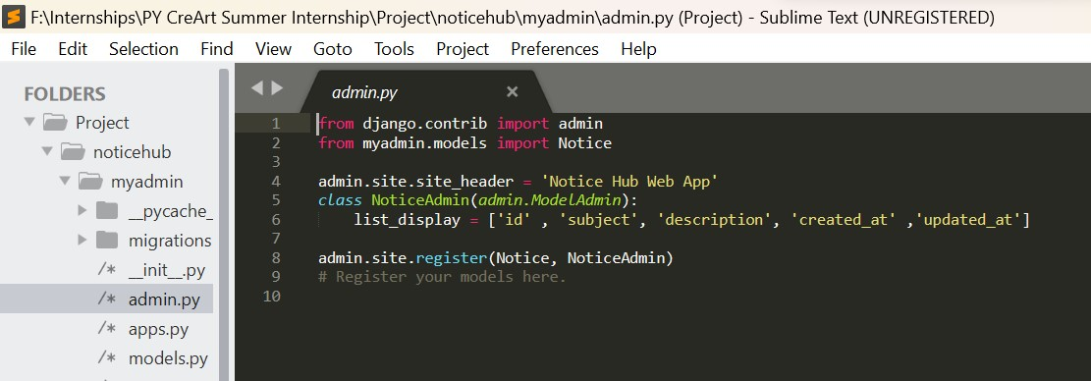
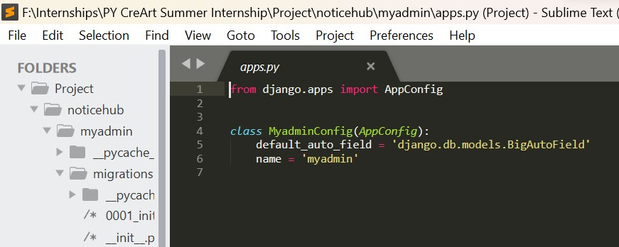
Frontend using D’jango Framework (using HTML) :

Slide 22
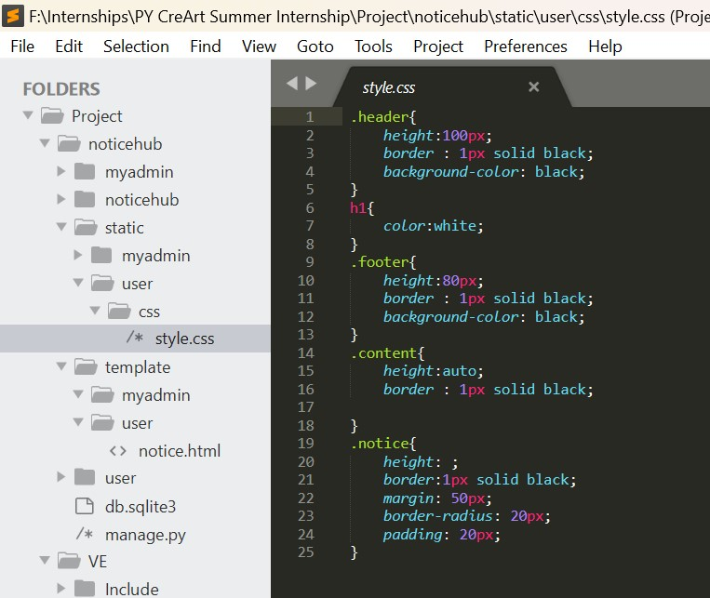
CSS

Slide 23
Mini Project
Overview of NoticeHub :
NoticeHub is a web application by which we can send the Notice to all employees/students etc. it has basically two panels: Admin & User. We can create & update Notices from Admin Panel and directly show it to all Users on User Panel.
It is very easy process to perform task, we just required a network connection. First we have to connect XAMPP server then go to browser, open the admin Panel, Create new notice or Update existing notice & lastly click on the submit button so that User successfully receive the Notices without any failure. It was implementing using HTML & CSS for frontend and Django, Python & MySQL for backend.

Slide 24
Mini project
Technology Used :
Frontend :
HTML: HTML is used to create and save web document.
CSS: Createattractive Layout and design the web page.
Backend :
Django: Django is a Python based web framework that follows the modeltemplate- views architectural pattern.
MYSQL: MySQL is a database, widely used for accessing querying and managing databases.

Slide 25
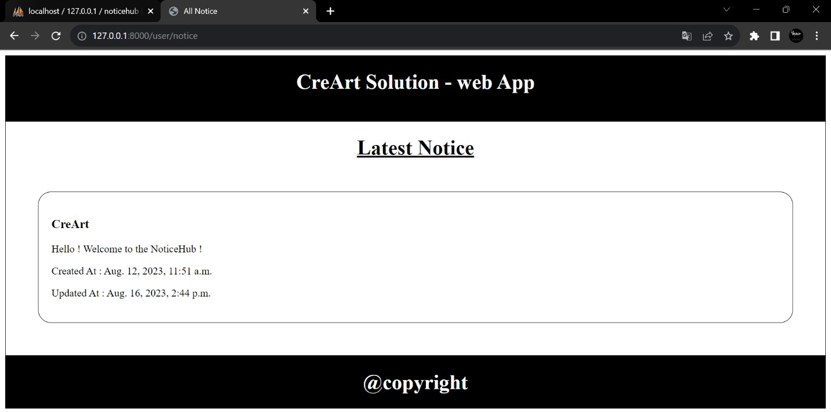
Mini project

Slide 26
Overall Experience
Technical experience: In this internship, I improved my Python knowledge, learned HTML/CSS, Django framework and learned API Concepts. I have done my tasks using SublimeText.

